Slide 1
Year 3 Home Learning
Fortnight beginning: 16/11/2020

Slide 2
Spellings:
WB 16/11/20:
heart, height, history, imagine, increase, important, interest.
WB 23/11/20:
island, knowledge, learn, length, library, material, medicine.
Use your spelling strategies to practice. You could:
Rainbow write.
Pyramid write.
Draw around the ascenders and descenders.
Create a spelling mnemonic.
Create a word search.

Slide 3
Times Tables:
Practice the times tables you are learning.
You could do this by:
Writing them out.
Creating representations in pictures.
Creating a song.
Looking for the numbers around the house.

Slide 4
Reading:

Slide 5
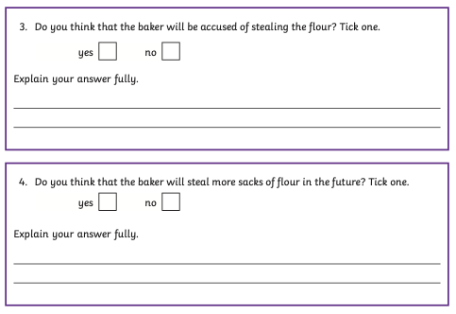
Reading continued:

Slide 6
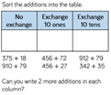
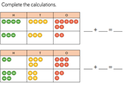
Maths:

Slide 7
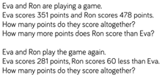
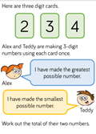
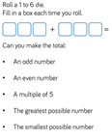
Maths continued:

Slide 8
English:
in the early stone age times, poeple didnt have meny belongings as thay had too move around a lot two find food they lived in caves witch cant have been very worm four them
a) I have missed out 2 full stops. What are they?
b) I have missed out 2 contracting apostrophes. Where should they go?
c) How many spelling mistakes did you spot (including incorrect homophones.
Using the WAGOLL, come up with 3 bullet points to create sentences around for your own Stone Age non-chronological text.
Expand these sentences to create your own introduction.

Slide 9
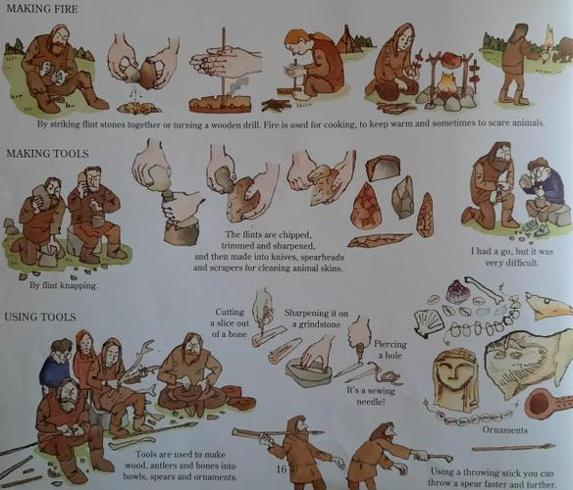
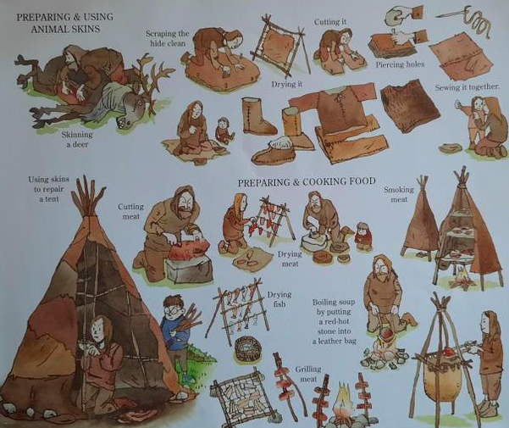
English continued:
Write the following up as bullet points, group them into subheadings. What subheadings do you
think will be relevant?

Slide 10
English continued:
Using your subheadings, research more information and add them to your bullet pointed list that you have already started.
One of the facts that I have found is:
They used flint to make and sharpen tools.
Can you put this into a sentence using a subordinating conjunction and more information? After you have done this, do it for one of your bullet points.
Using your bullet points, plan out your non-chronological report. Use the following to help you plan:
Heading
Introduction
Sub-headings
Fact box
Pictures
Use your plan to write up your non-chronological report.

Slide 11
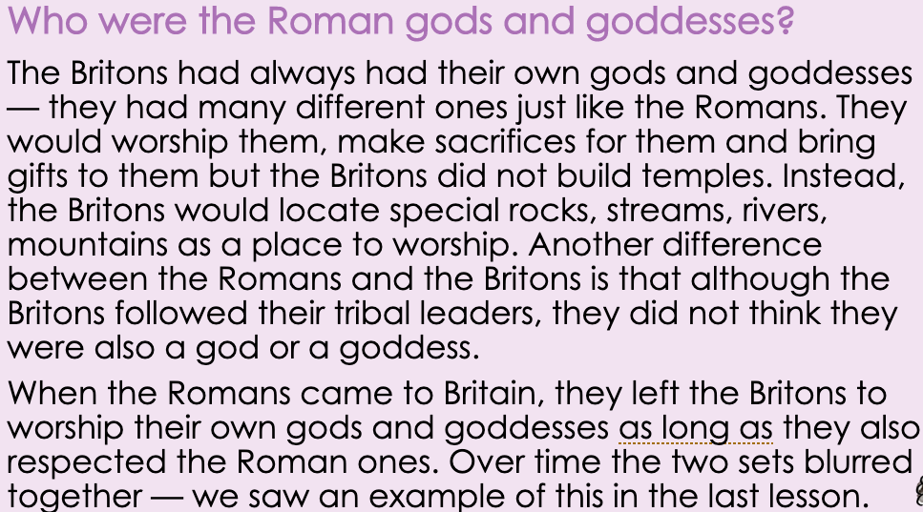
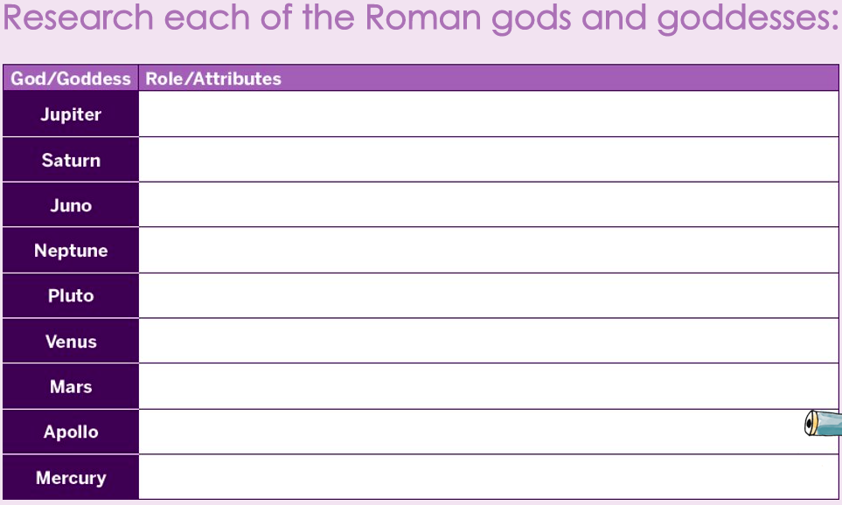
Topic:
What does polytheism mean?​
​
Why do you think the Romans allowed the Britons to continue to worship their own gods and goddesses?​
​
Who did the Romans also believe was a god?​
​
Why do you think they wanted people across the empire to believe that?

Slide 12
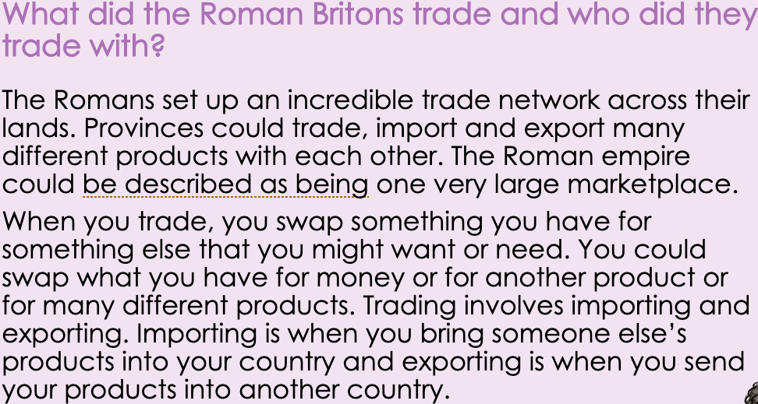
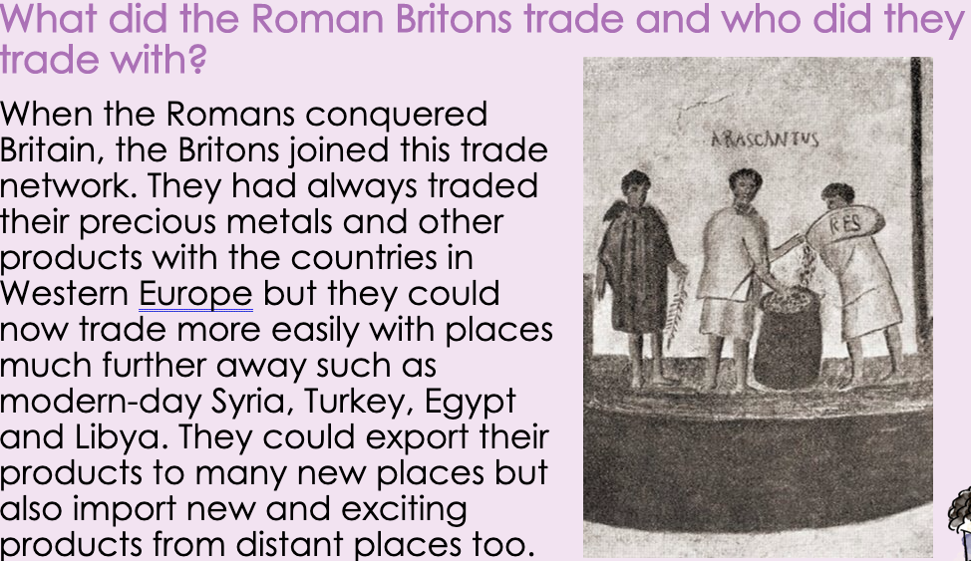
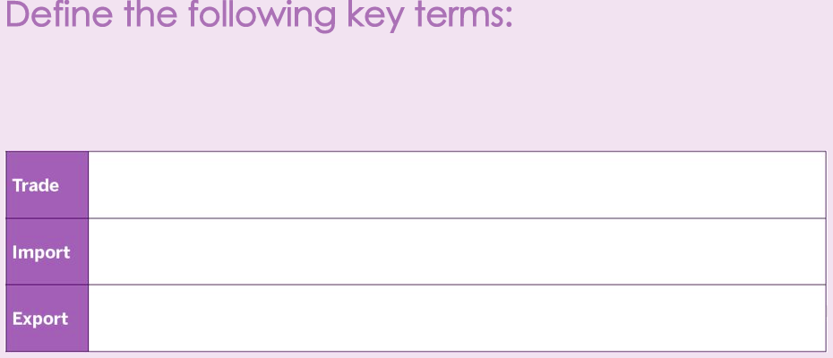
Topic continued:
How could the Roman empire be described?​
​
Why can it be described in this way?​
​
How did Britain benefit from joining this network?​
​
Why was the same system of money used across the empire?

