Slide 1
Year 8 RE – Autumn 2: Christianity 2: Reconciliation
Task 1: Communicate & Apply
Look at the statue (slide 2) What do you think of? Feel?
Finish this sentence-’To me reconciliation means….’
Look up the definition of ‘Reconciliation’ & write it down.
Personal response: Have you experienced a time where you have put your differences with someone to one side? What would have happened if it could not have been reconciled? What does there need to be for reconciliation to work? Research problems in today’s society? (eg Palestine) Why might they be difficult to reconcile?
Task 2: Enquire:
Why did Jesus have to die?
What happens in the sacrament of reconciliation? Complete task 1 on the worksheet
For Christians the first reconciliation that needed to happen was between humanity and God.
Read the information sheet and sum up in a couple of sentences God’s relationship with humans at each stage- The garden, Life in the Wilderness, The moment of Truth & the deepest secret.
Using this information answer: why did Jesus have to die?
Task 3: Enquire
What is the Christian view of reconciliation?
Look at the Haitian Hunger Cloth (slide 4) & answer the questions
Read about the meaning of the hunger cloth on the next slide.
Design your own hunger cloth to represent the reconciliation between man and God (refer back to Task 2). It should include the story of Adam & Eve (the garden) and Jesus’s sacrifice and resurrection and an image to represent the reconciliation.
Task 4: Contextulise: Northern Ireland
Read the information sheet about the troubles in Northern Ireland. Then watch the clip https://www.youtube.com/watch?v=1kR11vn41XU to ensure understanding.
Read about Corrymeela and answer the questions (slide 9)
How does the work of Corrymeela link to reconciliation? How does it link to the statue on slide 2?
Task 5: Evaluate
Is reconciliation humanly possible in our world today?
Write a detailed response to the key question using the bullet points to give guidance on slide 11 as to what to include

Slide 2
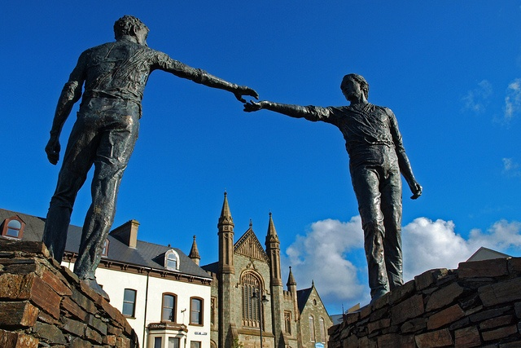
Reconciliation: Communicate & Apply
Task 1

Slide 3
Reconciliation: Enquire
Task 3

Slide 4
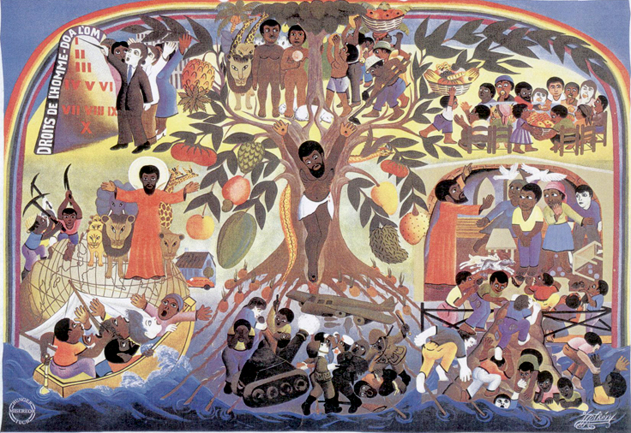
What is happening at the bottom of the picture?
What is happening in the centre?
What is happening at the top?
What do you think is the main message?

Slide 5
Human salvation
Jesus’ sacrifice for our sins
Suffering and torture

Slide 7
Hunger Cloth template

Slide 8
Reconciliation: Contextulise
Task 4

Slide 9
Corrymeela: Northern Ireland Read the webpage: https://www.youtube.com/watch?v=1kR11vn41XU and answer the questions below.
Click on ‘About’ from the menu
What is Corrymeela?
What do they do?
What does Corrymeela promote?
Click on ‘About’ + ‘Our History’
Who was the founder of Corrymeela?
What thought did he have as a prisoner in Dresden?
3) What did he want to set up in Northern Ireland and why?
4) When was Corrymeela set up?
Click on ‘About’ + ‘Who we are’
5) What is the motto of Corrymeela?

Slide 10
Reconciliation: Evaluate
Task 5

Slide 11
Is reconciliation possible in our world?
Think about the world we live in. Think about examples you have heard in the news recently, do you think reconciliation is possible in the world we live in today or d you think there are always going to be a clash of ideas and opinions.
Individual Task (10 minutes)
Write up a response to the question above.
Yes it is possible- refer to the Christian view of reconciliation and why it is important to them. Explain Corrymeela as an example
No it is not possible- refer to reasons why reconciliation is hard/not possible. Try and support with examples of problems/conflicts in the world today that are hard to solve.
Give your final opinion- I think reconciliation is possible/not possible because
Key Words: Reconciliation, Peace, Forgiveness, Equality

