Slide 1
Unit: C6 Rate and extent of chemical reactions
This power point contains embedded videos that you will need to watch and answer the questions provided.
Complete the progress checkers as you go along .
Once you have finished watching all the videos complete the Revision activity mat.
Now complete the Educake quiz:
C6 Quarantine F (Sets T3, S3, T4 and S4)
C6 Quarantine H (Sets T1, S1, T2 and S2)

Slide 2
Mean rate of reaction
Click here if the video doesn’t play
Watch the video and answer the questions on the next slide

Slide 3
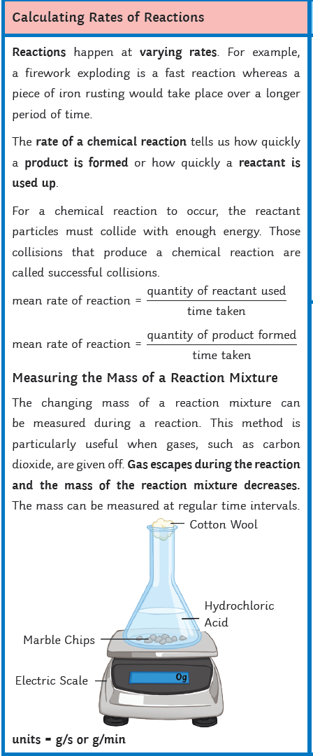
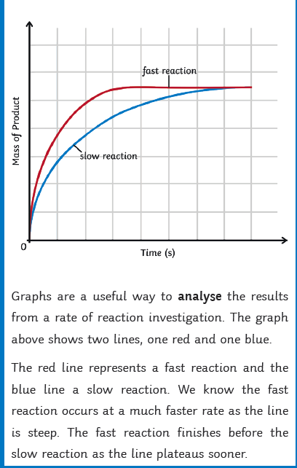
Copy and answer the following questions:
Give two ways in which we can measure the rate of reaction.
What does a steep line on a rate of reaction graph tell you?
Why does the slope of a rate of reaction graph flatten out?
Write the equation to calculate the rate of reaction using the quantity of reactant used..
Write the equation to calculate the rate of reaction using the quantity of product formed.
In a chemical reaction 70g of product formed in 50s. Calculate the rate of reaction.
In a chemical reaction 50g of reactant was used up in 100s. Calculate the rate of reaction.

Slide 4
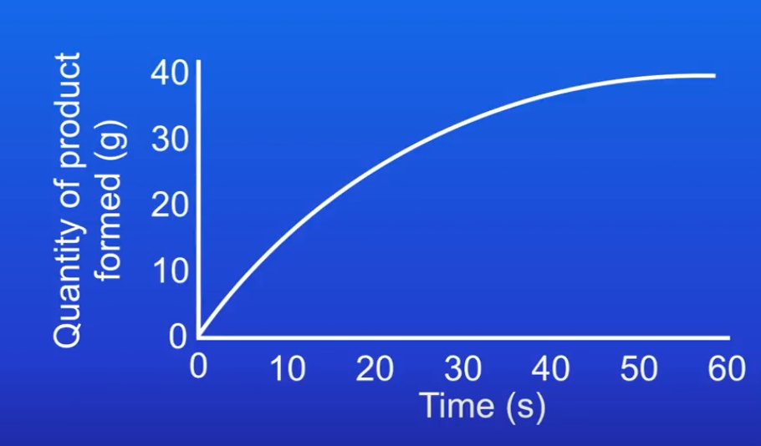
Using tangents to work out rate of reaction
Watch the video and answer the following questions:
Copy the rate of reaction graph shown on the right. Explain how you could use a tangent to work out the rate of reaction at a given point.
HIGHER TIER: Copy the rate of reaction graph shown on the right. Calculate the rate of reaction at 40 seconds.
Click here if the video doesn’t play

Slide 5
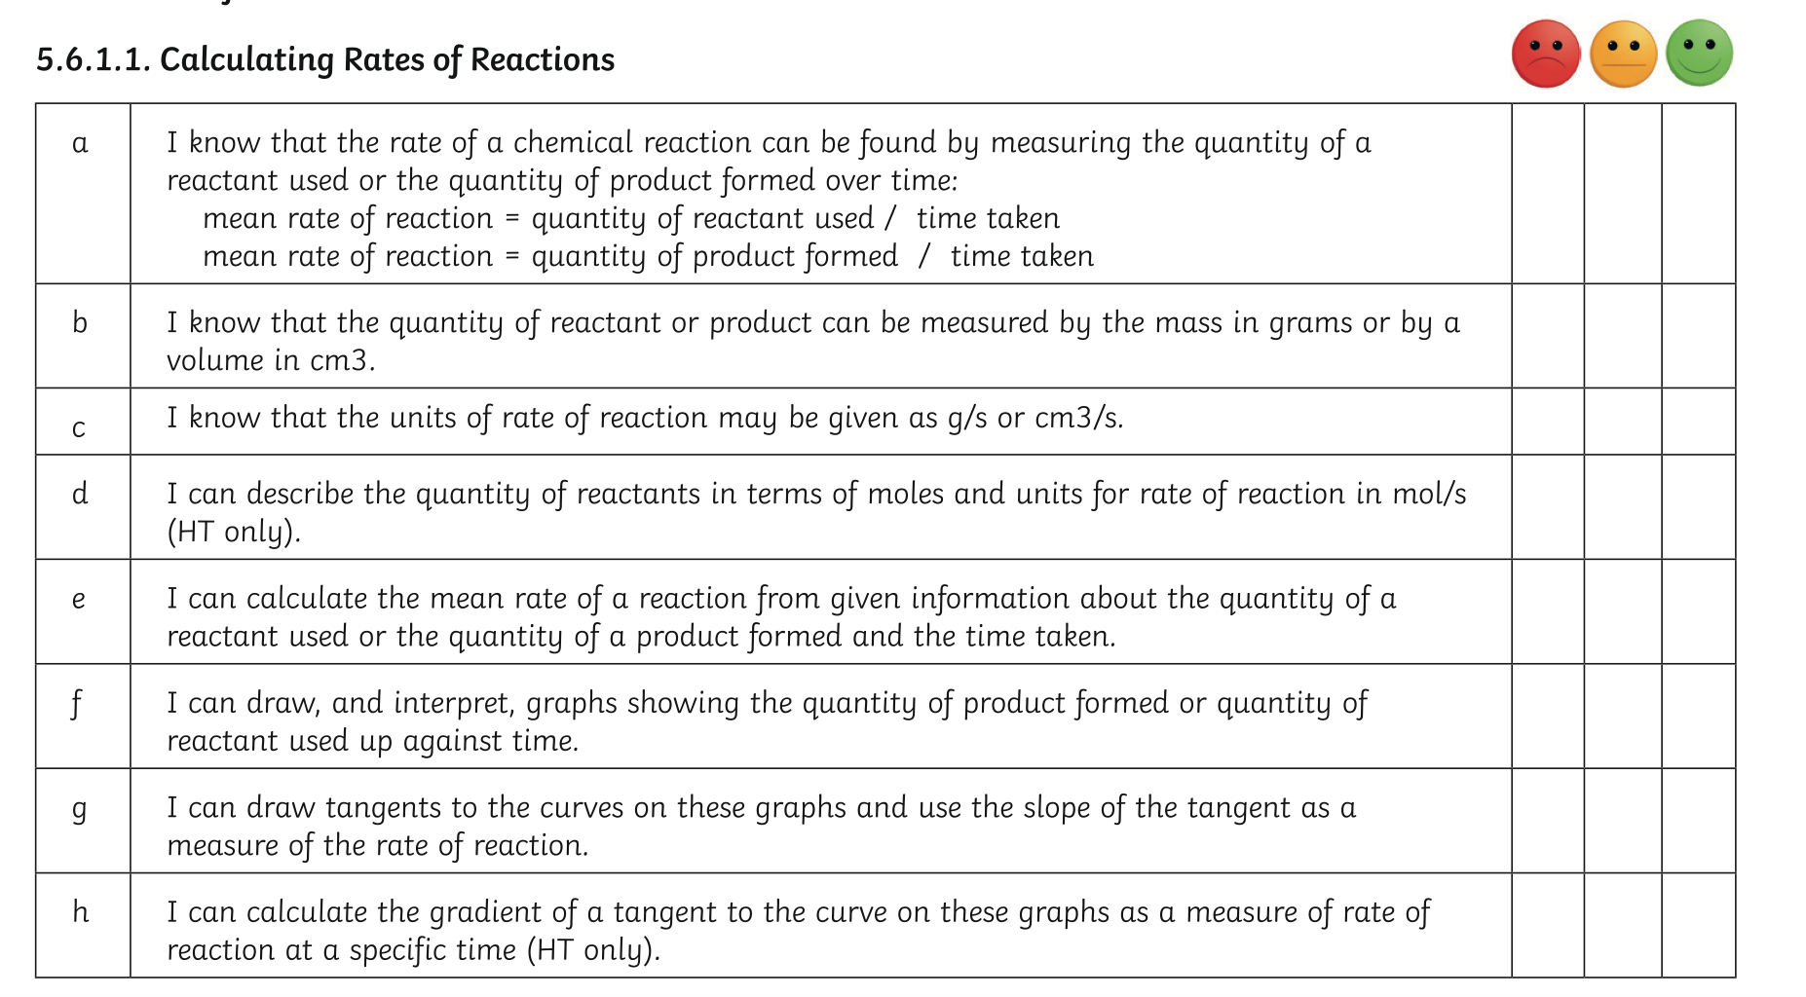
Check your learning: Rate your confidence

Slide 6
Using tangents to work out rate of reaction ANSWERS
Copy the rate of reaction graph shown on the right. Explain how you could use a tangent to work out the rate of reaction at a given point.
Draw a straight line that just touches the curve (in the area of the graph under study), this is called a tangent.
The slope of the tangent will tell you the rate of reaction.
FOUNDATION students will not be expected to calculate the slope (gradient) of the tangent

Slide 7
Using tangents to work out rate of reaction ANSWERS
2) HIGHER TIER: Copy the rate of reaction graph shown on the right. Calculate the rate of reaction at 40 seconds.
Draw a straight line that just touches the curve (in the area of the graph under study), this is called a tangent.
The slope of the tangent will tell you the rate of reaction.
To calculate the gradient of the slope:
y/x
= 10/60
0.17g/s

Slide 8
Mean rate of reaction ANSWERS
Give two ways in which we can measure the rate of reaction.
Measure how quickly a product is formed.
Measure how quickly a reactant is used up.
2.What does a steep line on a rate of reaction graph tell you?
Fast rate of reaction, more reactant particles are available to collide for a reaction to take place.
3. Why does the slope of a rate of reaction graph flatten out?
The rate of reaction slows down as there are less reactant particles available to collide, to allow a reaction take place.
4. Write the equation to calculate the rate of reaction using the quantity of reactant used.
Rate of reaction = quantity of reactant used
time taken

Slide 9
Mean rate of reaction ANSWERS
5. Write the equation to calculate the rate of reaction using the quantity of product formed.
Rate of reaction = quantity of product formed
time taken
4. In a chemical reaction 70g of product formed in 50s. Calculate the rate of reaction.
Rate of reaction = quantity of reactant used
time taken
Rate of reaction = 70/50 = 1.4g/s
5. In a chemical reaction 50g of reactant was used up in 100s. Calculate the rate of reaction.
Rate of reaction = quantity of reactant used
time taken
Rate of reaction = 50/100 = 0.5g/s

Slide 10
Effects of concentration on rate of reaction
Click here if the video doesn’t play

Slide 11
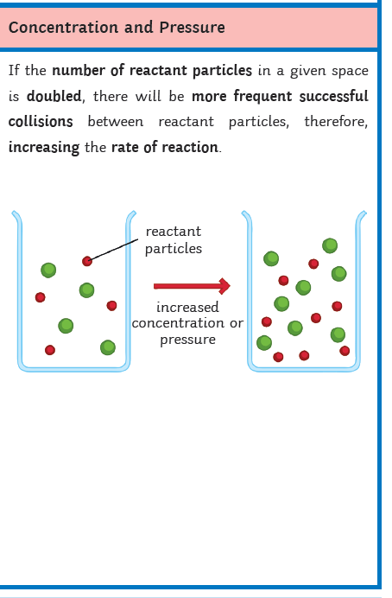
Effects of concentration on rate of reaction
Watch the video and answer the following questions:
What is collision theory?
How do collisions affect the rate of reaction?
Describe the shape of the graph on the right using collision theory.
Explain using diagrams how concentration affects the rate of reaction.
How does pressure in a gas affect rate of reaction?
Draw graph to show how concentration affects the rate of reaction

Slide 12
Effects of the concentrations of reactants in solution & pressure of reacting gases on the rate of reaction
Increasing the concentration of reactant particles, the particles become more crowded, this increases the frequency of particle collisions. Therefore increases the rate of reaction
The energy of particles does not change
Increasing the pressure of a reacting gas, the particles are closer to each other, this increases the frequency of particle collisions. Therefore increases the rate of reaction
The energy of particles does not change

Slide 13
Check your learning: Rate your confidence

Slide 14
Effects of concentration on rate of reaction ANSWERS
What is collision theory?
Chemical reactions will only take place if reacting particles collide with sufficient energy.
2) How do collisions affect the rate of reaction?
The rate of reaction is determined by the number of successful collisions.
3) Describe the shape of the graph on the right using collision theory.
At first there is a fast rate of reaction, there is a large number of reacting particles, therefore there are a large number of collisions. The rate of reaction slows down as the number of reacting particles goes down and the number of collisions falls. Eventually, the reactant particles run out and the number of collisions is zero, the reaction stops.

Slide 15
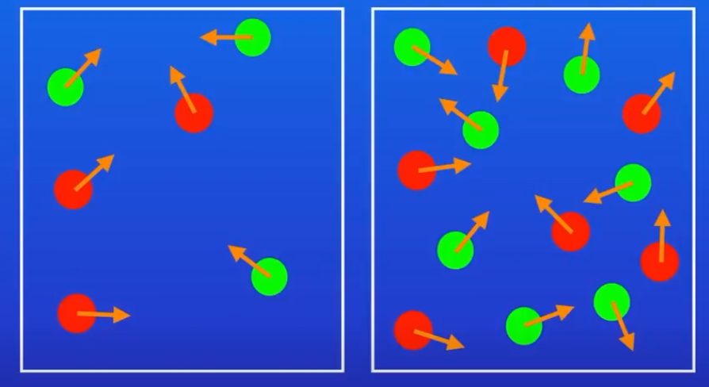
Effects of concentration on rate of reaction ANSWERS
4) Explain using diagrams how concentration affects the rate of reaction.
If you increase the concentration, the number of successful collisions increases. The rate of reaction is proportional to the concentration.
Low concentration
High concentration

Slide 16
Effects of concentration on rate of reaction ANSWERS
How does pressure in a gas affect rate of reaction?
If you increase the pressure in a gas, the number of successful collisions increases. The rate of reaction is proportional to gas pressure.
Low pressure
High pressure

Slide 17
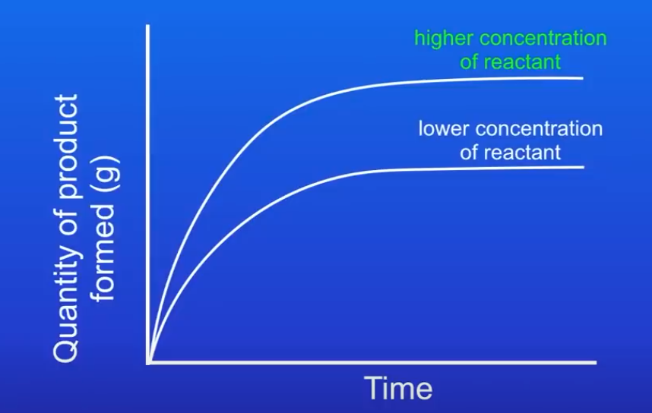
Effects of concentration on rate of reaction ANSWERS
6) Draw graph to show how concentration affects the rate of reaction

Slide 18
Required practical: Rate of reaction
Useful link:
https://www.bbc.co.uk/bitesize/guides/z3nbqhv/revision/7
Watch the video and answer the questions on the next slide
Click here if the video doesn’t play

Slide 19
Required practical: Rate of reaction
Watch the video and answer the following questions:
What is a hypothesis?
2) for the reaction between sodium thiosulphate and hydrochloric acid.
3) Why does the solution go cloudy?
4) What is turbidity?
5) Describe a method for the disappearing cross colour change method to measure the rate of reaction.
6) What is reproducibility?
7) What is the problem with the disappearing cross experiment?
8) Explain how the rate of reaction can be measured when a gas is the product.

Slide 20
Required practical: Rate of reaction ANSWERS
Watch the video and answer the following questions:
What is a hypothesis?
a proposal that can explain a fact or an observation, it needs to be testable.
2) Write the word equation for the reaction between sodium thiosulphate and hydrochloric acid.
sodium thiosulphate + hydrochloric acid→ sodium chloride + sulphur dioxide + sulphur

Slide 21
Required practical: Rate of reaction ANSWERS
3) Why does the solution go cloudy?
A solid sulphur precipitate forms
4) What is turbidity?
Cloudiness
5) Describe a method for the disappearing cross colour change method to measure the rate of reaction.
Go to: https://www.bbc.co.uk/bitesize/guides/z3nbqhv/revision/7

Slide 22
Required practical: Investigate how changes in concentration affect the rates of
reactions by a method involving a change in colour or turbidity.
To investigate the effect of changing the temperature on the rate of a reaction.
Sodium thiosulfate solution reacts with dilute hydrochloric acid:
sodium thiosulfate + hydrochloric acid → sodium chloride + water + sulfur dioxide + sulfur
Na₂S₂O₃(s) + 2HCl(aq) → 2NaCl(aq) + H₂O(l) + SO₂(g) + S(s)
The sulfur forms a cloudy yellow-white precipitate during the reaction. The time taken for this to achieve a given cloudiness provides a way to measure the reaction time.
Using a measuring cylinder, add 50 cm³ of dilute sodium thiosulfate solution to a conical flask.
Place the conical flask on a piece of paper with a black cross drawn on it.
Using a different measuring cylinder, add 10 cm³ of dilute hydrochloric acid to the conical flask. Immediately swirl the flask to mix its contents, and start a stop clock.
Look down through the reaction mixture. When the cross can no longer be seen, record the time on the stop clock.
Measure and record the temperature of the reaction mixture, and clean the apparatus as directed by a teacher.
Repeat steps 1 to 5 with different starting temperatures of sodium thiosulfate solution.

Slide 23
Required practical: Investigate how changes in concentration affect the rates of
reactions by a method involving a change in colour or turbidity.
To investigate the effect of changing the temperature on the rate of a reaction.
Sodium thiosulfate solution reacts with dilute hydrochloric acid:
sodium thiosulfate + hydrochloric acid → sodium chloride + water + sulfur dioxide + sulfur
Na₂S₂O₃(s) + 2HCl(aq) → 2NaCl(aq) + H₂O(l) + SO₂(g) + S(s)
The sulfur forms a cloudy yellow-white precipitate during the reaction. The time taken for this to achieve a given cloudiness provides a way to measure the reaction time.
In the required practical you changed the concentration of the acid.
You maybe asked to change another factor, such as the temperature of the reactants, you could carry out the test in water baths with different temperatures

Slide 24
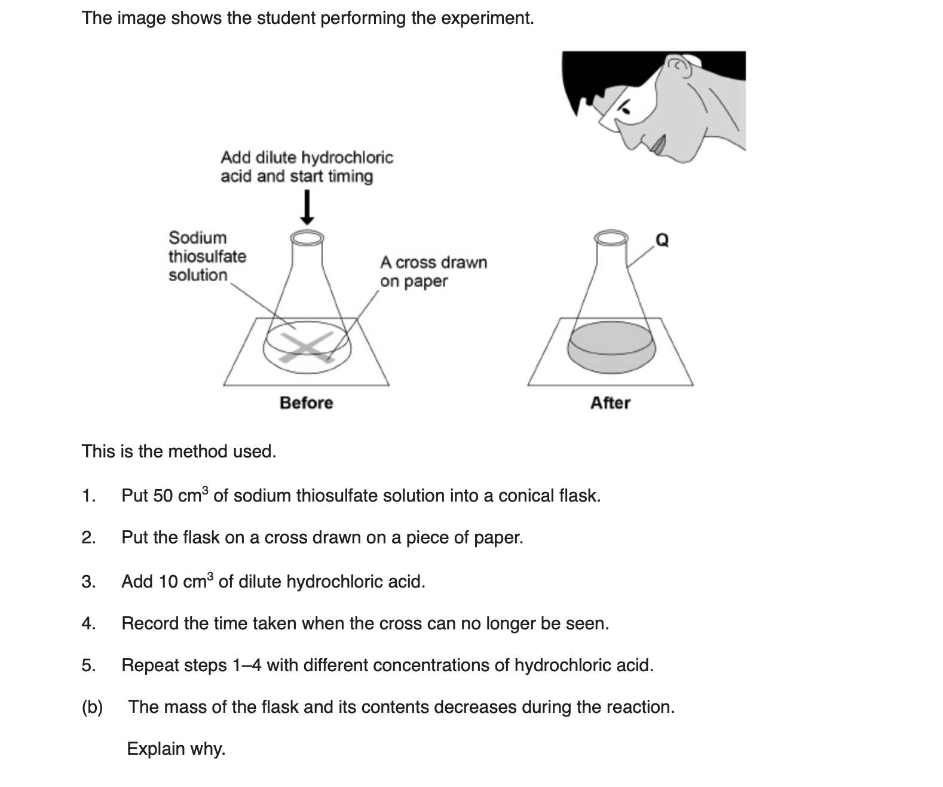
sulfur dioxide is produced
allow ‘a gas is produced’

Slide 25
Required practical: Rate of reaction ANSWERS
6) What is reproducibility?
The same result can be achieved when a method is repeated by another person, using a different method of equipment.
7) What is the problem with the disappearing cross experiment?
Different people have different eyesight, some may see the cross disappear more quickly than others. However, if all students use the same sized cross, this problem may be not as great

Slide 26
Required practical: Rate of reaction ANSWERS
8) Explain how the rate of reaction can be measured when a gas is the product.
https://www.bbc.co.uk/bitesize/guides/z3nbqhv/revision/6

Slide 27
Required practical: Investigate how changes in concentration affect the rates of reactions by a method involving measuring the volume of a gas
Calcium carbonate reacts with dilute hydrochloric acid:
calcium carbonate + hydrochloric acid → calcium chloride + water + carbon dioxide
CaCO₃(s) + 2HCl(aq) → CaCl₂(aq) + H₂O(l) + CO₂(g)
Measuring the rate of reaction: The volume of carbon dioxide gas produced can be measured using a gas syringe.
Method
Set up a a gas syringe with a stand, boss and clamp.
Using a measuring cylinder, add 50 cm³ of dilute hydrochloric acid to a conical flask.
Add 0.4 g of calcium carbonate to the flask. Immediately connect the gas syringe and start a stop clock.
Every 10 seconds, record the volume of gas produced.
When the reaction is complete, clean the apparatus as directed by a teacher.
Repeat steps 1 to 5 with different concentrations of hydrochloric acid.

Slide 28
Required practical: Investigate how changes in concentration affect the rates of
reactions by a method involving measuring the volume of a gas
Calcium carbonate reacts with dilute hydrochloric acid:
calcium carbonate + hydrochloric acid → calcium chloride + water + carbon dioxide
CaCO₃(s) + 2HCl(aq) → CaCl₂(aq) + H₂O(l) + CO₂(g)
Measuring the rate of reaction: The volume of carbon dioxide gas produced can be measured using a gas syringe.
In the required practical you changed the concentration of the acid.
You maybe asked to change another factor, such as the surface area to volume ratio of the calcium carbonate (different chip sizes) or potentially the temperature of the reactants (you could carry out the test in water baths with different temperatures

Slide 29
Effects of surface area on rate of reaction
Watch the video and answer the questions on the next slide
Click here if the video doesn’t play

Slide 30
Effects of surface area on rate of reaction
Watch the video and answer the following questions:
If you had a solid in a solution, which particles in a solid are able to react?
The particles on the surface of the solid will react with the solution
2) How does surface area affect the rate of reaction?
If you increase the surface area, the number of particles exposed and able to react increases, this mean that there will be more collisions per second and the rate of reaction increases.
3) Give three ways in which you can measure the rate of reaction if a gas?
Mass loss
Water displacement
Gas syringe

Slide 31
Effects of surface area: volume ratio on the rate of reaction
For a given mass of a solid, large lumps have smaller surface area to volume ratios than smaller lumps or powders.
If a large lump is divided or ground into a powder:
its total volume stays the same
the area of exposed surface increases
the surface area to volume ratio increases
If the surface area to volume ratio of a reacting solid is increased:
more reactant particles are exposed at the surface
the frequency of collisions between reactant particles increases
the rate of reaction increases

Slide 32
Effects of surface area on rate of reaction ANSWERS
If you had a solid in a solution, which particles in a solid are able to react?
The particles on the surface of the solid will react with the solution
2) How does surface area affect the rate of reaction?
If you increase the surface area, the number of particles exposed and able to react increases, this mean that there will be more collisions per second and the rate of reaction increases.
3) Give three ways in which you can measure the rate of reaction if a gas?
Mass loss
Water displacement
Gas syringe

Slide 33
Effects of temperature on rate of reaction
Watch the video and answer the questions on the next slide
Click here if the video doesn’t play

Slide 34
Effects of temperature on rate of reaction
Watch the video and answer the following questions
What is collision theory?
2) What is the activation energy?
3) How does the temperature affect the frequency of collisions between particles?

Slide 35
Effects of temperature on the rate of reaction
The greater the frequency of successful collisions, the greater the rate of reaction.
If the temperature of the reaction mixture is increased:
reactant particles move more quickly
the energy of the particles increases
the frequency of successful collisions between reactant particles increases
the proportion of collisions which are successful increases
the rate of reaction increases

Slide 36
Check your learning: Rate your confidence

Slide 37
Effects of temperature on rate of reaction ANSWERS
What is collision theory?
Chemical reactions can only occur when reacting particles collide with each other. The collisions must have sufficient energy.
2) What is the activation energy?
The activation energy is the minimum amount of energy that particles must have to react (collide successfully)
3) How does the temperature affect the frequency of collisions between particles?
The higher the temperature the faster the rate of reaction, this is because the particles have more energy and move faster, increasing the frequency of collision. The particles collide with more energy, the rate of reaction is proportionate to change in temperature

Slide 38
Catalysts
Click here if the video doesn’t play
Watch the video and answer the questions on the next slide

Slide 39
Catalysts
Watch the video and answer the following questions:
What is a catalyst?
2) Why are catalysts useful to industry?
3) How do catalysts work?
4) Why aren’t catalyst put in a reaction equation?
5) What are enzymes?

Slide 40
Effects of a catalyst on the rate of reaction
A catalyst:
Speeds up the rate of a reaction
Does not alter the products of the reaction
Is not chemically changed or used up at the end of the reaction
Only a very small mass of catalyst is needed to increase the rate of a reaction. Different substances catalyse different reactions.
IMPORTANT
A catalyst provides an alternative reaction pathway that has a lower activation energy than the uncatalysed reaction.

Slide 41
Catalysts ANSWERS
Watch the video and answer the following questions:
What is a catalyst?
Catalysts increase the rate of reaction but are not used up
2) Why are catalysts useful to industry?
Catalyst carry out reactions quickly, without needing to raise the temperature, saving money (lower energy costs). They can also be used again and again.
3) How do catalysts work?
Catalysts increase the rate of reaction by providing a different reaction pathway requiring less energy to cross the activation energy barrier.
4) Why aren’t catalyst put in a reaction equation?
Catalysts aren’t used up in a chemical reaction.
5) What are enzymes?
Catalysts found in living things (biological catalysts).

Slide 42
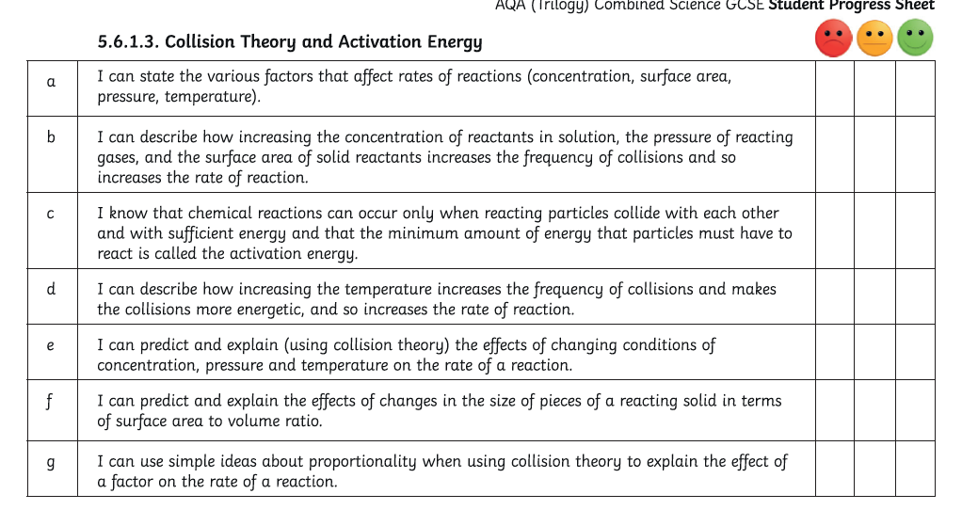
Check your learning: Rate your confidence

Slide 43
Check your learning: Rate your confidence

Slide 44
Reversible reactions
Watch the video and answer the questions on the next slide
Click here if the video doesn’t play

Slide 45
Reversible reactions
Watch the video and answer the following questions:
What is the symbol for a reversible reaction?
What is a reversible reaction?
the products of the reaction can react to produce the original reactants.
3) How can we change the direction of reversible reaction?
We can change the reaction conditions
4) How will heating and cooling affect the following reversible reaction:
Ammonium chloride ammonia + hydrogen chloride
Heating it will make the reaction go in the forward direction
Cooling it will make the reaction go in the backward direction

Slide 46
Reversible reactions
Watch the video and answer the following questions:
5) Describe the energy in reversible reactions.
6) What is equilibrium?

Slide 47
Reversible reactions
In some chemical reactions, the products of the reaction can react to produce the original reactants.
Such reactions are called reversible reactions and are represented:
The direction of reversible reactions can be changed by changing the conditions.
For example:
If a reversible reaction is exothermic in one direction, it is endothermic in the opposite direction. The same amount of energy is transferred in each case. For example:
When a reversible reaction occurs in apparatus which prevents the escape of reactants and products, equilibrium is reached when the forward and reverse reactions occur at exactly the same rate.

Slide 48
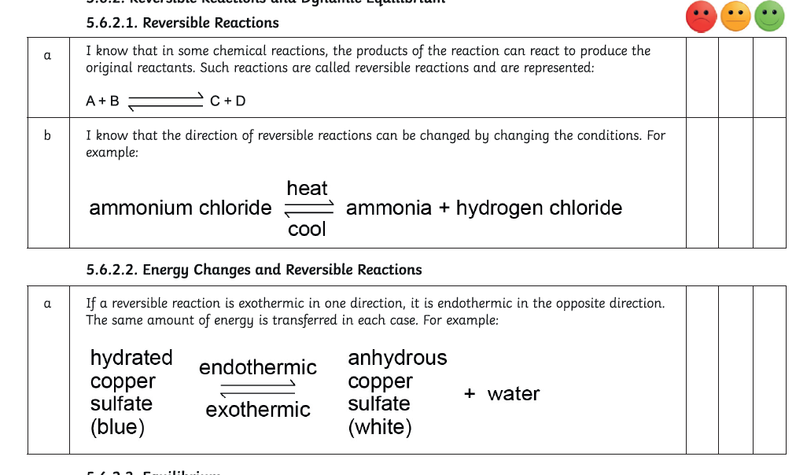
Check your learning: Rate your confidence

Slide 49
Reversible reactions ANSWERS
Watch the video and answer the following questions:
What is the symbol for a reversible reaction?
What is a reversible reaction?
the products of the reaction can react to produce the original reactants.
3) How can we change the direction of reversible reaction?
We can change the reaction conditions
4) How will heating and cooling affect the following reversible reaction:
Ammonium chloride ammonia + hydrogen chloride
Heating it will make the reaction go in the forward direction
Cooling it will make the reaction go in the backward direction

Slide 50
Reversible reactions ANSWERS
Watch the video and answer the following questions:
5) Describe the energy in reversible reactions.
If the reaction is endothermic in one direction, the reaction will be exothermic in the reverse direction.
6) What is equilibrium?
Equilibrium is when the forward and reverse reactions are taking place at the same rate

Slide 51
Concentration and reversible reactions HIGHER TIER
Watch the video and answer the questions on the next slide
Click here if the video doesn’t play

Slide 52
Concentration and reversible reactions HIGHER TIER
Watch the video and answer the following questions:
What is Le Chatelier’s principle?
2) How does concentration affect the position of the equilibrium?

Slide 53
What is a dynamic equilibrium?
When a reversible reaction happens in apparatus that prevents the escape of products or reactants (a closed system), it reaches a dynamic equilibrium.
At equilibrium:
the forward and backward reactions are still happening
the forward and backward reactions have the same rate of reaction
the concentrations of all the reacting substances remain constant

Slide 54
Check your learning: Rate your confidence

Slide 55
Temperature and reversible reactions
Click here if the video doesn’t play
Watch the video and answer the questions on the next slide

Slide 56
Temperature and reversible reactions HIGHER
Watch the video and answer the following questions:
Look at the reaction below. What will happen if the temperature of the system is a) increased b) decreased
2NO₂ N₂O₄
This reaction is exothermic in the forward reaction
This reaction is endothermic in the reverse reaction.

Slide 57
What factors affect the direction of a reversible reaction?
If a reaction is exothermic in one direction, it will be endothermic in the opposite direction. For example:
Exothermic
oxygen + glucose ⇌ carbon dioxide + water
Endothermic
The amount of heat (energy) transferred in the forward reaction is the same as the amount of heat (energy) transferred in the backward reaction.

Slide 58
Le Chatelier’s principle
The equilibrium position of a reversible reaction is a measure of the concentrations of the reacting substances at equilibrium.
At equilibrium, the concentrations and rate of reaction are constant.
Le Chatelier’s principle states that when you change the reaction conditions, the position of the equilibrium will change to minimise the change made.
The equilibrium position can be changed by changing the reaction conditions through:
changing the pressure
changing the concentration
changing the temperature
Extending
What is Le Chatelier’s principle?

Slide 59
How does temperature affect the position of equilibrium?
If a change is made to a system at equilibrium, the position of the equilibrium will move to counteract the change that was made.
Endothermic
Hydrated copper sulfate ⇌ anhydrous copper sulfate + water
Exothermic
If the temperature is increased, the position of equilibrium moves in the endothermic direction to reduce the temperature.
Extending
What is Le Chatelier’s principle?

Slide 60
Concentration and reversible reactions HT ANSWERS
Watch the video and answer the following questions:
What is Le Chatelier’s principle?
If the conditions are changed in system at equilibrium, the system (the reaction) will respond to counteract the change
2) How does concentration affect the position of the equilibrium?
The concentrations of all the chemicals will change until equilibrium is achieved again.

Slide 61
Temperature and reversible reactions ANSWERS
Watch the video and answer the following questions:
Look at the reaction below. What will happen if the temperature of the system is a) increased b) decreased
2NO₂ N₂O₄
a)This reaction is exothermic in the forward reaction
This reaction is endothermic in the reverse reaction.
If the temperature is increased, the equilibrium will shift in the direction of the endothermic reaction to the left, to reduce the temperature (as energy is taken in) . The amount of NO₂ produced will increase and the
amount of N₂O₄ will decrease.

Slide 62
Temperature and reversible reactions ANSWERS
Watch the video and answer the following questions:
Look at the reaction below. What will happen if the temperature of the system is a) increased b) decreased
2NO₂ N₂O₄
a)This reaction is exothermic in the forward reaction
This reaction is endothermic in the reverse reaction.
If the temperature is decreased, the equilibrium will shift in the direction of the exothermic reaction to the right, to increase the temperature (as energy is released) . The amount of N₂O₄ produced will increase and the amount of NO₂ will decrease.

Slide 63
Pressure and reversible reactions HIGHER TIER
Click here if the video doesn’t play
Watch the video and answer the questions on the next slide

Slide 64
Pressure and reversible reactions HIGHER TIER
Watch the video and answer the following questions:
What does the pressure in a gas depend on?
2) Write a balanced equation for the production of ammonia.
3) Which side of this equation has the most molecules?
4) What effect will increasing the pressure have on this reaction?

Slide 65
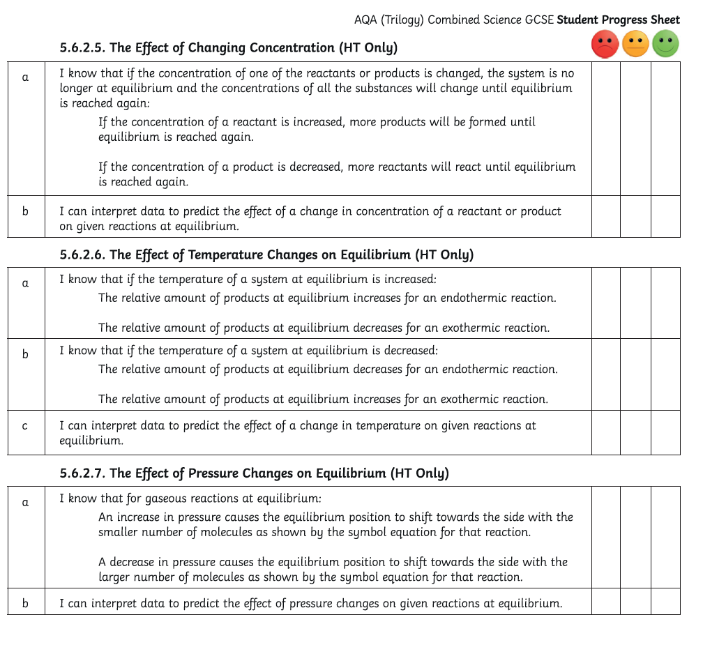
Check your learning: Rate your confidence

Slide 66
Pressure and reversible reactions HIGHER TIER
1) What does the pressure in a gas depend on?
The number of molecules in a given volume
2) Write a balanced equation for the production of ammonia.
N₂ + 3H₂ 2N₃
3) Which side of this equation has the most molecules?
Left = 4 molecules compared to 2 molecules =right

Slide 67
Pressure and reversible reactions HIGHER TIER
4) What effect will increasing the pressure have on this reaction?
Increasing the pressure on a reversible reaction causes the equilibrium to shift in the direction of the side with the smallest number of molecules.
In this reaction, an increase in pressure will cause more ammonia to be made
N₂ + 3H₂ 2N₃

