Slide 1
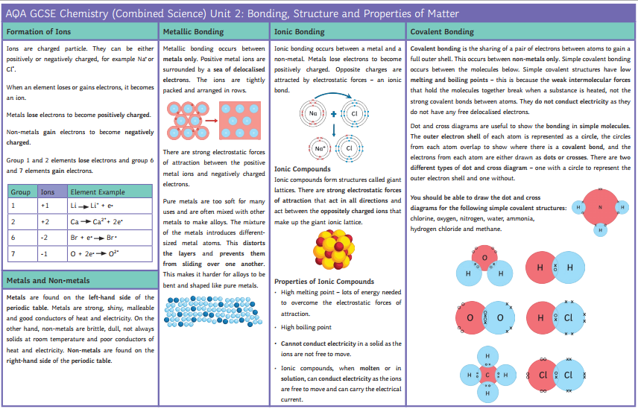
Atomic structure
21st September until 23th October
BBC bitesize links:
https://www.bbc.co.uk/bitesize/guides/ztc6w6f/revision/1
https://www.bbc.co.uk/bitesize/guides/z373h39/revision/1
https://www.bbc.co.uk/bitesize/guides/zgq8b82/revision/1

Slide 2
Atomic structure
https://classroom.thenational.academy/lessons/atomic-structure-6crk8d
Watch the video.
Complete the online worksheet.
Complete the final quiz.

Slide 3
Atomic mass and isotopes
Watch the video.
Complete the online worksheet.
Complete the final quiz.
Part 1
https://classroom.thenational.academy/lessons/isotopes-ccwp4c
Part 2
https://classroom.thenational.academy/lessons/isotopes-case-study-lesson-cguk0t

Slide 4
Electron configuration
https://classroom.thenational.academy/lessons/electron-configuration-and-the-periodic-table-61jp4c
Watch the video.
Complete the online worksheet.
Complete the final quiz.

Slide 5
Reactions
https://classroom.thenational.academy/lessons/why-elements-react-6cuk4d
Watch the video.
Complete the online worksheet.
Complete the final quiz.

Slide 6
Ionic bonding
Part 1
https://classroom.thenational.academy/lessons/ionic-bonding-introduction-70wk4c
Part 2
https://classroom.thenational.academy/lessons/further-ionic-bonding-6cu32c
Watch the video.
Complete the online worksheet.
Complete the final quiz.

Slide 7
Properties of ionic substances
https://classroom.thenational.academy/lessons/properties-of-ionic-compounds-6hj66c
Watch the video.
Complete the online worksheet.
Complete the final quiz.

Slide 8
Covalent bonding
https://classroom.thenational.academy/lessons/covalent-bonding-65hpcc
Watch the video.
Complete the online worksheet.
Complete the final quiz.

Slide 9
Covalent bonding
Part 1
https://classroom.thenational.academy/lessons/covalent-bonding-65hpcc
Part 2
https://classroom.thenational.academy/lessons/simple-covalent-molecules-70v66e
Part 3
https://classroom.thenational.academy/lessons/the-giant-covalent-structures-c5h3cc
Watch the video.
Complete the online worksheet.
Complete the final quiz.

Slide 10
Carbon structures
https://classroom.thenational.academy/lessons/giant-covalent-structures-graphene-68rp6e
Watch the video.
Complete the online worksheet.
Complete the final quiz.

Slide 11
Educake quiz
Title of the quiz:
Atomic structure quarantine work
If you do not know your Educake log in details, e-mail your Science teacher.
They will provide you with your log in as soon as possible.

