Slide 1
Science Quarantine pack
Year 10 – Spring 1
Topic : Energy changes
Tasks:
Watch the videos and answer the questions.
Download and complete the worksheet
Complete the quizzes
Complete the online quiz at the end of the topic

Slide 3
exothermic and endothermic reactiobs
Watch the following videos:
https://www.youtube.com/watch?v=4HS6D0hTzdg https://classroom.thenational.academy/lessons/exothermic-and-endothermic-reactions-cgw32t?step=1&activity=video
Answer the following questions:
What is an exothermic reaction?
Give two examples of exothermic reactions.
What is an endothermic reaction?
Give two examples of endothermic reactions.
What is activation energy?
Draw and describe an energy profile diagram for an exothermic reaction
Draw an energy profile diagram for an endothermic reaction.
Give two uses of exothermic reactions.
Give two uses of endothermic reactions.
Download and complete the worksheet: https://classroom.thenational.academy/lessons/exothermic-and-endothermic-reactions-cgw32t?step=2&activity=worksheet
Complete the quiz:
https://classroom.thenational.academy/lessons/exothermic-and-endothermic-reactions-cgw32t?step=3&activity=exit_quiz

Slide 4
Required practical temperature change
Watch the following videos:
https://www.youtube.com/watch?v=rdI7xEq4Ew8
https://classroom.thenational.academy/lessons/required-practical-temperature-change-part-1-6tgp8c?step=1&activity=video
https://classroom.thenational.academy/lessons/required-practical-temperature-change-part-2-ccwkjt?step=1&activity=video
Answer the following questions:
What type of reaction is a neutralization reaction?
What is the independent variable in this investigation?
What is the dependent variable in this investigation?
Describe a step-by-step method to investigate the temperature change in an experiment.
Explain how you would prevent heat being lost in this investigation.
Download and complete the worksheets: https://classroom.thenational.academy/lessons/required-practical-temperature-change-part-1-6tgp8c?step=2&activity=worksheet
https://classroom.thenational.academy/lessons/required-practical-temperature-change-part-2-ccwkjt?step=2&activity=worksheet
Complete the quiz: https://classroom.thenational.academy/lessons/required-practical-temperature-change-part-1-6tgp8c?step=3&activity=exit_quiz
https://classroom.thenational.academy/lessons/required-practical-temperature-change-part-2-ccwkjt?step=3&activity=exit_quiz

Slide 5
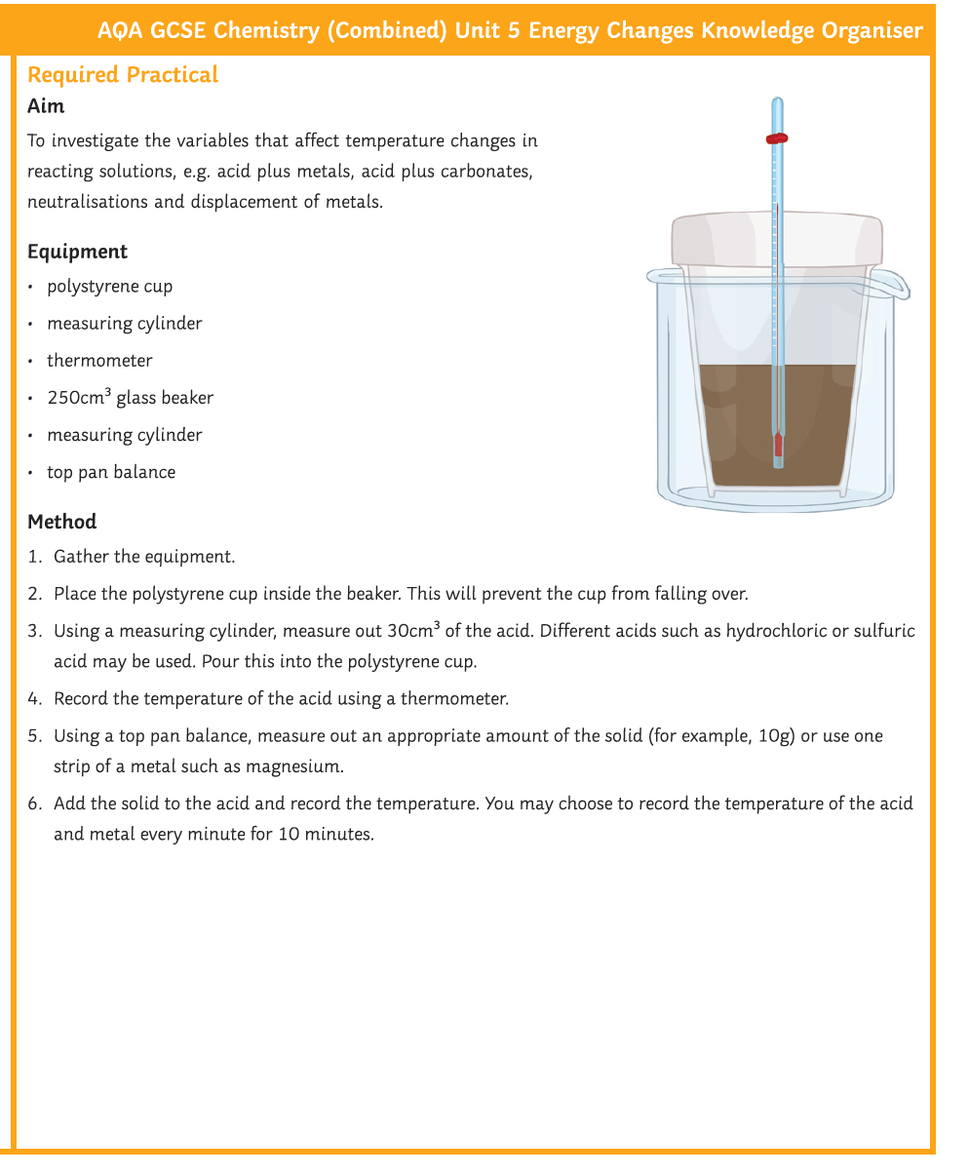
Required practical temperature change

Slide 6
Energy level diagrams
Watch the following videos:
https://classroom.thenational.academy/lessons/energy-level-diagrams-cgv68e?step=1&activity=video
Download and complete the worksheet: https://classroom.thenational.academy/lessons/energy-level-diagrams-cgv68e?step=2&activity=worksheet
Complete the quiz: https://classroom.thenational.academy/lessons/energy-level-diagrams-cgv68e?step=3&activity=exit_quiz

Slide 7
Calculating bond energies (higher)
Watch the following videos:
https://www.youtube.com/watch?v=eExCBkp4jB4
https://www.youtube.com/watch?v=PdValXAVUOc
https://classroom.thenational.academy/lessons/calculating-bond-energies-68tker?step=1&activity=video
Answer the following questions:
Describe how energy is transferred in exothermic reactions.
Why are exothermic reactions shown as a negative value?
Describe how energy is transferred in endothermic reactions.
Why are endothermic reactions shown as a positive value?
What happens to bonds in an exothermic reaction?
What happens to bonds in an endothermic reaction?
What is bond energy?
Show the energy changes in the reaction between hydrogen and chlorine, showing where bonds are made and broken in order to calculate the transfer of energy in this reaction.
Show the energy changes in the reaction between methane and oxygen, showing where bonds are made and broken in order to calculate the transfer of energy in this reaction.
Download and complete the worksheet: https://classroom.thenational.academy/lessons/calculating-bond-energies-68tker?step=2&activity=worksheet
Complete the quiz: https://classroom.thenational.academy/lessons/calculating-bond-energies-68tker?step=3&activity=exit_quiz

Slide 8
Calculating bond energies (higher)

Slide 9
Now complete the online quiz:
https://forms.office.com/Pages/ResponsePage.aspx?id=17eMxmGmGkarCHowlNbkEX_7RlQGl65KkokfIEkV_9ZUMkhEUE81RE9LMzRBN09JSkdQWkRUSFFVNCQlQCN0PWcu
OR

