Slide 1
Science Quarantine pack
Year 9 – Spring 1
Topic 1: Chemistry of the atmosphere
Tasks:
Watch the videos and answer the questions.
Download and complete the worksheet
Complete the quizzes
Complete the online quiz at the end of the topic

Slide 2
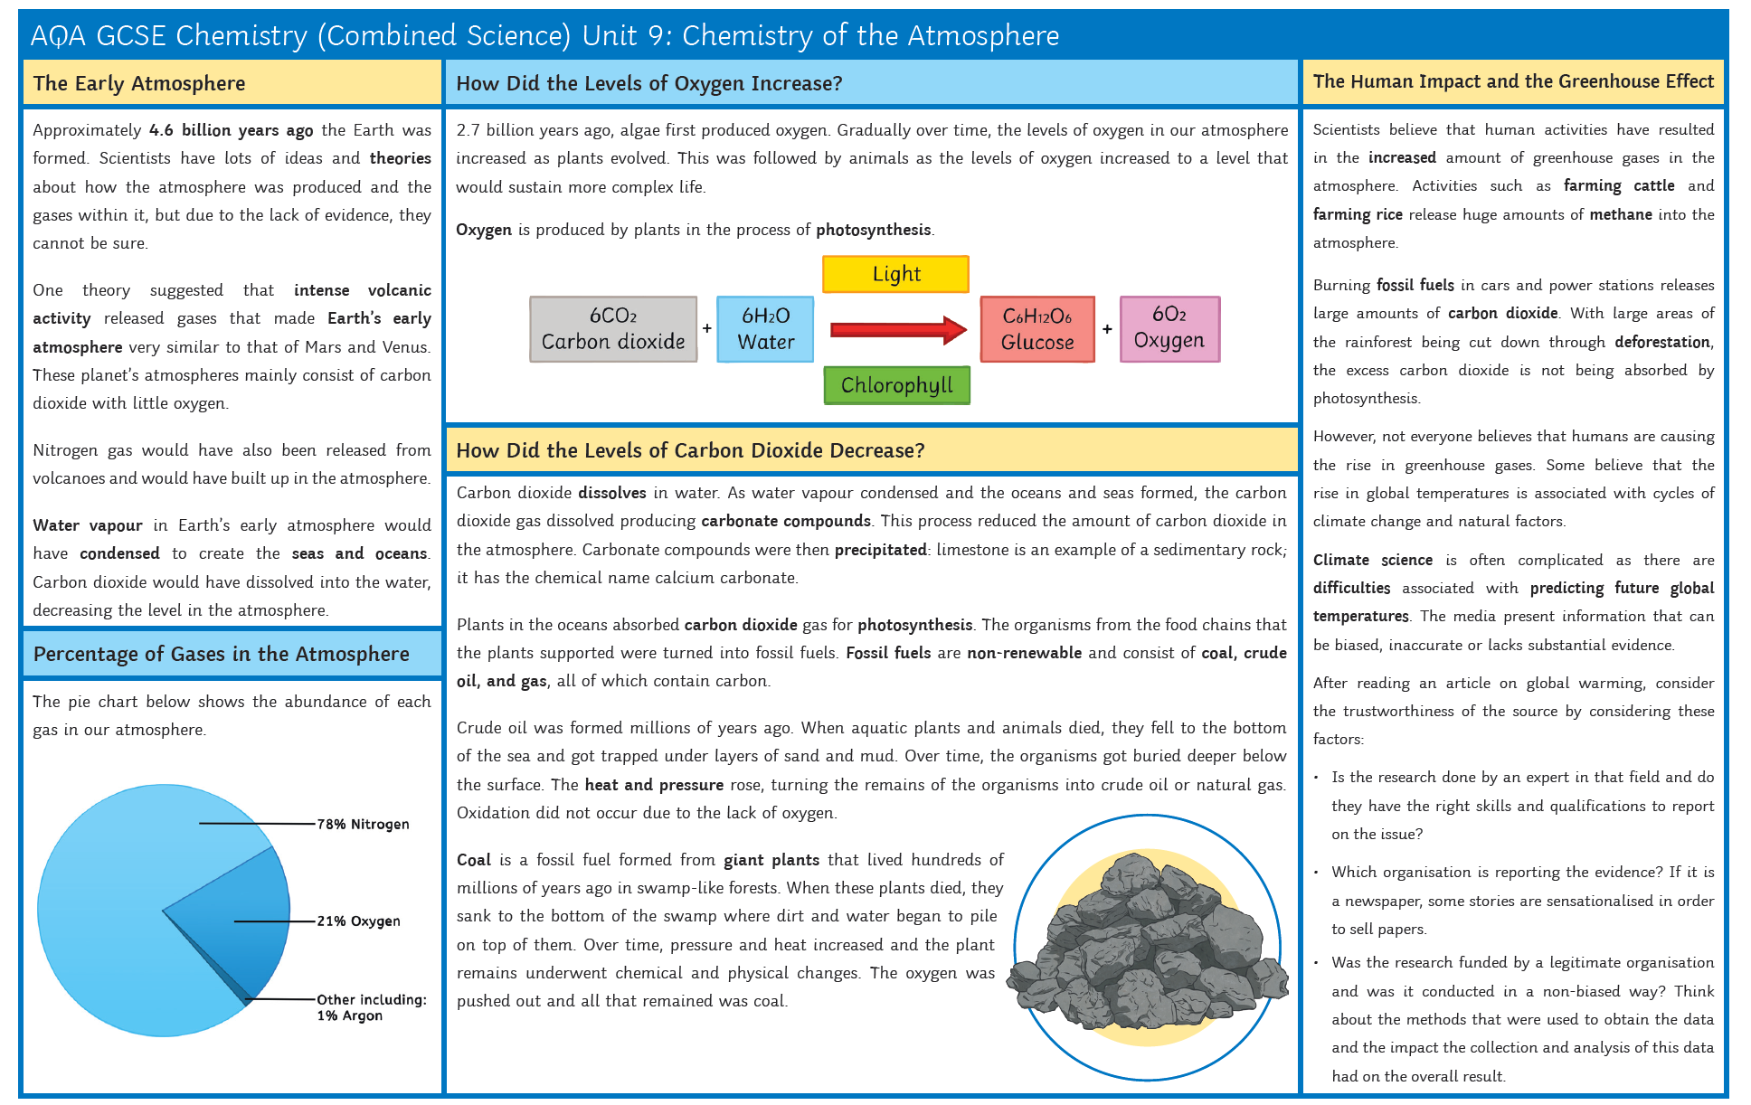
Useful links:
Early atmosphere and evolution of the atmosphere:
https://www.bbc.co.uk/bitesize/guides/z9pk3k7/revision/1

Slide 3
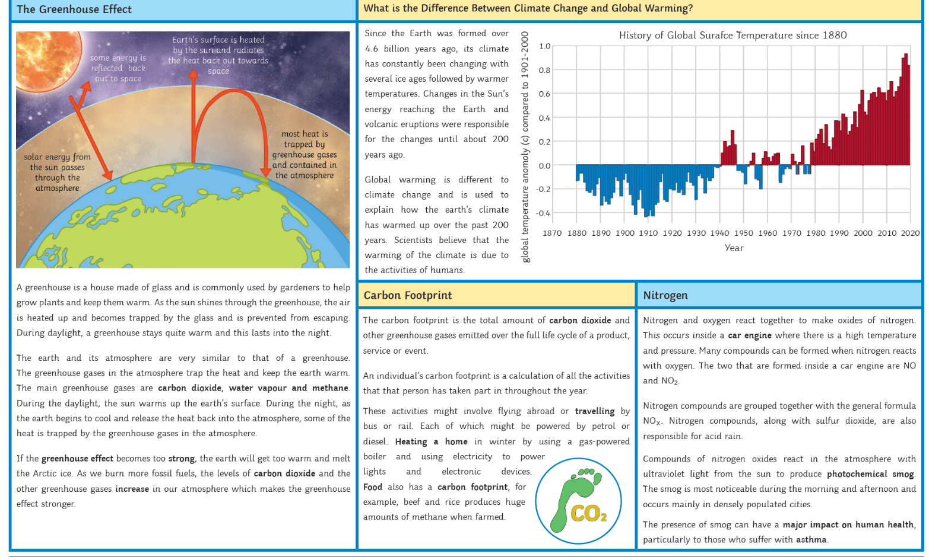
Polluting the atmosphere:
https://www.bbc.co.uk/bitesize/guides/zq3797h/revision/1

Slide 5
The atmosphere
Watch the following videos:
https://www.youtube.com/watch?v=t1Z3GlNldLA
https://classroom.thenational.academy/lessons/the-earths-atmosphere-74wk2e?step=1&activity=video
Answer the following questions:
Describe the composition of the Earth’s atmosphere.
How old is the Earth?
Describe the composition of the early atmosphere.
Describe how the earth’s atmosphere has changed.
How did the carbonate deposits change the composition of the atmosphere?
How did the evolution of photosynthesising plants lead to a change in the earth’s atmosphere?
Compare the early and modern Earth’s atmosphere.
Complete the worksheet: https://classroom.thenational.academy/lessons/the-earths-atmosphere-74wk2e?step=2&activity=worksheet
Complete the quiz:
https://classroom.thenational.academy/lessons/the-earths-atmosphere-74wk2e?step=3&activity=exit_quiz

Slide 6
The Greenhouse effect
Watch the following videos:
https://www.youtube.com/watch?v=K5vXnDGcOE4
https://classroom.thenational.academy/lessons/the-greenhouse-effect-6gup6r?step=1&activity=video
Answer the following questions:
What are the 3 main greenhouse gases?
How does energy from the Sun travel to Earth?
What is the greenhouse effect? Why is it so important?
Complete the worksheet: https://classroom.thenational.academy/lessons/the-greenhouse-effect-6gup6r?step=2&activity=worksheet
Complete the quiz: https://classroom.thenational.academy/lessons/the-greenhouse-effect-6gup6r?step=3&activity=exit_quiz

Slide 7
Climate change
Watch the following videos:
https://www.youtube.com/watch?v=MxS4pMc2O2Y
https://classroom.thenational.academy/lessons/climate-change-6gu6ce?step=1&activity=video
Answer the following questions:
Explain how human activities are leading to the levels of carbon dioxide increasing?
Explain how human activities are leading to the levels of methane increasing?
What is climate change?
What are the effects of climate change?
What is the relationship between the greenhouse gases and climate change?
What is bias?
Complete the worksheet: https://classroom.thenational.academy/lessons/climate-change-6gu6ce?step=2&activity=worksheet
Complete the quiz: https://classroom.thenational.academy/lessons/climate-change-6gu6ce?step=3&activity=exit_quiz

Slide 8
Pollutants
Watch the following videos:
https://www.youtube.com/watch?v=yLp6LOgPHmI
https://classroom.thenational.academy/lessons/pollutants-6rukcc?step=1&activity=video
Answer the following questions:
What is a fuel?
Give two examples of fuels.
What are the uses of hydrocarbons?
What happens when hydrocarbons are burnt in air? What gas is produced?
What is complete combustion?
What are the issues with burning hydrocarbons?
What are the problems with carbon monoxide?
What fuels produce sulphur dioxide? What are the problems with sulphur dioxide?
What type of fuels produce oxides of nitrogen? What are the problems with oxides of nitrogen?
How do we get particulates? What are particulates?
What is global dimming? What are the problems with global dimming?
Complete the worksheet: https://classroom.thenational.academy/lessons/pollutants-6rukcc?step=2&activity=worksheet
Complete the quiz: https://classroom.thenational.academy/lessons/pollutants-6rukcc?step=3&activity=exit_quiz

Slide 9
Now complete the online quiz:
https://forms.office.com/Pages/ResponsePage.aspx?id=17eMxmGmGkarCHowlNbkEc0l92ahD1pLr-8eKxLOb75UMzA1QllRRUhaRFJVRFRITENaMEtDUU9XVS4u
OR

Slide 10
Science Quarantine pack
Year 9 – Spring 1
Topic 2: Magnetism
Tasks:
Watch the videos and answer the questions.
Download and complete the worksheet
Complete the quizzes
Complete the online quiz at the end of the topic

Slide 11
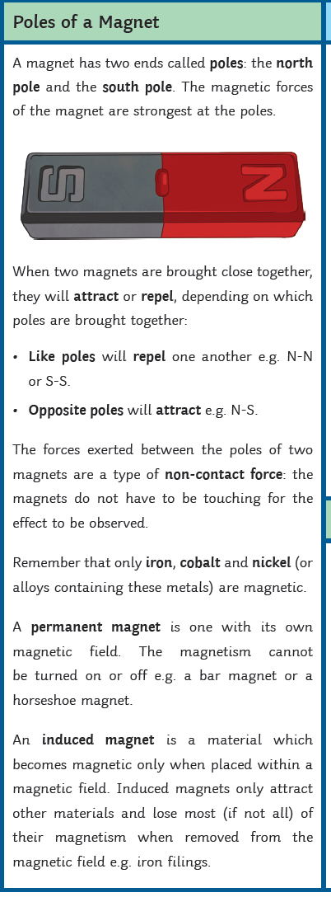
Title: Permanent and induced magnets
What are the two poles of a bar magnet called?
What would happen if you brought together two north poles?
What would happen if you brought together a north pole and south pole?
What type of force is exerted between the poles of two magnets?
What is a permanent magnet?
What is an induced magnet?
What type of force is produced by induced magnetism?

Slide 12
Title: Permanent and induced magnets
Watch the following videos:
https://www.youtube.com/watch?v=sRyy7-jEu3Q
https://classroom.thenational.academy/lessons/magnetism-75jpad
Answer the following questions:
What are the two poles of a bar magnet called?
What would happen if you brought together two north poles?
What would happen if you brought together a north pole and south pole?
What type of force is exerted between the poles of two magnets?
What is a permanent magnet?
What is an induced magnet?
What type of force is produced by induced magnetism?
Complete the worksheet: https://classroom.thenational.academy/lessons/magnetism-75jpad?step=2&activity=worksheet
Complete the quiz:
https://classroom.thenational.academy/lessons/magnetism-75jpad?step=3&activity=exit_quiz

Slide 13
Title: Permanent and induced magnets
What are the two poles of a bar magnet called?
North pole
South pole.
2. What would happen if you brought together two north poles?
Repulsion
3. What would happen if you brought together a north pole and south pole?
Attraction
4. What type of force is exerted between the poles of two magnets?
Non-contact force
5. What is a permanent magnet?
A permanent magnet produces its own magnetic field
6. What is an induced magnet?
An induced magnet is a material that becomes a magnet when placed in a magnetic field.
7. What type of force is produced by induced magnetism?
Induced magnetism always causes a force of attraction

Slide 14
Check your learning

Slide 15
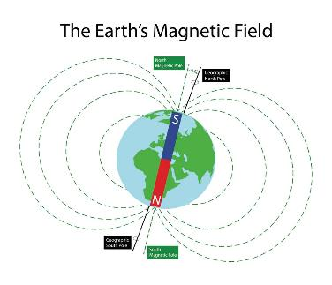
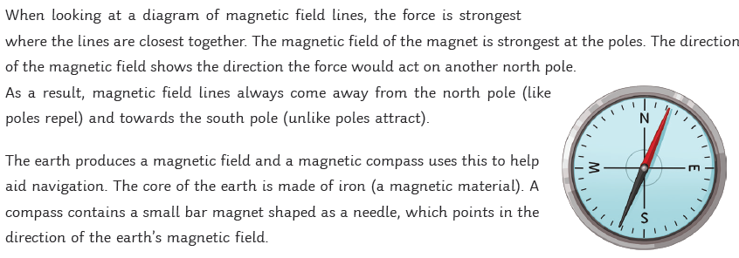
Title: magnetic fields
There are four types of magnetic material:
Iron
Nickel
Cobalt
Steel
All of these magnetic materials can be made into a permanent magnet or an induced magnet.
The direction of a magnetic field is always from the north-seeking pole to the south-seeking pole
A compass contains a tiny bar magnet, the compass needle will always point in the direction of the Earth’s magnetic field

Slide 16
Title: Magnetic fields
Click here if video doesn’t play
Give four types of magnetic material
What is a magnetic field?
If you place a magnetic material into a magnetic field, what kind of force will it experience?
How does distance from the magnet affect the strength of the magnetic field?
Where is the magnetic field the strongest?
How do we find the direction of the magnetic field?
What causes a compass to always point north-south?

Slide 17
Title: Magnetic fields
Watch the following videos:
https://www.youtube.com/watch?v=FodEDHaEY68&list=PL9IouNCPbCxVean2cWoznpfC5PxYbs9TX&index=2
https://classroom.thenational.academy/lessons/magnetic-fields-61jkcc?step=1&activity=video
Answer the following questions:
Give four types of magnetic material
What is a magnetic field?
If you place a magnetic material into a magnetic field, what kind of force will it experience?
How does distance from the magnet affect the strength of the magnetic field?
Where is the magnetic field the strongest?
How do we find the direction of the magnetic field?
What causes a compass to always point north-south?
Complete the worksheet: https://classroom.thenational.academy/lessons/magnetic-fields-61jkcc?step=2&activity=worksheet
Complete the quiz:
https://classroom.thenational.academy/lessons/magnetic-fields-61jkcc?step=3&activity=exit_quiz

Slide 18
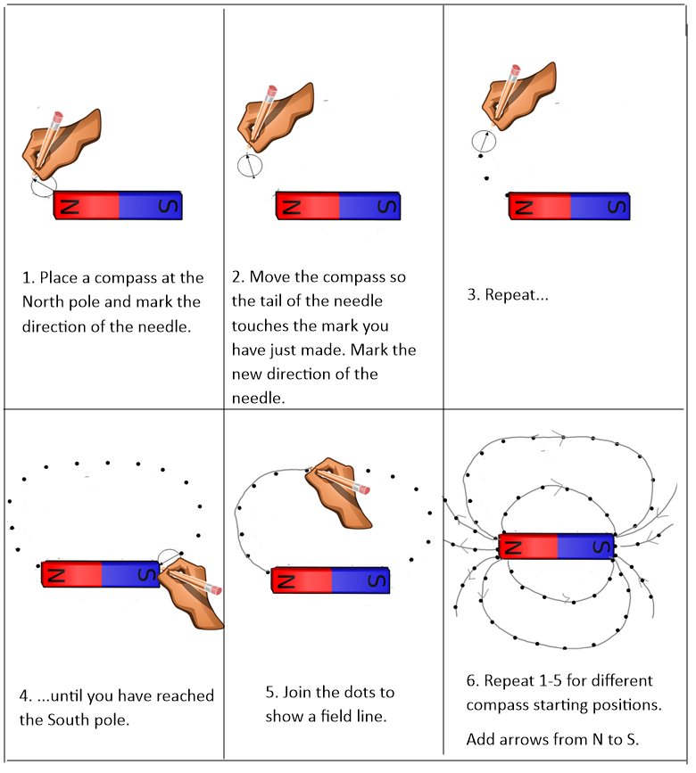
Title: Magnetic fields
What are the four types of magnetic material? Cobalt, nickel, iron and steel.
What is a magnetic field? The region around a magnet where a force acts on another magnet of magnetic field.
If you place a magnetic material into a magnetic field, what kind of force will it experience? An attractive force.
How does distance from the magnet affect the strength of the magnetic field? The magnetic field is strongest closest to the magnet, getting weaker as you move further away from the magnet.
Where is the magnetic field the strongest? At the poles of the magnet.
How do we find the direction of the magnetic field? See diagram to the right.
What causes a compass to always point north-south?
The Earth has its own magnetic field due to the Earth’s core
How do we find the direction of the magnetic field?

Slide 19
Check your learning

Slide 20
Title: Electromagnets
Click here if video doesn’t play
In which direction does conventional current flow?
What is produced around a current-carrying wire?
How does the size of the current affect the magnetic field?
Where is the magnetic field the strongest?
What happens to the direction of the magnetic field if direction of the current is changed?
Describe the shape of the magnetic field around a solenoid.
How else can we increase the strength of the magnetic field in a solenoid?
Give a use of an electromagnet?

Slide 21
Title: Electromagnets
Watch the following videos:
https://www.youtube.com/watch?v=dMbWkodL12I&list=PL9IouNCPbCxVean2cWoznpfC5PxYbs9TX&index=3 https://classroom.thenational.academy/lessons/electromagnetism-cgv64r?step=1&activity=video
Answer the following questions:
In which direction does conventional current flow?
What is produced around a current-carrying wire?
How does the size of the current affect the magnetic field?
Where is the magnetic field the strongest?
What happens to the direction of the magnetic field if direction of the current is changed?
Describe the shape of the magnetic field around a solenoid.
How else can we increase the strength of the magnetic field in a solenoid?
Give a use of an electromagnet?
Complete the worksheet: https://classroom.thenational.academy/lessons/electromagnetism-cgv64r?step=2&activity=worksheet
Complete the quiz:
https://classroom.thenational.academy/lessons/electromagnetism-cgv64r?step=3&activity=exit_quiz

Slide 22
Check your learning

Slide 23
Title: Electromagnetism
In which direction does conventional current flow? From the positive terminal to the negative terminal
What is produced around a current-carrying wire? A magnetic field
How does the size of the current affect the magnetic field? The larger the current, the stronger the magnetic field.
Where is the magnetic field the strongest? Closest to the wire
What happens to the direction of the magnetic field if direction of the current is changed? The direction of the magnetic field is reversed.
Describe how to use the right-hand grip rule? Place the right hand around the wire with the thumb pointing in the direction of the current. The fingers will point in the direction of the magnetic field.
Describe the shape of the magnetic field around a solenoid. The same as the magnetic field around a bar magnet.
How else can we increase the strength of the magnetic field in a solenoid? Increase the size of the current, increase the number of turns on the coil or use an iron core.
Give a use of an electromagnet? Scrap yards

Slide 24
Title: The motor effect
Click here if video doesn’t play
What happens when you place a current-carrying wire perpendicular to a magnetic field?
What is the equation that links magnetic flux, force, current and length of wire?
3. What are the units of magnetic flux density?
4. What is magnetic flux density?
5. A 1.25m wire is carrying a current of 0.8A. The magnetic flux density is 0.05T. Calculate the size of the force on the wire.
6. What factors affect the size of the force?
7. How could you work out the direction of the force?
8. What will happen if the current carrying wire is parallel to the magnetic field?

Slide 25
Title: The motor effect and left hand rule
Watch the following videos:
https://www.youtube.com/watch?v=fiQ38p6vb8o&list=PL9IouNCPbCxVean2cWoznpfC5PxYbs9TX&index=6
https://classroom.thenational.academy/lessons/the-motor-effect-and-left-hand-rule-cctp8c?step=1&activity=video
Answer the following questions:
What happens when you place a current-carrying wire perpendicular to a magnetic field?
What is the equation that links magnetic flux, force, current and length of wire?
3. What are the units of magnetic flux density?
4. What is magnetic flux density?
5. A 1.25m wire is carrying a current of 0.8A. The magnetic flux density is 0.05T. Calculate the size of the force on the wire.
6. What factors affect the size of the force?
7. How could you work out the direction of the force?
8. What will happen if the current carrying wire is parallel to the magnetic field?
Complete the worksheet: https://classroom.thenational.academy/lessons/the-motor-effect-and-left-hand-rule-cctp8c?step=2&activity=worksheet
Complete the quiz:
https://classroom.thenational.academy/lessons/the-motor-effect-and-left-hand-rule-cctp8c?step=3&activity=exit_quiz

Slide 27
Title: The motor effect
What happens when you place a current-carrying wire perpendicular to a magnetic field? The magnetic field around the wire will interact with the magnetic field between the magnet, the wire experiences a force, causing the wire to move. This is called the motor effect.
What is the equation that links magnetic flux, force, current and length of wire?
Force (N) = magnetic flux (T) x current (A) x length of wire (m)
3. What are the units of magnetic flux density? Tesla, T.
4. What is magnetic flux density? A measure of the strength of the magnetic field.
5. A 1.25m wire is carrying a current of 0.8A. The magnetic flux density is 0.05T. Calculate the size of the force on the wire.
F = 0.05 x 0.8 x 1.25 F = 0.05N
6. What factors affect the size of the force? magnetic flux density, current and the length of the wire.
7. How could you work out the direction of the force?
Use Fleming’s left hand rule – Hold thumb, first finger and second finger at right angles. First finger – Magnetic field (N→S), second finger – Direction of current (Positive to negative terminal. Thumb – Will point in the direction of the motion (the force)
8. What will happen if the current carrying wire is parallel to the magnetic field? Nothing.No force will be experienced in the conducting wire.

Slide 28
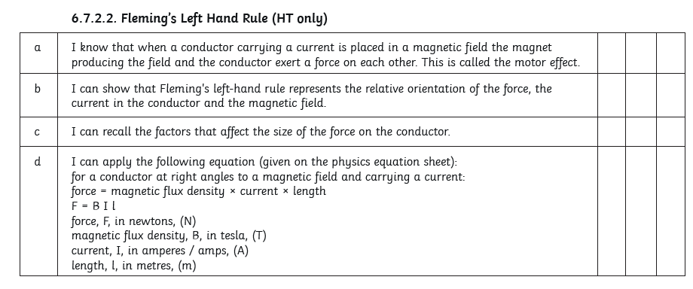
Check your learning

Slide 29
Title: The DC electric motor
Click here if video doesn’t play
If you place a loop of current-carrying wire in a magnetic field, what will happen to the loop of wire?
Why is the direction of the current swapped when the loop is at right angles to the magnetic field?

Slide 30
Title: DC Motors
Watch the following videos:
https://www.youtube.com/watch?v=fiQ38p6vb8o&list=PL9IouNCPbCxVean2cWoznpfC5PxYbs9TX&index=6
https://classroom.thenational.academy/lessons/dc-motors-74r32c?step=1&activity=video
Answer the following questions:
If you place a loop of current-carrying wire in a magnetic field, what will happen to the loop of wire?
Why is the direction of the current swapped when the loop is at right angles to the magnetic field?
Complete the worksheet: https://classroom.thenational.academy/lessons/dc-motors-74r32c?step=2&activity=worksheet
Complete the quiz:
https://classroom.thenational.academy/lessons/dc-motors-74r32c?step=3&activity=exit_quiz

Slide 31
Title: The electric motor
If you place a loop of current-carrying wire in a magnetic field, what will happen to the loop of wire? The loop will rotate.
Why is the direction of the current swapped when the loop is at right angles to the magnetic field?
To keep the loop spinning.

Slide 32
The electric motor gap fill
A simple electric __________ can be built using a coil of wire that is free to rotate between two opposite magnetic ____________. When an electric current flows through the coil, the coil experiences a___________and moves.
The direction of the current must be reversed every half turn, otherwise the coil comes to a ____________ again. This is achieved using a conducting ring split in two, called a ____________or commutator. A coil of wire is used with lots of turns to increase the effect of the magnetic field.
Split ring poles motor force halt

Slide 33
The electric motor gap fill
motor
A simple electric __________ can be built using a coil of wire that is free to rotate between two opposite magnetic ____________. When an electric current flows through the coil, the coil experiences a___________and moves.
The direction of the current must be reversed every half turn, otherwise the coil comes to a ____________ again. This is achieved using a conducting ring split in two, called a ____________or commutator. A coil of wire is used with lots of turns to increase the effect of the magnetic field.
poles
force
halt
Split ring
Split ring poles motor force halt

Slide 34
Now complete the online quiz:
https://forms.office.com/Pages/ResponsePage.aspx?id=17eMxmGmGkarCHowlNbkEc0l92ahD1pLr-8eKxLOb75UM1RQTDhWWU1MWlUzR0VaTUMyOUxHMTY0Si4u
OR

