Slide 1
Science quarantine pack
Spring 2
Year 11: P6 Waves
This unit is made up of 7 lessons.
Tasks:
Watch the videos and answer the questions
Download and complete the worksheet
Complete the online quizzes and forms quizzes

Slide 2
Title: Transverse and longitudinal waves
Watch the following videos and read BBC Bitesize notes :
https://www.youtube.com/watch?v=0f5iYCNCnow https://www.bbc.co.uk/bitesize/guides/z3yq4qt/revision/1
Answer the following questions:
What is a longitudinal wave? Give two examples
What is a transverse wave? Give two examples
What do all waves transfer?
What do ripples transfer?
What is an oscillation?
In which direction is energy transferred by transverse waves?
In which direction is energy transferred by transverse waves?
What are compressions and rarefactions
What are the differences between longitudinal and transverse waves.
Complete the BBC test: https://www.bbc.co.uk/bitesize/guides/z3yq4qt/test

Slide 3
Check your learning, if you have any red or amber topics watch the videos and read through the BBC Bitesize notes again.

Slide 4
Title: Properties of waves
Watch the video and read the BBC Bitesize notes:
https://www.youtube.com/watch?v=ITe6snlZBp8
https://www.youtube.com/watch?v=Aucu7YshyQ0
https://www.bbc.co.uk/bitesize/guides/zwkn2nb/revision/1
https://classroom.thenational.academy/lessons/wave-properties-60vk0d?step=1&activity=video
https://classroom.thenational.academy/lessons/measuring-the-speed-of-waves-in-solids-c9gk6t?step=1&activity=video
Answer the following questions:
What do waves do?
Draw a labelled diagram to show a waves: wavelength, amplitude, wave peak and wave trough.
Give the equation to calculate the time of a wave
Give the equation to calculate wave speed.
How could you calculate the speed of sound in air?
What do the particles in a wave do?
What is an oscillation?
Define a longitudinal wave
Define a transverse wave
What is a mechanical wave?
Give two examples of longitudinal waves
Give two examples of transverse waves
What is the difference between a peak and amplitude?
What are the units of wavelength?

Slide 5
Title: Properties of waves
Watch the video and read the BBC Bitesize notes:
https://www.youtube.com/watch?v=OY0lXHPo_nM
https://www.youtube.com/watch?v=UNmv6H-f180
https://www.youtube.com/watch?v=ZXAmiRC0GBo
https://www.bbc.co.uk/bitesize/guides/zwkn2nb/revision/4
https://www.bbc.co.uk/bitesize/guides/zwkn2nb/revision/5
Answer the following questions:
1. Describe a method to Measure the frequency, wavelength and speed of waves in a ripple
Tank.
2. Describe a method to Measure the frequency, wavelength and speed of waves
in a solid.
Download and complete the following worksheets: https://classroom.thenational.academy/lessons/wave-properties-60vk0d?step=2&activity=worksheet
https://classroom.thenational.academy/lessons/measuring-the-speed-of-waves-in-solids-c9gk6t?step=2&activity=worksheet
Complete the quizzes https://classroom.thenational.academy/lessons/wave-properties-60vk0d?step=3&activity=exit_quiz
Complete the following test: https://www.bbc.co.uk/bitesize/guides/zwkn2nb/test

Slide 6
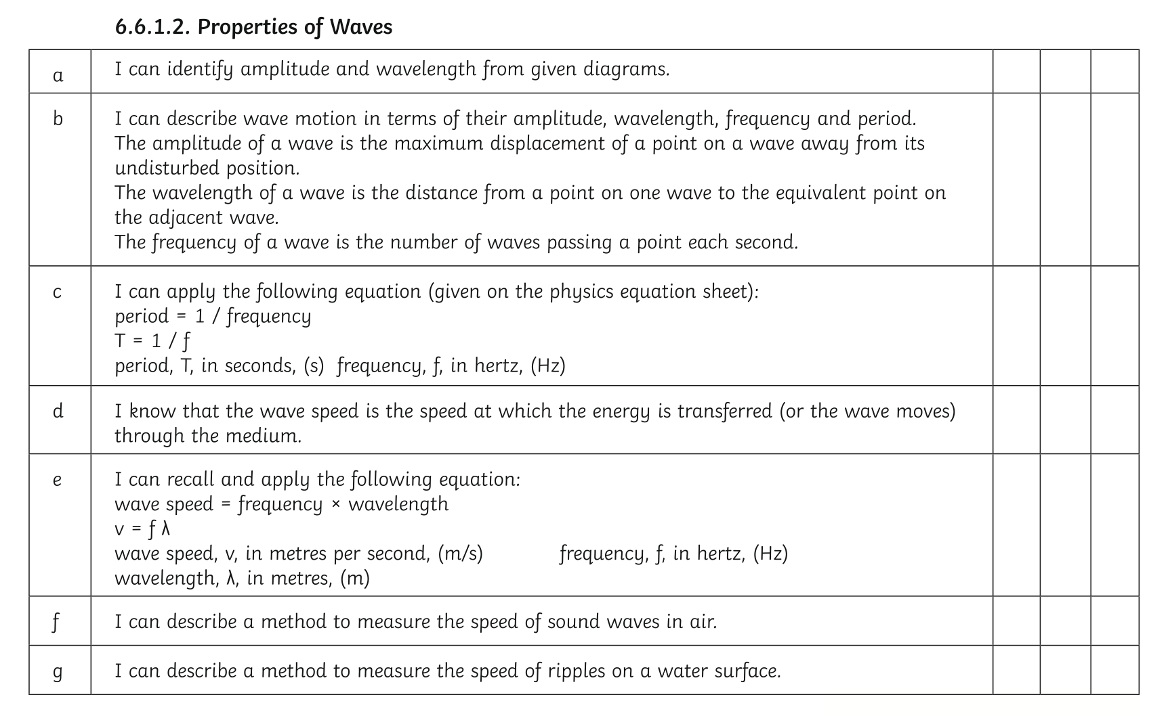
Check your learning, if you have any red or amber topics watch the videos and read through the BBC Bitesize notes again.

Slide 7
Title: Types of electromagnetic waves
Watch the following video and read the BBC Bitesize notes:
https://classroom.thenational.academy/lessons/electromagnetic-spectrum-part-1-6dk62r?activity=video&step=1
https://www.youtube.com/watch?v=u5vkYjV1V1A
https://www.bbc.co.uk/bitesize/guides/z3yq4qt/revision/3
Answer the following questions:
What type of waves are electromagnetic waves?
What is the electromagnetic spectrum?
Which electromagnetic waves are humans able to see?
List the types of electromagnetic wave in order of increasing frequency.
List the types of electromagnetic wave in order of decreasing wavelength.
Describe the properties of electromagnetic waves.
define the terms transmission, absorption, reflection and refraction.
Complete the worksheet: https://classroom.thenational.academy/lessons/electromagnetic-spectrum-part-1-6dk62r?step=2&activity=worksheet
Complete the quiz:
https://classroom.thenational.academy/lessons/electromagnetic-spectrum-part-1-6dk62r?step=3&activity=exit_quiz

Slide 8
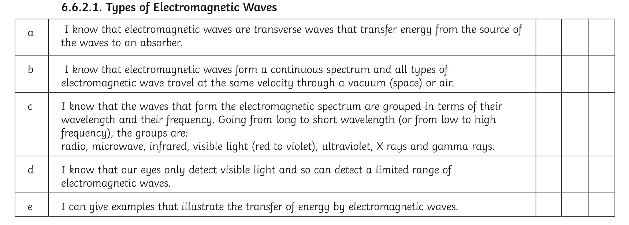
Check your learning, if you have any red or amber topics watch the videos and read through the BBC Bitesize notes again.

Slide 9
Title: Properties of electromagnetic waves (Higher Tier)
Read the BBC Bitesize notes:
Reflection:
https://www.bbc.co.uk/bitesize/guides/z2xjdxs/revision/1
Answer the following questions:
What is reflection?
What is the law of reflection?
What is specular reflection
What us a virtual image?
What is diffuse reflection?
Please note you only need to have a general knowledge of reflection for combined Science and describe how transverse waves are reflected.

Slide 10
Title: properties of electromagnetic waves (Higher Tier)
Watch the videos and read the BBC Bitesize notes:
https://classroom.thenational.academy/lessons/refraction-cmr64c?activity=video&step=1
https://www.youtube.com/watch?v=wO49W5lsP0s
https://www.bbc.co.uk/bitesize/guides/z2xjdxs/revision/2
Answer the following questions:
What is refraction?
What happens to the speed of transverse waves such as light when the enter a denser medium?
What happens to the speed of transverse waves such as light when the enter a less dense medium?
How does the speed of a wave affect its wavelength?
What is the relationship between wave velocity and refraction?
Construct a ray diagram to show the refraction of light at the boundary between air and another medium.
Construct a wave front diagram to show what happens to waves when they enter a different medium
Download and complete the following worksheets: https://classroom.thenational.academy/lessons/refraction-cmr64c?step=2&activity=worksheet Complete the quizzes https://classroom.thenational.academy/lessons/refraction-cmr64c?step=3&activity=exit_quiz
https://www.bbc.co.uk/bitesize/guides/z2xjdxs/test

Slide 11
Check your learning, if you have any red or amber topics watch the videos and read through the BBC Bitesize notes again.

Slide 12
Title: Properties of Electromagnetic waves
Watch the following videos and read the BBC Bitesize notes:
https://classroom.thenational.academy/lessons/electromagnetic-spectrum-part-2-c9h3cr?step=1&activity=video
Answer the following questions:
What is the relationship between the frequency of waves and the amount of energy carried by the waves?
Name the two types of electromagnetic radiation that are ionising.
Describe one danger of ultraviolet radiation?
Describe how x-rays and gamma waves can be dangerous to humans.
What are the risks to human health of ionising radiation?
Which type of waves cause mutation to human cells?
Download and complete the following worksheets:
https://classroom.thenational.academy/lessons/electromagnetic-spectrum-part-2-c9h3cr?step=2&activity=worksheet
Complete the quiz:
https://classroom.thenational.academy/lessons/electromagnetic-spectrum-part-2-c9h3cr?step=3&activity=exit_quiz

Slide 13
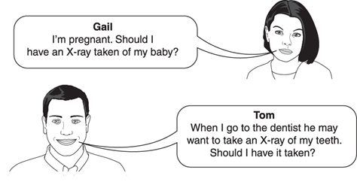
Worked Example - Examination question
Gail and Tom are discussing whether to have an X-ray
taken. Here are some data about radiation doses.
Use the data and your own knowledge to advise Gail and Tom about the benefits and risks of having an X-ray taken. [6]
The quality of written communication will be assessed in your answer.
Source of radiation | Dose in mSv
Background radiation per year | 2.600
X-ray of body | 0.700
X-ray of teeth | 0.005
Answers as discussed in this slide have not been seen or verified by OCR.
OCR, Twenty First Century Physics B, Paper A182/01, June 2015

Slide 14
Worked Example - Examination question
Source of radiation | Dose in mSv
Background radiation per year | 2.600
X-ray of body | 0.700
X-ray of teeth | 0.005
Use the data and your own knowledge to advise Gail and
Tom about the benefits and risks of having an X-ray taken. [6]
Answers as discussed in this slide have not been seen or verified by OCR.
OCR, Twenty First Century Physics B, Paper A182/01, June 2015

Slide 15
Check your learning, if you have any red or amber topics watch the videos and read through the BBC Bitesize notes again.

Slide 16
Title: Uses of Electromagnetic waves
Watch the following videos and read the BBC Bitesize notes:
https://www.youtube.com/watch?v=L0iivb-acqU
https://www.bbc.co.uk/bitesize/guides/z3yq4qt/revision/4
https://www.bbc.co.uk/bitesize/guides/z3yq4qt/revision/5
Answer the following questions:
Describe the uses of the different electromagnetic waves.
What are the uses of: a) radiowaves b) microwaves c)infrared d) visible light e) ultraviolet f) x-rays and g) gamma rays?
Explain why each type of radiation is selected for each specific use (HT only)
Complete the BBC Test: https://www.bbc.co.uk/bitesize/guides/z3yq4qt/test

Slide 17
Check your learning, if you have any red or amber topics watch the videos and read through the BBC Bitesize notes again.

