Slide 1
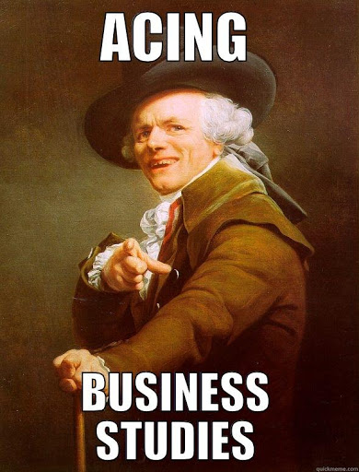
Revision Cards Year 11

Slide 2
Business Operations

Slide 3
25. Operations management
What is efficiency?
What is quality?

Slide 4
26. Flow production
What is flow production
What is specialisation
Main advantages of flow production
Main limitations of flow production

Slide 5
27. Lean production
What is lean production?

Slide 6
28. Kaizen
What does Kaizen mean?

Slide 7
29. Just-in-time stock
What is JIT manufacturing?
What re the advantages and disadvantages

Slide 8
30. Lean Design
What is lean design?
What are the features of lean design?
What are the impacts of lean production?

Slide 9
31. Cell production
What is cell production?

Slide 10
32. Growth
What is economies of scale
What is meant by bulk buying
Technical economies of scale
Specialist economies of scale
Financial economies of scale

Slide 11
33. Diseconomies of scale
What is diseconomies of scale and explain the following types:
Poor communication
Poor motivation
Poor coordination

Slide 12
34. Quality assurance
What is a quality product?
What are the main causes of quality problems?

Slide 13
35. Total Quality management
What is TQM?
Give an example?

Slide 14
HR

Slide 15
23 Recruitment
When would a business recruit?
What is internal and external recruitment?
Define part time and full time workers?
Advantages of full and part time workers?

Slide 16
24 Recruitment process
What are the five steps and explain each step briefly?

Slide 17
25 Rewarding employees
Explain how pay depends on the following?
Skills needed
Experience
Other competitors pay
What are monetary and non monetary rewards?

Slide 18
26 Motivation
What is motivation?
Why is motivation important?
Monetary techniques?
Non – monetary techniques?

Slide 19
16. Organisational Structure
What is an organisational structure?
What ere the benefits of having a structure?
What is the span of control?
What are layers of management?

Slide 20
17. Tall organisational structure
Draw a tall organisational structure (Diagram A)
What are the benefits of this structure?

Slide 21
18. Flat organisational structure
Draw the structure (Diagram B)
Explain the benefits of a flat structure?

Slide 22
19. Centralisation
Define the term?
What are the benefits and challenges of centralisation?

Slide 23
20. Decentralisation
Define the term?
What are the benefits and challenges of decentralisation?

Slide 24
21. Recruitment
What re the benefits of recruiting the best staff?
Define: Job analysis, job description, job specification?
What is internal and external recruitment?
How will a business select?

Slide 25
22. Training
Benefits of training?
Costs of training?
What is on the job?
What is off the job?
What is induction training?

Slide 26
23. Staff Appraisal
What is an appraisal?
What are the benefits of appraisals?
What are the main methods of appraisal?

Slide 27
24. Motivating staff
Why do businesses want a motivated staff?
What is autocratic and democratic management?
What methods of pay can motivate staff?

