Slide 1
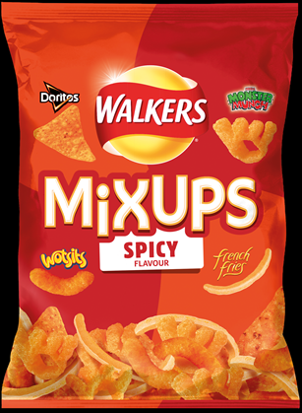
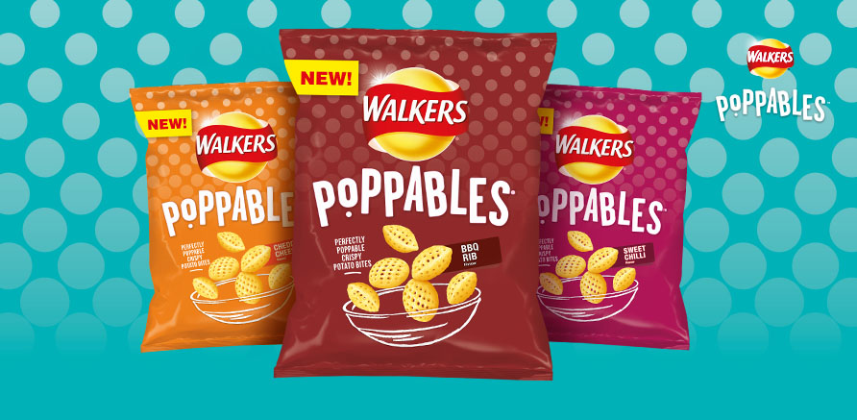
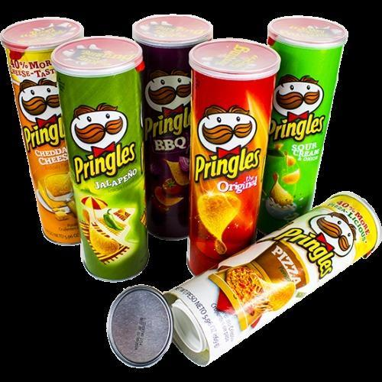
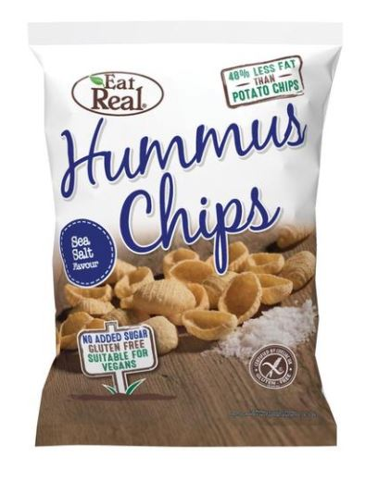
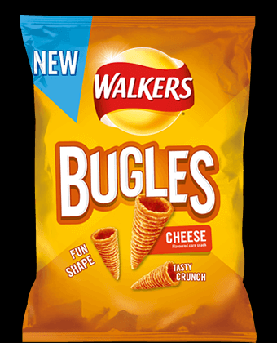
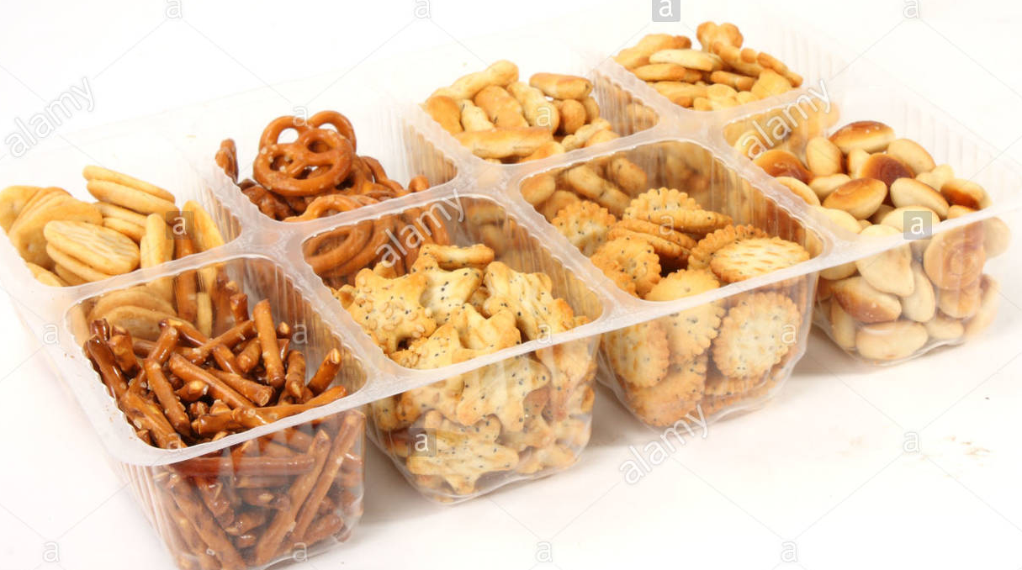
Project Snack!
Do you dare to enter the Dragon’s Den?

Slide 2
Project Snack!
Market research is very important and needs to be carried out effectively before launching a new product.
You need to look at what is currently available. You need to think about who your target market is. You need to look at the strengths and weaknesses of your current products.
Your business plan must include details of recommended retail pricing for your product. You have a budget per unit based on a premium, mid range or cheaper product type.
You are going to work in small groups to:
Research
Develop
Pitch
a new snack to be sold in supermarket stores.

Slide 3
Project Snack!
Between now and Christmas you will need to come up with a pitch for a new product. This pitch will be delivered to the supermarket board (Mayfield staff and pupils) and they will decide who should win.
There will be prizes in the following categories:
Best market research
Best brand design
Best packaging design
Best business plan
Best pitch
Best overall product
Your group can win in multiple categories.

Slide 4
Project Snack!
Ideas for market research:
Collecting existing packaging and annotating it to show features that are positive and negative
Finding out how much in total the snack market is worth in the UK and how much share of this different companies, such as Walkers, have
Asking people to comment on snacks that they think are missing from the market
Researching nutritional information for a variety of snacks
Looking at what competitors offer currently
Looking at colour schemes
Looking at failed products within the snacks market
Looking at current recommended retail pricing for snacks on the market already

Slide 5
Business Plan
Names of owners: Business name: Email address:
Section 1
Product name: Product summary: Financial information: (how much you are investing)
Section 2
Description of product: Est selling price per unit: Cost per unit:
Unique selling point:
Section 3
Link between your market research and final product: (what did you find out and how did it help you to develop your product)
Section 4
Why should the retailer buy your product?

Slide 6
Project Snack!
Your task is to produce a professional business pitch for a new snack product. You can work in groups of no more than three.
https://www.youtube.com/watch?v=HYQuhWZXqG0 (27mins -32mins)
Watch the clip to see how to do it…or not to do it!
You MUST provide:
Evidence of research (primary and secondary)
Packaging design
Business plan (including recommended retail price based on your projected cost per unit)
Brand logo
A pitch
Research ideas:
Pie chart showing current market share of different snack providers
Bar chart showing popularity of existing snacks
Results of questionnaire – what do people want from a snack? What don’t they want from a snack?
Evaluation of current packaging – is it recyclable? Is it easy to stack in a supermarket? Does it appeal to the target market?
Projected costs per unit (you can spend a maximum per unit as follows):
Packaging-Premium £0.29, mid range £0.22, cheap £0.13
Ingredients-Premium £0.67, mid range £0.61, cheap £0.54
Grade 6 pupils will product a pitch of professional standard which details clear market research linked to their idea. They understand the impact of market research and planning for a new business idea.
Grade 3 pupils will complete market research but it may not be relevant to their pitch. Their pitch may not be linked to their research. They have a basic understanding of the importance of market research and business planning.

Slide 7
Project Snack!
There will be prizes in the following categories:
Best market research
Best brand design
Best packaging design
Best business plan
Best pitch
Best overall product
You MUST provide:
Evidence of research (primary and secondary)
Packaging design
Business plan (including recommended retail price based on your projected cost per unit)
Brand logo
A pitch
Research ideas:
Pie chart showing current market share of different snack providers
Bar chart showing popularity of existing snacks
Results of questionnaire – what do people want from a snack? What don’t they want from a snack?
Evaluation of current packaging – is it recyclable? Is it easy to stack in a supermarket? Does it appeal to the target market?
Projected costs per unit (you can spend a maximum per unit as follows):
Packaging-Premium £0.29, mid range £0.22, cheap £0.13
Ingredients-Premium £0.67, mid range £0.61, cheap £0.54
Grade 6 pupils will product a pitch of professional standard which details clear market research linked to their idea. They understand the impact of market research and planning for a new business idea.
Grade 3 pupils will complete market research but it may not be relevant to their pitch. Their pitch may not be linked to their research. They have a basic understanding of the importance of market research and business planning.

