Slide 1
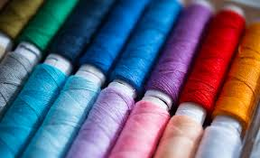
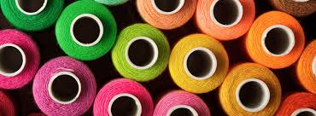
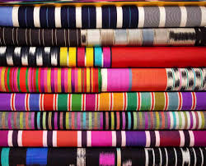
Textiles – Miss Astles
I have chosen textiles as an option because…
I hope to learn … this year.
Previously in textiles I have enjoyed…

Slide 2
Textiles – Embroidery Techniques
Extension Task!
7. French Knots
Complete the following stitches looking at the handout and example board provided to help you:
Running Stitch
Back Stitch
Blanket Stitch
Cross Stitch
Chain Stitch
Crown Stitch

Slide 3
Steps
Choose your thread
Split the thread into two strands on three (originally it should be 6 strands thick)
Thread your needle
Tie a knot at the end of your thread
Start sewing!
Notes:
https://www.youtube.com/watch?v=vh1BslM5BUw

Slide 5
Self Assessment
Looking at the stitching techniques you have created write self assessment looking at the sentence starters below. Leave space above this reflection to stick in your sewing:
Whilst practising stitching techniques I learnt how do to…
I found … the most successful stitch because…
I found … stitch challenging because…
To improve my stitching I need to think about…
(Going carefully, unpicking mistakes before they get bigger, tying a knot in my thread, practising threading the needle, practising splitting the thread, challenging myself with more complicated stitches).
Overall I think I improved my embroidery techniques because…
(Before/at the start I could not… and now I can…)
Notes:
https://www.youtube.com/watch?v=vh1BslM5BUw

Slide 6
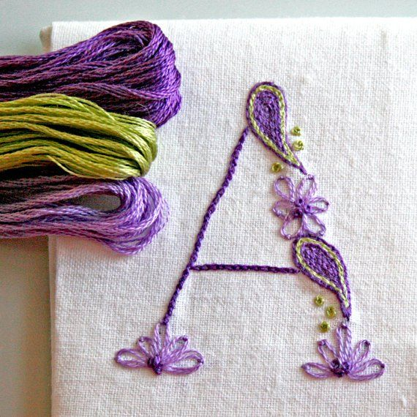
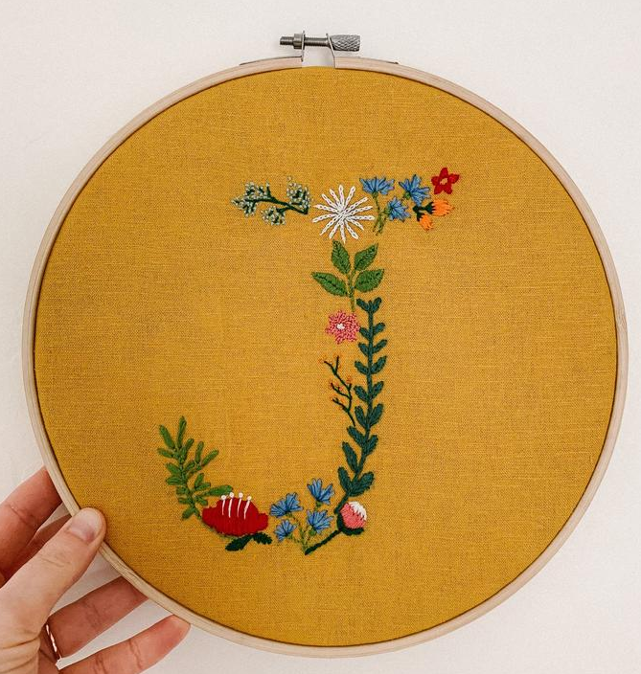
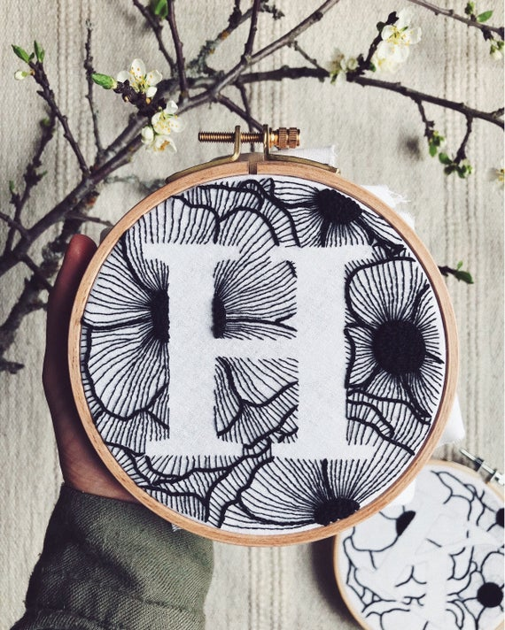
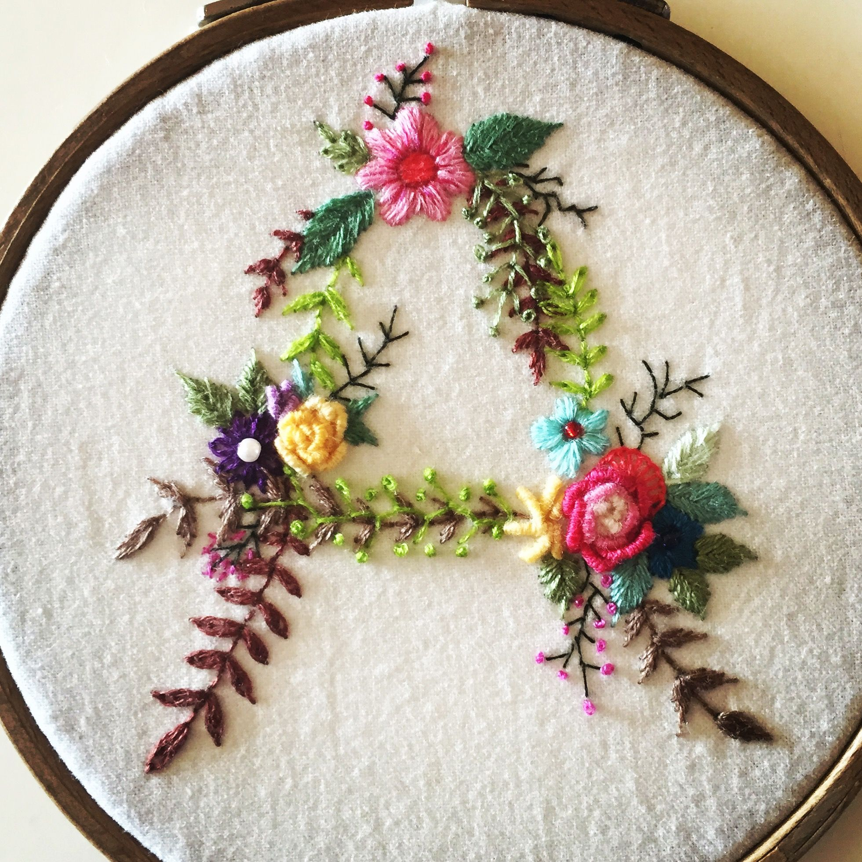
Using the stitches you have been practicing you will be creating a design for the first letter of your name.
This could look like any of the following images.
Try to be creative and use different stitches, patterns or colours.
Draw a rough design beforehand, so you have a plan.
Some of you that are feeling confident can stitch onto polycotton fabric.
Try to make you design bold and eye catching!
Use stitching techniques that you feel the most confident with.

Slide 7
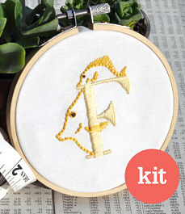
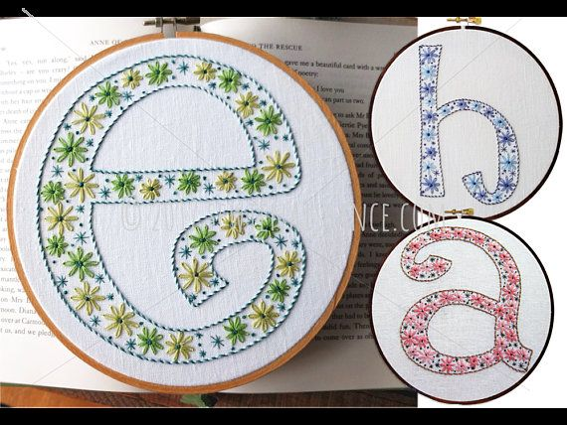
Using the stitches you have been practicing you will be creating a design for the first letter of your name.
Success Criteria:
Level 1-2 = I have created a letter out of more than one embroidery stitch.
Level 3 = I have created a clear letter and used more than one embroidery stitch.
Level 4 = Same as level 3, however my stitching is very consistent and neat throughout my design.
Level 5/6 = I have completed the above, however I have chosen a creative and challenging design, whilst skilfully applying more than four different stitching techniques.
Level 7 + = I have completed all of the above and completed more than five different stitching techniques. Including more complicated stitched such as French knots. My design is very creative, neat and bold.

Slide 8
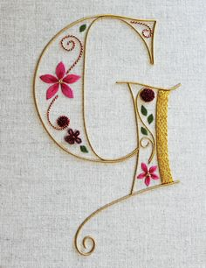
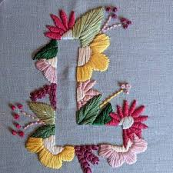
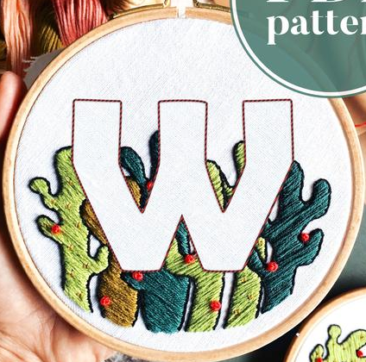
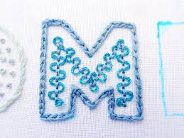
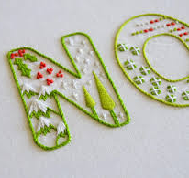

Slide 9
Self Assessment
Looking at the stitching techniques you have created write self assessment looking at the sentence starters below. Leave space above this reflection to stick in your sewing:
Whilst creating my letter design I learnt how do to…
I found … the most successful because…
I found … challenging because…
To improve my design I need to think about…
(Going carefully, unpicking mistakes before they get bigger, tying a knot in my thread, practising threading the needle, practising splitting the thread, challenging myself with more complicated stitches, sewing curved shapes).
Overall I think I improved my embroidery techniques because…
(Before/at the start I could not… and now I can…)
Notes:
https://www.youtube.com/watch?v=vh1BslM5BUw

