Slide 1

Macbeth

Slide 2
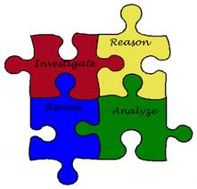
Objectives:
Assessment Objectives (AOs)
AO1 Read, understand and respond to texts.
Students should be able to:
• maintain a critical style and develop an informed personal response
• use textual references, including quotations, to support and illustrate interpretations.
AO2 Analyse the language, form and structure used by a writer to create meanings and effects, using relevant subject terminology where appropriate.
AO3 Show understanding of the relationships between texts and the contexts in which they were written.
AO4 Use a range of vocabulary and sentence structures for clarity, purpose and effect, with accurate spelling and punctuation.

Slide 3
Remember these? Use the look cover write check strategy to learn these.
Spellings
Macbeth
Scottish
throne
witch
thane
armour
Macduff
tragedy
equivocation
society
pathetic fallacy
weather
Shakespeare
character
atmosphere
contemporary
audience
unnatural
Banquo
Jacobean
prophecy
prediction

Slide 4
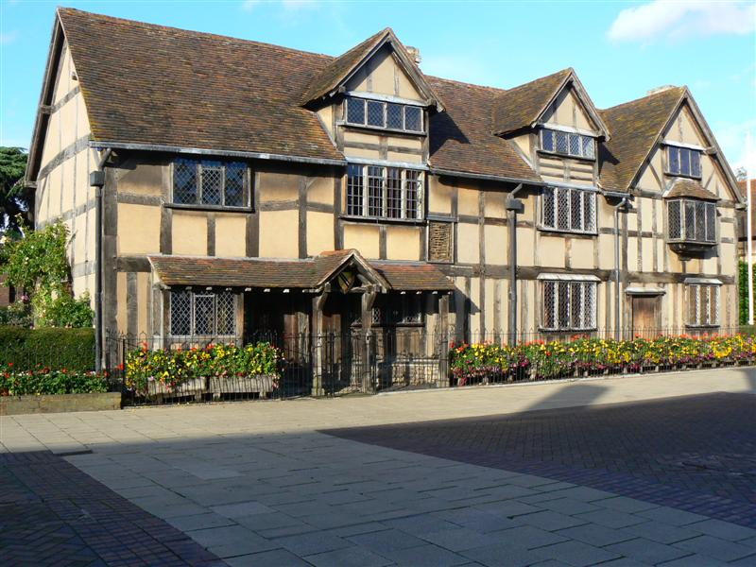
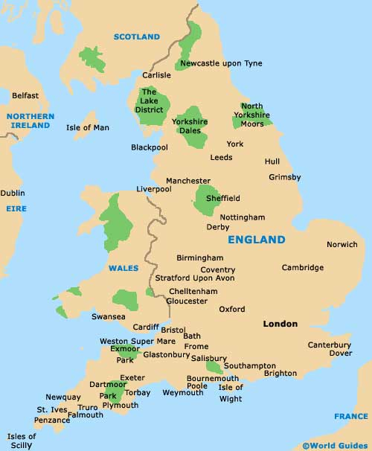
L.O. To understand the social, cultural and historical context of Shakespeare’s ‘Macbeth’
William Shakespeare was born in Stratford-upon-Avon in 1564

Slide 5
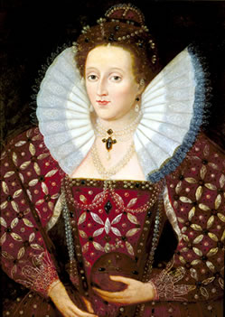
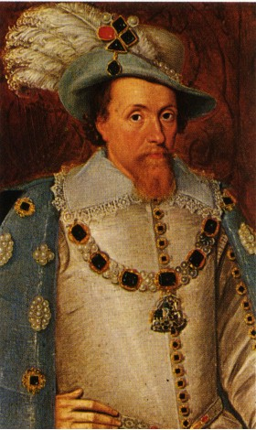
L.O. To understand the social, cultural and historical context of Shakespeare’s ‘Macbeth’
Queen Elizabeth I
1558-1603
James I
1603-1625

Slide 6
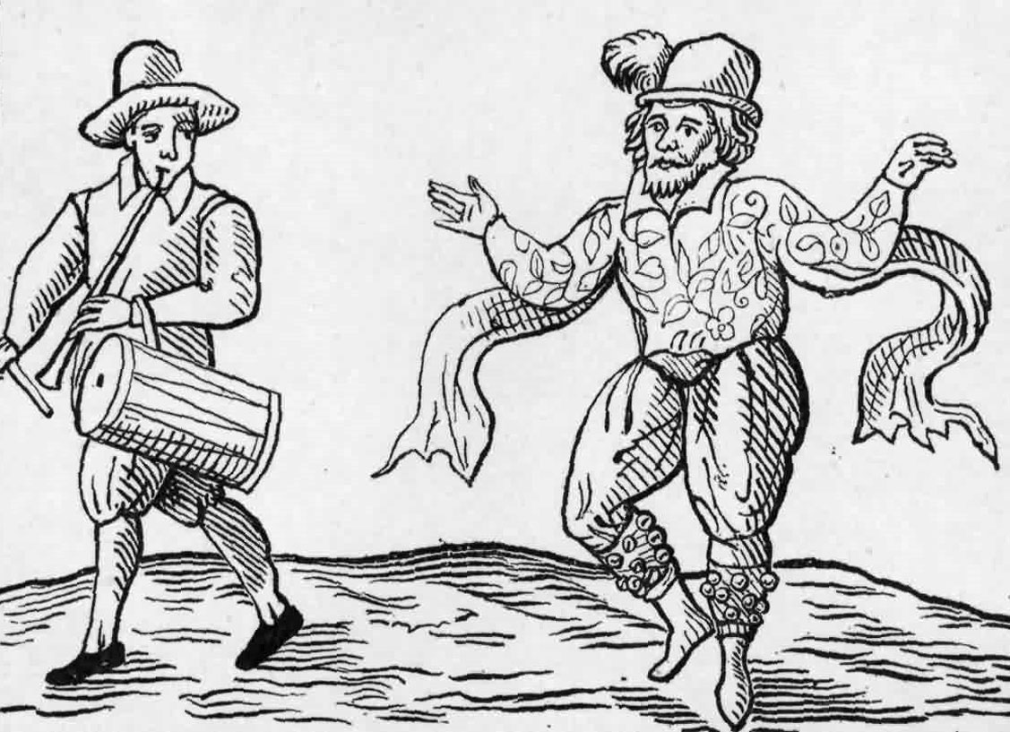
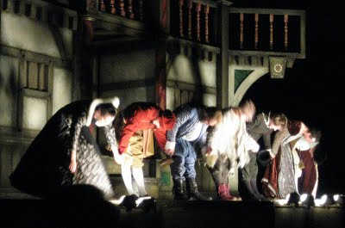
L.O. To understand the social, cultural and historical context of Shakespeare’s ‘Macbeth’
Following on from Shakespeare’s marriage to Anne we know very little about him, until 1592 when he settled in London and earned a reputation as an actor and a playwright.
In 1594, The Lord Chamberlain’s Men was formed and Shakespeare was one of the shareholders. They became the King’s Men in 1603, with King James I as their patron.

Slide 7
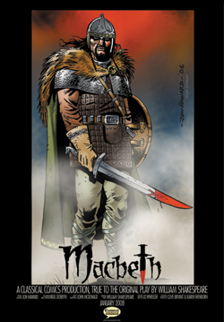
L.O. To understand the social, cultural and historical context of Shakespeare’s ‘Macbeth’
Macbeth was written in 1606, probably for a performance before the King of Denmark, who was in London on a visit to his brother-in-law, James I

Slide 8
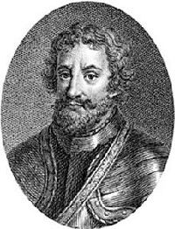
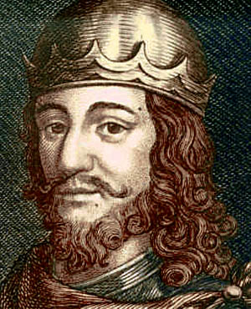
Shakespeare based his story on history books
Macbeth was a real person. He was King of Scotland 1040-1057.
Shakespeare’s story about him is somewhat embellished
Duncan I was King of Scotland from 1001 to 1040
An imagined portrait of Macbeth
King Duncan I

Slide 9
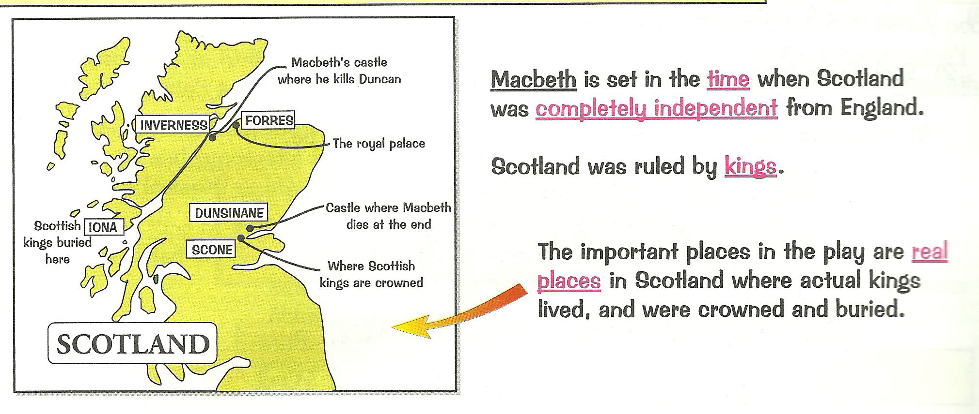
In Scotland, the King’s successor didn’t always have to be his eldest son
Therefore, people would plot to become King
A Thane is a Scottish version of a Lord and they can gain and lose power

Slide 10
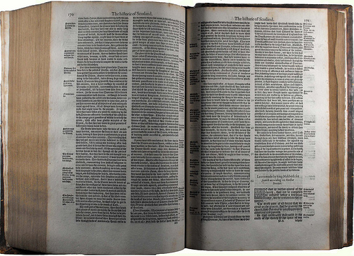
Shakespeare’s inspiration for Macbeth came from Raphael Holinshed’s Chronicles of England, Scotland and Ireland (1587).
Shakespeare invented Lady Macbeth’s story; Banquo’s ghost; the witches; he changed Duncan from an ineffectual king into an old and revered ruler and omitted Macbeth’s ten years of good rule.

Slide 11
Use the following quotations slides to learn some key quotes and consider who says it? Why?/key words/devices/themes and tone.

Slide 12
“Fair is foul and foul is fair,
Hover through the fog and filthy air.”
Act 1;Scene 1

Slide 13
“This supernatural soliciting
Cannot be ill, cannot be good.”
Act 1; Scene 3

Slide 14
“My thought, whose murder yet is but fantastical,
Shakes so my single state of man that function
Is smothered in surmise, and nothing is,
But what is not.”
Act 1; Scene 3

Slide 15
“Stars hide your fires,
Let not light see my black and deep desires.”
Act 1; Scene 4

Slide 16
“Yet I do fear thy nature,
It is too full of o’th’ milk of human kindness….
…Art not without ambition but without the illness should attend it.”
Act 1; Scene 5

Slide 17
“Come, you spirits that tend on mortal thoughts, unsex me here, and fill me from the crown to the toe top-full of direst cruelty. Make thick my blood.
…Come to my woman’s breasts, and take my milk for gall, you murd'ring ministers…
Come, thick night, and pall thee in the dunnest smoke of hell, that my keen knife see not the wound it makes, nor heaven peep through the blanket of the dark to cry, “Hold, Hold.”
Act 1; Scene 5

Slide 18
“I have no spur
To prick the sides of my intent, but only vaulting ambition which o’erleaps itself…”
Act 1; Scene 7

Slide 19
“When you durst do it, then you were a man.”
Act 1; Scene 7

Slide 20
“Screw your courage to the sticking-place and we’ll not fail!”
Act 1; Scene 7

Slide 21
“Art though a dagger of the mind, a false creation, proceeding from the heat oppressed brain.”
Act 2; Scene 1

Slide 22
“My hands are your colour, but I shame to wear a heart so white.”
Act 2; Scene 2

Slide 23
“Though hast it now, King, Cawdor Glamis, all,
As the weird women promised, and I fear though played most foully for’t.”
Act 3; Scene 1

Slide 24
“Though hast it now, King, Cawdor Glamis, all,
As the weird women promised, and I fear though played most foully for’t.”
Act 3; Scene 1

Slide 25
“We have scorched the snake not killed it.”
Act 3; Scene 2

Slide 26
“Oh full of scorpions is my mind, dear wife!”
Act 3; Scene 2

Slide 27
“O, treachery!
Fly good Fleance, fly, fly, fly!”
Act 3; Scene 3

Slide 28
“Never shake thy gory locks at me!”
Act 3; Scene 4

Slide 29
“Macbeth, Macbeth, Macbeth, beware Macduff!”
Act 4; Scene 1

Slide 30
“Dispute it like a man.
…
I shall do so ;
But I must also feel it as a man.””
Act 4; Scene 3

Slide 31
“Here’s the smell of the blood still: all the perfumes of Arabia will not sweeten this little hand. O, O, O.”
Act 5; Scene 1

Slide 32
“The queen, my lord, is dead.”
Act 5; Scene 5

Slide 33
“Tomorrow and tomorrow and tomorrow
Creeps this petty pace from day to day to the last syllable of recorded time...
It is a tale told by an idiot, full of sound and fury
Signifying nothing.”
Act 5; Scene 5

Slide 34
Beyond here are other useful slides …

Slide 35
Lesson Objective: To understand how to empathise with a character
What did the witches prophesise?
To Macbeth:
FIRST WITCH All hail Macbeth, hail to thee, Thane of Glamis
SECOND WITCH All hail Macbeth, hail to thee, Thane of Cawdor.
THIRD WITCH All hail Macbeth, that shall be king hereafter.
To Banquo:
FIRST WITCH Lesser than Macbeth, and greater.
SECOND WITCH Not so happy, yet much happier
THIRD WITCH Thou shalt get kings, though be none.
- Rewrite their prophecies in your own words

Slide 36
Lesson Objective: To understand how to empathise with a character
This is how Banquo reacts to the witches’ prophecies:
BANQUO
That trusted home,
Might yet enkindle you unto the crown,
Besides the Thane of Cawdor. But ‘tis strange,
And oftentimes, to win us to our harm,
The instruments of darkness tell us truths;
Win us with honest trifles, to betray’s
In deepest consequence -

Slide 37
Lesson Objective: To consider the structure and effect of an aside.
Recap
How does Macbeth react to the prophecies?
MACBETH [Aside]
Two truths are told,
As happy prologues to the swelling act
Of the imperial theme. – I thank you, gentlemen. –
This supernatural soliciting
Cannot be ill, cannot be good. If ill.
Why hath it given me earnest of success,
Commencing in a truth? I am Thane of Cawdor.
If good, why do I yield to that suggestion,
Whose horrid image doth unfix my haor
And make my seated heart knock at my ribs
Against the use of nature? Present fears
Are less than horrible imaginings.
My thought, whose murder yet is but fantastical,
Shakes so my single state of man that function
Is smothered in surmise, and nothing is,
But what is not.

Slide 38
Lesson Objective: To understand how to empathise with a character
How does Macbeth react to the prophecies Act 1 Scene 3?
MACBETH [Aside]
Two truths are told,
As happy prologues to the swelling act
Of the imperial theme. – I thank you, gentlemen. –
This supernatural soliciting
Cannot be ill, cannot be good. If ill.
Why hath it given me earnest of success,
Commencing in a truth? I am Thane of Cawdor.
If good, why do I yield to that suggestion,
Whose horrid image doth unfix my haor
And make my seated heart knock at my ribs
Against the use of nature? Present fears
Are less than horrible imaginings.
My thought, whose murder yet is but fantastical,
Shakes so my single state of man that function
Is smothered in surmise, and nothing is,
But what is not.

Slide 39
Task: Independently identify the semantic field of language linked to evil .
KQ: How does Lady Macbeth challenge the expectations of a contemporary audience?
Act 1; Scene 5
The raven himself is hoarse that croaks the fatal entrance of Duncan under my battlements.
Come, you spirits that tend on mortal thoughts, unsex me here, and fill me from the crown to the toe top-full of direst cruelty. Make thick my blood.
Stop up the access and passage to remorse, that no compunctious visitings of nature shake my fell purpose, nor keep peace between the effect and it!
Come to my woman’s breasts, and take my milk for gall, you murd'ring ministers, wherever in your sightless substances you wait on nature’s mischief.
Come, thick night, and pall thee in the dunnest smoke of hell, that my keen knife see not the wound it makes, nor heaven peep through the blanket of the dark to cry “Hold, hold!

Slide 40
Task: Independently analyse this text and annotate for ideas to show Lady Macbeth as an unnatural/atypical Jacobean female.
KQ: How does Lady Macbeth challenge the expectations of a contemporary audience?
Act 1; Scene 5
The raven himself is hoarse that croaks the fatal entrance of Duncan under my battlements.
Come, you spirits that tend on mortal thoughts, unsex me here, and fill me from the crown to the toe top-full of direst cruelty. Make thick my blood.
Stop up the access and passage to remorse, that no compunctious visitings of nature shake my fell purpose, nor keep peace between the effect and it!
Come to my woman’s breasts, and take my milk for gall, you murd'ring ministers, wherever in your sightless substances you wait on nature’s mischief.
Come, thick night, and pall thee in the dunnest smoke of hell, that my keen knife see not the wound it makes, nor heaven peep through the blanket of the dark to cry “Hold, hold!

Slide 41
KQ: How does Lady Macbeth challenge the expectations of a contemporary audience?
Women were ‘objects’
They were ‘owned’ by their fathers, then by their husbands
They were not allowed out on their own
They were not allowed to own money or property
They had to obey their father and then their husband
They married young
They were not educated like boys
A woman’s job was to look after their husband and have babies
Women were not allowed to act on the stage

Slide 42
Task: Independently analyse this text and annotate for ideas to show Lady Macbeth as an unnatural/atypical Jacobean female..
Act 1;Scene 5
The raven himself is hoarse that croaks the fatal entrance of Duncan under my battlements.
Come, you spirits that tend on mortal thoughts, unsex me here, and fill me from the crown to the toe top-full of direst cruelty. Make thick my blood.
Stop up the access and passage to remorse, that no compunctious visitings of nature shake my fell purpose, nor keep peace between the effect and it!
Come to my woman’s breasts, and take my milk for gall, you murd'ring ministers, wherever in your sightless substances you wait on nature’s mischief.
Come, thick night, and pall thee in the dunnest smoke of hell, that my keen knife see not the wound it makes, nor heaven peep through the blanket of the dark to cry “Hold, hold!

Slide 43
KQ: How far is Lady Macbeth driven by ambition?
Starter: Soliloquy TCH
What is a soliloquy?
Write a definition in your books.
How does a soliloquy help an audience?
What effect does it have on the audience? (audience positioning)

Slide 44
KQ: How far is Lady Macbeth driven by ambition?
Read the script and answer the following questions:
What are your first impressions of Lady Macbeth?
Thinking about what you know about how women were viewed and treated in Shakespeare’s time what do you think the audience would have thought about the way Lady Macbeth behaved?
Find a quote to support your idea.
Do you think a modern audience would feel the same way? Why/why not?
She speaks her thoughts in a soliloquy. What is the significance of this?

Slide 45
Act 1 Scene 7
KQ: How far is Lady Macbeth driven by ambition?
Macbeth is reluctant to commit the murder,
“We will proceed no further in this business.”
Lady Macbeth’s angry response clearly refers to the ever present theme of ambition.
“Was the hope drunk
Wherein you dress’d yourself?” (Act 1 scene 7 lines 35-36)
She mocks her husband’s lack of courage and in a chilling image (next slide) declares she would do anything if she had made a promise to Macbeth. What does this show about her character?

Slide 46
KQ: How far is Lady Macbeth driven by ambition?
“I would, while it was smiling in my face,
Have plucked my nipple from his boneless gums
And dashed the brains out, had I so sworn
As you have done to this.” (Act 1 Scene 7 lines 56-59)
Consider the effect this imagery has on the audience:
What does this reveal about Lady Macbeth’s character?
Why is this image so shocking?
What effect does this speech have on Macbeth?

Slide 47

KQ: How far is Lady Macbeth driven by ambition?
“I would, while it was smiling in my face,
Have plucked my nipple from his boneless gums
And dashed the brains out, had I so sworn
As you have done to this.” (Act 1 Scene 7 lines 56-59)
Task: Copy this quotation in the middle of a page and explode it!
Exploding a quotation means annotating it for anything you can find including language features (SPAMROD), impact on the reader, ideas about the context (how it would affect an audience now and then.

Slide 48
KQ: How far is Lady Macbeth driven by ambition?
Shakespeare presents Lady Macbeth as an unnatural and evil Jacobean women, “I would…plucked my nipple from its boneless gums…” This imagery makes the reader feel uncomfortable and creates a disturbing image of a mother violently removing a baby from a natural feeding position. The phrase ‘boneless gums’ refers to a tiny baby associated with innocence and purity. When lady Macbeth talks of harming an innocent creature, ‘dashed the brains out…’ it shows she has the capacity to be truly evil, linking her to the witches. The verb ‘dashed’ is a violent action juxtaposed to the natural instinct of nurturing. Furthermore, Lady Macbeth’s ambition is to become queen at any cost. The reader may start to wonder if lady Macbeth is exaggerating to manipulate Macbeth into committing regicide. A Shakespearean audience would have found Lady Macbeth challenging as she acts atypically of women at the time.

Slide 49
KQ: How far is Lady Macbeth driven by ambition?
Shakespeare presents Lady Macbeth as an unnatural and evil Jacobean women, “I would…plucked my nipple from its boneless gums…” This imagery makes the reader feel uncomfortable and creates a disturbing image of a mother violently removing a baby from a natural feeding position. The phrase ‘boneless gums’ refers to a tiny baby associated with innocence and purity. When lady Macbeth talks of harming an innocent creature, ‘dashed the brains out…’ it shows she has the capacity to be truly evil, linking her to the witches. The verb ‘dashed’ is a violent action juxtaposed to the natural instinct of nurturing. Furthermore, Lady Macbeth’s ambition is to become queen at any cost. The reader may start to wonder if lady Macbeth is exaggerating to manipulate Macbeth into committing regicide. A Shakespearean audience would have found Lady Macbeth challenging as she acts atypically of women at the time.

Slide 50
L.O. To understand how to support ideas with textual evidence
Compare and contrast the characters of Macbeth and Lady Macbeth in Act 2 scene 2. Which of the two has the stronger character?
On the next slides I have a copy of an extract from the script which will help us answer these questions. Let’s annotate it together…

Slide 51
L.O. To understand how to support ideas with textual evidence
MACBETH
This is a sorry sight.
[Looking on his hands]
LADY MACBETH
A foolish thought, to say a sorry sight.
MACBETH
There's one did laugh in's sleep, and one cried
'Murder!'
That they did wake each other: I stood and heard them:
But they did say their prayers, and address'd them
Again to sleep.
LADY MACBETH
There are two lodged together.
MACBETH
One cried 'God bless us!' and 'Amen' the other;
As they had seen me with these hangman's hands.
Listening their fear, I could not say 'Amen,'
When they did say 'God bless us!'

Slide 52
L.O. To understand how to support ideas with textual evidence
LADY MACBETH
Consider it not so deeply.
MACBETH
But wherefore could not I pronounce 'Amen'?
I had most need of blessing, and 'Amen'
Stuck in my throat.
LADY MACBETH
These deeds must not be thought
After these ways; so, it will make us mad.
MACBETH
Methought I heard a voice cry 'Sleep no more!
Macbeth does murder sleep', the innocent sleep,
Sleep that knits up the ravell'd sleeve of care,
The death of each day's life, sore labour's bath,
Balm of hurt minds, great nature's second course,
Chief nourisher in life's feast.

Slide 53
L.O. To understand how to support ideas with textual evidence
LADY MACBETH
What do you mean?
MACBETH
Still it cried 'Sleep no more!' to all the house:
'Glamis hath murder'd sleep, and therefore Cawdor
Shall sleep no more; Macbeth shall sleep no more.'
LADY MACBETH
Who was it that thus cried? Why, worthy thane,
You do unbend your noble strength, to think
So brainsickly of things. Go get some water,
And wash this filthy witness from your hand.
Why did you bring these daggers from the place?
They must lie there: go carry them; and smear
The sleepy grooms with blood.

Slide 54
L.O. To understand how to support ideas with textual evidence
MACBETH
I'll go no more:
I am afraid to think what I have done;
Look on't again I dare not.
LADY MACBETH
Infirm of purpose!
Give me the daggers: the sleeping and the dead
Are but as pictures: 'tis the eye of childhood
That fears a painted devil. If he do bleed,
I'll gild the faces of the grooms withal;
For it must seem their guilt.
Exit

Slide 55
Macbeth | Quote | Lady Macbeth | Quote
Feels guilty | He cannot speak the word ‘Amen’ line 28 | Thinks Macbeth is foolish
Terrified to return |  | Domineering (Bossy)
Paranoid |  | Full of action
Scared |  | Thinks Macbeth is a coward (again!)

Slide 56

L.O. To confidently know the characters, plot, narrative, setting and themes of Macbeth.
New-spellings/sentences
Subsequently
Ironically
Peculiarly
Consequently
Subconsciously
Persuasively
Triumphantly
emphatically
Hubristically
Narcissistically
Historical context. Independent –presenting to others

Slide 57
L.O. To confidently know the characters, plot, narrative, setting and themes of Macbeth.
Monday 3rd April 2017
Starter-spellings
trouble
persuasion
murderous
manipulative
semantic field
soliloquise
ambitious
supernatural
taunts
aggressive
New-spellings/sentences
Subsequently
Ironically
Peculiarly
Consequently
Subconsciously
Persuasively
Triumphantly
emphatically
Hubristically
Narcissistically
Historical context. Independent –presenting to others

Slide 58
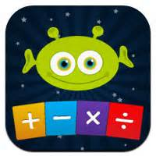

L.O. To explore the impact of structure in Macbeth
Tuesday 4th April 2017
STARTER: Iambic Pentameter
An iamb is a metrical foot that consists of an unstressed syllable followed by a stressed one—daDUM.
Penta- means five.
Meter refers to a regular rhythmic pattern in poetry.
So iambic pentameter is a kind of rhythmic pattern that consists of five iambs per line, almost like five heartbeats: daDUM daDUM daDUM daDUM daDUM.
E.G. The first line of Shakespeare's Twelfth Night:
“If music be the food of love, play on.”
Historical context. Tradition-heritage

Slide 59
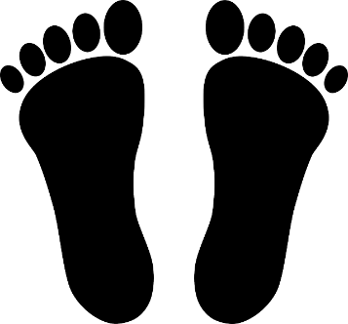
L.O. To explore the impact of structure in Macbeth
Tuesday 4th April 2017
Iambic Pentameter
https://youtu.be/0Qv-sjQHgZ8 iambic pentameter
https://youtu.be/_GotKaqMTVI post murder-shared lines
https://youtu.be/hS-8VhIjRCg post murder acted
https://youtu.be/9y6aAC_HoQ8 Patrick Stewart 2010
Historical context. Independent –explore text

Slide 60

L.O. To explore the impact of structure in Macbeth
Task:
Watch the versions of Macbeth and consider how the shared lines are delivered/presented.
Focus on:
Macbeth
Lady Macbeth
Iambic pentameter
Shared lines

Slide 61

L.O. To explore the impact of structure in Macbeth
Task:
What is the impact of structure on the audience?
Structure A02:
How is it structured?
Why has Shakespeare done this?
Effect on the audience? Impact of structure? Do we learn anything about the characters through this structure?

Slide 62
L.O. To explore Shakespeare’s use of soliloquy
Thursday 27th April 2017
Write a sentence about Macbeth’s soliloquising in Act 2; Scene1, using one of the words listed opposite.
E.g. Shakespeare presents Macbeth as hallucinating at the start of Act Two during his soliloquy, thus exemplifying his anxious state of mind.
Extension-imagine you are Macbeth write down a list for/against murdering King Duncan.
New spellings-’showing’
illustrating
illuminating
demonstrating
proving
clarifying
elucidating
exemplifying
highlighting
expounding
explicating
Historical context. Independent –presenting to others

Slide 63
L.O. To explore Shakespeare’s use of soliloquy
Task:
Close analysis of Macbeth’s soliloquy, Act 2; Scene 1
Language A02:
What language stands out-words/phrases?
What language features can you identify?
Effect of language on the audience? Impact of structure?
What do we learn anything about the characters through the language?

Slide 64
L.O. To explore Shakespeare’s use of soliloquy
Task:
What is the impact of structure on the audience?
Structure A02:
How is it structured?
Why has Shakespeare done this?
Effect on the audience? Impact of structure? Do we learn anything about the characters through this structure?

Slide 65
L.O. To understand how to draw links across a text
Friday 28th April 2017
Starter
Who is Macbeth?
Write down your ideas about the character based on his soliloquy in Act 2;Scene 1.
Extension-what sorts of questions linked to this soliloquy would you expect for this exam? Try writing an exam style question. Remember you will have a small extract and you will need to refer to the whole play.
E.g. How does Shakespeare present….in this extract and the play as a whole?
Historical context. Independent –presenting to others

Slide 66
L.O. To understand how to draw links across a text
Why cross reference?
Cross referencing is an important skill and allows us to make connections, draw interpretations and explore the structure of a text. Often when we cross reference we reveal deliberate choices and the craft of the writer. E.g. where repetition of language is used or foreshadowing occurs. It is also important to familiarise yourself with the text so that you can deliver a knowledgeable, critical and personal response.
Remember you need to have learnt key quotations and know the play very well in order to respond well to the Literature question.

Slide 67
L.O. To place the key events of ‘Macbeth’
Task:
Sort the twelve cards into the correct order

Slide 68
Duncan, King of Scotland is under threat from rebellions by some of his nobles and attacks by invading Vikings | Macbeth, Thane of Glamis, emerges as the fiercest warrior in support of the King and is rewarded with the title of Thane of Cawdor | Witches prophesise events letting Macbeth believe he will be king and Banquo that his children will be king. Macbeth takes their predictions very seriously
Duncan comes to stay with Macbeth and Lady Macbeth convinces him to kill the king | Fearing for their lives Duncan’s sons, Malcolm and Donalbain flee and Macbeth is crowned king | Because the witches predicted that Banquo’s son, Fleance will be king Macbeth arranges for them to be murdered. Banquo is murdered, but Fleance escapes
The ghost of Banquo appears, terrifying Macbeth | Macbeth seeks out the witches and hears more prophesies. He becomes paranoid. | Macduff leaves Scotland either to flee or to seek help from the English to overthrow Macbeth. Macbeth arranges for his family to be killed. When Macduff hears, together with Malcolm, he starts to get an army together
Lady Macbeth goes mad; riddled with guilt. She commits suicide | Macduff kills Macbeth | Malcolm is declared king of Scotland

Slide 69
L.O. To place the key events of ‘Macbeth’
Thinking about the information you gathered and the ideas you came up with about witches last lesson watch the two contrasting adaptations of the opening scene.
Which do you think is more effective and why?
Write a paragraph in your book. It is important that you are using your knowledge of historical context.

Slide 70
L.O. To place the key events of ‘Macbeth’
In Shakespeare’s day, people were genuinely frightened and repelled by the witches. In today’s society we struggle to share the same beliefs about them.
In the BBC’s adaptation, makeup, costumes and special effects have been used to try and replicate Shakespeare’s stage directions and possibly the original intent which for a modern audience has little impact. Which is perhaps why … chose to depict the witches as young, attractive girls, running amok in a grave yard. This suggests in our society people are more likely to be threatened by …

Slide 71
L.O. To understand how to follow Lady Macbeth’s emotions throughout the play

Slide 72
L.O. To understand how to follow Lady Macbeth’s emotions throughout the play
Act 1, scene 5 – Lady Macbeth reads a letter from Macbeth
Act 2, scene 2 – After the King’s murder, Lady Macbeth takes charge of the situation
Act 3, scene 2 – Lady Macbeth tries to reassure her husband and urges him to act cheerful
Act 3, scene 4 – Lady Macbeth tries to calm her husband and take control of the situation when Banquo’s ghost appears
Act 5, scene 1 – Lady Macbeth is witnessed sleepwalking
Act 5, scene 5 – Macbeth learns of his wife’s death

Slide 73
L.O. To understand how to summarise an entire text
Starter:
Using a dictionary look up the term ‘hubris’ and write a definition IN YOUR OWN WORDS.

Slide 74
L.O. To understand how to summarise an entire text
Task:
Write a synopsis of the entire play. You should aim to condense the whole information into just one paragraph of up to six sentences.

Slide 75
The whole play!

Slide 76
Duncan, King of Scotland is under threat from rebellions by some of his nobles and attacks by invading Vikings
Macbeth, Thane of Glamis, emerges as the fiercest warrior in support of the King and is rewarded with the title of Thane of Cawdor
Witches prophesise events letting Macbeth believe he will be king and Banquo that his children will be king. Macbeth takes their predictions very seriously
Duncan comes to stay with Macbeth and Lady Macbeth convinces him to kill the king

Slide 77
Fearing for their lives Duncan’s sons, Malcolm and Donalbain flee and Macbeth is crowned king
Because the witches predicted that Banquo’s son, Fleance will be king Macbeth arranges for them to be murdered. Banquo is murdered, but Fleance escapes
The ghost of Banquo appears, terrifying Macbeth
Macbeth seeks out the witches and hears more prophesies. He becomes paranoid.

Slide 78
Macduff leaves Scotland either to flee or to seek help from the English to overthrow Macbeth. Macbeth arranges for his family to be killed. When Macduff hears, together with Malcolm, he starts to get an army together
Lady Macbeth goes mad; riddled with guilt. She commits suicide
Macduff kills Macbeth
Malcolm is declared king of Scotland

Slide 79
L.O. To understand how to plan for a controlled assessment
The Question:
How does Shakespeare explore the effect of ambition on Macbeth and Lady Macbeth?

