Slide 1
Section A
Multiple choice responses.

Slide 2
Section A: A summary
4 questions
Each worth 1 mark ( only)
Will cover stage roles and the role of theatre makers
Multiple choice
Compulsory

Slide 3
Role of theatre makers

Slide 4
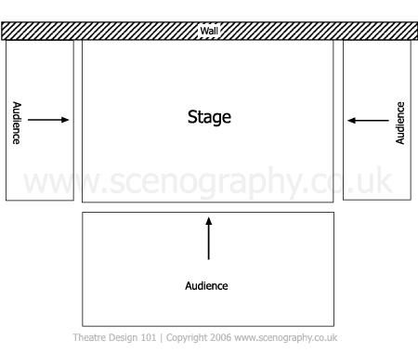
It’s quiz time!
End on
thrust
traverse

Slide 5
POSITIVES | NEGATIVE
Can have a backdrop / scenery | Be aware of audience on three sides
Clear projection of voice | Use all of the space
4th wall doesn’t really exist / more immersive. | Be aware of how much set / entrances and exits

Slide 6
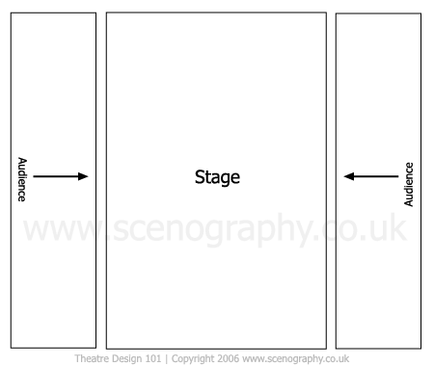
traverse
thrust
proscenium

Slide 7
POSITIVES | NEGATIVE
Intimate space – no need to project fully | Always have a section with your back to audience
Immersive as an audience | Fall = accident
Audience can see characters clearly | Not ideal for large performance

Slide 8
http://www.bbc.co.uk/schools/gcsebitesize/english_literature/dramabloodbrothers/0drama_bloodbrothers_contrev1.shtml

