Slide 1
Lesson Objective:
To understand how to communicate imaginatively, clearly and effectively
Success Criteria (Graded): 5+
AO5: Communicate clearly, effectively and imaginatively;
AO5: Select and adapt tone, style and register for different forms, purposes and audiences;
AO5: Organise information and ideas using structural and grammatical features to support coherence and cohesion of texts;
AO6: Use a range of vocabulary for clarity, purpose and effect with accurate spelling and punctuation.
Friday, 23 February 2018
Starter:
How do we use the following punctuation marks?
EXTENSION: Why should we vary punctuation?
: | … | - | ( ) | ;

Slide 2
Friday, 23 February 2018
LO: To understand how to communicate imaginatively, clearly and effectively
Punctuation:
Punctuation |  | Uses
Colon | : | Goes before an explanation or a list.
Ellipsis | … | Creates suspense and tension, also shows that something has been missed out
Dash | - | Separates extra information from the main clause of a sentence
Brackets | ( ) | Used to separate extra (subordinate) information.
Semi-colon | ; | Used to show two sentences that are related (share a topic/idea).

Slide 3
Friday, 23 February 2018
LO: To understand how to communicate imaginatively, clearly and effectively
Semi-colon:
Used to connect two independent clauses/sentences.
It acts like a moderate pause in speech (e.g. longer than a comma but shorter than a full stop).
It isn’t used with connectives (and, but etc.).
Hint!
Use one where you could use either a full stop or comma!

Slide 4
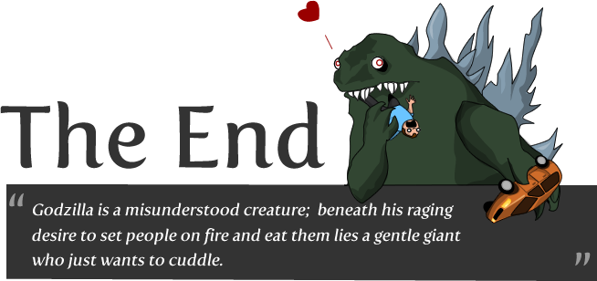
Friday, 23 February 2018
LO: To understand how to communicate imaginatively, clearly and effectively
Semi-colon:

Slide 5
Friday, 23 February 2018
LO: To understand how to communicate imaginatively, clearly and effectively
TASK: Paper 1 – Writing Question
You are given a choice of two tasks for GCSE English Language Paper 1 Question 5.
You only have to do ONE!
(24 marks for content and organisation
16 marks for technical accuracy)
[40 marks]

Slide 6
Friday, 23 February 2018
LO: To understand how to communicate imaginatively, clearly and effectively
TASK: Paper 1 – Writing Question
You are advised to spend about 45 minutes on this section.
Write in full sentences.
You are reminded of the need to plan your answer.
You should leave enough time to check your work at the end.
EXAM BOARD GUIDANCE!

Slide 7
Friday, 23 February 2018
LO: To understand how to communicate imaginatively, clearly and effectively
TASK: Paper 1 – Writing Question
TASK: Writing Question
Make your choice of a writing question:
EITHER a description based on the image;
OR
A story based on the prompt.
Discuss your choice with a partner.

Slide 8
Friday, 23 February 2018
LO: To understand how to communicate imaginatively, clearly and effectively
Ready: Timings
Planning
Writing
Checking

Slide 9
Friday, 23 February 2018
LO: To understand how to communicate imaginatively, clearly and effectively
Mark Scheme:
Band | Mark | Skills Descriptor
Level 4 Compelling and convincing | Upper Level 4 22-24 marks | Content Register is convincing and compelling for audience Assuredly matched to purpose Extensive and ambitious vocabulary with sustained crafting of linguistic devices
 |  | Organisation Varied and inventive use of structural features Writing is compelling, incorporating a range of convincing and complex ideas Fluently linked paragraphs with seamlessly integrated discourse markers

Slide 10
Friday, 23 February 2018
LO: To understand how to communicate imaginatively, clearly and effectively
What have you learnt today?
How do we use a variety of punctuation in our writing?

