Slide 1
Year 10 Photography work
You will need to complete the following projects:
Surrealism (see Checklist)
Light Photography Project
For any students that need to add more Photoshop experiments you can get a free 7 day trial with Photoshop.
See annotation guides for support and help on how to annotate your work.
Remember that these projects make up 60% of your final GCSE grade so you want to complete everything that you can.

Slide 2
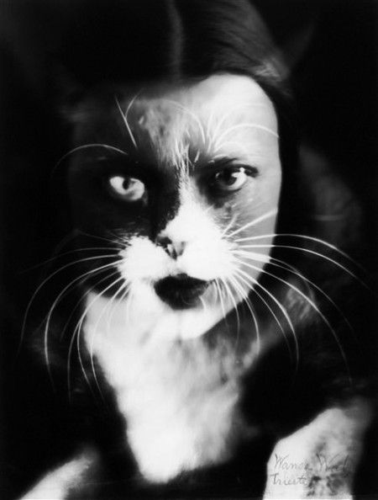
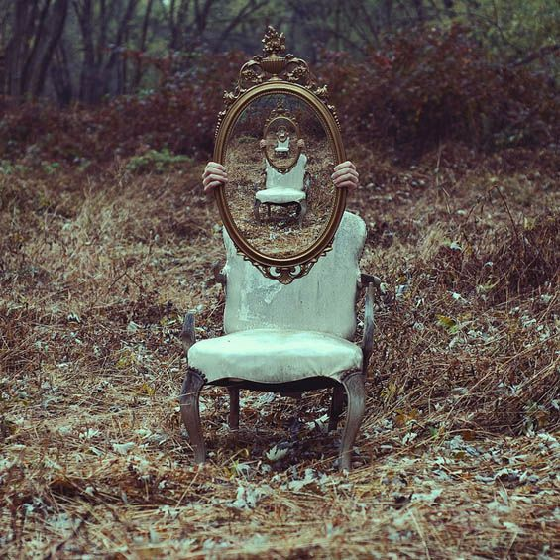
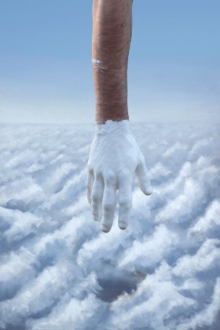
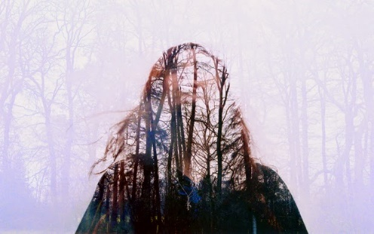
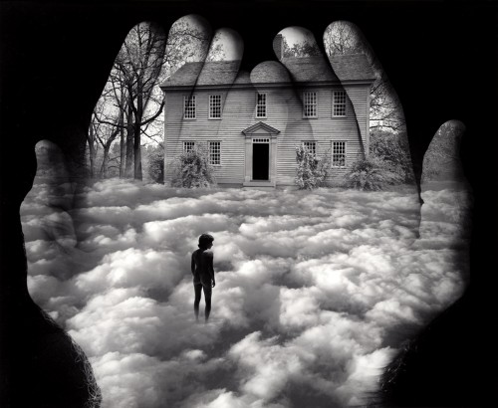
Todays Tasks:
Look through the surrealism checklist and make sure you have not left any gaps.
Make sure you have at least three photoshop experiments for each photographer.
Man Ray
Oliver Morris
Jerry Uelsmann
Chris McKenney
Kevin Corrado
Experimenting with layers
Creating a the double exposure effect from your own photography
Experimenting with 3-4 layers to create a silhouette double exposure effect.
Using tools to edit the opacity of each layer
Experimenting with the double exposure technique with the landscapes you took over the summer.
Develop further by colour popping elements of the image.
Experimenting with layers.
Using the eraser tool to merge two or more layers together to create unusual/ haunting compositions.
Combing multiple techniques.
Double exposure, eraser tool to combine layers.
Painting on top of your photography

Slide 3
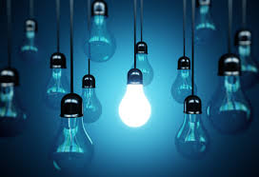
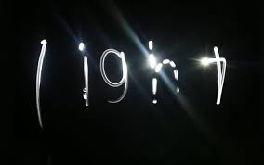
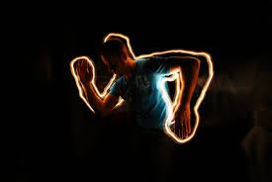
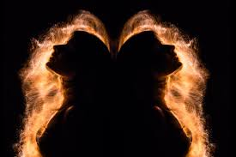
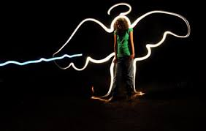
Light Photography
Drawing with Light
Steps:
Create a title page for Light Photography
Create a mood board of images
Add synonyms that linked to light
Create a mind map of ideas, skills, photographers that you have found to combine into your project.
Create a research slide on Picasso’s photography
Create a research slide on William Klein’s photography
Create a research slide on Toby Keller’s photography
Create a research slide on your chosen photographer that links to light photography.
Create a ‘Steps to creating my own Light Photography’ page and document the steps you need to take. Add to this slide what effects you intend to create with the camera, thinking about shapes, words, body outlines, ghosting, movement.
Make a slide for each technique and find an inspiration/ example photo that you would like to recreate.
Add and annotate your own outcomes and explain how they link to each photographer. Remember to edit some, but keep the original to compare. Constantly linking to the formal elements. See annotation guides for help.

