Slide 1
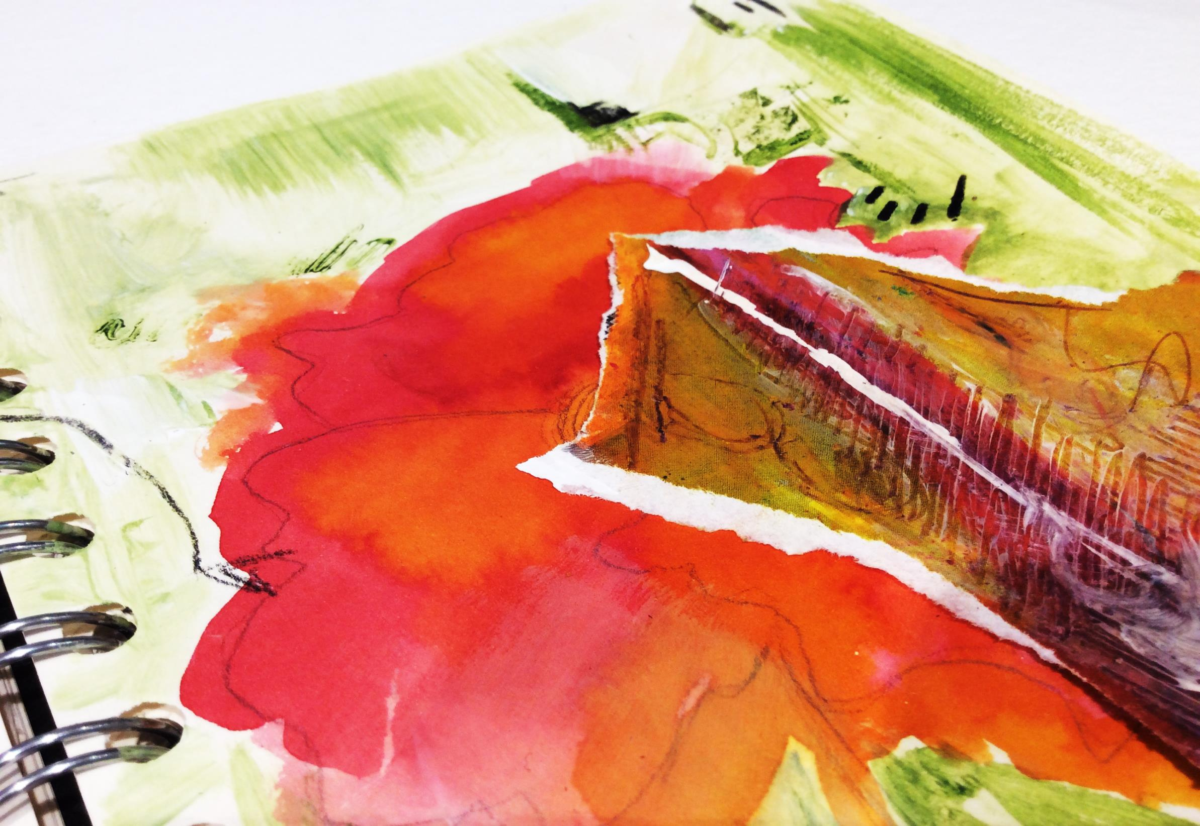
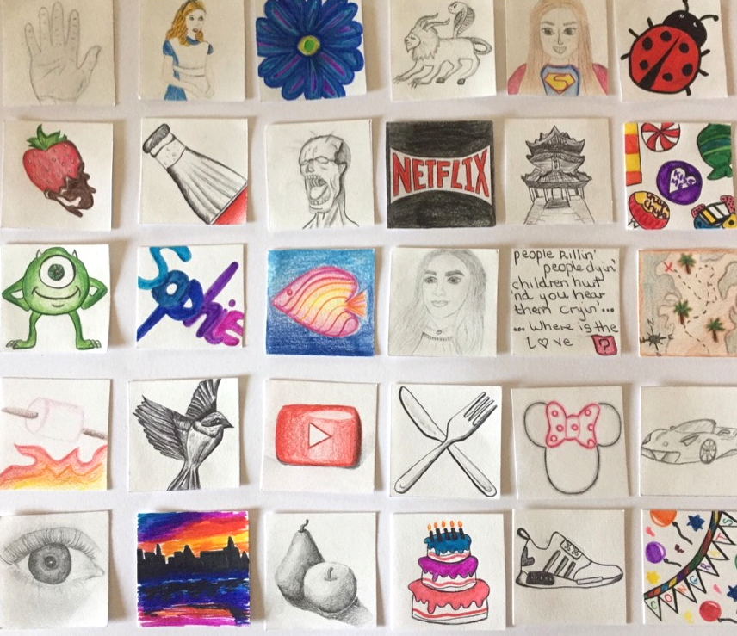
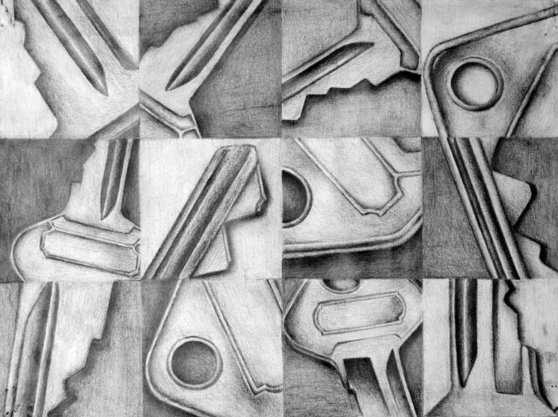
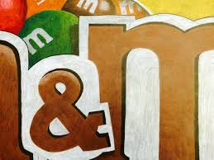
Year 7 Art Home Learning Drawing Challenge:
Draw all 30 images on the list. Each one must only be 5cm x 5cm
You can use any materials you like to draw the images with, for example -pen, pencil, collage, paint, digital etc.
Present them all on one sheet of A3 or several smaller sheets of A4 or A5.
1.Your hand
2. A character from a book
3. A plant or flower
4. Your own mythical creature
5. Yourself as a superhero
6. An insect
7. Your favourite food
8. A drinks can or bottle
9. A zombie
10. Something red
11. A building
12. Sweets
13. Something green
14.Your initials in an interesting font
15. A weird fish
16. Favourite film character
17. A song lyric
18. A treasure map
19. A car
20. A bird
21. Knife and fork
22. Something that makes you laugh
23. A childhood memory
24. Something you love
25. Your eye
26. A reflection
27. A phone
28. A cake
29. A shoe
30. A key
Try to be as detailed and accurate as you can. You must complete all 30 drawings and remember that they have to all be 5cm x 5cm.
Challenge! Try to crop your drawings so your artwork fills the whole box! The best outcomes will be put into an exhibition and display.

Slide 2
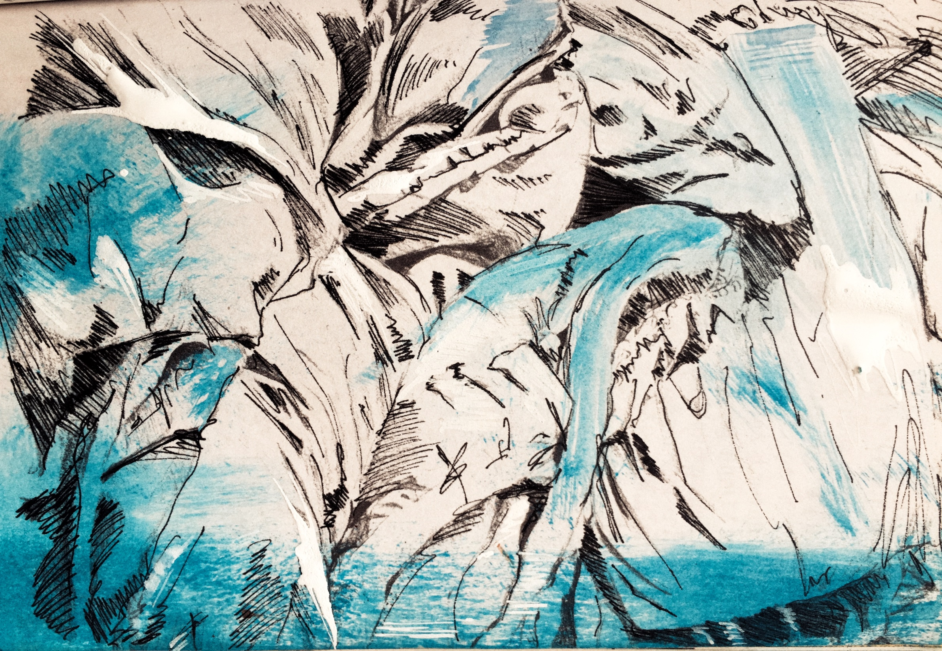
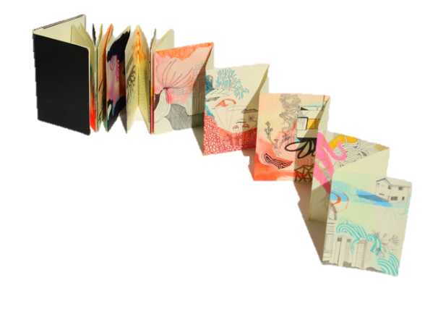
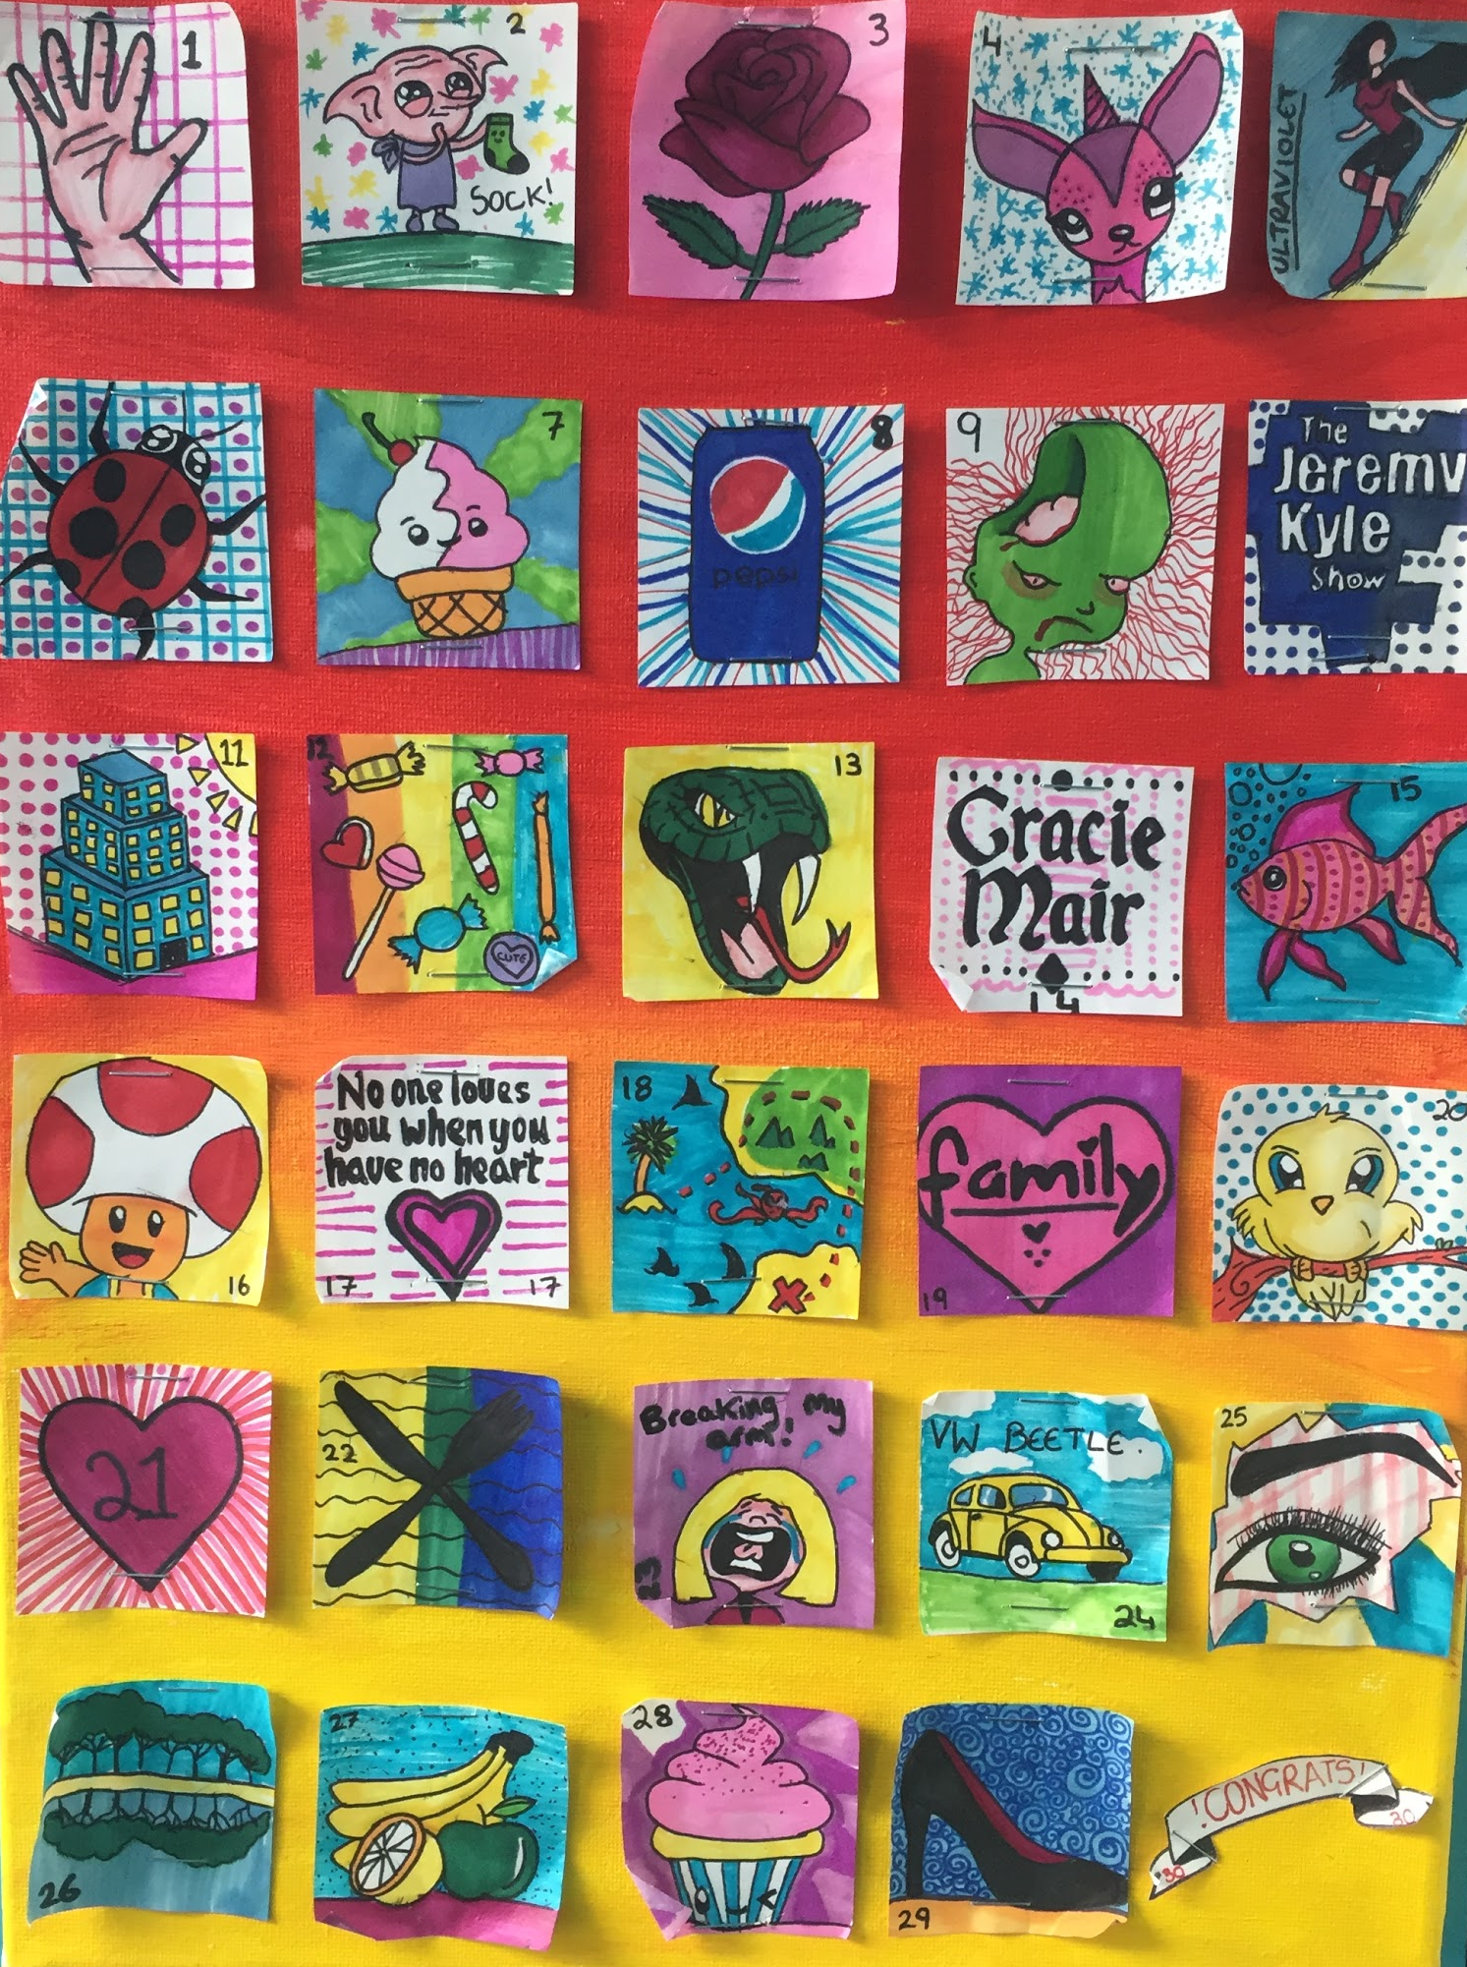
Y8 Art Home Learning Drawing challenge:
Draw all 30 images on the list. Each one must only be 5cm x 5cm
You can use any materials you like to draw the images with, for example -pen, pencil, collage, paint, digital etc.
Present them all on one sheet of A3 or several smaller sheets of A4 or A5.
A building
A plant or flower
Something yellow
A weird creature
A view through a window
A fragment
Your favourite food
A toilet
Your street
Something rough
Your hand
Sweets
A green object
An empty space
Something spiky
16. Your front door
17. Inside your fridge
18. A smooth object
19. Something close up
20. A key
21. Something red
22. A knife and fork
23. Inside a bag
24. A mouth
25. Your eye
26. A reflection
27. An insect
28. A journey
29. Your feet
30. Your name using an interesting font.
Try to be as detailed and accurate as you can. You must complete all 30 drawings and remember that they have to all be 5cm x 5cm.
Challenge! Try to crop your drawings so your artwork fills the whole box! The best outcomes will be put into an exhibition and display.

