Slide 1
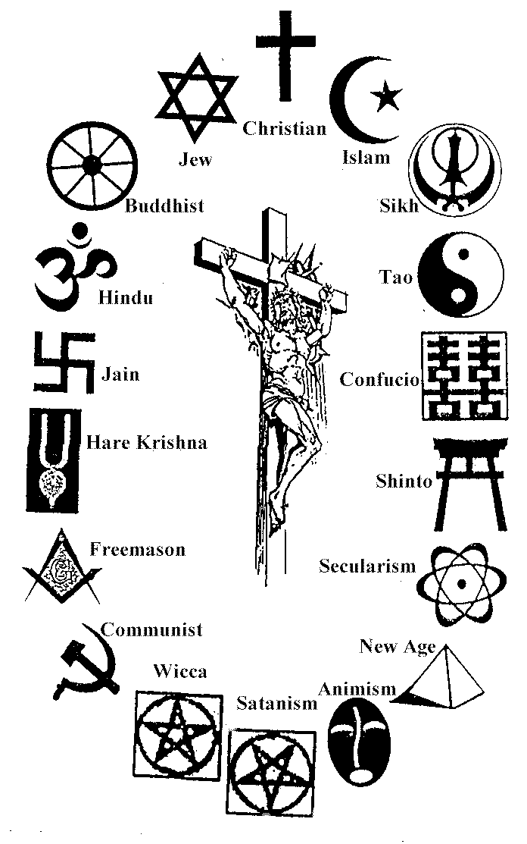
Year 7
Work Booklet Religion
Name:

Slide 2
In this booklet you will learn about the basics of the 6 major world religions:
By the end of this booklet you will be able to:
Know the 6 major world religious founders/leaders
Know some festivals and understand them
Develop a deeper understanding about the religious communities
Express your own opinions better
Express your own beliefs

Slide 3
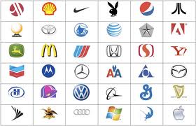
Symbols
Identity as many of the symbols as you can:
1.
2.
3.
4.
5.
6.
7.
8.
9.
10.
11.
12.
13.
14.
15.
16.
17.
18.
19.
20.
21.
22.
23.
24.
25.
26.
27.
28.
29.
30.
31.
32.
33.
34.
35.
36.
Why are symbols important? (give 4 reasons)

Slide 4
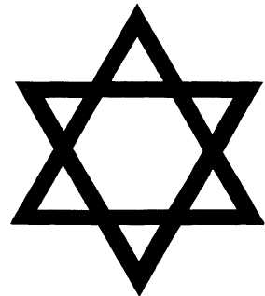
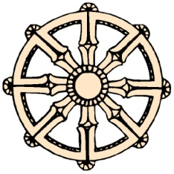
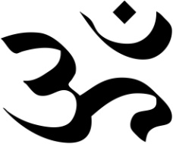
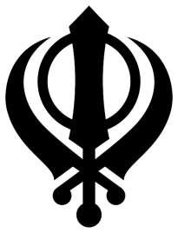
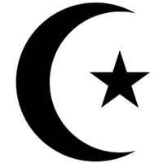
Questions: 1. Why do you think symbols are important for religions? I think symbols are important for religions because…. For example… I also think they are important for religions because…. For example…
Task 1:
Look at the following pictures of religious symbols. For each one write down the religion it belongs to…..
_____________
_____________
_____________
_____________
_____________
Sikhism
Christianity Hinduism Buddhism Islam Judaism Sikhism

Slide 5
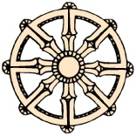
Symbols are really important because they stand for something. They represent an idea or a feeling. In religion symbols are very important and often tell a lot about that religion. Look at the meaning of each symbol below:
Christians use the cross because it is a reminder of the struggle and sacrifice Jesus went through and made. The Cross represents Jesus who is there leader.
Jewish people have the star of David because it ancient times, David was a great leader who rebelled against the rule of the time so that Jewish people could worship their God properly.
Hindus use this symbol called an Om or Aum. This is also a sound. It was meant to be the sound that God uttered as he made the world and is often used in meditation
Buddhists use the Dharma Wheel. This represents their journey through life and shows them when they die where they will go if they have had a good life.
Muslim people use the star and moon for their symbol. It represents the star and moon that is present at the beginning of their festival Ramadan.
Sikhs use variety of symbols put together to make up their symbol. There is a circle in the middle to represent eternity- no end and no beginning.
Draw a few designs that you might have for your own symbol:

Slide 6
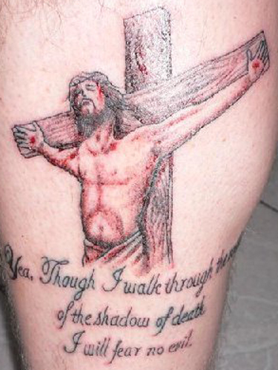
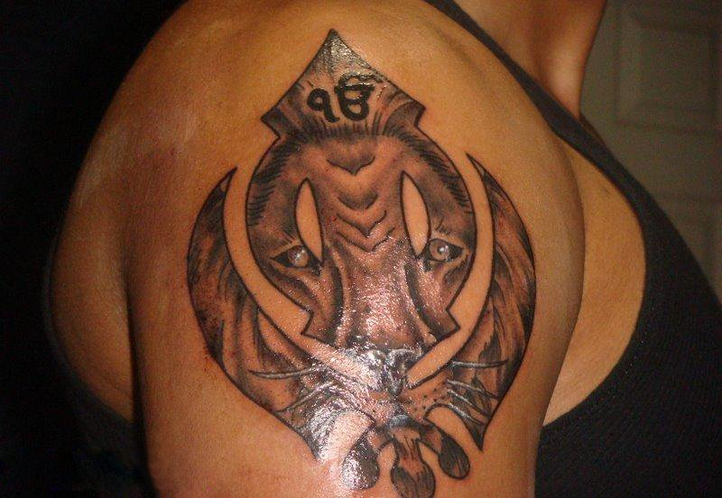
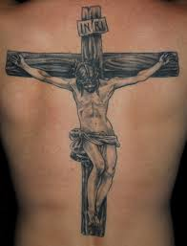
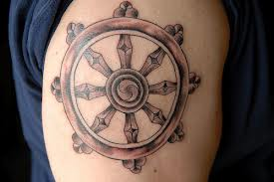
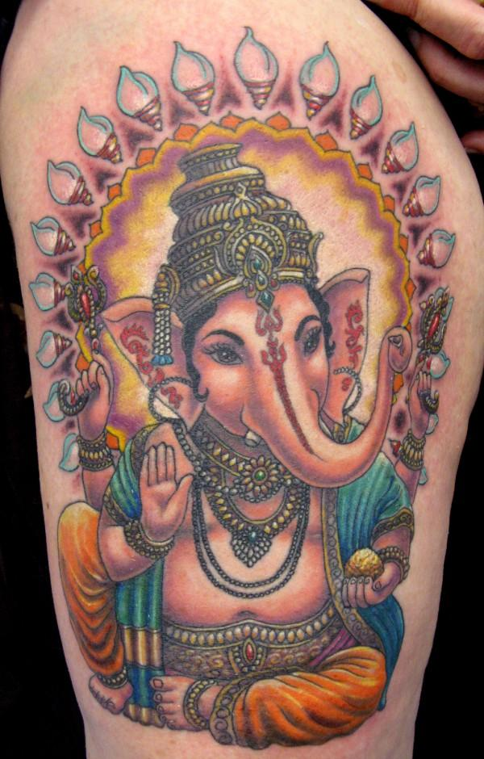
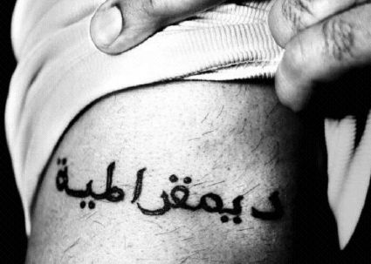
A lot of religious people take their religion and their religious symbols seriously. Look at some of these tattoos

Slide 7
Task: Draw your own tattoo to reflect what you believe in
Explain what you have drawn and why?

Slide 8
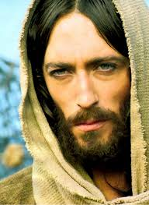
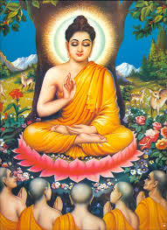
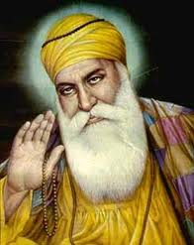
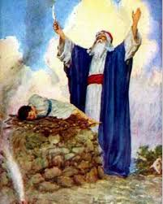
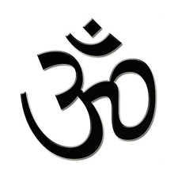
Religious leaders
Muhammad
This section will focus on looking more closely at religious leaders. These include: Jesus, Guru Nanak (among others) , Buddha and Abraham.

Slide 9
Jesus of Nazareth
Jesus belonged to the Christian religion and was born approx. 0 B.C. He lived for about 30 years before he was crucified.
Draw a picture of what jesus looked liked:
Explain how you know that Jesus looked like this: (for example from a book, Tele vision etc)

Slide 10
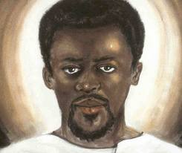
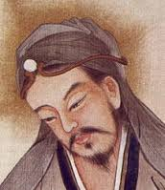
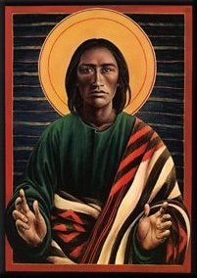
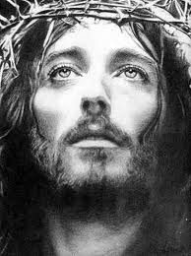
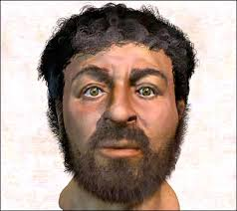
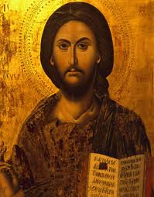
Look at these image Jesus closely. Write ONE sentence underneath of why he may have looked like this…
____________________________________________________________________________________________________
____________________________________________________________________________________________________
____________________________________________________________________________________________________
____________________________________________________________________________________________________
____________________________________________________________________________________________________
____________________________________________________________________________________________________

Slide 11
Jesus most probably looked like this because he lived in a hot country so his hair would have been short. His skin would have been slightly darker than the tradition images of Jesus.
Know write as much information as you can about Jesus i.e. born in a stable, son of God etc. Aim for 10 facts
Jesus

Slide 12
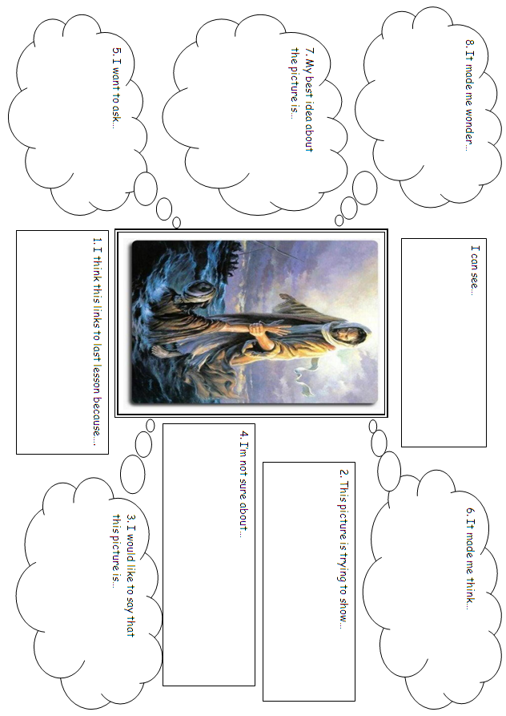

Slide 13
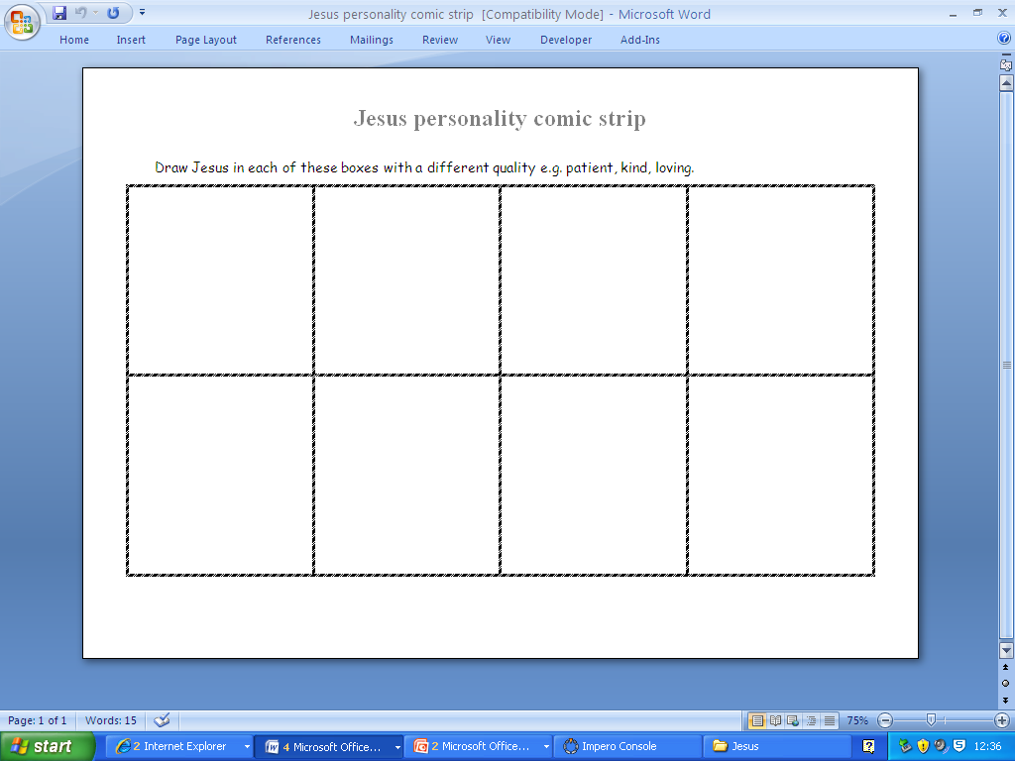

Slide 14
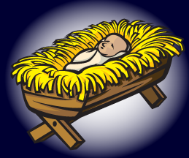
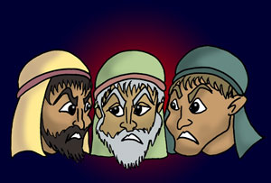
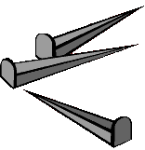
Read this story about the life of Jesus
Jesus is God's Son. God sent Him to live here on earth for a while. This happened a long time ago.
When Jesus lived here, He did something that nobody else has ever done. Jesus never sinned!
Jesus taught people many great things. He also made blind people see and made sick people better
Then, some angry people decided to get rid of Jesus. They lied and said bad things about Jesus. The governor, who was in charge of the land, didn't think Jesus had done anything wrong, but he was afraid to let Jesus go. The governor thought that the angry people would get mad at him if he let Jesus go.
So, the governor had some men beat Jesus up really bad, and they also made fun of Jesus. Then, they decided to kill Jesus.
They killed Jesus in a very mean way. They nailed Him to a cross. A cross is two big wooden boards tied together, and then stuck into the ground. They put nails through Jesus' hands and feet and hung Him from the cross. They left Him there until He died.

Slide 15
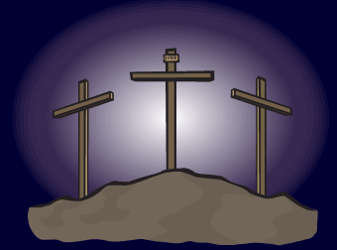
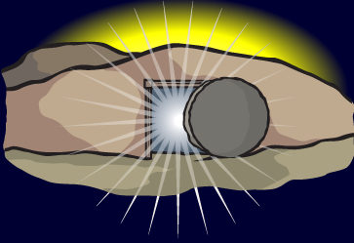
This was really sad, but Jesus knew that this was going to happen. In fact, that's why Jesus came in the first place! Jesus knew that if He came to earth and died, it would take away all of our sin. When Jesus died, He made a way for you and me to be clean again so we wouldn't be dirty anymore! That means that we CAN be with God!
couple of days after Jesus died, something really cool happened. Jesus came back to life! All by Himself! He can do that because He is God! Jesus is still alive today, and He will live forever in heaven.
Quick Questions:
Who is the Father of Jesus?
Who tried to kill Jesus?
Who didn’t think Jesus had done anything wrong?
How did they kill Jesus?
Why did Jesus have to die?
How did Jesus come back?

Slide 16
Create a newspaper article about the life of Jesus. You should write it as if Jesus has died and risen again. Report on his early life and also the wonderful things Jesus did.

Slide 17
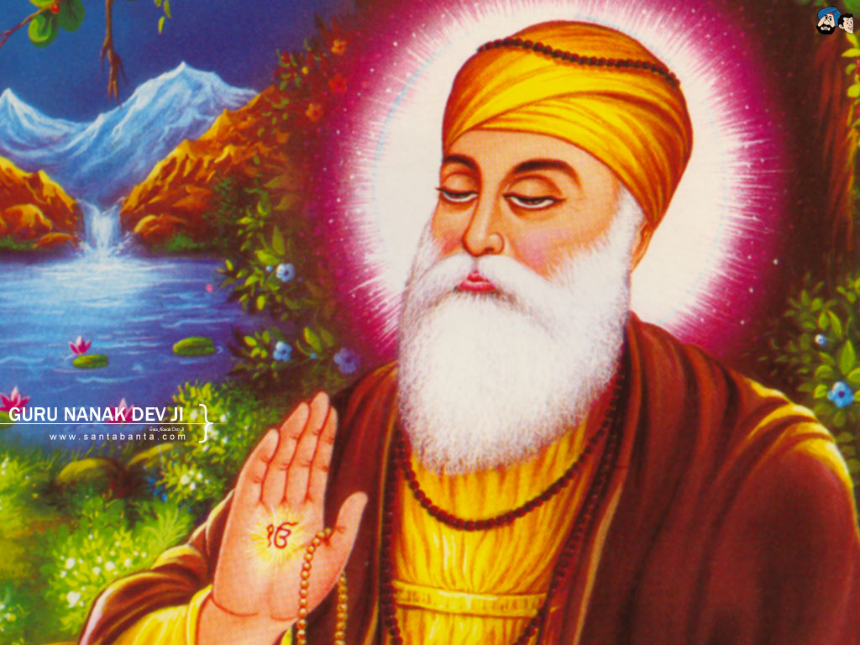
Guru Nanak
Look at this image of Guru Nanak Dev Ji.
Write down how you know this man is important…
_____________________________________________________________________________________________________________________________________________________________________________________________________________________________________________________________________________________________________________________________________________________________________

Slide 18
Guru Nanak
Guru Nanak was the founder of the Sikh religion..
Read though this story and draw a picture from each paragraph and colour it :
In the small town of Talwandi lived a man called Mheta Kalu and his wife Tripta.
He was well known and respected in the town.
Late one night he was feeling worried, nervously walking up and down the garden as his wife was just about to have a baby. Soon he was called by the nurse who told him he had a new baby boy.
“But I didn’t hear a baby cry,” replied Kalu.
“I know. I saw a strange light when he was born, and instead of crying he smiled at me. I think he is going to be someone special!” explained the nurse.
This made Kalu very happy, he gave the nurse a gift of money.
“Thank you, and thank God.”

Slide 19
Kala rushed to the room and was very pleased to see his daughter Nanaki holding her new brother proudly. Soon everyone in the town of Talwandi knew and came to congratulate Kalu. Everyone was given sweets.
A few days later an astrologer
came to visit, and was asked to
prepare a horoscope for the baby.
Hardyal Dass said “Sir, your son will be a great leader and many people will love and respect him.”
The son was then named Nanak, meaning ‘the unique one.”
Later the name of the small town was called Nankana Sahib meaning ‘a place where Nanak came.’
This place is now in Pakistan – a few kilometres from the city of Lahore.

Slide 20
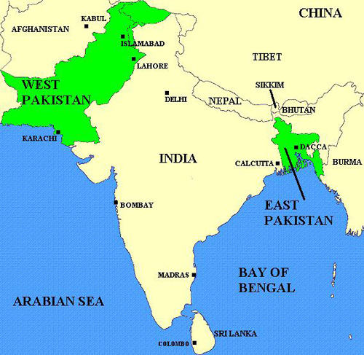
Birth place of Guru Nanak

Slide 21
Nanak grew up to be a fine young man but was more interested in thinking and spending time with the monks rather than doing any work.
One day Kalu had an idea. He gave him 20 rupees, told him to take it to the city, buy something, sell it and make a profit. Earn his living!
Reluctantly he went. He went on his journey with his friend Bala.
In the city he saw some monks sitting under trees. They looked pale and frail. They told Nanak they had not eaten for 3 days.
“Wait there!” said Nanak and went into the city. He bought food for the monks and took it back to them. “Bless you,” they said.
But now it was Nanak’s turn to be sad. He had to return home to face his angry father.
As his father was telling him off, Nanak said “what could be a better bargain than feeding the hungry?”
This made Kalu even angrier and was about to strike Nanak but his sister saved him from punishment. She asked if he could live with her and her husband instead. Kalu agreed.

Slide 22
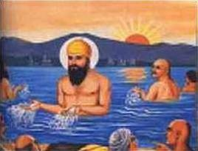
Nanak started his first job as a storekeeper at Sultanpur.
He would often explain his ideas to people gathered in the village. People liked the way he explained how to love and follow God.
Some began to call him a ‘GURU’ which means a teacher. Others called him ‘SAT GURU’ which means true teacher.
One morning, when Nanak was 30 years old, he went to bathe in the river. He disappeared and people thought he had drowned.
Three days later, the reappeared and remained silent for a whole day.
Then he said: “There is neither a Hindu nor as a Muslim, only God’s path and I shall follow God’s path.”
He meant that all human beings are EQUAL in God’s eyes as was not interested in labels.

Slide 23
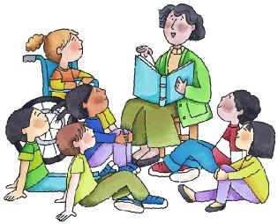
Nanak decided to journey around all the parts of India to share his teaching and ideas.
He travelled with his close friends Bala and Mardana.
We share learn about Guru Nanak’s beliefs and teachings through this unit of work.
Nanak decided to journey around all the parts of India to share his teaching and ideas.
He travelled with his close friends Bala and Mardana.
We share learn about Guru Nanak’s beliefs and teachings through this unit of work.
Now you have read through the story of Guru Nanak Dev Ji try and answer these questions in full sentences:
What was Guru Nanak like as a Young Boy?
_________________________________________________________________________________________________________________________________________________________________________________________________________________________________________________________________________

Slide 24
What was Guru Nanak like as a Young Boy?
_________________________________________________________________________________________________________________________________________________________________________________________________________________________________________________________________________
How did people know that Guru Nanak was special? _________________________________________________________________________________________________________________________________________________________________________________________________________________________________________________________________________
What did he do with his friends that showed he was a good person? _________________________________________________________________________________________________________________________________________________________________________________________________________________________________________________________________________
How did Guru Nanak ‘find’ God?
_________________________________________________________________________________________________________________________________________________________________________________________________________________________________________________________________________
Do you think guru Nanak actually went into the lake for 3 days if yes how and why? And if not then what happened?
________________________________________________________________________________________________________________________________________________________________________________________________________________________________________________________________________________________________________________________________________________________________________________________________________________________________________________________________________________________________________________________________________________________________

Slide 25
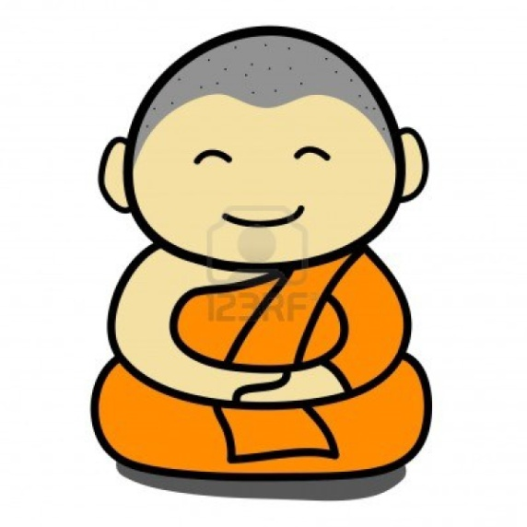
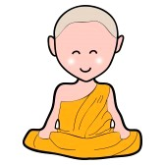
Buddha
Spot the difference Buddha:
List as many differences as you can about these images
Task:
Why do you think the two Buddha's look so different? Give 2 reasons in full sentences
_______________________________________________________________________________________________________________________________________________________________________________________________________________________________________________________________

Slide 26
If you thought a major difference between the two Buddha's is that one was ‘fat’ and the other one wasn’t then well done!
This is because the ‘fat Buddha’ (Chinese name’ is from Chinese culture and represents luck. Some people say you get good luck from the Buddha by rubbing his belly.
The other Buddha however is more like the Buddha that we will be looking at.
Write down as many facts as you know about Buddhisma nd the Buddha including the ones you have already discovered:
Buddhism and the Buddha

Slide 27
Unjumble task:
Look at the sentences and unjumble them so that they make sense:
Gautama Buddha's name birth is Siddhartha Gautama
____________________________________________________________________
He is of the religion the founder called Buddhism.
___________________________________________________________________
Buddha was in Lumbini a prince
___________________________________________________________________
Hindu Buddha was a originally
___________________________________________________________________
Siddhartha was brought up by his mother's younger sister, Maha Prajapati
___________________________________________________________________
Siddhartha married Yasodhara when he was 16. Yasodhara gave birth to a son Rahula.
___________________________________________________________________
spent 29 Siddhartha years in Kapilavastu as prince
___________________________________________________________________
29 He ran to discover the world away at. what he saw He didn’t like
___________________________________________________________________

Slide 28
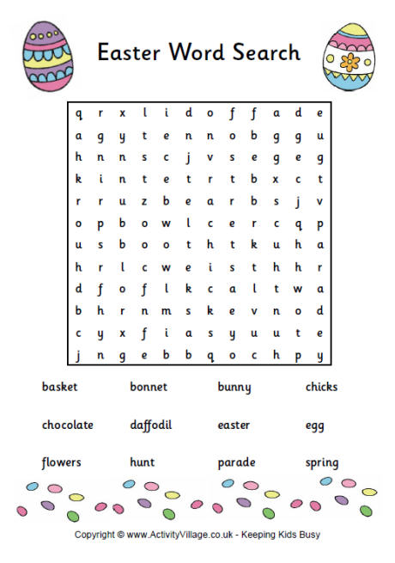
Easter

Slide 29
Try to complete this crossword:

Slide 30
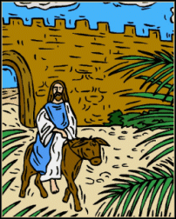
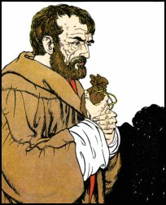
Which Puzzle do you think was the best to show what Easter is about? Give a reason why _________________________________________________________________________________________________________________________________________________________________________________________________________
Jesus Rides into Jerusalem Jesus and his disciples were walking to Jerusalem to celebrate Passover. When they were nearly there, Jesus sent two of his friends for a donkey. He told them to tell the owner that he needed it. The disciples did as they were asked and brought the donkey to Jesus. As he rode into Jerusalem, people saw Jesus coming and covered the path with their garments and palm leaves. They shouted 'Hosanna' and 'Jesus is the King.'
Most people were very happy, but this did not include some of the priests who were jealous of Jesus. They did not like it that ordinary people liked him so much. They wanted an excuse to arrest Jesus and kill him. Judas Iscariot, one of Jesus' disciples went to them in secret and told them he would betray him. The priests and elders gave Judas thirty pieces of silver. From then on he waited for his chance to get Jesus into trouble.

Slide 31
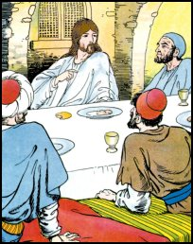
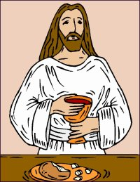
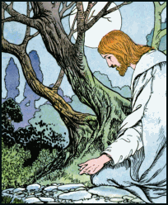
Jesus sat down to a meal with his twelve friends. He looked very sad. His friends asked him 'What is the matter?' He told them he would have to go away the next day to be with his Father in heaven. Jesus' friends were sad then too. The disciples said they would not let anything happen to him. Jesus told them that one of them had already taken money to betray him. They all looked at each other. Judas stood up and walked out.
Jesus told his friends about the people in Jerusalem who did not like him and that the next day he would be arrested and nailed to a cross.
So that they would remember him Jesus broke some bread and said 'This is my body. Take it and eat it and remember me.' Then he took a cup of wine and told them that it was his blood. They should drink it and remember him.
Jesus and his friends walked to the garden of Gethsemane. Jesus was very sad and asked Peter, James and John to watch over him while he prayed.
As he prayed, his friends fell asleep as they were very tired. Just then, Judas arrived with many men who carried swords. They had been sent by the priests to arrest Jesus.

Slide 32
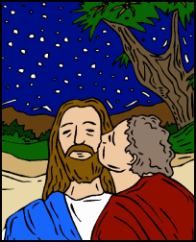
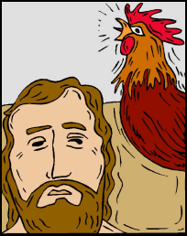
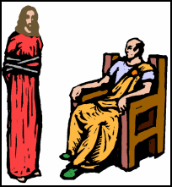
Judas went up to Jesus and kissed him on the cheek. This was Judas' way of picking out Jesus to the soldiers. Straight away two of the guards seized Jesus.
Peter drew his sword and cut off the ear of one of these men. Jesus told him he should not have done that. He touched the man and his ear was healed. The disciples were afraid and ran for their lives.
Earlier Jesus had predicted that his disciples would betray him. Peter said this was not possible. Jesus explained 'Before the cock crows at dawn you will have disowned me three times.' Peter had replied 'Never'. Jesus, now under arrest, was being questioned by the Jewish council. As Peter watched from a distance, people asked if he was a friend of Jesus. Three times he denied knowing him. Suddenly the cock crowed and he cried as he recalled Jesus' words.
The Jewish leaders wanted Jesus to be guilty. They found it difficult to find anything that he had done wrong, even though they paid people to lie about him. Eventually they asked him if he was the Son of God. Jesus replied 'I am.' This was enough. They said this was an insult to God. Jesus was taken before Pontius Pilate, the Roman Governor. Pontius Pilate sentenced him to death by crucifixion

Slide 33
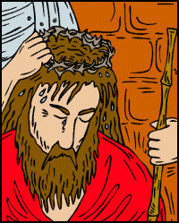
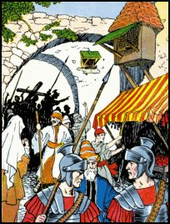
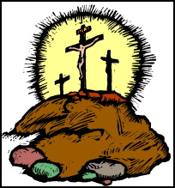
The soldiers took Jesus away, removed his clothes and dressed him in a purple robe. On his head they placed a crown of thorns. Mocking him they knelt down before him and said 'Hail, King of the Jews'. As the blood ran down his forehead they made fun of him. Jesus never said a word.
Then they took him away and laid a heavy wooden cross on his back.
Jesus was made to carry the cross out of the city gates and up a nearby hill. On the way some of the crowd cheered, others wept.
On top of the hill Jesus was put on the cross and nails were put through his hands and feet. The cross was raised up. Two robbers were also put on crosses, one on either side of Jesus. One of the robbers was feeling very afraid. Jesus spoke to him and comforted him.
Jesus' mother watched him on the cross. He called to one of his friends to look after her now. Many people in the crowd were cruel. They said 'You saved other people, why don't you save yourself now?'
At noon darkness fell on the land. It lasted a few hours. Jesus cried out aloud, 'My God, my God, why have you abandoned me?' In the sadness and the dark, Jesus died

Slide 34
At the moment Jesus died, the earth shook. One of the soldiers who had been keeping guard said 'This man was the Son of God.' Many people began to feel afraid.
Some of the friends of Jesus and his mother waited for permission from Pontius Pilate to take Jesus down from the cross. They laid the body in a tomb cut in the rock. The tomb was sealed with a large stone.
Two days later a friend of Jesus known as Mary Magdalen went to the tomb. She was astonished to find that the huge stone had been moved and the body had gone.
She ran to tell Peter and John who only found burial sheets in the tomb. Mary, weeping, was approached by a man she did not know, who asked her why she was crying. She explained that it was because they had taken her Lord away. The man was Jesus risen from the dead
Now that you have read the story of easter think carefully about what it is trying to show

Slide 35
Easter falls round about spring time.
Make a list of all the things that are born/grow during spring :
_______________________________________________________________________________________________________________________________________________________________________________________________________________________________________________________________
Can you link together the story of Easter and this season.?
Why might Easter fall in Spring? (Think about what happens in spring)
_______________________________________________________________________________________________________________________________________________________________________________________________________________________________________________________________
Jesus died and rose again. He showed us new life and a new beginning. Why do you think it was important that Jesus rose from the dead ?(what does it show)
_______________________________________________________________________________________________________________________________________________________________________________________________________________________________________________________________
Jesus was a very special person and a Jew! Why do you think some Jews hated Jesus?
________________________________________________________________________________________________________________________________________________________________________________________________________________________________________________________________________
Why do you think Judas Iscariot betrayed Jesus to the Jewish people?
________________________________________________________________________________________________________________________________________________________________________________________________________________________________________________________________________
Would you have betrayed Jesus? Why?
________________________________________________________________________________________________________________________________________________________________________________________________________________________________________________________________________

Slide 36
Easter represents the idea of Hope and New life. It also proved that Jesus was the Son of God (to the Christians) because he returned from the dead. Make a poster to show the true meaning of Easter

