Slide 1
Year 2 ‘Need to know’ Parent Meeting
September 8th 2023

Slide 2
Welcome to Year 2
Year 2 is such an exciting year, where the children really flourish and get to show off all their amazing learning as they come to the end of the Key Stage. They can support the younger children and set an example, not only in behaviour, but also their high expectations of learning.
They really Shine Brightly and Reach for the Stars!
Introductions –
Narwhal Class – Miss Taylor (M, T, W, T)
and Mrs Banks (F)
Chameleon Class – Mr Simpson
On Tuesday Afternoons Year 2 staff have planning and management time. Classes are covered by Mrs Polovina and Mrs Walker.

Slide 3
End of Year Expectations
Your child will come home with a set of end of Key Stage 1 standards in Reading, Writing and Maths.
Unlike Year 1 which is a best fit teacher judgement. In Year 2 children must meet all the objectives in order to achieve either Working Towards, Expected or Greater Depth standard within each subject.
These are what we use to assess the children at the end of the year, even though the taught curriculum is much broader.
This year hinges on the partnership between home and school, so your help is necessary for your child to succeed and make progress.

Slide 4
Reading
Reading is at the heart of everything we do, it is extremely important and unlocks all other subject areas.
In class we will read every day in a wide range of situations, whether this is in a small group, as a whole class or on a 1:1 basis. We have story time every day, sharing picture books, chapter books and poetry.
School Books – Usually children will bring home two books; this will be either two colour band books for Reading for Pleasure, or one Reading for Pleasure book plus a phonics book that is matched with the phase of phonics your child is still working within. Please ensure you read with your child at least 3 times a week and record this on Class Dojo each time, in addition to sharing your own books together at home. Please ensure that all school books are in your child’s bag every day so that we can hear them read in class.

Slide 5
Reading
Library – We will visit the library every fortnight. We are lucky to have a wonderful range of exciting and challenging texts, as well as familiar favourites. Please make sure the library book comes to school every day so that we can talk about them and use them in our learning.
Class Reading – In class we read together using the VIPERS scheme to build comprehension, understanding and inference. We will ask and answer question, both verbally and as a written comprehension task. These kinds of questions include; checking understanding of vocabulary, predicting what will happen, explaining what you think and making inferences about what is happening; are the kind of questions you could ask when reading at home.

Slide 6
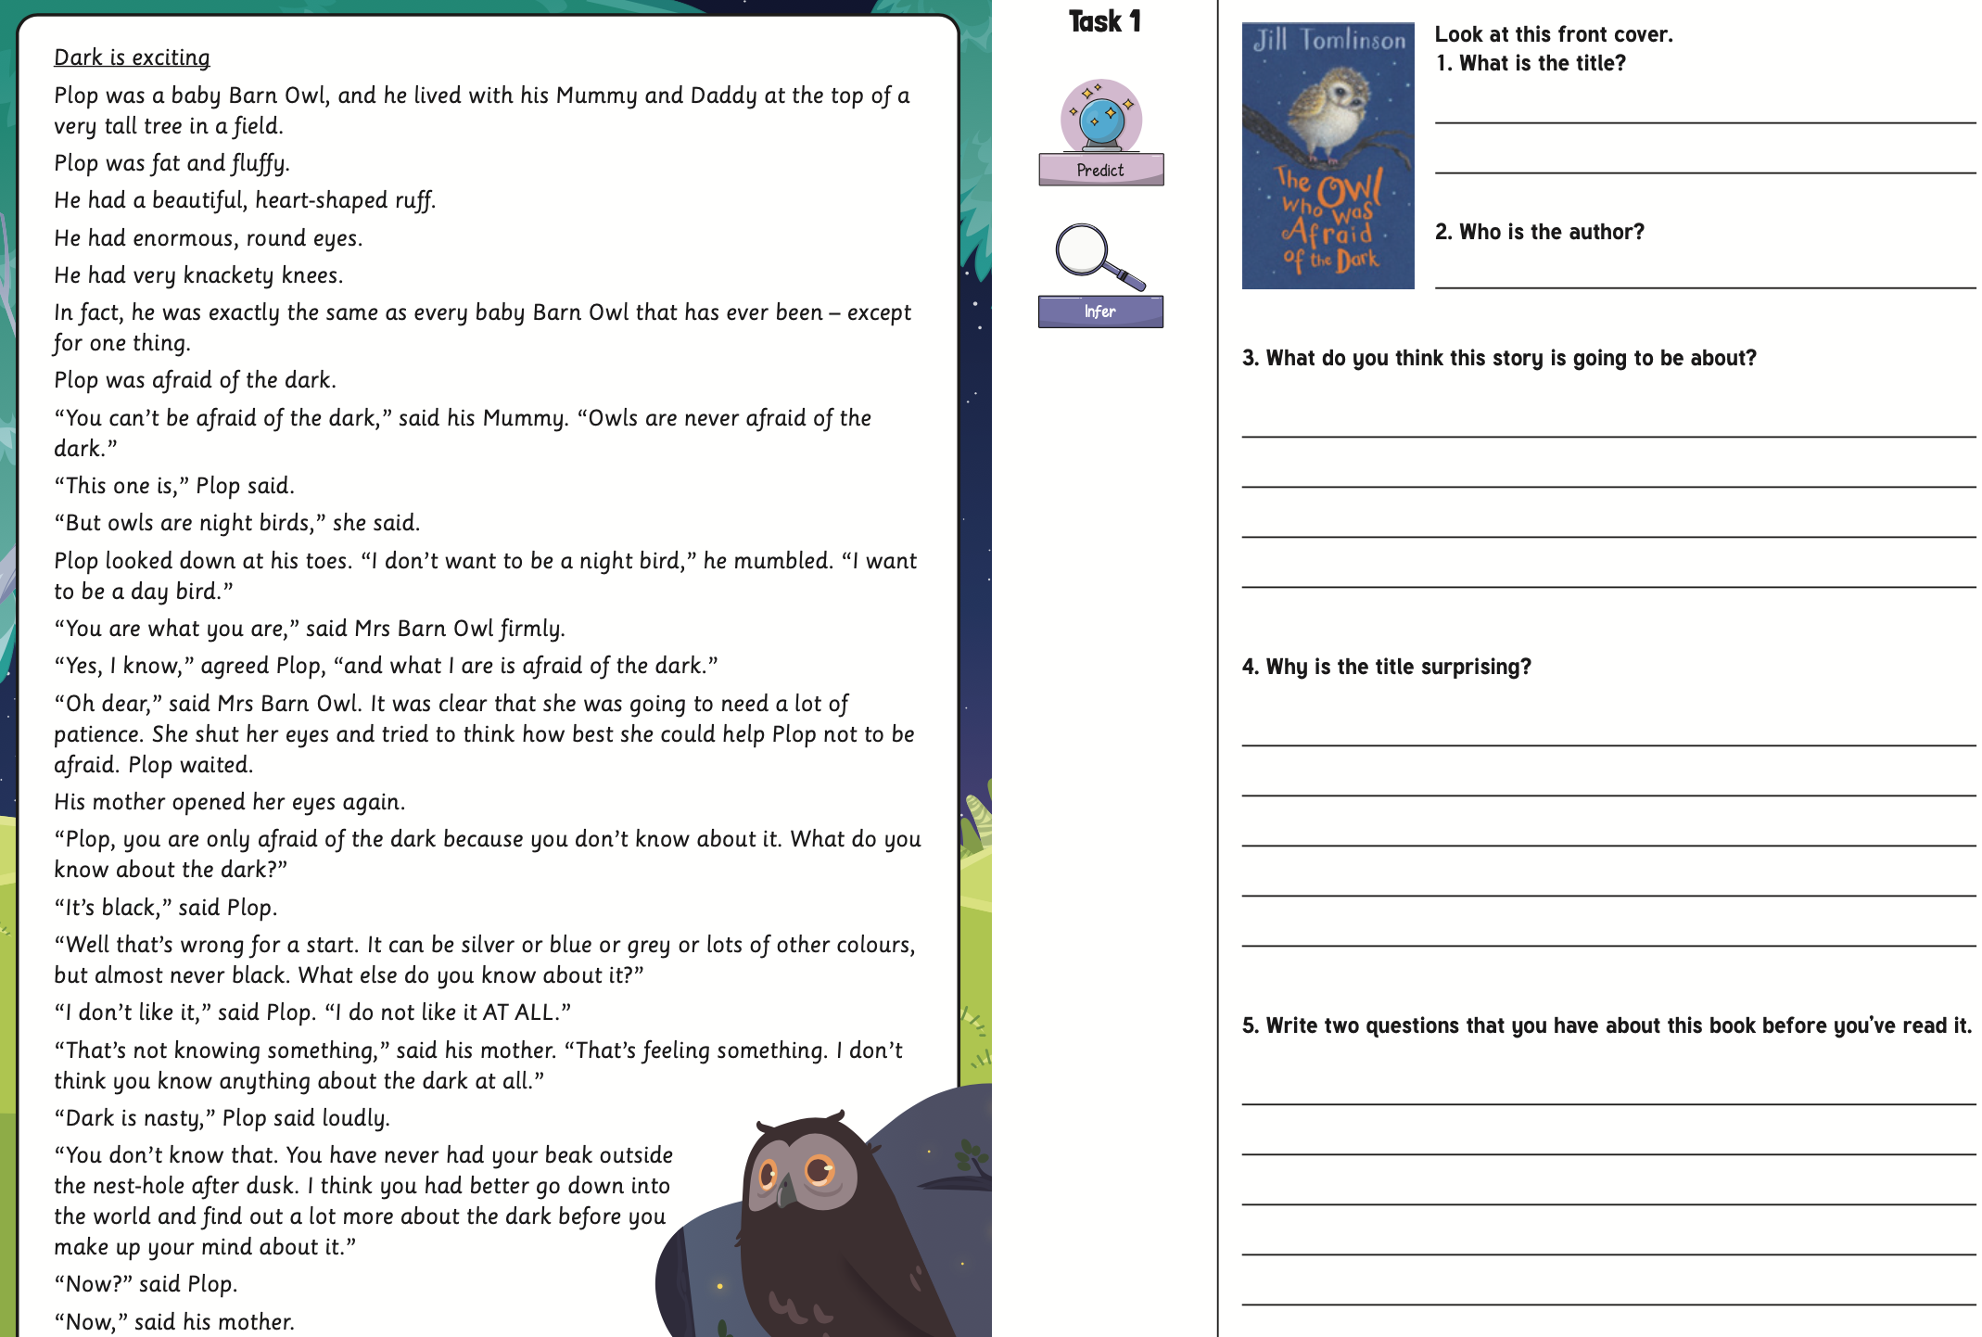
Reading

Slide 7
Phonics
We teach phonics every day as a whole class. We will begin year 2 by revisiting Phase 5 sounds / phonemes the children have already covered in order to embed them in both reading and spelling. Early next week you will receive a pack of missing phonemes. It is imperative that these are practiced and learned at home as this was Year 1 content.
The majority of Year 2 is spent teaching phase 6 and focusses on teaching spelling rules, including suffixes, and applying them in their writing.

Slide 8
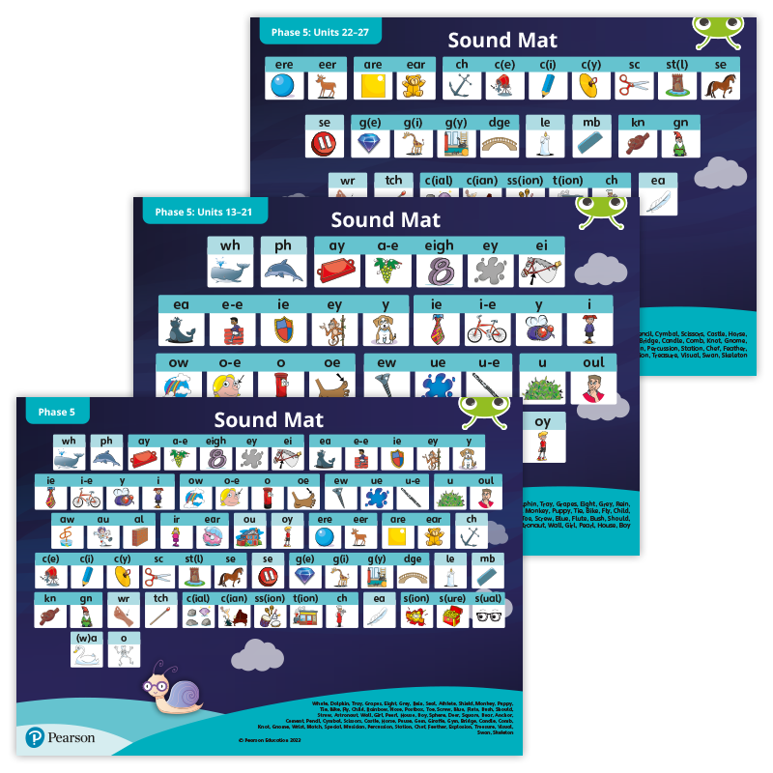
Phonics

Slide 9
Spellings
In the Autumn term we start with the Year 1 Common Exception Words already taught, again to embed them so that the children use them in all of their writing. Once these have been taught, we move on to the year 2 CEW. As you will see in the standards, spelling these words correctly is crucial.
To support their learning in this, spelling sheets will be sent home on a Friday. The words are practised in class, in preparation for a spelling check on the following Friday morning. In class we focus on spelling each word using taught strategies, looking for patterns, using mnemonics, etc. Weekly spellings will be either common exception words or words relating to the spelling rules being covered in class that week. All children have access to Spelling Shed as a fun way to learn their spellings.

Slide 10
BugClub / Spelling Shed
The login details for Bug Club and Spelling Shed will remain the same as last year. Each week we will set a Bug Club reading book and phonics games to practise the graphemes, and a Spelling Shed assignment with the current week’s spellings.

Slide 11
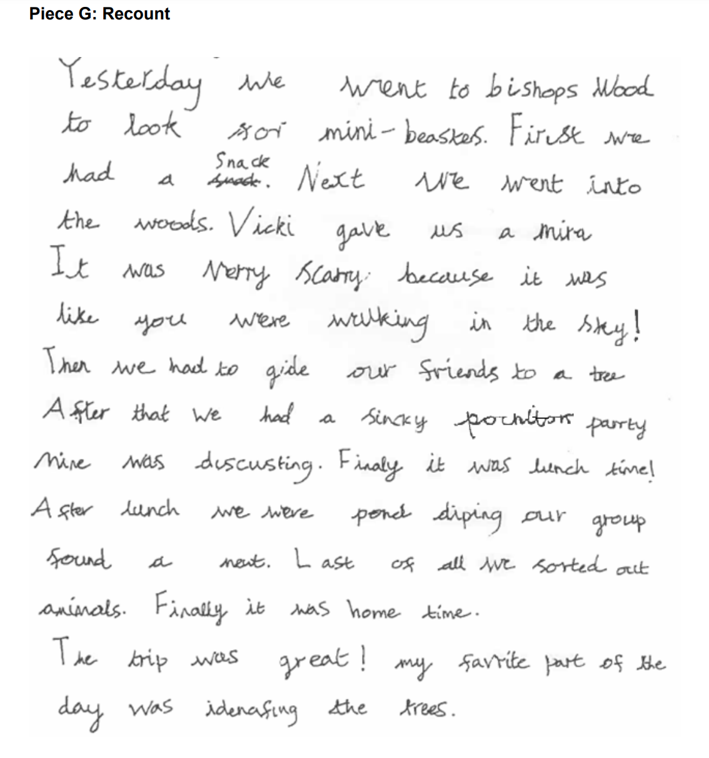
Writing
We write every day, across all the subjects. Sentences should be written using the spellings, phonic choices and handwriting that has been taught, along with correct punctuation. We write for many different purposes and cover different genres throughout the year.

Slide 12
Handwriting
We regularly practise the correct formation of letters. We group letters into families, thinking about starting points and exit strokes. Critically, letters must be of a similar size and correct orientation. This forms a big part of the expected writing standard.

Slide 13
Maths
We follow the White Rose scheme, which is broken into small steps of learning. The children have lots of opportunity to ‘Show’, ‘Explain’ and ‘Draw’ their learning and to build their problem solving and reasoning skills, with a focus on mathematical vocabulary.
Maths homework is sent home on a Friday and includes tasks that revise the learning from that week. We also set a One Minute Maths challenge to be completed on the App and then posted on Dojo.

Slide 14
Resources and Strategies
Numicon
Number fans
Tens and ones
Counting objects
100 squares
Number lines
Tens Frames

Slide 15
Homework
Each week we will set a Portfolio on ClassDojo for Reading, Spellings/Phonics and Maths.
This term is called Far Far Away, which focusses on Australia.
Each term we will send home a Homework Map, which features a variety of tasks related to different curriculum areas. These are designed to be fun and enhance the learning we will be doing in school. On the back of this map, you will find all the different objectives that we will be teaching that term.

Slide 16
P.E. Days
Mondays and Fridays are our P.E. Days.
Children MUST come to school P.E. ready in our P.E. uniform. Please see the school website for more information.

Slide 17
Class Dojo
This is the first point of contact to speak to your class teacher. Messages will be monitored between 8:30am and 4:30pm.
Friday blogs will be posted, giving you a snapshot of your child’s week.
Please check class story regularly as we do post information and requests on here.
Don’t forget to post any homework you do so we can reward the children!

