Slide 1
Section A American West quick test.
Q1: Give two terms of the 1868 Fort Laramie Treaty.
Q2: Who were the Mormons?
Q3: Who led the Mormon migration?
Q4: What is ranching?
Q5: What was the Exoduster movement?
Q6: Who was responsible for the extermination of the Buffalo?

Slide 2
Section A: American West quick test.
1: Give two terms of the 1868 Fort Laramie Treaty: bring peace between the whites and the Sioux. Sioux agreed to settle within the Black Hills reservation in the Dakota Territory. The government therefore agreed to close the Bozeman Trail and the forts along it.
2: Who were the Mormons? A religious white settler group initiated by Joseph Smith in upstate New York during the 1820s.
3: Who led the Mormon migration? After Smith's death in 1844, the Mormons followed Brigham Young 1846-7 to what would become the Utah Territory.
4: What is ranching? The practice of raising herds of animals on large tracts of land.
5: What was the Exoduster movement? A name given to African Americans who migrated from southern states to Kansas in the late 1870’s (1879).
6: Who was responsible for the extermination of the Buffalo?
White settlers, rail road companies & the US government.

Slide 3
How do we answer Paper 2?
Section A: American West c.1835-1895 and Section B Early Elizabethan England 1558-1588.
Exam details:
1 hr 45 minute exam (around 50 mins each paper)
64 marks
32 marks Section A: American West (x3 Q’s)
32 marks Section B: Elizabethan England (x3Q’s)
NO sources!!
You will be given both papers. You must manage your time carefully.

Slide 4

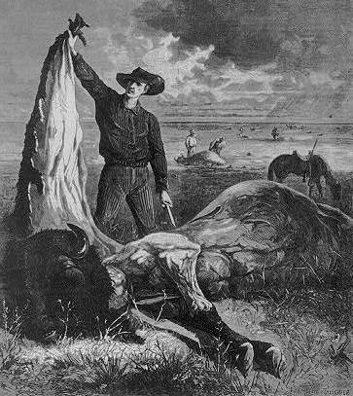
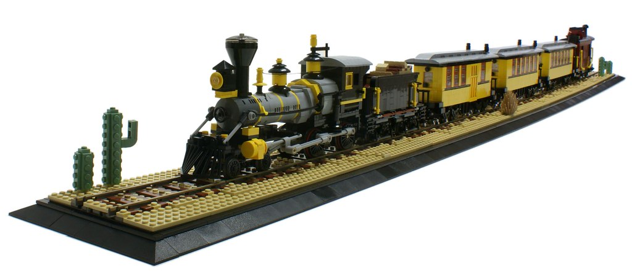
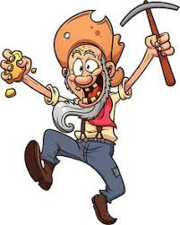

Q1. Explain two consequences of….
Section A: American West c.1835-1895
4+4 marks (one per consequence P>E>E)
CRISP= Consequence Results Impact Short & Long term People

Slide 5
Q2. Write a narrative account analysing…
Section A: American West c.1835-1895
8 marks (3 events linked by connectives)
This led to, As a consequence…
…how the US government policy towards the Plains Indians developed c.1835-1851?
You can use: -Permanent Indian Frontier -Mexican-American War
P1: At first President Jackson promised…..
Then in 1834….
P2: The result of the victory against Mexico in 1848 was….
As travelling by sea to the west coast took a long time and was expensive, this meant…
P3: Finally, government policy changed again in 1851…
Overall the government policy became…..

Slide 6
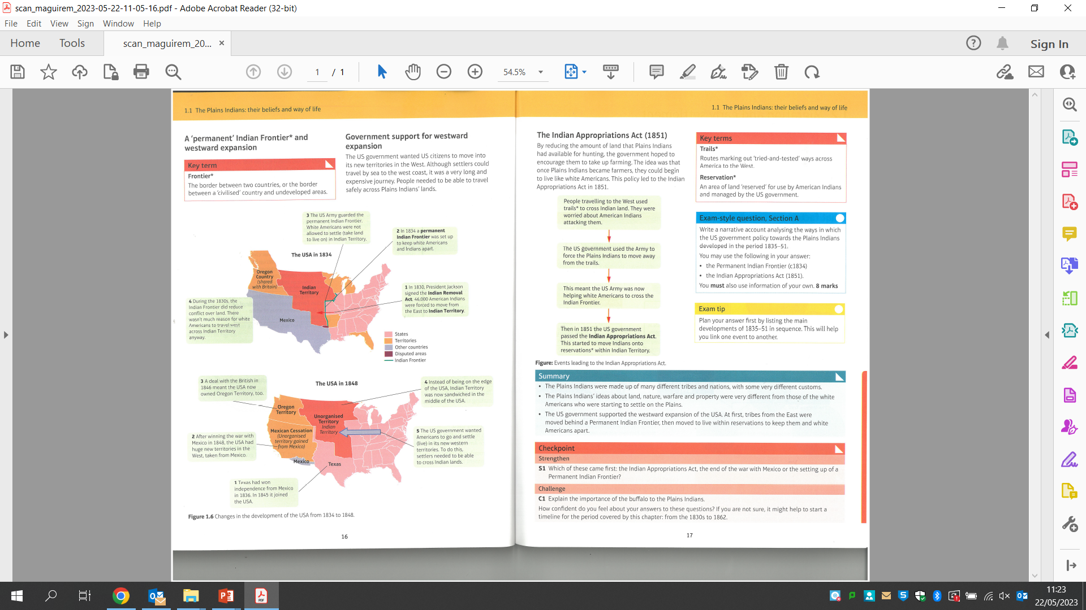
Write a narrative account analysing how the US government policy towards the Plains Indians developed c.1835-1851.

Slide 7
Q2. Write a narrative account analysing…
Section A: American West c.1835-1895
8 marks (3 events linked by connectives)
This led to, As a consequence…
…how the US government policy towards the Plains Indians developed c.1835-1851?
You can use: -Permanent Indian Frontier -Mexican-American War
P1: At first President Jackson promised…..
Then in 1834….
P2: The result of the victory against Mexico was….
As travelling by sea to the west coast took a long time and was expensive, this meant…
P3: Finally, government policy changed again in 1851…
Overall the government policy became…..

Slide 8
Q2. Write a narrative account analysing how the US government policy towards the Plains Indians developed c.1835-1851. You can use:
-Permanent Indian Frontier -Mexican-American War
…
Section A: American West c.1835-1895
8 marks -3 events linked by connectives
This led to, As a consequence…
P1: The US government policy towards the Plains Indians developed as more land was settled further westwards between c.1835-1851. At first President Jackson promised to grant land west of the Mississippi River to Indian tribes that agreed to give up their homelands under the Indian Removal Act 1830. This was built upon in 1834 when the Permanent Indian Frontier was set up to keep white settlers and Native Americans apart. The US army guarded this frontier and this reduced conflict over land as there was not much reason for white Americans to travel West.
P2: However by 1848 the US gov. policy had changed as a result of the victory against Mexico was in the Mexican American War. Texas had won its independence by 1836, joining the USA in 1845….Furthermore new territories in the West taken from Mexico in 1848 and the Oregon territory acquired through a deal with the British in 1846 meant the Indian Frontier was now surrounded on the East and West by the United States gov.
As travelling by sea to the west coast took a long time and was expensive, this meant…
P3: The US government therefore wanted to protect settlers moving across Indian land to reach the West…
Finally, government policy changed again in 1851…
Overall the government policy became…..

Slide 9
Q3. Explain the importance of two of the following:
Section A: American West c.1835-1895
8 + 8 marks (2 key reasons for a development being significant for a further factor or event)
Key topic 1: The development of new mining towns for law and order in the early West
Key topic 2:
Joseph McCoy to the development of the cattle industry
Key topic 3:
The Dawes Act, 1887 for the way of life of the Plains Indians

Slide 10
Key Topic 1: Early Settlement of the West Key Topic 2: Development of the Plains c.1835-c.1862 c. 1862-c.1875
CONSEQUENCE: (4 + 4 marks)
Explain one consequence of x2 topics:
The setting up of the Oregon Trail 1836
The Fort Laramie Treaty
The American victory in the Mexican-American War
The discovery of gold in Colorado in 1858
NARRATIVE: (8 marks)
Write a narrative account analysing the..
Ways in which the Us government policy towards the Plains Indians developed in the period 1835-51
Why Americans went West in the years 1836-49
Main developments in US Government policy towards the Plains Indians in the period 1836-61
IMPORTANCE: (8 + 8 marks)
Explain the importance of...
The Oregon Trail for the early settlement of the West
The Indian Appropriations Act 1851 for the way of life of the Plains Indians
The buffalo to the Plains Indians’ way of life
Warrior societies to Plains Indian life
Breeding and training horses to the way of life and means of survival of the Plains Indians
Religion to the way of life of the Plains Indians
The development of new mining towns for law and order in the early West
The discovery of Gold in California 1848 for the settlement of the American West
The rapid growth of mining settlements for government efforts to bring law and order to the West
The leadership of Brigham Young to the successful settlement of the valley of the Great Salt lake by the Mormons
CONSEQUENCE: (4 + 4 marks)
Explain one consequence of x2 topics:
The Homestead Act 1862
The ending of the Civil War in 1865 for the settlement of the West
The development of ranching on the Plains in the years 1866-76
The opening of the First Transcontinental Railroad 1869
The discovery in 1871 in an eastern tannery of a process to make high quality leather from buffalo hides
The introduction of barbed wire in the West (1874)
NARRATIVE: (8 marks)
Write a narrative account analysing the..
Key events in the years 1851-66 that led to the beginning of Red Cloud’s War
Events of the Indian Wars 1862-1868
Key stages in the growth of cattle ranching 1861-72
Ways in which homesteaders solved the problems of farming on the Great Plains in the years 1862-76
Development of the railroads in the years 1860-75
IMPORTANCE: ( 8 + 8 marks)
Explain the importance of...
The Homestead Act 1862 for the settlement of the West
Cattle trails for the development of the cattle industry in the 1860’s
Joseph McCoy to the development of the cattle industry
Cowboys for the cattle industry
The railroads for changes in the way of life of the Plains Indians
Of the strategy of total war for the US army’s defeat of the Plains Indians
The Fort Laramie Treaty of 1868
The Sand Creek Massacre in 1864

Slide 11
Key Topic 3: Conflicts and Conquest c. 1876- c.1895
CONSEQUENCE: (4 + 4 marks)
Explain one consequence of x2 topics:
The defeat of the Seventh Calvary at the Battle of the Little Big Horn
The ending of the Civil War for African-Americans
The winter of 1886-87 for the cattle Industry
The Johnson County War in 1892
NARRATIVE: (8 marks)
Write a narrative account analysing the..
Ways in which settlement in the West developed in the years 1876-1895
Conflict between the Plains Indians and the US government in the years 1876-1890
IMPORTANCE: (8 + 8 marks)
Explain the importance of...
The Battle of Little Bighorn 1876 for government attitudes towards the Plains Indians
The winter of 1886-87 for the cattle industry
The Dawes Act, 1887 for the way of life of the Plains Indians
The Johnson County War 1892 for law and order in the West
The Oklahoma Land Rush of 1893 for settlement of the West
If you can’t answer these—you need to revise some more !

Slide 12
Section B Early Elizabethan Mock feedback quick test.
Section B Early Elizabethan England 1558-1588
Q1: Was Shakespeare producing plays by 1588?
Q2: Did Walter Raleigh lead the colonies to Virginia?
Q3: How did the Tiger get damaged?
Q4: What is the Papacy?
Q5: What was the excommunication?
Q6: When did Francis Drake attack Cadiz?

Slide 13
Section B Early Elizabethan quick test
Section B Early Elizabethan England 1558-1588
Q1: Was Shakespeare producing plays by 1588? NO! First play produced in 1591.
Q2: Did Walter Raleigh lead the colonies to Virginia? No! He organised and funded them.
Q3: How did the Tiger get damaged? Ran aground on rocks off the coast of Virginia.
Q4: What is the Papacy? The Pope and Vatican
Q5: What was the excommunication? The Papal Bull of 1570 issued by the Pope banished Elizabeth from the Catholic Church, Heaven and forbade all nobles, subjects and people to obey Elizabeth on pain of excommunication.
Q6: When did Francis Drake attack Cadiz? 1587 delaying the Spanish armada by one year.

Slide 14
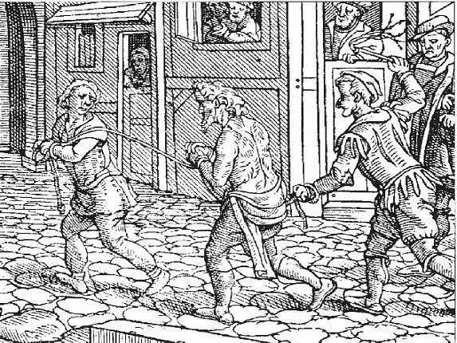
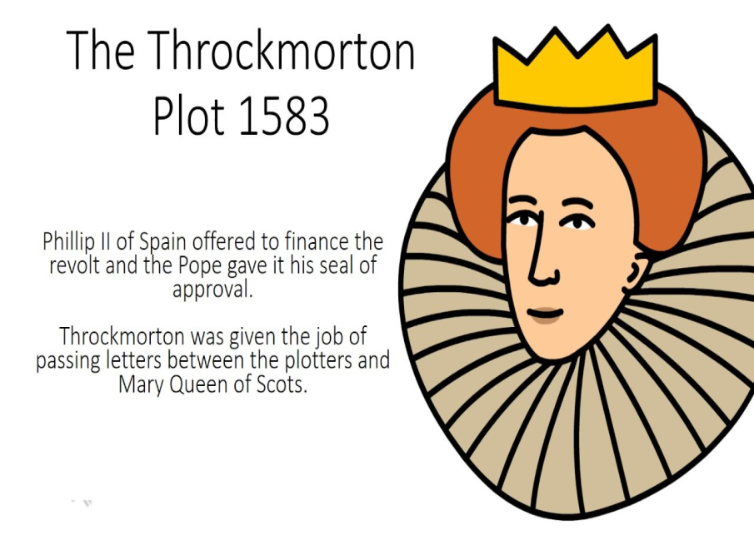
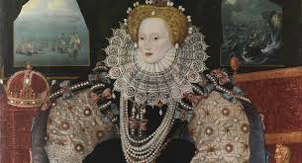
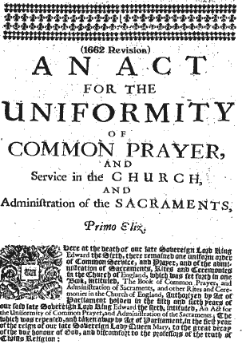
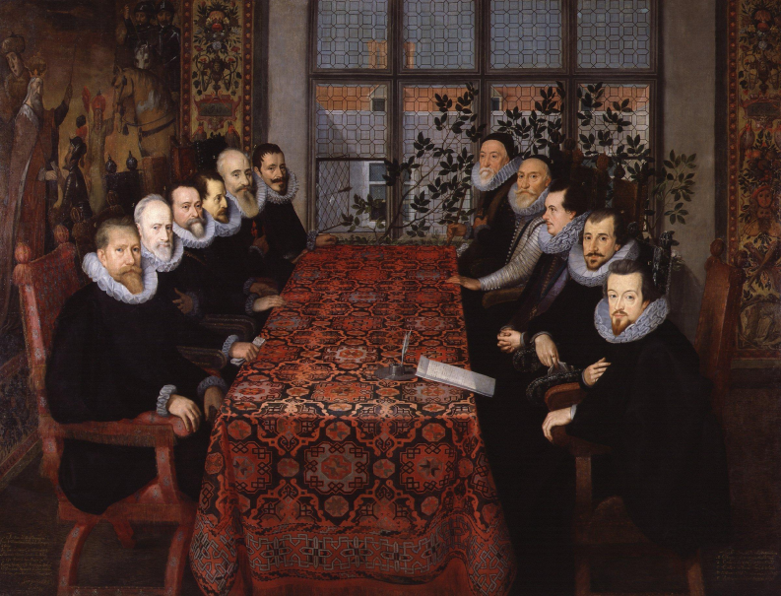
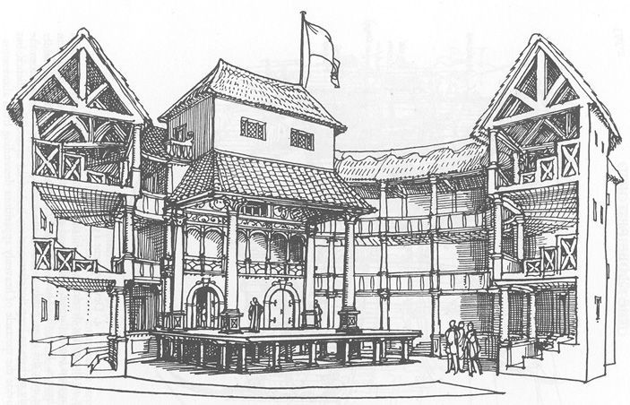
Q1a. Describe two features of…
Section B Early Elizabethan England 1558-1588
4 marks (2 marks per description)

Slide 15
Question 1 (a) on Paper 2 is worth 4 marks. It asks you to describe two features of an aspect of Elizabethan England you have studied and is worded as follows:
Each feature is worth two marks. You need to:
  identify the feature
  write a sentence that adds further detail.
You only need to write about two features.
1. Describe two features of [a topic]
Feature 1
Feature 2

Slide 16
Key Topic 1: Queen, Government and religion Key Topic 2: Challenges to Elizabeth at home ad abroad
1558-1569 1569-1588
Q1a. DESCRIBE: (4 marks)
Describe two features of the Privy Council.
Describe two features of the challenge from Puritans between 1558 and 1569.
Q1b. EXPLAIN: (12 marks)
Explain why Religion was so important in sixteenth century England.
Explain why Mary, Queen of Scots posed a problem for Elizabeth in 1568.
Q1c. JUDGEMENT: (16 marks)
i. ‘Elizabeth dealt with the problems of 1558 successfully.’ How far do you agree? Explain your answer.
-War with France - Debt
OR
ii. ‘The religious settlement of 1559 did not solve the problem of religion in Elizabethan England.’ How far do you agree? Explain your answer.
-Recusants -Protestant reaction
Q1a. DESCRIBE: (4 marks)
Describe two features of the English navy sent against the Spanish.
Describe two features of plots against Elizabeth between 1571 and 1587.
Q1b. EXPLAIN: (12 marks)
Explain why the Throckmorton Plot (1583) was a threat to Queen Elizabeth.
Explain why the Spanish Armada was defeated in 1588.
Q1c. JUDGEMENT: (16 marks)
i. ‘ The threat of the Northern Earls was not a significant threat to Elizabeth.’ How far do you agree? Explain your answer. - Mary, Queen of Scots – Earl of Sussex army
OR
ii. ‘The Babington Plot was the main reason for the execution of Mary, Queen of Scots.’ How far do you agree? Explain your answer.
-Spanish threat – Catholic support
i. ‘The Spanish Armada was defeated due to the weather.’ How far do you agree?
-Battle of Gravelines –Spanish weaknesses

Slide 17
Key Topic 3: Elizabethan society in the age of exploration, 1558-88.
Q1a. DESCRIBE: (4 marks)
Describe two features of Drake’s circumnavigation of the world.
Describe two features of sports and pastimes for the wealthy.
Q1b. EXPLAIN: (12 marks)
Explain why Elizabeth was worried about the ‘idle poor’ and vagabonds.
Explain why men such as Francis Drake went on voyages of exploration.
Q1c. JUDGEMENT: (16 marks)
‘Events in the New World were the main reason for the breakdown of relations with Spain.’ How far do you agree? Explain your answer.
-Francis Drake - Spanish Netherlands
OR
‘Relations with the Native Americans were the main reason for the failure of the Virginia colonies.’ How far do you agree? Explain your answer.
-Walter Raleigh -Roanoke Island

Slide 18
Explain why men such as Francis Drake went on voyages of exploration.
You may use: - The New World
-Circumnavigation of the world 1577-80
Pages 94-98
Three factors:

Slide 19


Structuring your answer
PARAGRAPH 1
Write one good length paragraph for the first reason.
  Introduce the reason and link it to the question (green in the example).
  Fully explain it with evidence (blue in the example).
EXAMPLE
Mary was far more of a problem to Elizabeth in England because she was likely to become the focus of plots by English Catholics because of their dissatisfaction with the Religious Settlement. In 1559 Elizabeth had set up a Protestant Church of England with penalties for those who did not attend it. After ten years most people in England had accepted the new Church but there remained some Catholics who wanted to bring back the Catholic religion and the Pope. For many of these Catholics it was Mary who should be Queen of England and not Elizabeth because they believed her parents’ marriage had been illegal. The arrival of Mary in England provided these opponents of the Religious Settlement with a Catholic alternative to replace Elizabeth.
INTRODUCTION
  Identify the key reasons you are going to explain in your answer
  (green in the example).
  Link them to the question (blue in the example).
EXAMPLE
Mary’s arrival in England in 1568 created a problem for Elizabeth because it intensified the threat she already posed to Elizabeth. For those English Catholics who could not accept Elizabeth’s Religious Settlement, Mary, as Elizabeth’s cousin with a strong claim to the throne, represented an alternative and Catholic monarch. Mary was also a problem because although she had been overthrown in her native Scotland, she still had strong ties with France, also Catholic and England’s traditional enemy.
PARAGRAPH 3
Write one good length paragraph for the third reason.
  Introduce the reason and link it to the question (green in the example).
  Fully explain it with evidence (blue in the example).
EXAMPLE
Any attempt to overthrow Elizabeth and replace her with Mary would have a greater chance of success if it had support from abroad, particularly France. Mary had strong links with France, a Catholic country which was traditionally the ally of Scotland and enemy of England. Mary’s mother and first husband were French and she had grown up in France. The prospect of the combination of a Catholic rebellion in England, possibly led by powerful discontented English nobles and backed by forces from France and perhaps in alliance with the Pope, would place Elizabeth’s throne, and life, in great danger. When Mary arrived in England therefore she became more dangerous to Elizabeth who now had the additional problem of deciding what to do with her without making the situation worse.
PARAGRAPH 2
Write one good length paragraph for the second reason.
  Introduce the reason and link it to the question (green in the example).
  Fully explain it with evidence (blue in the example).
EXAMPLE
Religion was not the only issue which made Mary a problem, however. She also had a strong claim to the English throne. Elizabeth and Mary were cousins and as long as Elizabeth remained childless, her heir was Mary. In 1565 Mary had strengthened her position by marrying Henry, Lord Darnley, who also had a claim to the throne through his grandmother, and by producing a son which established a line of succession. As heir to the throne Elizabeth feared that Mary in England could attract the support of any discontented nobles who felt they had been excluded from power, particularly if they happened to be Catholic. There were several of these powerful figures in the North of England, where Mary landed, who had already seen their political power decline since Elizabeth became Queen.
INTRODUCTION
Identify the key reasons you are going to explain in your answer.
The diagram shows you the steps to write a good answer to this type of question. Each point or reason you have chosen should be given a paragraph and your answer should start with an introduction which introduces your reasons. Click on the different parts of the diagram for examples of how to answer the question:
Explain why Mary, Queen of Scots created a problem for Elizabeth
when she came to England in 1568.
FIRST PARAGRAPH – FIRST REASON
  Introduce the first reason.
  Fully explain this reason, giving evidence to support it.
SECOND PARAGRAPH – SECOND REASON
  Introduce the second reason.
  Fully explain this reason, giving evidence to support it.
THIRD PARAGRAPH – THIRD REASON
  Introduce the third reason.
  Fully explain this reason, giving evidence to support it.
Close
Close
Close
Close

Slide 20
Provide evidence to support your argument.
The New World was the area in South America which had been captured by Spain. Only ships licensed by Spain could trade with this area. Meanwhile, Spanish ships carried back gold and silver from South America across the Atlantic. From the 1560s onwards English sailors such as John Hawkins and Francis Drake could not resist the opportunity to restore England’s declining export trade and make financial profits from selling goods to the Spanish colonists and by attacking Spanish treasure fleets. In 1562 and 1564 Hawkins made two voyages to sell slaves but on his third voyage was attacked by the Spanish at San Juan de Ullua in 1568 with considerable loss of life. In the 1570s it was Francis Drake who set out to revenge this by attacking Spanish towns and ships including Nombre de Dios in Peru in 1572 and the capture of the wealthy Cacafuego during his circumnavigation of the world. Drake had the unofficial backing of the Queen who was able to pay off the national debt from the treasure Drake brought back.
How to answer
The steps below and on the next slide give you guidance on how to structure an essay to this type of question. There are four steps in total. The first step is below. Click on it to see a sample answer.
Link your argument back to the question with some judgement.
The King of Spain, Philip II, always made formal complaints but the timing of these events shows it is unlikely they were a direct cause of the breakdown in relations in 1585, although Drake’s activities certainly angered Spain.
Start your paragraph by linking your argument to the statement.
Events in the New World, particularly the activities of Francis Drake, have often been seen as a major, if not the major, cause of the breakdown in relations between England and Spain in 1585.
Step 1: paragraph 1
Write a good length paragraph or two in support of the statement:
  Start your paragraph by linking your argument to the statement.
  Provide evidence to support your argument.
  Link your argument back to the question with some judgement.
Example
Example
Example
Close

Slide 21
Write a conclusion weighing up the evidence and coming to a judgement.
Click on the different coloured text for further guidance.
Events in the New World, like religious rivalries and the plots to replace Elizabeth with Mary, Queen of Scots, had been a cause of tension between England and Spain for nearly twenty-five years and have been considered as an important reason for the breakdown in relations in 1585. However, the main incidents against Spain in the New World took place years before war was declared. Both countries had learnt to live with their rivalry and for most of the time to remain allies. Instead, the main cause in the breakdown of relations in 1585 was events in the Netherlands. Once Elizabeth authorised sending an army to help the Dutch rebels fight Spain there was no possibility of maintaining peaceful relations and England and Spain prepared for war.
Provide evidence to support your argument.
The Netherlands was controlled by Spain but was important to England both for exporting woolen cloth and for its proximity across the Channel. Elizabeth had been secretly helping Dutch Protestant rebels there against Spain since 1572 but had to act openly when their leader, William of Orange, was assassinated in 1584. In 1585 in the Treaty of Nonsuch Elizabeth agreed to send an army of 7,000 under the Earl of Leicester to help the rebels and prevent a big buildup of Spanish military power just across the Channel.
Step 2: paragraph 2
Write a good length paragraph or two to counter (disagree with) the statement:
  Start your paragraph linking your
  argument to the statement.
  Provide evidence to support
  your argument.
  Link your argument back to the
  question with some judgement.
Step 3: paragraph 3
Write another good length paragraph to counter (disagree with) the statement:
  Start your paragraph linking your
  argument to the statement.
  Provide evidence to support
  your argument.
  Link your argument back to the
  question with some judgement.
Events in the New World, like religious rivalries and the plots to replace Elizabeth with Mary, Queen of Scots, had been a cause of tension between England and Spain for nearly twenty-five years and have been considered as an important reason for the breakdown in relations in 1585.
Start with your judgement on the statement using words from the question.
Provide evidence to support your argument.
From the time of the establishment of the Protestant Church of England, and especially after the Papal Bull of Excommunication in 1570, it was expected that a Catholic power such as Spain would lead a religious crusade against England. The arrival of Mary, Queen of Scots in England, the Revolt of the Northern Earls, the missions of the Jesuit priests and the plots against Elizabeth’s life all had links to Spain.
How to answer
Below are the next steps. Click on the example buttons to see sample answers.
Link your argument back to the question with some judgement.
Philip however never did anything concrete like send an army. In many ways he preferred to have Elizabeth on the throne than Mary who had strong ties with France, Spain’s enemy. So religious rivalry, although a factor, wasn’t the main cause of the breakdown in relations in 1585.
Start your paragraph by linking your argument to the statement.
It used to be thought that religious rivalry, centered on the imprisoned Mary, Queen of Scots, was a major cause of the breakdown in relations between England and Spain.
Link your argument back to the question with some judgement.
The arrival of this army was taken as a sign by both England and Spain that they were now at war and relations had broken down completely.
Start your paragraph by linking your argument to the statement.
The most important reason for the breakdown in relations between England and Spain was events in the Netherlands in 1584–5.
Example
Example
Example
However, the main incidents against Spain in the New World took place years before war was declared. Both countries had learnt to live with their rivalry and for most of the time to remain allies.
Give an example of some evidence to counter this.
Example
Example
Example
Give your overall supported judgement.
to remain allies. Instead, the main cause in the breakdown of relations in 1585 was events in the Netherlands. Once Elizabeth authorised sending an army to help the Dutch rebels fight Spain there was no possibility of maintaining peaceful relations and England and Spain prepared for war.
Step 4: paragraph 4
Write a conclusion weighing up the evidence and coming to a judgement.
  Start with your judgement using words from the question.
  Show that you are aware there is some evidence to counter this and give the best example.
  Support your judgement by explaining why, overall you
  have reached your judgement: give your key reason why.
Close
Example

Slide 22

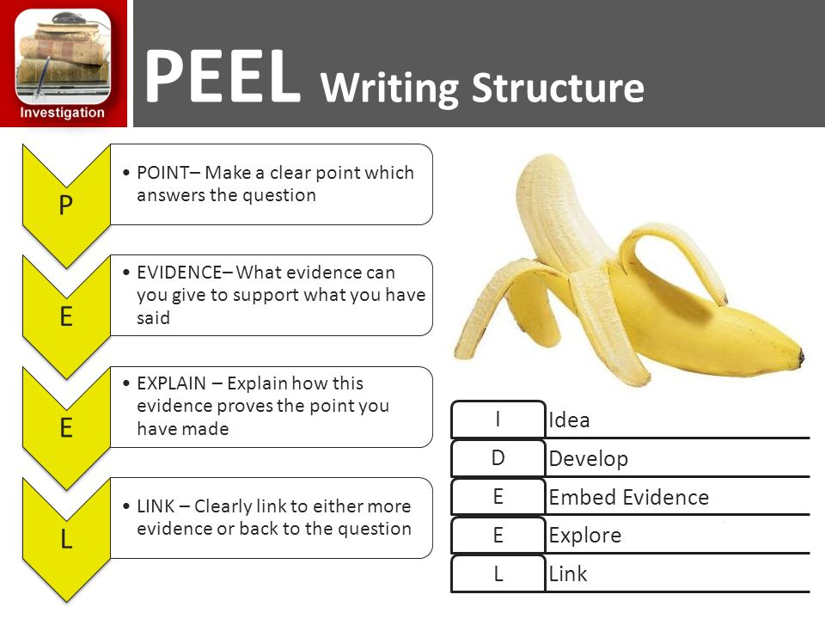



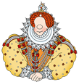
To some extent…..
To a large extent
However…
Additionally
This proves that …
You need to think carefully about the focus of the question and use connectives to give a strong line of argument.
STAGE 3 PLANNING: LINE OF ARGUMENT
Notes:
Just share! Get students to look at useful phrases and connectives in their purple student handout.

Slide 23
Last minute hints!
Section B has two of the largest questions in whole paper (Q1b and 1c I or ii).
Give yourself enough time to answer these.
You have two choices in this paper AW Q3. Choose two out of the 3 questions.
& one out of the two for Elizabeth Q1ci or Q1cii.
Timing is important. 55 minutes on each section.
AW 32 m & EE 32 m = Total 64 marks

Slide 24
Grade Boundaries (total 64)
Grade | 9 | 8 | 7 | 6 | 5 | 4 | 3 | 2 | 1
% | 80 | 72 | 64 | 56 | 48 | 40 | 29 | 17 | 6
Marks | 51 | 46 | 41 | 36 | 31 | 27 | 19 | 11 | 4

Slide 25
Grade Boundaries (total 64)
Section A or B (total 32)
Grade | 9 | 8 | 7 | 6 | 5 | 4 | 3 | 2 | 1
% | 80 | 72 | 64 | 56 | 48 | 40 | 29 | 17 | 6
Marks | 51 | 46 | 41 | 36 | 31 | 27 | 19 | 11 | 4
Section A /B | 9 | 8 | 7 | 6 | 5 | 4 | 3 | 2 | 1
% | 81 | 72 | 66 | 56 | 50 | 44 | 31 | 19 | 6
Marks | 26 | 23 | 21 | 18 | 16 | 14 | 10 | 6 | 2

Slide 26
Grade Boundaries (total 64)
Section A or B (total 32)
Section A /B | 9 | 8 | 7 | 6 | 5 | 4 | 3 | 2 | 1
% | 81 | 72 | 66 | 56 | 50 | 44 | 31 | 19 | 6
Marks | 26 | 23 | 21 | 18 | 16 | 14 | 10 | 6 | 2

