Slide 1
A Level Summer project
Brief: Document, research, observations and develop ideas to produce a creative personal response to the title “Holiday”.
Your outcome is completely your own ideas

Slide 2
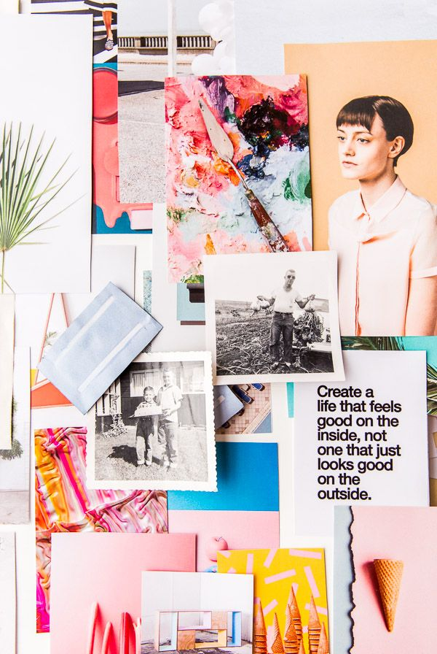
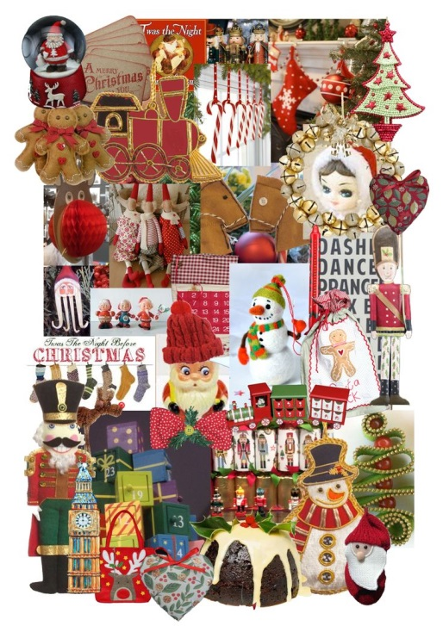
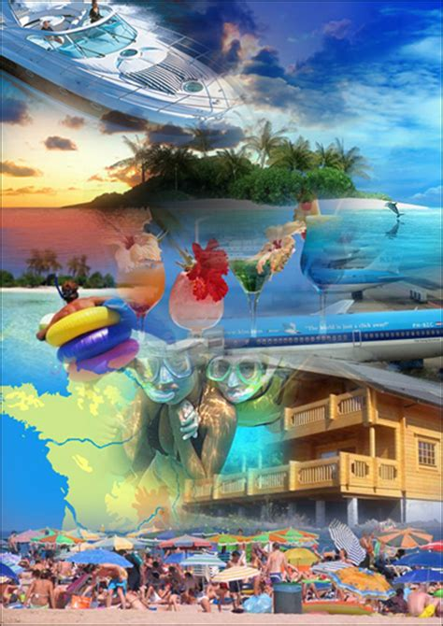
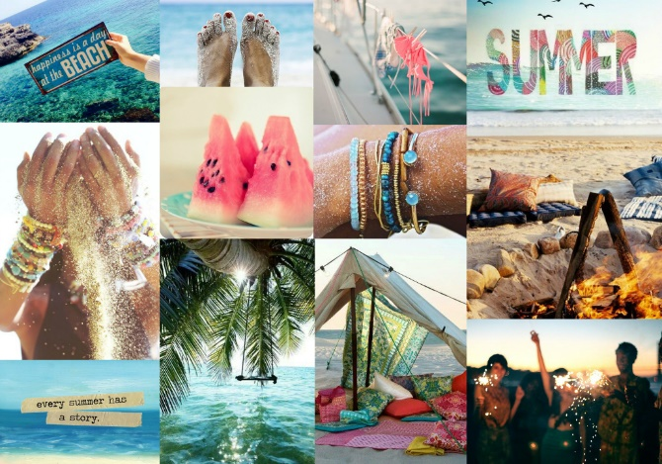
Research and inspirations.
AO1 and 3:
Record Ideas, observations and insights relevant to your intentions in visual form and Other .
Tasks:
Create a couple of pages that show Primary and secondary inspirational images along with a mind map of key words ideas for your project.
Try to present your work creatively using a variety of methods and techniques that are appropriate to your project.

Slide 3
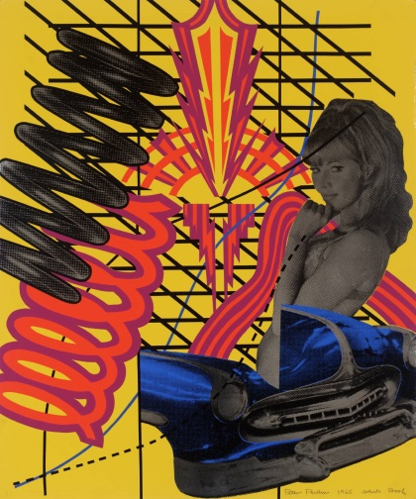
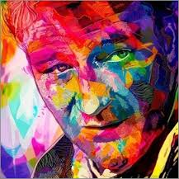
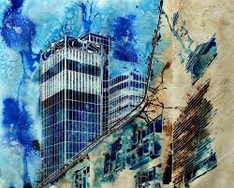
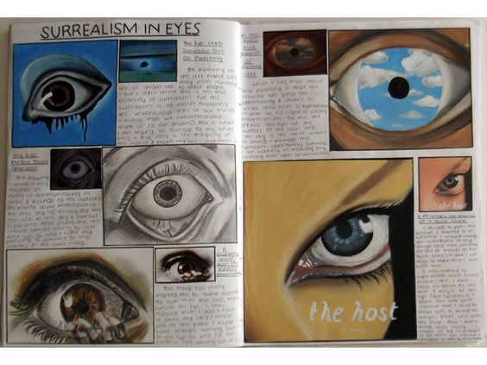
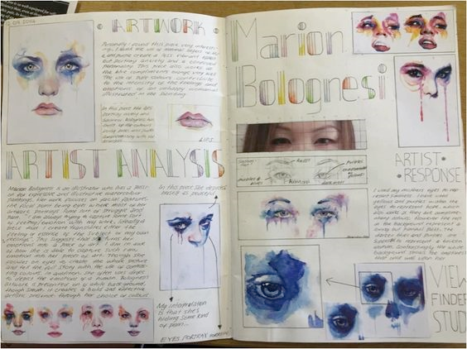
Artist research and inspirations.
AO1: Develop ideas through investigations informed by contextual and other sources demonstrating analytical and cultural understanding.
Complete at least 1 research page. It could be an artist, Photographer designer, maker or art style of your choice.
Introduction
Facts about the arts. What they produce and their inspirations.
Analysis.
What do you think is happening in the piece? Why?
What do you think the piece is trying to tell you? Why?
How is the artist trying to tell you? Why?
What effect does the piece give? Why? Relate to the formal elements and basic principles of art.
Describe.
What can you see?
How would you describe its composition, organisation, rhythm, movement, pattern..?
What formal elements are used? Line, shape, space, tone, form, texture?
Evaluate.
What is good/bad? Why?
What do you think others say about the work? Why?
What is the artist trying to tell you? Why?
What effect does the piece give? Why? Relate to the formal elements and basic principles of art.
Can you relate to it?
Is the work similar to anything else?
What interests you most about the work?
Quality printed images
Copies of their work using appropriate and similar mediums.

Slide 4
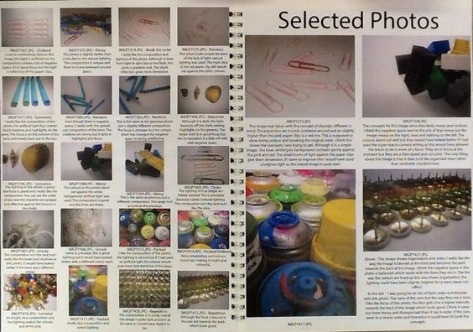
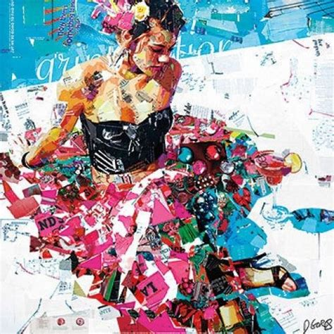
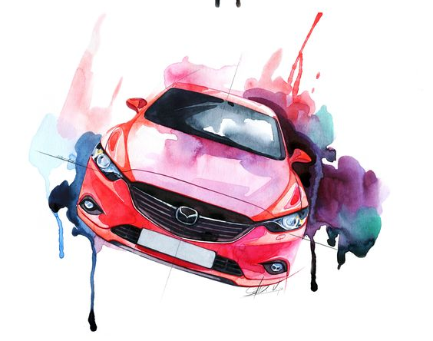
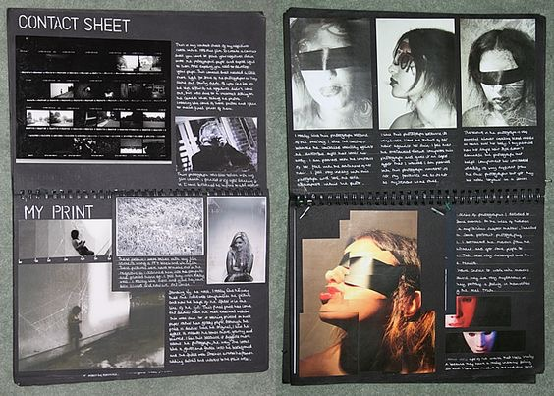
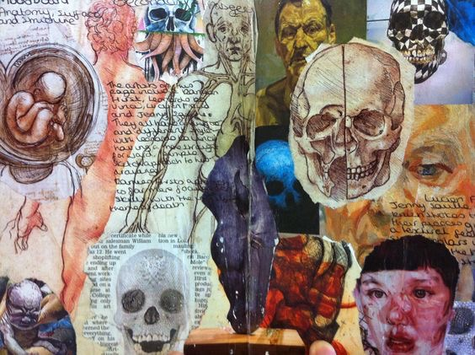
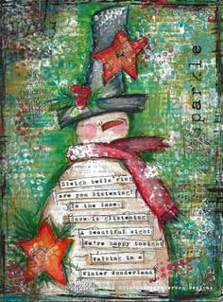
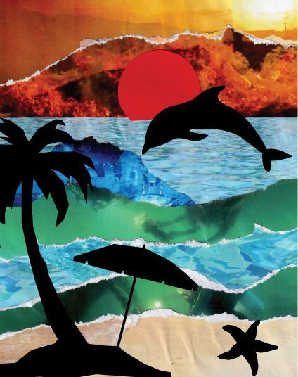
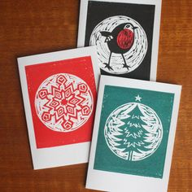
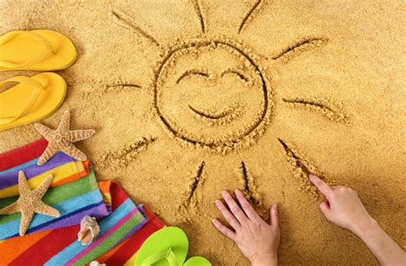
AO2 and AO3:
Record Ideas, observations and insights relevant to your intentions in visual form and Other .
Observations and Experimentation.
Gather relevant Photographs, Sketches', observational drawings using your research to develop your ideas of the subject of your interest:
Photos
Quality clear Photographs.
Composition considered.
Digital or physical edits.
2D & 3D observationals:
Graphite
Felt pens and water
Pen
Paint
Ink
Prints
Colour pencil
Mixed Media
Collage
Models
Illustrator/ Photoshop
Sand art

Slide 5
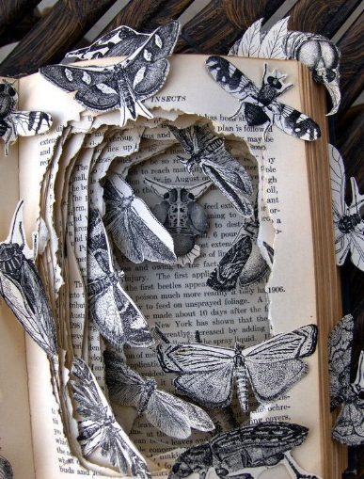

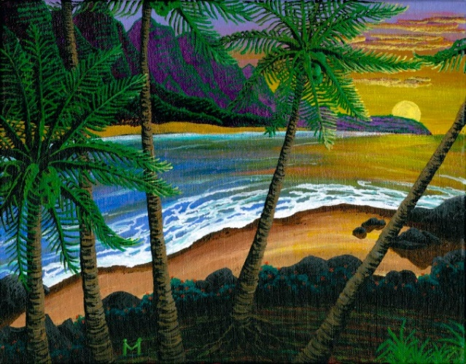
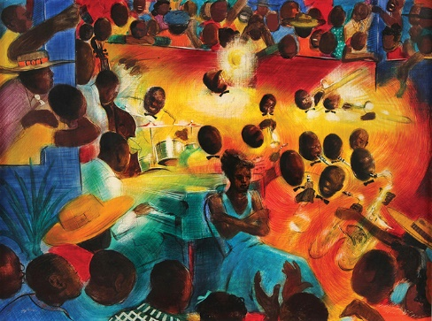

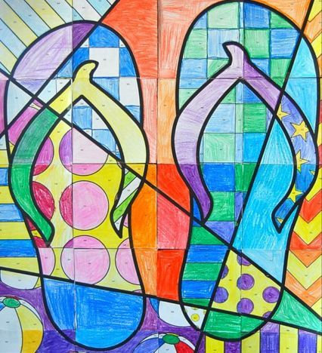
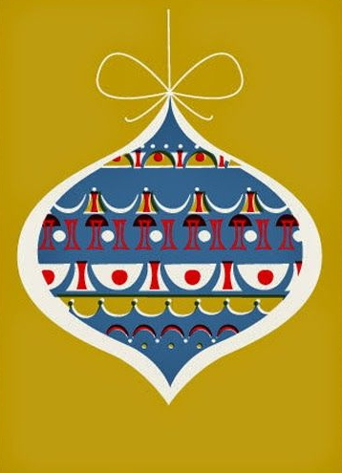
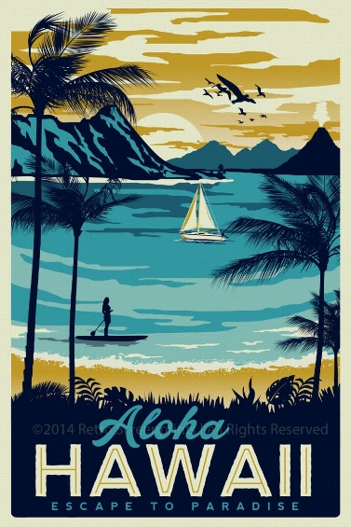

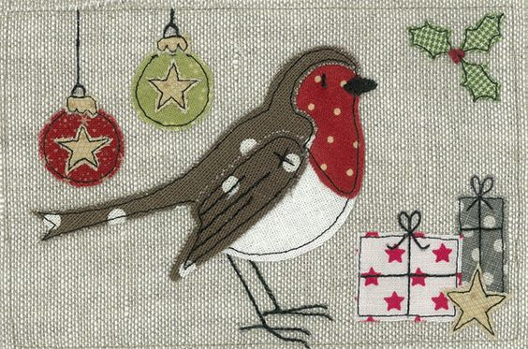
AO4: Present a personal , informed and meaningful response, realising intentions and where appropriate.
Task: Complete your personal response focusing on demonstrating skills and techniques relevant to your research:
Skillfully controlling tools and materials
Refinement from your mock piece
Quality of marks
Fine details
Perspective
  Deadline: 3rd September

