Slide 1
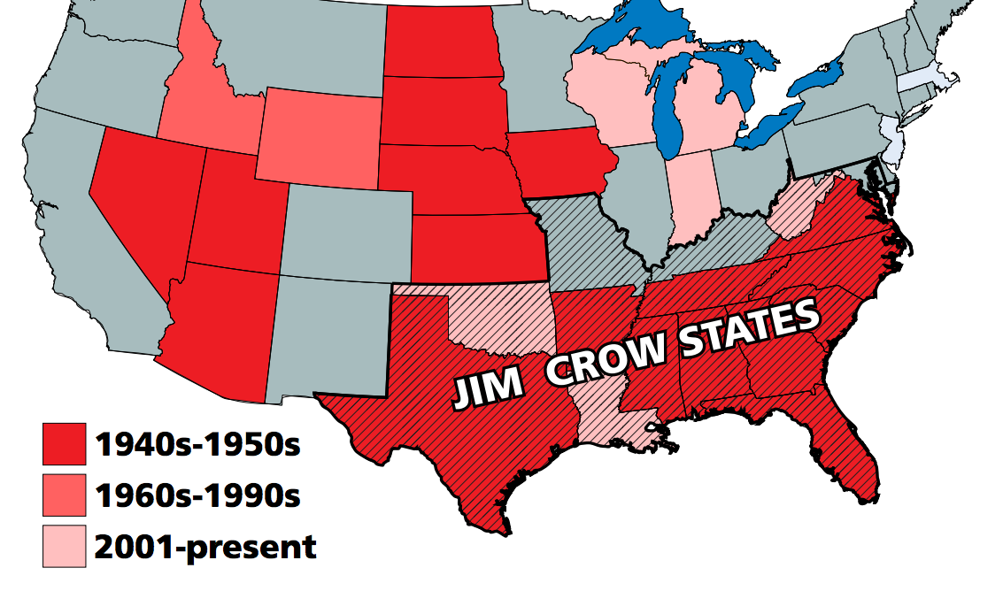
Knowledge Organiser - Topic 1.1: Black Americans in the early 1950s
Key Events
1 | 1896 – Plessy vs Ferguson This upheld the Jim Crow laws by deciding that segregation was acceptable under ‘separate but equal’ conditions
2 | 1909 – NAACP founded This stood for the National Association for the Advancement of Coloured People.
3 | 1941 – 45 Second World War Over 1 million black Americans had fought in the war and had hoped for more equality when the war ended.
4 | 1942 – CORE is founded This stood for the Congress of Racial Equality
5 | 1955 - Emmett Till murdered 14 year old boy visiting his cousins in Mississippi is murdered. At the trial the accused walk free.
6 | 1956 – 20% of black Americans in the South were registered to vote. Many had been prevented from voting in the South.
12 | NAACP | Focused on fighting for civil rights through the courts.
13 | CORE | Had a smaller membership than NAACP and was based mainly in the North. They chose to use non violent direct action.
14 | Boycotts | Refusal to use a service if you believed it was doing something wrong
15 | Pickett | Demonstrating outside a place you believe is doing something wrong
16 | Sit in | Sitting down somewhere and refusing to move. E.g at a ‘white only’ lunch counter
17 | Dixiecrats | Opponents of any attempts to increase rights of black Americans. Presidents needed their support so had to take their views into account.
Key Words
7 | Segregation | Separating groups of people usually by race or religion
8 | Discrimination | Treating people unfairly because of their race or religion
9 | Jim Crow laws | These enforced segregation, separating black and white people. They did vary from state to state.
10 | Ghettos | The poorest parts of towns and cities where people are crowded together with poor facilities.
11 | Ku Klux Klan | A group who persecuted anyone that was not white. Many members were in the police or court system.

Slide 2
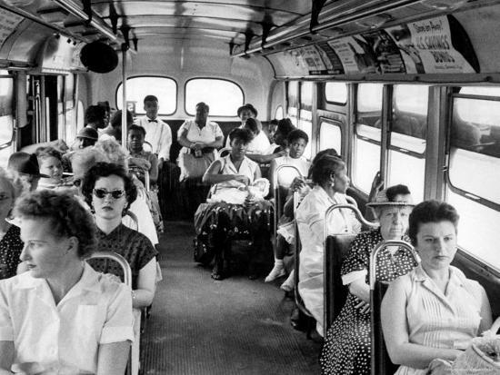
Knowledge Organiser Checklist- Topic 1.1: Black Americans in the early 1950s
1. Answer the questions in the space below
Give 2 examples of Jim Crow laws found in the South
Name 2 Jim Crow states
Name 2 groups that campaigned for civil rights
Name 2 ways that the civil rights movement faced opposition in the South
3. Give 2 things you can infer from the source about segregation in 1956. Give detail in the source that tells you this (4 marks) The photograph shows black and white Americans on a segregated bus in Florida in April 1956. The black Americans are sat at the back of the bus.
___________________________________________________________ ___________________________________________________________ ____________________________________________________________________________________________________________________________________________________________________________________________________________________________________________________________________________________________________________________________________________________________________________________________________________________________________________________________________________________________________________________________________________________________________________________________________________________________________________________________________________________________________________________________________
2. Key Terms: Learn these spellings and use them correctly in a sentence in the space provided.
Boycott | Segregation | Dixiecrats
Ghettos | Federal | Ku Klux Klan

Slide 3
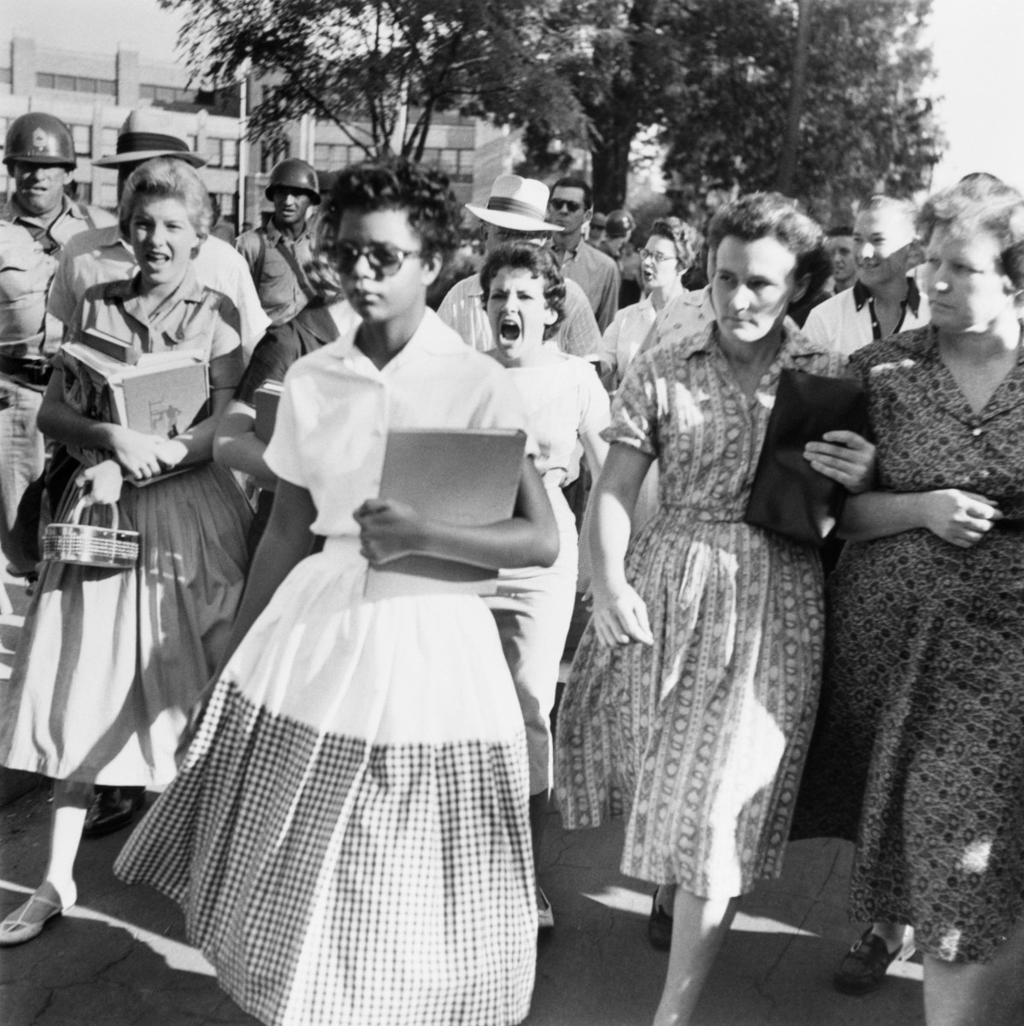
Knowledge Organiser - Topic 1.2: Progress in Education
Key Events
Source A: A photograph of Elizabeth Eckford trying to get to school
on 4 September 1957
1 | 1951 – The Browns and 12 other parents went to court to fight for their children to go to their nearest school. They lost as a result of the Plessy ruling.
2 | May 1954 – Judges ruled that life had changed since the Plessy ruling. It was declared that ‘separate but equal’ for education was unconstitutional.
4 | May 1955– Brown vs Topeka ruled that desegregation should be carried out with ‘deliberate speed’
5 | September 1957 – Tv pictures show black students at Little Rock High School being verbally abused and threatened. National troops had to be sent in. Faubus closed every Little Rock School for the following year.
5 | 1960 – Schools in 5 states in the Deep South were still entirely segregated
Key Words
8 | Black Monday | Term used to describe the day of the Brown decision in the South. Threats of violence were made.
9 | White Citizens’ Council | These were set up in Mississippi following the Brown decision. They aimed to preserve segregation and used extreme violence.
10 | Orval Faubus | Governor of Arkansas during the incident at Central High School.
11 | Eisenhower | President at the time of the Little Rock 9 incidents who was forced to send in Federal troops.

Slide 4

Knowledge Organiser Knowledge Check - Topic 1.2: Progress in Education
1. The events, dates and consequences have all been muddled. Colour code them so that the date, event and consequence are matched.
Event | Date | Consequence
Desegregation has not happened in all Southern states – 5 states’ schools remain untouched. | May 1955 | Civil Rights leaders become more aware of the media to help their cause.
Brown Vs Topeka decides that schools should begin desegregating | Sept 1957 | Civil Rights leaders continue to work on ways to challenge the Southern states.
Little Rock 9 are seen on tv screens across the USA. | 1960 | Violence erupts in the Southern states and White Citizens’ Councils are set up
3. How useful is Source A for an enquiry into attitudes to integration in the Deep South? Explain your answer
______________________________________________________________________________________________________________________________________________________________________________________________________________________________________________________________________________________________________________________________________________________________________________________________________________________________________________________________________________________________________________________________________________________________________________________________________________________________________________________________________________________________________________________________________________________________________________________________________________________________________________________________________________________________________ __________________________________________________________ __________________________________________________________________________________________________________________________________________________________________________________________________________________________________________________________________________________________________________________________________________________________________________________________________________________________________________________________________________________________________________________________________________
2. Answer the questions in the space below
Which 2 states were involved in Brown and Little Rock 9?
Why was the Brown decision so significant?
Why was the Little Rock crisis so significant?

Slide 5
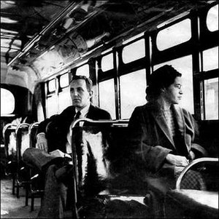
Knowledge Organiser - Topic 1.3: Montgomery Bus Boycott
Key Events
Key Words
1 | 1946 - Women’s Political Council (WPC) is set up in Montgomery to fight discrimination.
2 | 1950 – Jo Ann Robinson becomes president of the WPC. They led calls for changes to the seat rule and requesting that black men could be employed as drivers.
2 | 1st Dec 1955- Rosa Parks is arrested after refusing to move seats on a bus in Montgomery, Alabama.
3 | 5th Dec 1955 – The WPC called for a one day boycott of the buses with 90% if black people who used them boycotting them. The Montgomery Improvement Association is set up on the same evening.
4 | 12th Dec 1955 – The first car pools begin to enable people to travel without the buses. They eventually have over 300 cars.
5 | 30th Jan 1956 – King’s home is bombed as well as other homes and churches. This only increased sympathy towards the boycotters.
6 | 1st Feb 1956 – NAACP filed Browder vs Gayle against bus segregation.
7 | 20th Dec 1956 – Supreme Court upholds decision and the MIA stops the boycott. Integrated services began the following day. The boycott had lasted 381 days.
8 | 9th Sept 1957 – Civil Rights Act allowed federal courts to prosecute states that prevented all people voting. (Although any trials would be held with an all white jury) It did show a step forward.
9 | Martin Luther King | Chosen as leader of the MIA. He was new to the area, was a clergyman, well educated and wanted to use non violent direct action to fight for civil rights.
10 | SCLC | Southern Christian Leadership Council was set up to coordinate church based protest. The group was led by Martin Luther King and Ralph Abernathy.

Slide 6
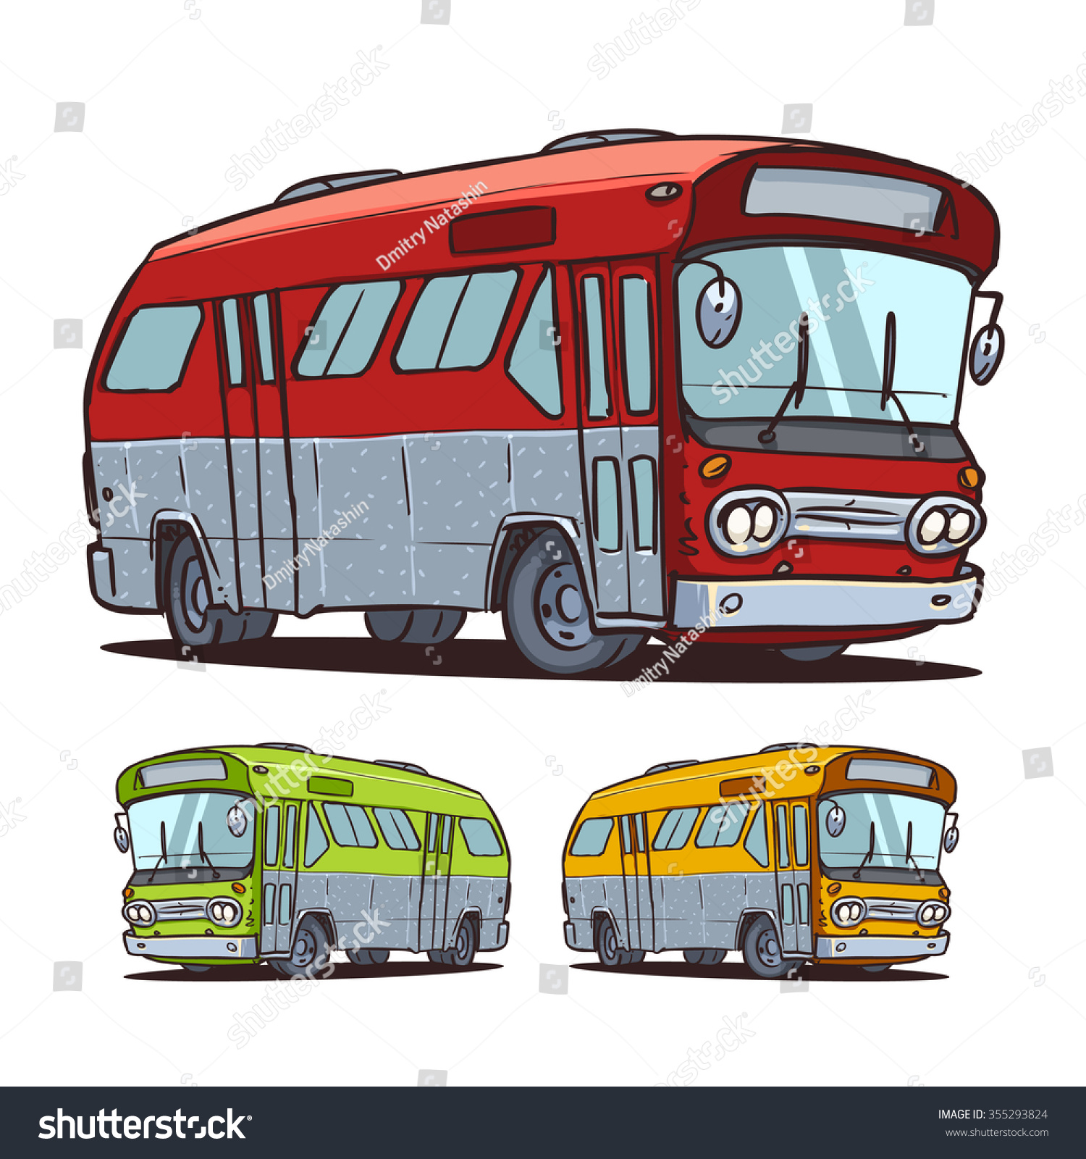
Knowledge Organiser Knowledge Check - Topic 1.3: Montgomery Bus Boycott
1. What happened on each date? Write in the space provided.
5th Dec 1955
12th Dec 1955
9th Sept 1957
4. Recall quiz
What were Jim Crow laws and give an example of one law and one state that they were applied?
What was the ruling in Brown Vs Topeka?
Who was Emmett Till and why was he significant?
What were White Citizens’ Councils?
Who was Jo Ann Robinson?
Who were the Dixiecrats?
2. Describe and explain 3 reasons why Rosa Parks became the figurehead of the bus boycott

Slide 7
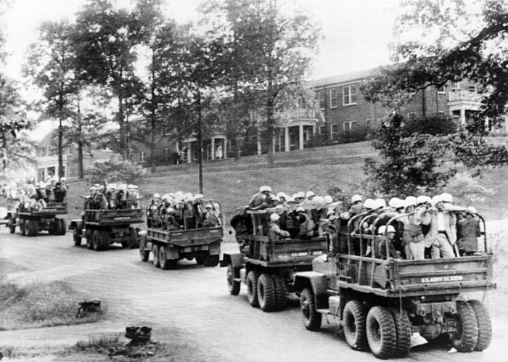
Knowledge Organiser - Topic 2.1: Protest, progress and radicalism 1960 - 75
Key Events
1 | 1 Feb 1960 – Beginning of Greensboro sit in at Woolworth’s lunch counter. Hundreds of young black and white people eventually took part
2 | 15 April 1960 – SNCC is set up with the aim of using non violent protest to campaign for civil rights. Student Non-Violent Coordinating Committee. It built on the principles of CORE and Martin Luther King. This included demonstrating peacefully and not reacting to violence.
3 | 4 May 1961 – ‘Freedom Riders’ left Washington to test if desegregation was happening. In total there were over 60 Freedom Rides
4 | 15 May 1961 – One of the buses reaches Anniston, Alabama and is surrounded by KKK members. Passengers were injured and the bus blew up.
5 | 1 Nov 1960 – The federal government declared that federal officers would enforce desegregation if the states did not obey.
6 | 1st Oct 1962 – James Meredith registers at the University of Mississippi. He has to be guarded for the whole year to graduate.
Source A: A photograph showing federal troops driving into Mississippi in September 1962. Their arrival stopped the rioting that prevented James Meredith enrolling at the University.

Slide 8
Knowledge Organiser - Topic 2.1: Protest, progress and radicalism 1960 - 75
1. Give at least three reasons why the Greesnboro sit in was so significant. a) b) c)
3. How useful is Source A for an enquiry into opposition to desegregation? Explain your answer using the source and your own knowledge.
______________________________________________________________________________________________________________________________________________________________________________________________________________________________________________________________________________________________________________________________________________________________________________________________________________________________________________________________________________________________________________________________________________________________________________________________________________________________________________________________________________________________________________________________________________________________________________________________________________________________________________________________________________________________________ __________________________________________________________ ___________________________________________________________________________________________________________________________________________________________________________________________________________________________________________________________________________________________________________________________________________________________________________________________________________________________________________________________________________________________________________________________________________________
2 Explain how the Freedom Rides were different from Greensboro

Slide 9
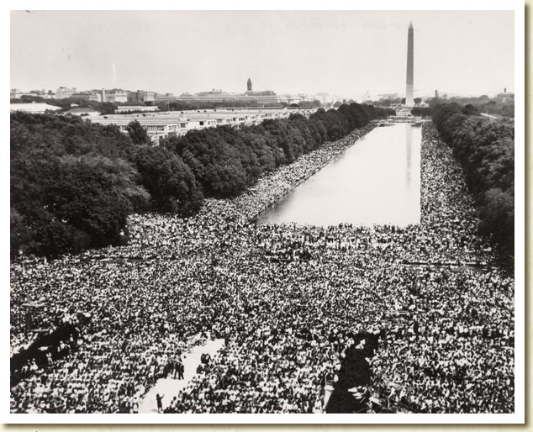
Knowledge Organiser - Topic 2.2: Peaceful Protests and their impact, 1963 - 65
Key Events
17 | Bombingham | Nickname given to Birmingham due to regular bombing of black churches, homes and businesses
18 | Campaign C | C stood for confrontation. This included sitins, mass meetings and peaceful protest marches.
19 | James Bevel | Charismatic member of SNCC that organized protests whilst most of the leaders had been imprisoned.
20 | Bull Connor | Chief of Police in Alabama
21 | John F Kennedy | President who was sickened by the photos and news reports from Alabama. He had appointed black people to high level jobs e.g Thurgood Marshall in the courts. He had also pressed for escorts for the Freedom Riders.
22 | Lyndon Johnson | As President he pressed for laws to improve lived for black Americans; intervened with executive orders and placed personal pressure on Southern politicians.
1 | 2nd April 1963 – Campaign C is begun to end segregation in Birmingham, Alabama
2 | 2nd May 1963 – 6000 students marched to replace the adults, including Martin Luther King, that had been imprisoned.
3 | 3rd May 1963 – With more people marching Bull Connor ordered increased violence on the protestors e.g dogs and fire hoses
4 | 28 August 1963 – Over 250,000 people attended the March on Washington. At the time this was the largest political gathering in US history. King delivered his ‘I have a dream’ speech.
5 | 22 Nov 1963 – Kennedy is assassinated and is replaced by Johnson. Johnson has good relations with the Dixiecrats. He argued the Civil Rights Act was an appropriate way to remember Kennedy.
6 | 1964 – Freedom Summer – SNCC and CORE members went to Mississippi to encourage voter registration. The KKK responded with violence and intimidation.
7 | June 1964 – bodies of CORE workers were found, having been shot, whilst part of the Freedom Summer.
8 | 2nd July 1964 – Civil Rights Act Made some changes in theory e.g banned job discrimination, but there was still the problem of enforcing laws in Southern states
9 | March 1965 – Protestors march from Selma to Montgomery. They were stopped on a bridge with the police firing tear gas and using cattle prods. Johnson had to send in the national guard to escort them to Montgomery.
10 | 6 August 1965 – Voting Rights Act Federal officials were to run voter registration where less than 50% of those qualified had registered to vote.

Slide 10
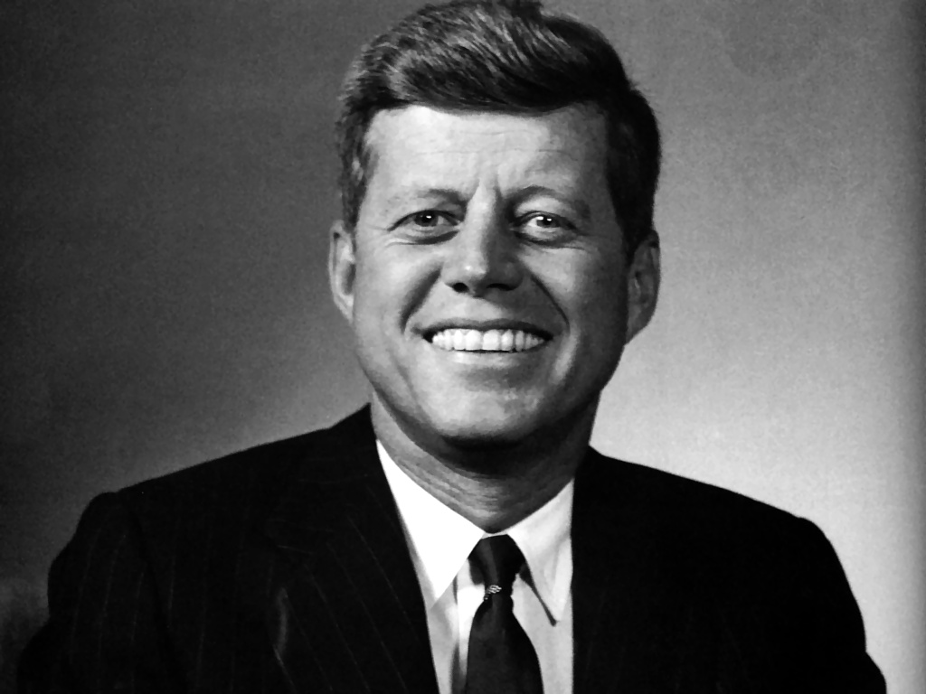
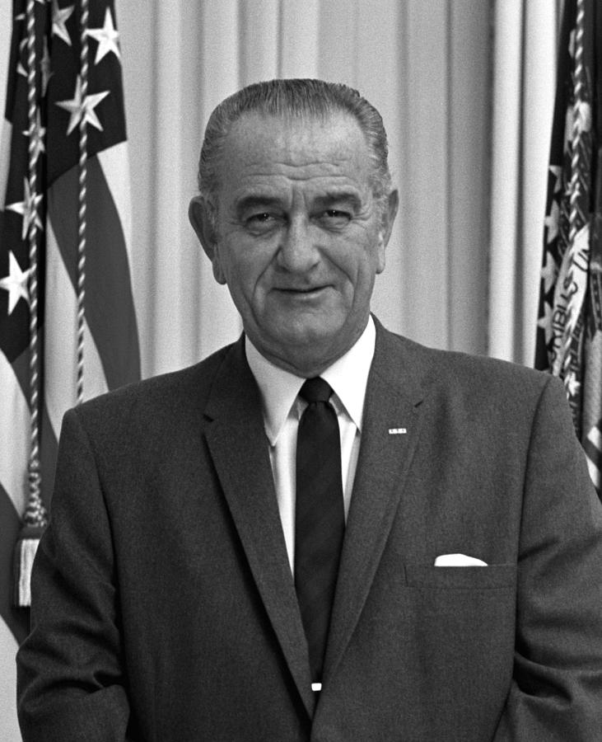
Knowledge Organiser - Topic 2.2: Peaceful Protests and their impact, 1963 - 65
1. Key People – give 2 facts about each individual in the space provided.
Bull Connor
James Bevel
3. Answer the following questions:
Why did the Freedom Summer Campaign make some white Southerners so angry? Explain what was significant about the violence in Birmingham and at Selma?
2. Label the picture explaining how each President supported Civil Rights
4. What happened on each date? Write in the space provided.
2nd April 1963
28th August 1963
2nd July 1964
6th August 1965

Slide 11
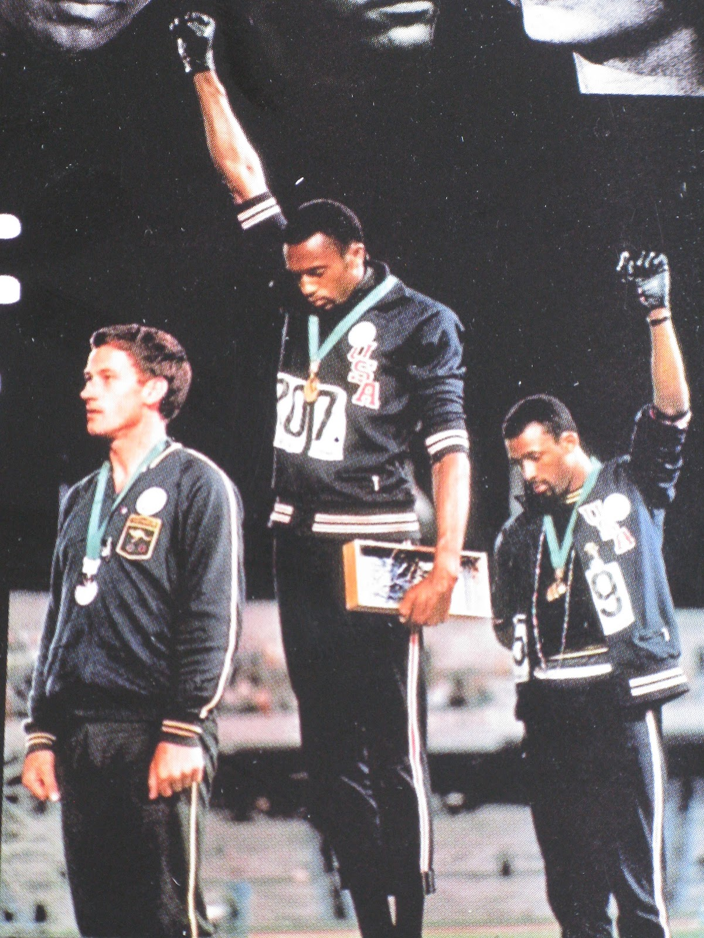
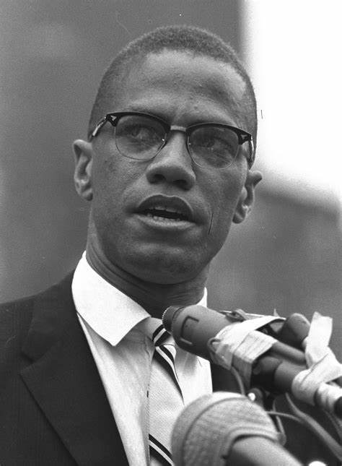
Knowledge Organiser - Topic 2.3: Malcolm X and Black Power, 1963 - 70
Key Events
Key Words
1 | 1946 – Malcolm X is imprisoned Whilst there he joins the Nation of Islam. When he was released he became an NOI minister and then its spokesman.
2 | 1964 –Malcolm X leaves the NOI and sets up his own religious organization. The NOI threaten. He became more willing to consider integration and accept white help.
3 | 21st Feb 1965– Malcolm X is assassinated by 3 members of the Nation of Islam. Over 15, 000 people attended his funeral the following day.
4 | May 1966 – Stokely Carmichael is elected chairman of SNCC. He brought more people who believed in Black Power into SNCC and so it became more radical.
5 | June 1966 – James Meredith led the March Against Fear through Mississippi protesting against violence black Americans in the South faced. Meredith was shot and Martin Luther King replaced him.
6 | October 1966 – Huey P Newton and Bobby Seale set up the Black Panthers. They believed white officials and police were not supporting black communities. They were willing to work with white people who shared their beliefs. They provided them with medical clinics, ran breakfast clubs and ran courses.
7 | 1968 – Mexico Olympics sees Tommie Smith and John Carlos protest when accepting their medals. They received a negative response.
8 | Black nationalism | The belief that black people would never be equal and integrated. Their aim was to create a separate black nation.
9 | Nation of Islam | This group said white Americans deliberately held black people back and that black people needed their own state.
10 | Militant | In favour of confrontation or violence in support of a cause.
11 | Black Power | A slogan used by black radical groups who wanted black people to be proud of their culture, argued black people should rely on themselves and argued against forced integration.
Source B From a 2001 interview with Raney Norwood from North Carolina, who joined the Panthers in 1967.
What really caught my attention was a group of Black Panthers. They weren’t really recruiting at the time. What they were trying to do was help. We decided to hang out with them and see what it’s all about.
They taught us a lot. It was not just hatred. They were teaching us what was really going on. They were showing us black kids being sent to school with no breakfast, sitting there at school with only half the books they needed.
We decided to join up. When you became a Panther you came back into the black neighbourhood. It was hard for them to accept you because they were afraid.
We might have been trouble makers, we might have been the type to kill police offivcer.

Slide 12
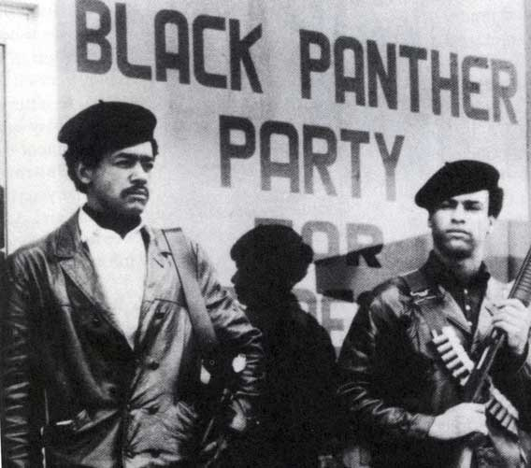
Knowledge Organiser - Topic 2.3: Malcolm X and Black Power, 1963 - 70
1. Answer the questions in the space below
What was black nationalism?
How did Stokely Carmichael change SNCC?
What was the March Against Fear?
What happened to Tommie Smith and John Carlos on their return to the USA?
3. How useful is Source B for an enquiry into the aims of the Black Panthers. Explain your answer using the source and your own knowledge.
___________________________________________________________________________________________________________________________________________________________________________________________________________________________________________________________________________________________________________________________________________________________________________________________________________________________________________________________________________________________________________________________________________________________________________________________________________________________________________________________________________________________________________________________________________________________________________________________________________________________________________________________________________________________________________________________________________________________ _______________________________________________________________________ ___________________________________________________________________________________________________________________________________________________________________________________________________________________________________________________________________________________________________________________________________________________________________________________________________________________________________________________________________________________________________________________________________________________________________________________________________________________________________________________________________________________________________________________________________________________________________________________________________________________________________________________________________________________
2. Label the two pictures describing the key views of Malcolm X and the Black Panthers, as well as their aims

Slide 13
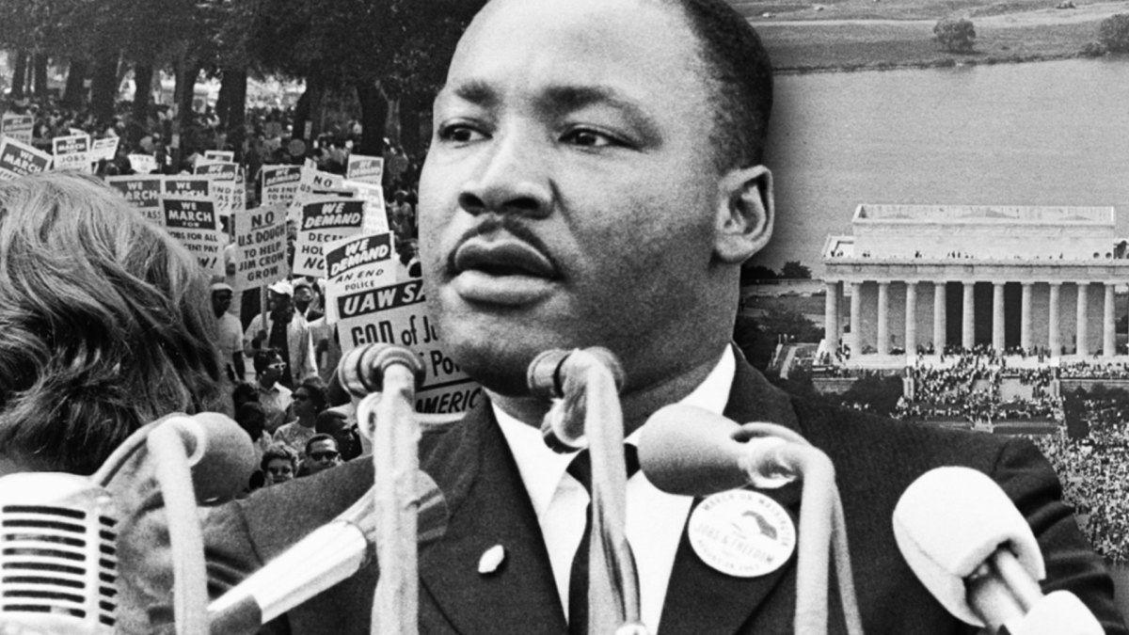
Knowledge Organiser - Topic 2.4 Civil Rights Movement, 1965 - 75
Key Events
Key Words
1 | 1965 – Riots in Watts region of LA. This was set off by police violence while arresting a young black man but was also linked to ghetto conditions.
2 | 7 Jan 1966 – SCLC announced plans for a Chicago Freedom Movement and King went to Chicago. Although meetings were called and demonstrations arranged they did not connect with the ghetto gangs.
3 | 1966 – Further riots follow in Chicago and Cleveland. They happened as a result of police discrimination, low levels of employment, poor education and poor living conditions. The riots caused more people to join the Black Power movement.
4 | 1968 - Kerner Report is published. It concluded that the riots were a result of ghetto conditions and the police needed to change the way they reacted to young black men. It was decided money should be given to improve conditions in the ghettos.
5 | 4 April 1968 – Martin Luther King is assassinated. At the time he was planning a Poor People’s Campaign on behalf of all the poor, not just poor black people. Widespread riots followed his death.
6 | 1969 – SNCC changed the N in its named from ‘non violent’ to ‘national’. The group lost almost all of its original members.
7 | 1969 – Richard Nixon becomes President. In his campaign he spoke up for civil rights but also realised he needed to keep the Southern vote. He used affirmative action.
8 | 1970 – Voting Rights Act was revised to ban state literacy tests.
12 | Operation Breadbasket | Part of the campaign in Chicago that aimed to pressurize white businesses to employ more black people. This was organized by SCLC.
13 | Poor People’s Campaign | This campaign went ahead after King’s death. This included a march on Washington but this failed.
14 | Affirmative action | The deliberate choosing of a black person for a job over a white person as a way to get more job equality.

Slide 14
Knowledge Organiser - Topic 2.4 Civil Rights Movement, 1965 - 75
1. What happened on each date? Write in the space provided.
7th Jan 1966
4th April 1968
1969 (2 events)
3. How much progress had their been in civil rights by 1975? In the space below note down the main changes there have been since the 1950s in rights for black Americans. Some categories are given for you to think about
Voting Rights Education Equality of other opportunities (jobs, wages) Overall, then, how much progress do you think has been achieved? Why?
2. Key Terms: Learn these key terms and use them correctly in a sentence in the space provided.
Operation Breadbasket | Poor People’s Campaign
Affirmative action | Kerner Report

