Slide 1
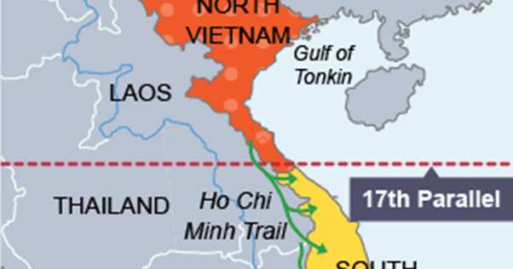
Knowledge Organiser - Topic 1:1/1:2 Involvement in Vietnam, 1954 - 64
Key Events
Key words
1 | 21 July 1954 – Geneva Accords decides that Vietnam is to be divided along the 17th parallel. This ended the fighting between the French and the Vietnamese.
2 | July 1956 – Diem refuses to hold elections in South Vietnam. President Eisenhower sent more aid even though it meant more reliance on the USA.
4 | March 1958 – the Vietcong, based in South Vietnam, continue to fight against Diem’s government. The setting up of the National Liberation Front made opposition more organised.
5 | 1961 – Kennedy becomes President and sends more advisers to South Vietnam
5 | 1962 – Strategic Hamlet Programme begins. These were large new villages with facilities such as schools that people could move to. It was aimed to stop the VC from recruiting villagers. 5,000 were built but they failed as people did not want to move and people went hungry.
6 | 11 June 1963 – Buddhist monk set light to himself in Saigon. This was to highlight the fact that Diem favoured Catholics.
7 | 1 Nov 1963 – Diem is overthrown by ARVN generals and is assassinated. Kennedy said the USA had a responsibility to help the new government, led by General Minh
8 | 22 Nov 1963 – Kennedy is assassinated and is replaced as President by Lyndon B Johnson.
9 | 1964 – Johnson has now sent 20,000 advisers to South Vietname
10 | 7 Aug 1964 - Congress passes the Gulf of Tonkin Resolution which gave Johnson the power to send troops to Vietnam. This followed an attached on the USS Maddox
1 | Communist | A political belief where the government controls all businesses and land in the country. Everyone works for the government
2 | Ho Chi Minh | Leader of North Vietnam, based in Hanoi. He wanted Vietnam to be independent.
3 | Dinh Diem | Prime Minister of South Vietnam, based in Saigon. He was supported by the USA despite being corrupt.
4 | Domino theory | The fear that if Vietnam became communist, other countries in South East Asia would follow.
5 | ARVN | The South Vietnamese army that was supported by the USA.
6 | Vietcong | Vietnamese Communists based in the South who were supported by North Vietnam and trained by them.
7 | Ho Chi Minh Trail | A series of dirt paths which ran through Laos and Cambodia from North to South Vietnam. It was used to send supplies and troops to the Vietcong.

Slide 2

Knowledge Organiser - Topic 1:1/1:2 Involvement in Vietnam, 1954 - 64
1. Explain, using the dates, how the USA became increasingly more involved in Vietnam between 1954 and 1963
1954
1956
1961
1962
1963
3. Key Terms: Learn these spellings and use them correctly in a sentence in the space provided.
ARVN | Ho Chi Minh Trail | Vietcong
4. Label the North Vietnamese flag explaining why the Vietcong were such a threat by 1964. Headings had been provided for you
2. Key People – give 2 facts about each person
Ho Chi Minh
Ngo Dinh Diem
President Kennedy
Foreign support
S Vietnamese government
Vietcong Ideals
Local support

Slide 3
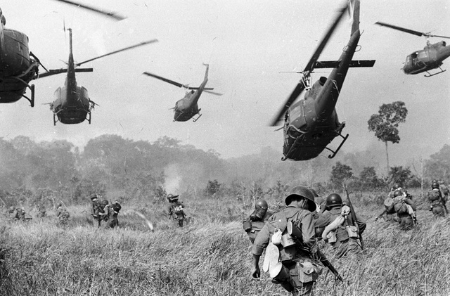
Knowledge Organiser - Topic 1.3: The nature of the conflict, 1964 - 68
Key Words
Key Dates
1 | Guerilla tactics | Tactics that avoid big battles. Instead attacks involving blowing up the enemy, ambushing them and striking them with sudden ‘hit and run’ tactics. The VC could easily blend in with the normal population.
2 | Tunnel network | The VC built almost 100 miles of tunnels on several levels connecting he villages around Saigon. This helped them move around unnoticed.
3 | Tunnel rats | US troops who were small enough and went down the tunnels to collapse them.
4 | Operation Rolling Thunder | Bombing campaign over North Vietnam targeting the Ho Chi Minh Trail and the little industry there was in North Vietnam.
5 | Napalm | A slow burning petrol mixture that stuck to the skin and could burnt through to the bone
6 | Agent Orange | A stronger herbicide used to kill crops
7 | Search and Destroy | Small units ordered to search the jungle for VC camps and supplies,
8 | Operation Ranch Hand | Programme that aimed to destroy the crops and jungle in South Vietnam.
9 | Embassy in Saigon | The VC temporarily took control of the Embassy. This led to greater opposition to the war in the USA from politicians and the public.
10 | Walter Cronkite | CBS news reporter that reported on the events of the Tet Offensive. These events prompted Johnson to decide not to stand for re-election as President.
Aug 1961 | First use of chemical weapons to destroy crops so that the VC could not be fed.
Feb 1965 | Johnson begins Operation Rolling Thunder. This lasted until 1968
8 March 1965 | Johnson sends ground forces to Vietnam. Previously the only troops in Vietnam were the air force. Johnson used the draft to get the greater number of troops required.
Jan 1968 | The VC launch the Tet offensive. This was different as cities were attacked. They were aiming to overthrow the South Vietnamese government. Thousands of VC died.
1970 | Over 24% of South Vietnam had been sprayed, including use of Agent Orange. The chemicals carried a poison that did not dissolve in water and stayed in the soils. Babies were born with birth defects.

Slide 4
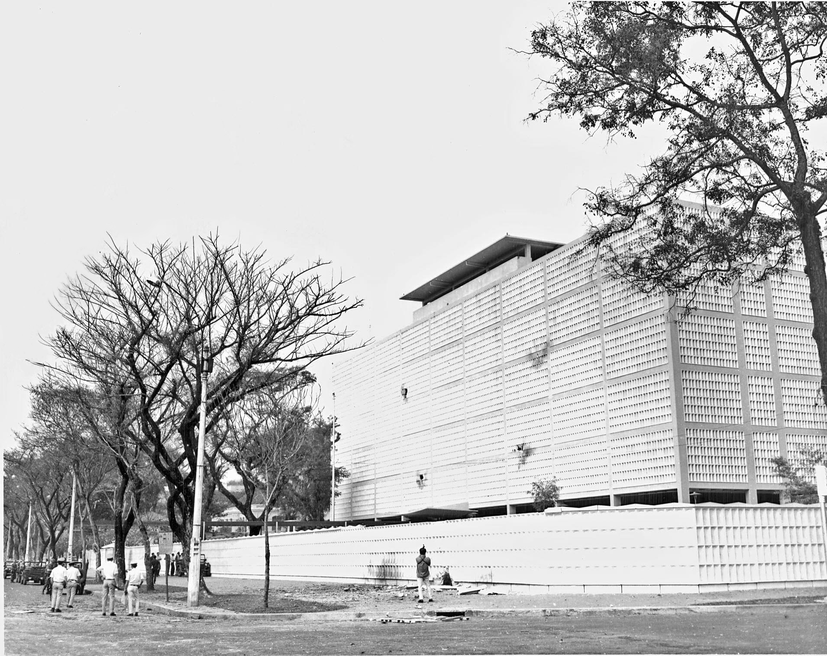
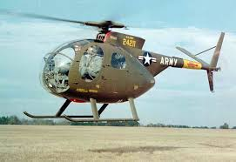
Knowledge Organiser - Topic 1.3: The nature of the conflict, 1964 - 68
1. The events, dates and further details have all been muddled. Colour code them so that the date, event and consequence are matched.
Event | Date | Further
The Tet Offensive is launched by the Vietcong. | Feb ‘65 | An attempt to prevent supplies being transported on the Ho Chi Minh Trail
Start of Operation Rolling Thunder | March ‘65 | Over 500, 000 men died within 3 years of this decision
Ground troops were sent into Vietnam. | Jan ‘68 | Although the VC lost more soldiers, the humiliation of the events led to increased opposition to the war in the USA.
2. Label the US Embassy in Saigon with reasons why the Tet Offensive came as a shock to the US public
2. Label the helicopter with reasons why the US tactics were likely to upset and alienate the South Vietnamese
4. Key – give 2 facts about each individual/group in the space provided.
Walter Cronkite
Tunnel rats

Slide 5
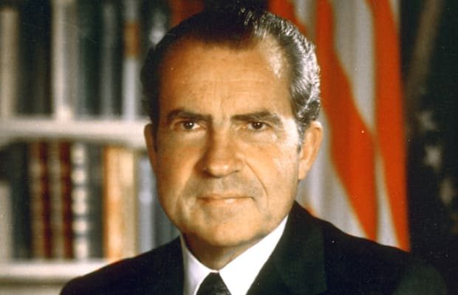
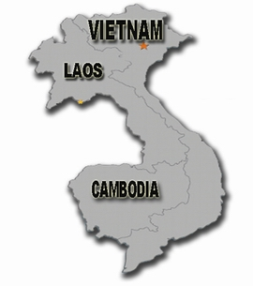
Knowledge Organiser - Topic 1.4 : Changes under Nixon, 1969 - 73
Key Events
Key Words
1 | 15 March 1969 – Nixon orders secret bombing of Ho Chi Minh Trail in Cambodia
2 | 14 July 1969 – The USA begins withdrawing troops from Vietnam
3 | 25 July 1969 – President Nixon gave a speech outlining the Nixon Doctrine. It stated that USA would support countries in South East Asia to fight communism USA would support them without sending troops
4 | March 1970 – US invasion of Cambodia. The Trail was damaged and communist bases were destroyed. However there as public outcry in the USA.
5 | Feb 1971 – The USA supports an invasion by the ARVN into Laos. This failed.
6 | 1971 – Drug use amongst US soldiers had steadily risen. Around 35,000 were heroin addicts.
7 | March 1972- North Vietnam crosses the border into South Vietnam and launches an attack. They are pushed back by the US and the ARVN.
8 | April 1972 – USA begin heavy bombing of North Vietnam. This time there were no restrictions on targets. This was called Operation Linebacker
1 | Vietnamisation | Word used for the application of the Nixon Doctrine in Vietnam. The USA had to withdraw troops but without them looking defeated and South Vietnam becoming communist.
2 | Easter Offensive | Attempt by the North Vietnamese to attack the south in March 1972. The ARVN manage to push them back with US air support.
3 | Operation Linebacker | Bombing campaign launched in April 1972. It almost wiped out all the industry in North Vietnam and led to China and USSR urging North Vietnam to reach a peace agreement.
4 | President Nixon | President replacing Johnson. He was elected largely because of his promise to get US troops out of Vietnam.

Slide 6
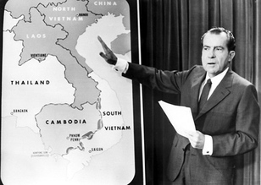
Knowledge Organiser - Topic 1.4 : Changes under Nixon, 1969 - 73
1. Label the picture of Nixon with the key features of Vietnamisation
3. Factual Recall Quiz What was the domino theory? What was a strategic hamlet? What happened as a result of the Gulf of Tonkin incident? What was Operation Rolling Thunder and how was Operation Linebacker different? Which president first sent ground troops to Vietnam? When was the Tet Offensive? Which neighbours of Vietnam were bombed in 1970 and 1971? Why?
1. Explain, using the dates, how the USA became increasingly more involved in Vietnam between 1954 and 1963/.
1954
1956
1961
1962
1963

Slide 7
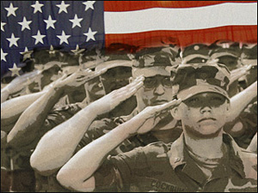
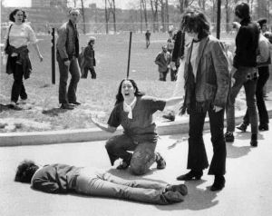
Knowledge Organiser - Topic 2.1 Opposition to the War
Key Words
Key Dates
1 | Counter culture | Refusing to live by the cultural rules of society. Students became part of this counter culture movement.
2 | The draft | This was compulsory service in the military.
3 | Exempt | This would state you could avoid the draft. Methods included being at college, being only son in a family, being physically unfit or leaving illegally to go abroad. Around 15 million avoided being drafted.
1965 | Students for a Democratic Society (SDS) had 3000 members and groups on over 80 college campuses.
Jan 1968 | Walter Cronkite broadcasts from Tet Offensive. He says that the war looked unwinnable.
Mar 1968 | My Lai massacre. 347 civilians were killed by Charlie Company under leadership of Lieutenant Calley as part of a search and destroy mission. This led to demonstrations against the war,
1969 | The draft system was changed to a lottery system, mixing up ages and making the draft fairer.
1970 | USA now had 8.5 million students. A significant number rejected their parents’ generation and wanted social change.
May 1970 | Kent State University shootings. 4 unarmed students are killed during a protest against the war. The public were horrified.

Slide 8
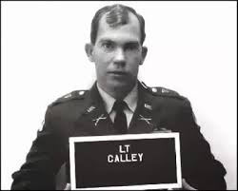
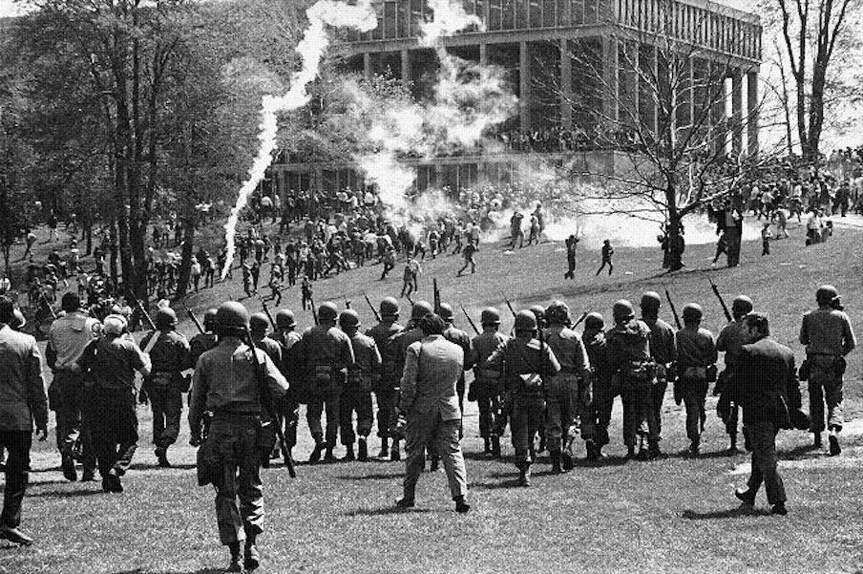
Knowledge Organiser Checklist- Topic 2.1: Opposition to the war
Why did opposition to the war increase?
Reason 1
Reason 2
Reason 3
Reason 4
Reason 5
3. Label the diagrams explaining what horrified the public about My Lai and the Kent State Shootings
2. Key Terms: Use these terms correctly in a sentence in the space provided.
Draft | Exempt | Counter Culture

Slide 9
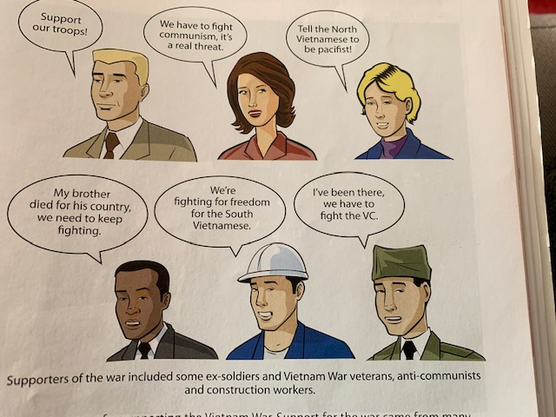
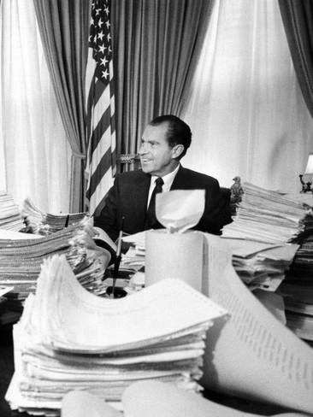
Knowledge Organiser - Topic 2.2: Support for the War
Key Dates
Key Terms
3 Nov 1969 | Nixon’s ‘silent majority’ speech on TV. He received letters of telegrams and letters of support following the speech. 77% of people stated they supported Nixon’s policy.
May 1970 | Hard Hat riot takes place in New York. Construction workers beat the protestors.
1970 | Congress begins to place restrictions on how money for the war could be spent. They still continued to fund the war.
1 | Red Scare | This was when many Americans feared US Communists would start a revolution. A reason to support the war.
2. | Patriotism | The love if and loyalty to one’s country. Fighting in Vietnam was seen as a way of showing this.
3 | Hard hats | The nickname given to construction workers who supported fighting the war in Vietnam. This came to represent working class support for the war.
4 | Silent majority | Nixon uses this term to describe the Americans who supported his policies but did not actively campaign for or against the war.
5 | Honorable peace | The term used for the USA to gradually withdrawal from Vietnam
Source B:
A photograph showing Nixon with telegrams delivered on 4 November 1969, after his ‘silent majority’ speech.

Slide 10
Knowledge Organiser Knowledge Check - Topic 2.2: Support for the War
1. List 3 reasons why Americans supported the war
Reason 1
Reason 2
Reason 3
4. Key Terms: Define these terms below
Red Scare | Hard hats
Silent majority | Honorable Peace
2. How useful is Source B for an enquiry into support for the Vietnam war?
_____________________________________________________________
_____________________________________________________________________________________________________________________________________________________________________________________________________________________________________________________________________________________________________________________________________________________________________________________________________________________________________________________________________________________________________________________________________________________________________

Slide 11
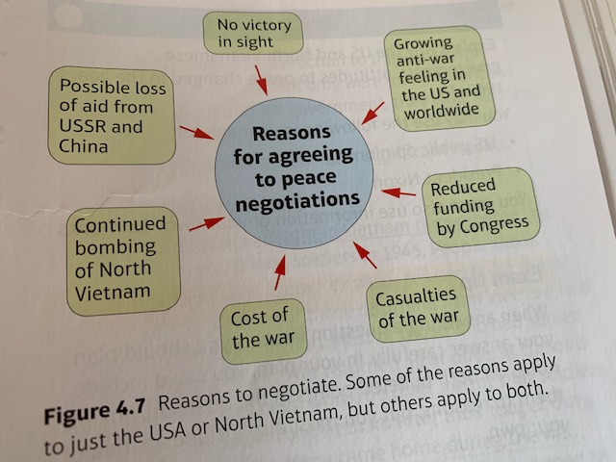
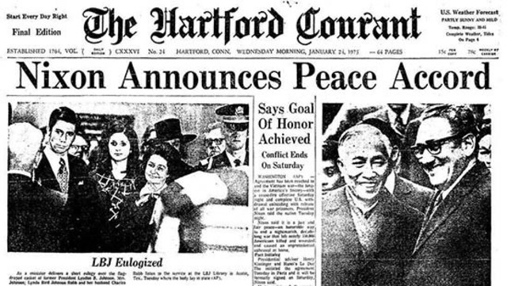
Knowledge Organiser - Topic 2.3 : The War Ends
Key Events
Key Facts
1968 | Peace talks began in Paris. USA wanted S Vietnam to be independent and non communist. N Vietnam wanted Vietnam reunified as one country. The talks go nowhere.
1972 | North Vietnamese launch their Easter Offensive and although it failed the attack had surprised the USA and showed that the war could drag on for a number of years.
8 Oct 1972 | USA and N Vietnam produce an agreement at the Paris talks, which they had agreed in secret meetings. South Vietnam refused to sign as they had not been included. The talks broke up without agreement. USA begins bombing North Vietnam
8 Jan 1973 | Talks begin again. The Paris Peace Accords gave the USA a way to leave the war.
Jan 1973 | Only 150 Marines left in South Vietnam
April 1975 | South Vietnam refuses to negotiate with the communists. Saigon falls to the North Vietnamese.
The war cost $167 billion
58,000 soldiers had died
850,000 survivors had severe psychological problems
300,00 were wounded with 75,000 being severely disabled
USA had lost a war for the first time and lost international respect

Slide 12

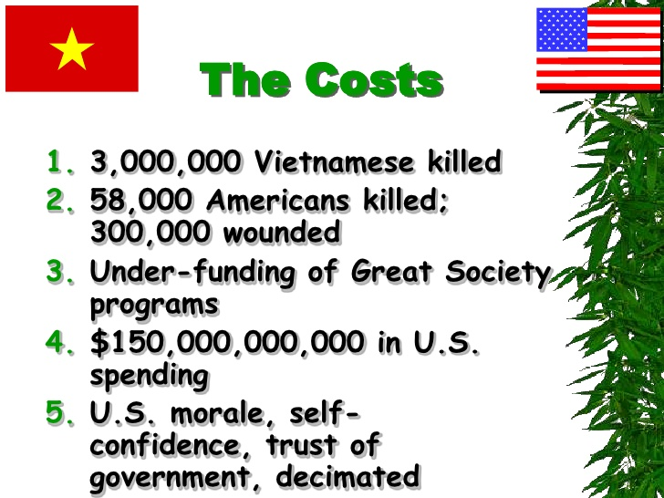
Knowledge Organiser Knowledge Check – 2.3 The War Ends
1. Label the dove explaining reasons for agreeing to peace negotiations
3. Explain how the Paris Peace Accords fell apart, using the dates to help you
1968
1972
1973
1975
2. What was the most significant cost of the war to the USA and why?

Slide 13
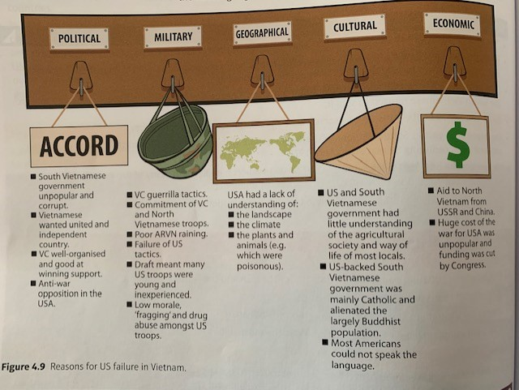
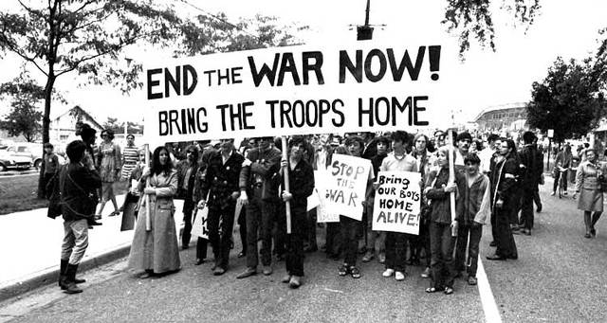
Knowledge Organiser - Topic 2.4 Why did the USA fail in Vietnam?
Strengths of North Vietnam
Weaknesess of the USA
Geographical strengths | The North Vietnamese understood the landscape, climate and language of the South.
Political and economic | Government were committed to a unified Vietnam. The VC were organised and well supplied. China and USSR sent over $3 billion in aid.
Military | They were used to fighting in jungle conditions, using guerrilla tactics.
Geographical and cultural | Some US troops were racist towards the Vietnamese. They did not speak the language, did not understand that villagers did not want to leave their land and did not understand the landscape.
Political and economic | The US backed South Vietnamese government was unpopular and corrupt. In the USA there was opposition to the cost of the war.
Military | The draft meant that troops were usually young and inexperienced. This and lack of training in guerrilla warfare meant soldiers started to avoid combat and abusing drugs.
Opposition | US public opinion worked against US involvement in the war. This was the first war in which returning soldiers openly campaigned the war.

Slide 14

Knowledge Organiser - Topic 3.4 Why did the USA fail in Vietnam?
Finish the sentences below about the failure of the US in Vietnam.
It was the dedication of the VC because …
It was the South Vietnamese government because…
It was the Ho Chi Minh Trail because…
3. Recall quiz
Who were the SDS? What was the draft? Who was Lieutenant Calley? What happened at Kent State University in 1970? Who were the ‘hard hats’? Who asked for the support of the ‘silent majority’? What did the Paris Peace Accords say should happen to Vietnam? How many troops died in Vietnam? When did the South Vietnamese government fail?
2. List three arguments to support the statement: ‘The USA failed in Vietnam because of its own weakness’

