Slide 1



Welcome Year 9 Key Stage 4 2026 to2028
RESPECT AMBITION PRIDE
Notes:
Dyslexia friendly – off white background, dark test, min font size 18, use visual images, don’t overload the slides

Slide 2

The Key Stage 4 Curriculum
Subject Grading – GCSE and Vocational
Ebacc Curriculum
Core Curriculum
How to make your choices
Key Dates

Slide 3
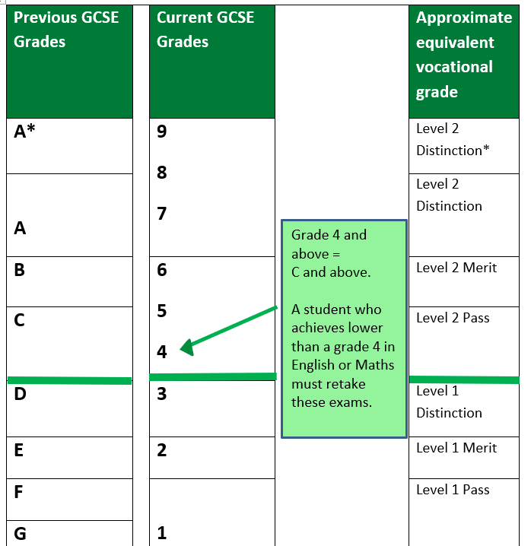
New Subject Grading

Slide 4
Research before you choose
Thinking Ahead - Research tells us that:
Most people will change jobs several times during their working lives;
Employers will need more people with qualifications at Level 3 (A-level, Level 3 vocational qualifications) or above;
Studying a broad curriculum enhances a student’s chance of progressing on to succeed in further education;
People with higher level qualifications will earn more and have better employment prospects than those with lower level qualifications or no qualifications at all;
Employers want people with good employability skills. For instance, employers know that studying a language develops invaluable and transferable skills including communication, confidence and other interpersonal skills.

Slide 5

How to make your choices?
Do your research before you decide
Course information booklet
Careers information – Unifrog, Careers Pilot
Head of Careers – Ms Tranter
Specialist staff – subject leaders
Tutor
The full information booklet is on our website under Curriculum / Key Stage 4 Courses

Slide 6
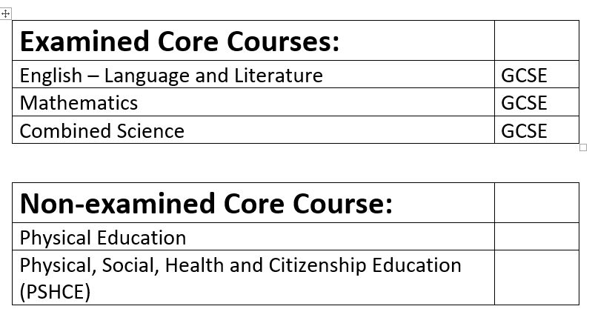
The Key Stage 4 Curriculum

Slide 7
Options – what do I get to choose?
GCSE Geography GCSE History
Choose 1 from:
Then choose 1 from:
2 more free choices
1 Reserve subject choice
9 qualifications in total
GCSE Triple Science GCSE Computer Science GCSE Spanish GCSE Drama GCSE Design Technology GCSE Art GCSE Textiles

Slide 8
Subjects!
Art and Design – Fine Art
Business Studies
Computer Science
Design and Technology
Drama (cannot be taken with Performing Arts)
Food Preparation and Nutrition
Religious Studies
Separate Sciences (increases Science from 2 to 3 GCSEs)
Spanish
Textiles (cannot be taken alongside Art)
Child Development
Creative and Digital Media
Music
Performing Arts (Dance)
Sport Studies
Subjects in bold are mainly coursework assessed

Slide 9
Options – Attendance
Some subjects are assessed by mainly coursework.
Coursework that must be completed at school in controlled conditions so that we know you have not had extra help / support
If your attendance is below 90% we will not guarantee you a place on coursework assessed subjects
You may be offered a trial period of 4 weeks in September of year 10 to prove you can sustain higher attendance
You have from now until the options deadline date 27th March to improve your attendance
I will look for the attendance figures from this half term and next half term when making decisions

Slide 10
Next Steps…
Discuss your preferred subjects with family / teachers / tutor
Do the research on any preferred career path
Subject reports go home next week
Taster Lessons day – 11th March periods 1 to 4
Parents Evening – 12th March
Subject Choices form online – released Friday 13th March
Subject Choices submission deadline – Friday 27th March
Ask for help if you need it!

