Slide 1

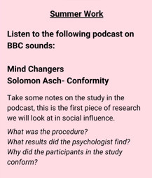


AQA A-Level Psychology
Mrs Woods nwoods@melkshamoak.co.uk Miss Gibbbs dgibbs@melkshamoak.co.uk

