Slide 1
RESPECT AMBITION PRIDE
Welcome to Melksham Oak
Proud to be part of The White Horse Federation Multi-Academy Trust | www.twhf.org.uk

Slide 2
Senior Leadership Team from September 2024
Executive Head Teacher – Mr David Cooper
Head Teacher – Mrs Abbie Clark
Deputy Head Teacher – Mrs Pavarnie Jackson
Deputy Head Teacher – Mr Scott Pollok
Assistant Head Teacher – Mrs Heidi Shore
Assistant Head Teacher – Mrs Ronnie Ebanks
Assistant Head Teacher – Mr Grant Mitchell
Assistant Head Teacher – Ms Sharon Kirwan
Year 7 Head of Year – Mrs Helen Pearce
SENCO – Miss Hannah Ornov

Slide 3
Melksham Oak – Working with the community
Partnership with parents is key
Shared High Expectations
Effective Communication
Shared Values
Contact with Tutor
Parents Evenings

Slide 4
High Standards and Expectations
Excellent behaviour and attitude
Politeness and respect
High aspirations
Uniform worn smartly with pride

Slide 5
F Face the front O 100% attention C Crossed arm U Upright S Silence
FOCUS
If you forget/get it wrong- we correct before we consequence

Slide 6
House Points and Rewards
MERITS
Effort
Classwork
Homework
Behaviour for Learning

Slide 7
Merits

Slide 8
Uniform
Jumper on
Shirt tucked in
Professional skirt length
5 sets of stripes on your tie
Correct shoes
Correct nails/jewellery/make up
Correct equipment (3 Pens, 2 Pencils, 1 ruler & calculator, timetable)
Full uniform list and PE Kit list on our website

Slide 9
Pastoral Support
First point of contact – Tutor
Head of Year - Mrs Pearce
SENCO – Miss Ornov
Meet the tutor event – Term 1
The Year 7 Team Building trip is already in the planning stages!

Slide 10
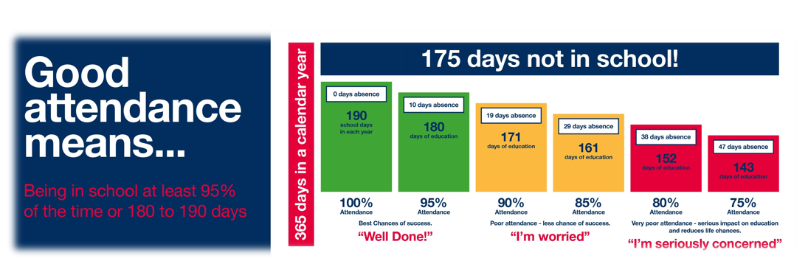
Attendance Matters
Please contact school every day that your child is absent
Via the Arbor App or
Phone: 01225 792700

Slide 12
Curriculum at Melksham Oak
Our 3 year Key Stage 3 curriculum is designed to create a strong foundation for learners in a broad range of subjects. This prepares them well for a wide range of GCSE options subjects available in Key Stage 4 (year 10) as well as the core of English, Maths and Science.
Our Heads of Faculty as subject specialists have worked hard to design a curriculum that meets the needs of Melksham Oak students whilst exposing them to a wide variety of knowledge, skills and experiences.
This includes providing school trips, extra curricular clubs and wider learning opportunities.

Slide 13
Cognitive Ability Test (CAT4)
CAT4 assessments are used to develop our understanding of the often hidden potential or challenges students face, by measuring a student’s verbal, non-verbal and spatial reasoning.
Students will take part in these during September. There is no need for students to prepare for these tests.
They will help us to get to know the students learning needs and then judge their progress as a learner.
CAT4 can often help identify students with previously undetected learning needs.
SENCO – Hannah Ornov

Slide 14
First Day in September!
Wednesday 4th Sept Year 7 and 12 only in school
Breakfast club 8 am (optional)
Gates open 8.25am
Enter through the student entrance to meet staff and go the Main Hall

Slide 15
SEND Parent Welcome
Miss Ornov - SENCO
SEND Coffee Morning – Tuesday 23rd July 9 – 10 am
Contact: OrnovH@Melkshamoak.wilts.sch.uk
To confirm attendance

Slide 16
Friends of The Oak
Friends of The Oak is looking for more volunteers!
To get involved email: query@melkshamoak.wilts.sch.uk

