Slide 1



RESPECT AMBITION PRIDE
Year 11 – Supporting Success 2026
Proud to be part of The White Horse Federation Multi-Academy Trust | www.twhf.org.uk

Slide 2

Give some clear strategies for supporting your child with effective revision
Give advice about health and well-being of young people during what can be a stressful period
Give some specific advice about preparation for core subjects
Purpose of the evening

Slide 3

Year 11 Overview
11 School Weeks
Formal GCSE Written exams start on 11th May
Final GCSE exam on 17th June (provisional)
Exam contingency day 24th June

Slide 4
Year 11 Overview
Students to attend lessons as normal during exam period
Teaching will have a really tight focus on exam practice
Revision sessions will be put on in school for all exams
AM exams will have 8am breakfast / revision sessions
PM exams will have revision sessions earlier in the day
Results day Thursday 20th August
Students must collect results in person

Slide 5



Year 11 – Supporting our Students
Period 6 Revision and support sessions
Science, English and Maths tutor time revision
Targeted interventions in Maths and English
Revision techniques and advice – lessons / tutor
Walking Talking Mocks
Lessons focused on exam structure and techniques, how to maximise marks
Online platforms for homework and exam practice

Slide 6
Parents – How can you help?
Most students are taking exams in at least 8 subjects
Most subjects will have at least 10 topics that need to be learned
Each topic could take at least 2 hours to learn fully…

Slide 7
Parents – How can you help?
3 parts revision to 1 part break
For most students this will be:
30 minutes revision
+
10 minutes break
…which means that before the real GCSE
exams, most students will need to find time for
around 200 hours of revision

Slide 8
Getting Through the Exam Season – How do we work together to support the students?
Supporting Attendance – School and extra revision sessions
Equipment
Build a revision timetable – and stick to it!
Exam timetable – reminders
Clear expectations
Learning checklists / specifications

Slide 9
Expectations of Revision
Encourage revision every day now
Remind what good revision looks like
Remind students to attend after school sessions
Reward students for keeping at it
Plan revision using the revision timetable to ensure enough time for practice
Don’t start with testing – review material learned in a topic first

Slide 10
What do students say?!
It’s too late to start
I’ve never revised before and I’ve done fine
I don’t remember it anyway
I can only revise with music on
It’s only mocks, they don’t matter
I’ve already revised that topic

Slide 11
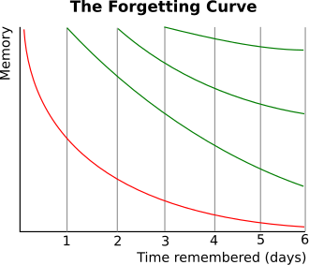
The Forgetting Curve
Spaced retrieval practice and active recall
Information is easier to recall when it's built upon things you already know

Slide 12
Supporting Student Progress
We believe firmly that the right place for students to prepare for exams is under the care and guidance of their teachers.
We can only guarantee support from subject specialists and monitoring of welfare by pastoral teams if students spend time with us during the exam season.
In recent years we have seen large improvements in performance in exams which occur late in the season. This has happened as a direct result of the additional support students have received.

Slide 13
Maintaining balance
All aspects of preparation are important for success:
Physical Health
Switching off
Observing yourself
Responding to your needs

Slide 14
RESPECT AMBITION PRIDE
Mrs Robinson
Head of English
GCSE English Language
GCSE English Literature
Proud to be part of The White Horse Federation Multi-Academy Trust | www.twhf.org.uk

Slide 15

GCSE English Language
Paper 1: Explorations in Creative Reading and Writing
What's assessed Section A: Reading one literature fiction text Section B: Writing descriptive or narrative writing
Assessed written exam: 1 hour 45 minutes 80 marks 50% of GCSE
Questions Reading (40 marks) (25%) – one single text 1 short form question (1 x 4 marks) 2 longer form questions (2 x 8 marks) 1 extended question (1 x 20 marks) Writing (40 marks) (25%) 1 extended writing question (24 marks for content, 16 marks for technical accuracy)
Paper 2: Writers' Viewpoints and Perspectives
What's assessed Section A: Reading one non-fiction text and one literary non-fiction text Section B: Writing writing to present a viewpoint
Assessed written exam: 1 hour 45 minutes 80 marks 50% of GCSE
Questions Reading (40 marks) (25%) – two linked texts 1 short form question (1 x 4 marks) 2 longer form questions (1 x 8, 1 x 12 marks) 1 extended question (1 x 16 marks) Writing (40 marks) (25%) 1 extended writing question (24 marks for content, 16 marks for technical accuracy)
Non-examination Assessment: Spoken Language
Assessed teacher set throughout course marked by teacher separate endorsement

Slide 16




GCSE English Literature
Paper 1: Shakespeare and the 19th-century novel
What's assessed Shakespeare plays The 19th-century novel
How it's assessed written exam: 1 hour 45 minutes 64 marks 40% of GCSE
Questions Section A Shakespeare (Macbeth): students will answer one question on their play of choice. They will be required to write in detail about an extract from the play and then to write about the play as a whole. Section B The 19th-century novel (A Christmas Carol): students will answer one question on their novel of choice. They will be required to write in detail about an extract from the novel and then to write about the novel as a whole.
Paper 2: Modern texts and poetry
What's assessed Modern prose or drama text The poetry anthology Unseen poetry
How it's assessed written exam: 2 hour 15 minutes 96 marks 60% of GCSE
Questions Section A Modern texts (An Inspector Calls): students will answer one essay question from a choice of two on their studied modern prose or drama text. Section B Poetry (Power and Conflict): students will answer one comparative question on one named poem printed on the paper and one other poem from their chosen anthology cluster. Section C Unseen poetry: Students will answer one question on one unseen poem and one question comparing this poem with a second unseen poem.

Slide 17

The most successful English students will…
Engage well in lessons, and demonstrate this through class contributions, asking questions and completing high quality work
Be motivated and focused
Re-read all Literature texts
Ask for help in order to improve
Be inquisitive and challenge ideas
Be organised
Complete home-learning to a
high standard and submit on time
Listen to feedback and respond
Most importantly, focus on your own personal goals and aspirations, and remember that everyone is striving for something different. A successful English student isn’t one that achieves a grade 9, but one that works hard and achieves a grade that they will be proud of!

Slide 18


GCSE English myth busters:
TikTok and social media English ‘Influencers’ are knowledgeable and qualified
Be careful with following and listening to advice given by people on social media regarding English exams. We do not know their credentials. Are they English teachers? Are they qualified to give advice? Your teachers are qualified, highly skilled and experts in these papers (some of them are actually examiners!)
The exam boards have flagged this as a major concern for underperformers.
Social media promotes the use of critical theory (e.g. Freud) but you will gain no additional marks for using these and will waste your time writing about them when you could be exploring more important ideas.
These influencers make predictions about
exam questions – last year not a single
predication was correct.
Your teachers know you well!
Trust teachers, not social media.

Slide 19

GCSE English myth busters:
You only need to pass English Language
The Department of Education has made it a requirement for all students to pass at least one of their English GCSEs. It does not have to be Language.
While some courses only require a 4 in one English GCSE, you need to consider life beyond college and 6th form. Having two English GCSE grades that you can be proud of will help your future pathways.
Language is not necessarily the easier of the two GCSEs. While Language doesn’t rely on memory, you are expected to read, understand and analyse 3 whole texts that you have never seen before. With Literature, you will know the texts inside out and will be able to engage with the questions in a critical way.
Many students achieve higher in Literature than Language, so treat both GCSEs equally to achieve your best possible results.
Neglecting your revision of Literature may result in two dramatically different grades – to a future employer, a grade 5 in language but a grade 2 in Literature may raise some questions.

Slide 20

GCSE English myth busters:
You can pre-learn responses to all English questions
You cannot learn exact responses and gain top marks. You have to be able to adapt your ideas to the questions you are faced with. Forcing a pre-planned response will hinder your marks.
Use the past paper questions to practice using the ideas we discuss in class. Build confidence in your ability to answer any English question and you won’t need to rely on pre-planned responses.
This is another suggestion promoted by social media influencers which is damaging student outcomes

Slide 21
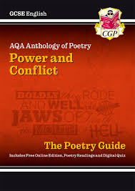
GCSE English myth busters:
Questions will never be repeated in exams
There is no pattern to Literature questions, so be prepared for themes, characters and poems to be repeated.
Do not waste time working out which poems you don’t think will come up, because there is no reason why a poem couldn’t be used two years in a row.
While some poems are much more challenging than others (Tissue, My Last Duchess…), they are still equally as likely to come up. Don’t avoid the challenging ones!

Slide 22
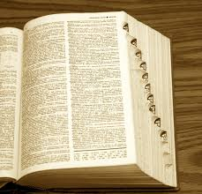
GCSE English myth busters:
Overly ambitious and complex vocabulary will guarantee a high grade
Using ambitious vocabulary may have a negative impact on your results if they aren’t used correctly. This is particularly true of Literature because it may mean that your responses lack clarity (unclear ideas).
Focus on making sure your responses are written very clearly and precisely.
Knowing and understanding the texts is far more important than knowing fancy terminology and vocabulary.

Slide 23
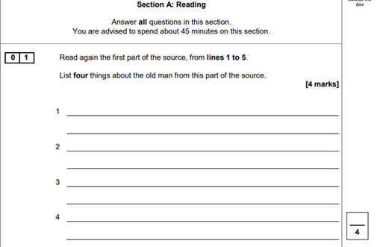
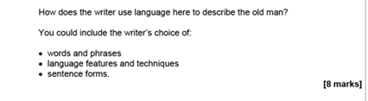

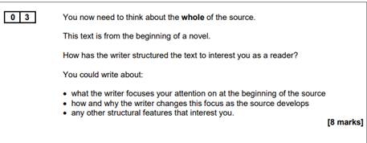
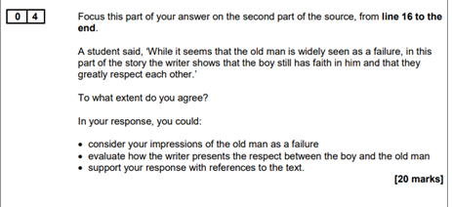
GCSE English Language
How do I revise for English?
Home-learning booklets
Exam questions
Revise writing frames
Tassomai
Yellow Knowledge Organiser
AQA website:
www.aqa.org.uk
Questions are always structured in the same way!

Slide 24
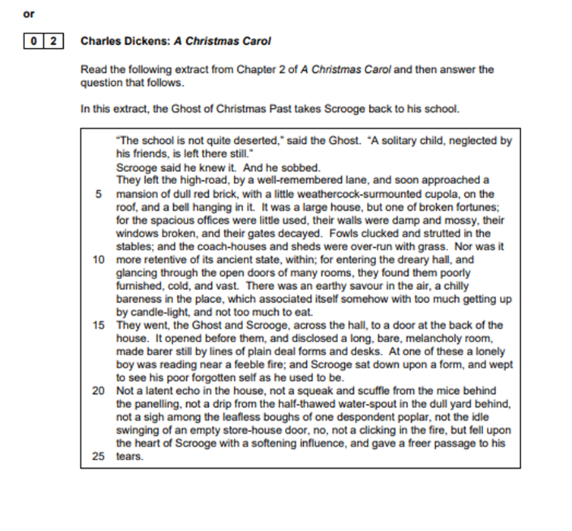
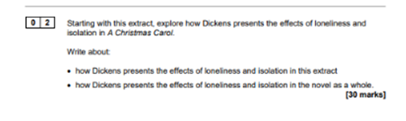
GCSE English Literature
English Literature Paper 1: Shakespeare and the 19th-century novel
Answer one question from Section A (Macbeth) and one question from Section B (A Christmas Carol)
The questions will be structured in the same way and pupils will always be given an extract.
We always follow the same steps:
1. Highlight/underline the key words in the question
2. Read the extract and highlight references (quotes)
3. Plan ideas for the rest of the novel/play

Slide 25
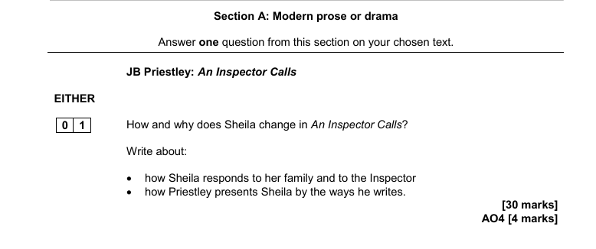
GCSE English Literature
English Literature Paper 2:
Modern texts and poetry
One question from Section A, one question from Section B and two questions from Section C
We always follow the same steps:
1. Highlight/underline the key words in the question
2. Read the poems and highlight references (quotes) linked to the question
3. Plan ideas

Slide 26





How much reading do you do?
Grade boundaries can vary each year

Slide 27
Grade Boundaries 2025
 | 1 | 2 | 3 | 4 | 5 | 6 | 7 | 8 | 9
English Language /160 | 16 | 35 | 54 | 73 | 82 | 91 | 100 | 109 | 119
English Literature /160 | 15 | 30 | 46 | 62 | 77 | 92 | 108 | 122 | 136
Grade boundaries can vary each year

Slide 28
Grade Boundaries 2025
English Language | 1 | 2 | 3 | 4 | 5 | 6 | 7 | 8 | 9
Paper 1 /80 | 8 | 17 | 26 | 36 | 40 | 44 | 49 | 54 | 59
Paper 2 /80 | 8 | 17 | 27 | 37 | 41 | 46 | 51 | 55 | 60
Grade boundaries can vary each year

Slide 29
Grade Boundaries 2025
English Literature | 1 | 2 | 3 | 4 | 5 | 6 | 7 | 8 | 9
Paper 1 /64 | 6 | 13 | 20 | 28 | 33 | 38 | 44 | 49 | 55
Paper 2 /96 | 9 | 17 | 25 | 34 | 44 | 54 | 64 | 72 | 81
Grade boundaries can vary each year

Slide 30

GCSE Mathematics
All exams are 90 minutes long
Foundation
Paper 1 | Paper 2 | Paper 3
Calculator | Non-Calculator | Calculator
Thurs 14th May | Weds 3rd June | Weds 10th June
Higher
Paper 4 | Paper 5 | Paper 6
Calculator | Non-Calculator | Calculator
Thurs 14th May | Weds 3rd June | Weds 10th June
All students will need normal equipment plus a scientific calculator, compass and protractor

Slide 31
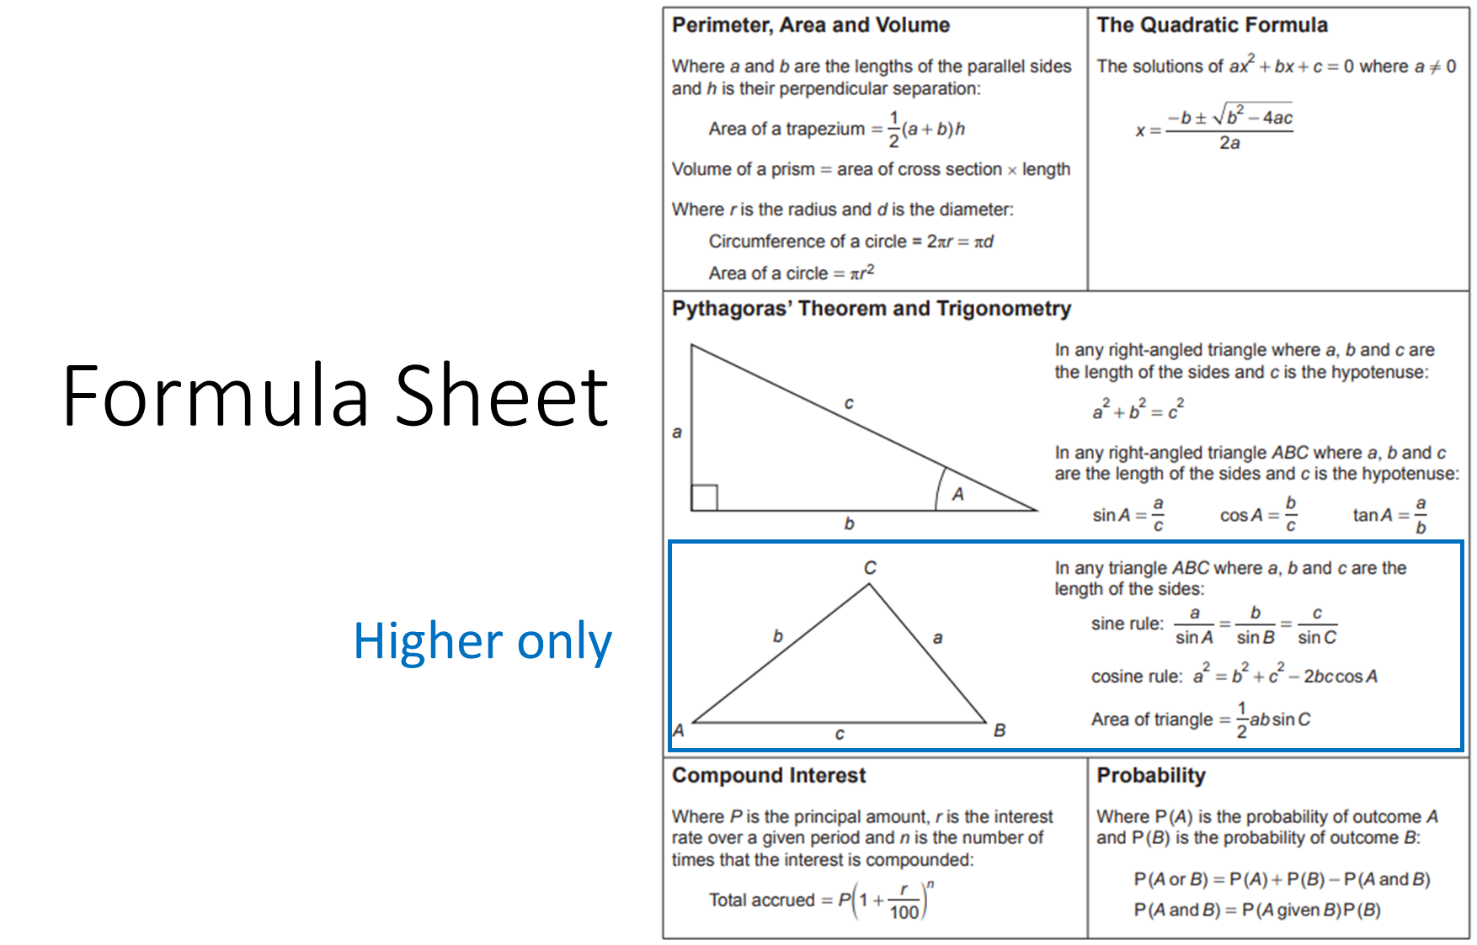

Slide 32
2025 Grade Boundaries
Foundation
Higher
Grade | Overall %
4 | 44
5 | 60
Grade | Overall %
4 | 16
5 | 29
6 | 42
7 | 55

Slide 33
KS4 Class Structure
Foundation Exam Classes Four mixed ability classes Aiming to achieve grades 3-5 Following mocks, streamline into grade 4 & grade 5 classes
Higher Exam Classes Learning mainly higher content since Year 10 Two top sets aiming for grades 5 to 9 Two intermediate sets Higher students achieving less than a 4 in the February Mocks may need to move to Foundation classes

Slide 34
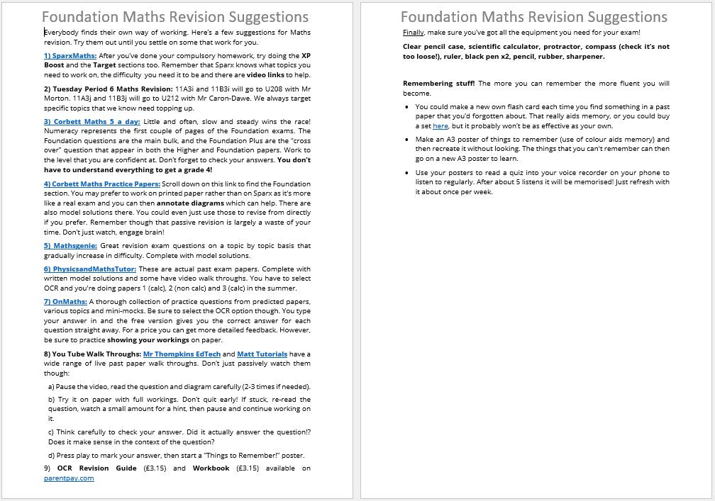
Revision Suggestions

Slide 35
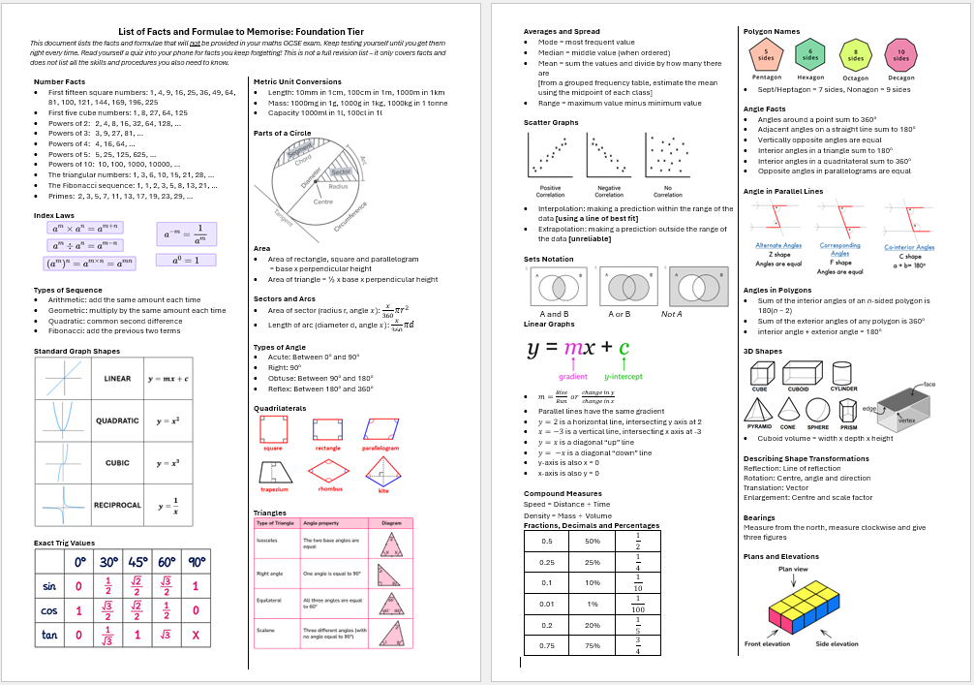
Things to Memorise!

Slide 36
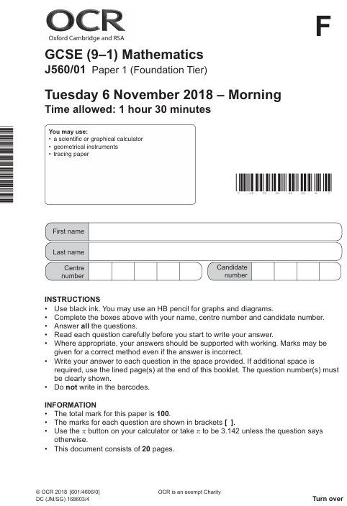
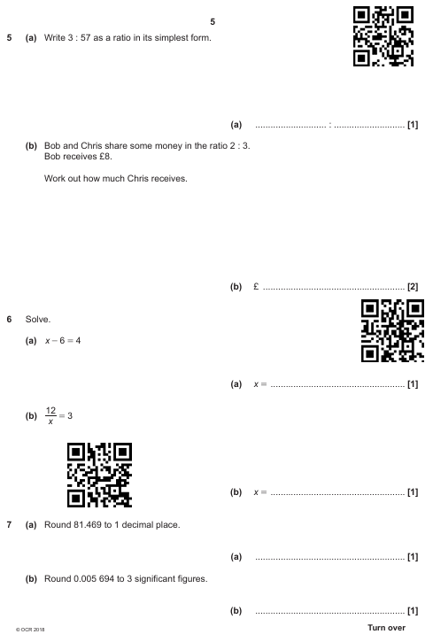
Revision Suggestions

Slide 37

Revision Suggestions

Slide 38

Revision Suggestions
www.learn-maths.online
A Foundation version will be available in mid February.
A year's subscription is £2.99
Refer to this week's newsletter for further information

Slide 39
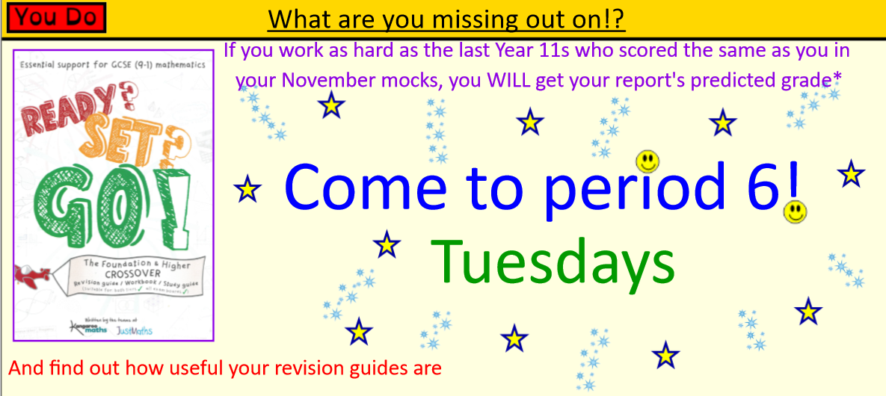
Maths Period 6

Slide 40
What do we do?
Quality assured lessons comprehensively covering all GCSE topics.
Administration of Sparx homework. Revision suggestions on Satchel.
Tuesday Period 6 covering targeted topics identified by mock exam analysis.
QR coded past papers printed for each holiday.
Walking Talking Mock yesterday, followed up on Satchel

Slide 41
What can you do?
Find the best revision resources that suit you. Revise often. Memorise the maths facts!
Do your Sparx HW on time every time.
Come to Tuesday Period 6, use your revision guide.
Practice with the QR coded past papers.
Ensure you have all of the correct exam equipment, especially a scientific calculator!

Slide 42
The Final Plan
All classes will finish learning content mid March.
Three fortnightly in lesson exam cycles:
Complete a practice exam, review and analysis, revise weak topics.
Students need to be complementing their lessons with personal revision from now, all the way up to their final exam.
Final lessons in exam season will consist of mini predicted paper exam cycles
Finally – If you work as hard as last year's Y11, you will get your predicted grade

Slide 43

Combined science
 | Combined Science Pathway | Separate Science Pathway
 | Combined Science | Biology | Chemistry | Physics
GCSEs | 2 | 1 | 1 | 1
Exams | Biology 1 Chemistry 1 Physics 1 | Biology 1 | Chemistry 1 | Physics 1
 | Biology 2 Chemistry 2 Physics 2 | Biology 2 | Chemistry 2 | Physics 2
Paper Length | 1h 15mins (each) | 1h 45mins (each) | 1h 45 mins (each) | 1h 45 mins (each)
Grade Higher: | 4-4 to 9-9 | 4 to 9 | 4 to 9 | 4 to 9
Grade Foundation: | 1-1 to 5-5 | 1 to 5 | 1 to 5 | 1 to 5

Slide 44
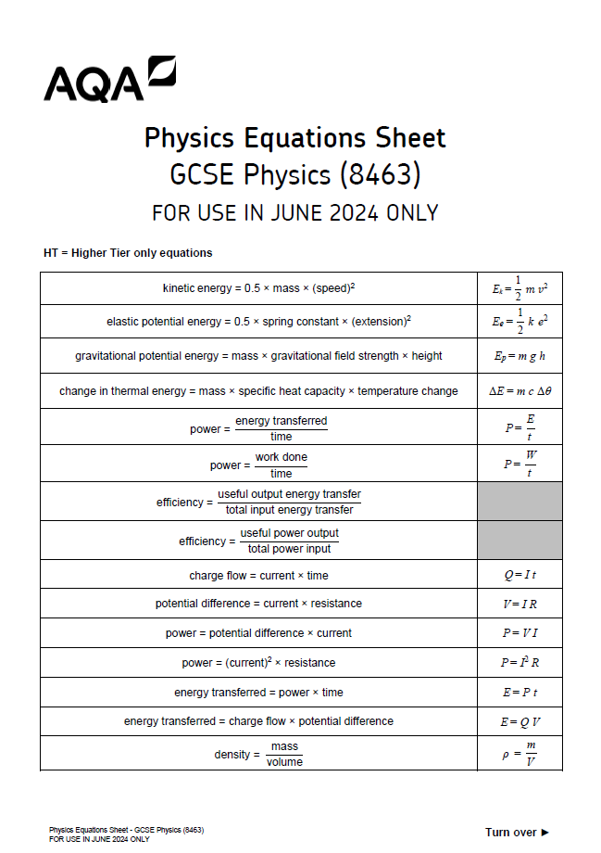

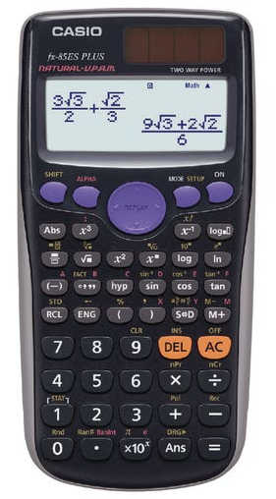

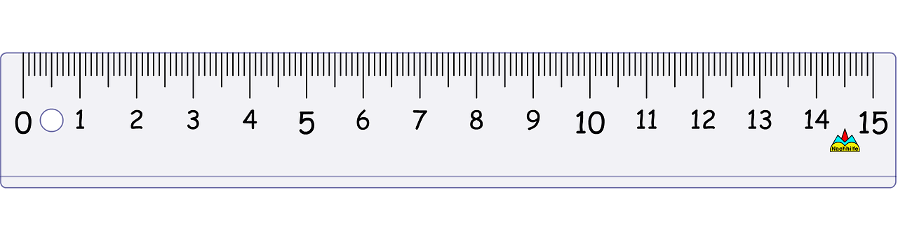
Combined science
Students will receive the full equation sheet
Maths skills in physics is worth approximately 30% of the marks – overall 20% of Science GCSE is dependent on Maths skills

Slide 45
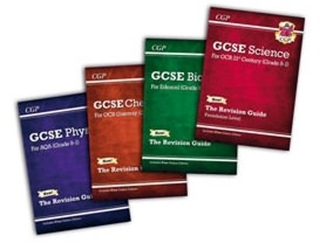





Combined science
Revision guides
Online resources:
  Tassomai - tailored self quizzing app
  Seneca - online revision
  Quizlet - online flashcards
  AQA Website - past papers

Slide 46
Science Revision strategy
This is the single best revision method for science.
How to do it
Answer questions from memory (no notes).
Use:
  Past paper questions
  Topic-based exam questions
  Flashcards (question on one side, answer on the other)
  Why it works
Strengthens long-term memory
Improves exam recall
Shows gaps quickly
Parent tip: Encourage short, regular quizzes rather than rereading notes.

Slide 47
Using Past Papers Science
AQA questions are very style-specific, so this is essential.
Best practice
Start with topic questions, then full papers later.
Use mark schemes to:
  Check key wording
  See how marks are awarded
Rewrite incorrect answers in purple pen
Triple Science students should:
Practise extended 6-mark questions regularly.
Focus on command words: explain, evaluate, compare.

Slide 48
Required Practicals Science
AQA assesses practical knowledge heavily.
Students should revise
Method (what was done and why)
Variables (independent, dependent, control)
Equipment and diagrams
Common errors and improvements
Graph skills
Good techniques
Create a one-page practical summary per experiment
Practise “describe an experiment” questions

