Slide 1



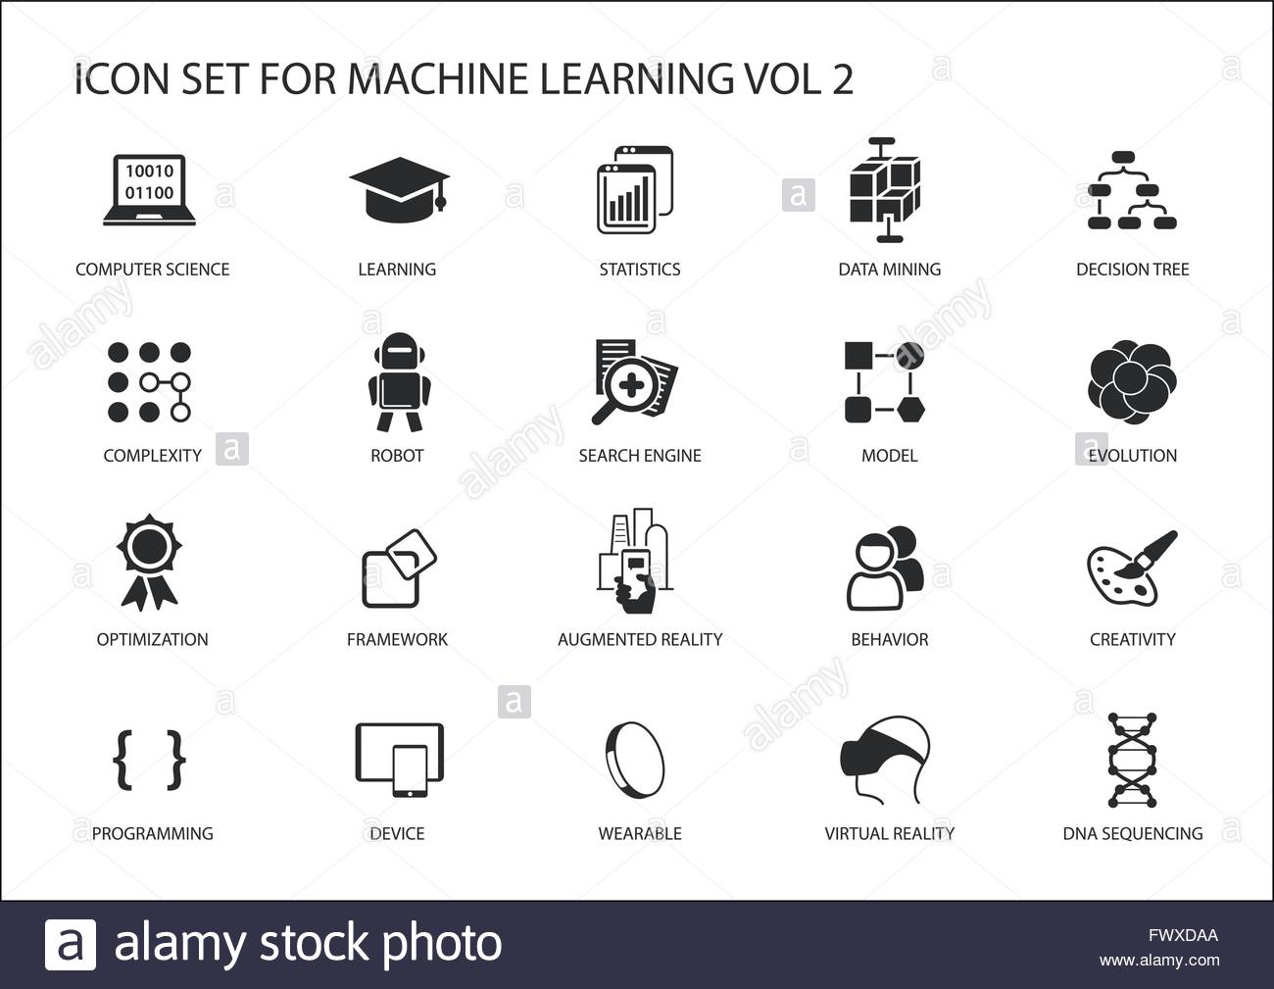




DESIGN TECHNOLOGY AT MIDDLETHORPE
Our design technology curriculum aims to inspire children to combine their creativity with judgement. To value the design, make and evaluate process when creating functional products with users and practical purposes in mind.
Big Ideas
Investigate and Evaluate existing products are explored to inspire ideas and find out about D&T in the wider world.
Focussed Tasks to learn specific skills and technical knowledge to both design and make.
Design, Make and Evaluate where children create functional products
Content and Sequencing
3 projects every year (I project each term)
Content of the National curriculum and to ensure our children have an accurate understanding of design and technology of the world in which they live.
D&T studies in KS1
Y1 Mechanisms – wheels and axles, Structures – freestanding structures, Food – preparing fruits and vegetables
Y2 Mechanisms – sliders and levers, Textiles- templates and joining, Food – preparing fruits and vegetables
D&T studies in KS2
Y3 Textiles – templates and joining, Structures – shell structures, Food – healthy ad varied diet.
Y4 Mechanisms – Levers and sliders, Electrical Systems – simple circuits and switches, Textiles – 2D shape to 3D product.
Y5 Food – celebrating cultures and seasonality, Textiles – combining shapes, Structures – frame structures.
Y6 Food – celebrating cultures and seasonality, Electrical Systems complex switches and circuits, Mechanical Systems – pulleys and gears.
Links with English and Maths
Every lesson is a reading lesson
High quality texts chosen for English that may link or inspire design technology projects
Expression of design ideas and evaluations, shared both orally and in written form
Shape, position, accurate measure, sequencing.
Retrieval Practice
Knowledge, skills and vocabulary are identified and connections are made to previous projects.
Focussed Tasks can be linked to previous experiences.
Design ideas are connected and built upon
Making skills are developed and connections made with previous products.
Evaluations are valued and reflection linked to previous projects is encouraged.
Outcomes
All units begin with an exploration of existing products.
Projects on a page is referred to and intentions shared.
All children complete practise tasks and make possibly create prototypes.
Designs are varied.
End products are individual.
End of unit product evaluation completed.
Support
Everyone has access to the Design & Technology National Curriculum.
Support is provided for those learners who require it.
Considerations is given for learners who grasp concepts more rapidly.

