Slide 1

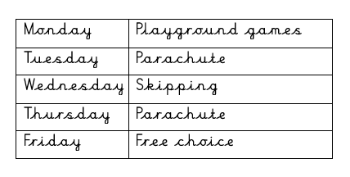
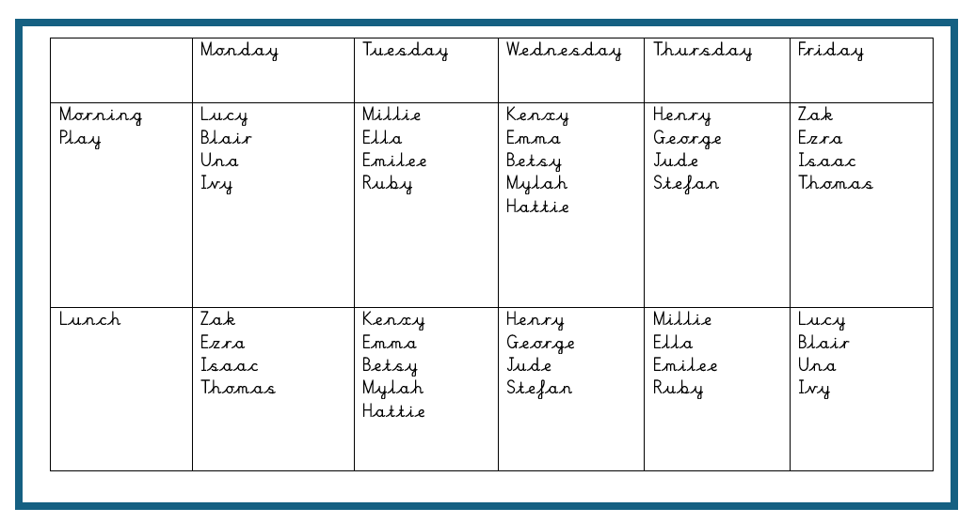



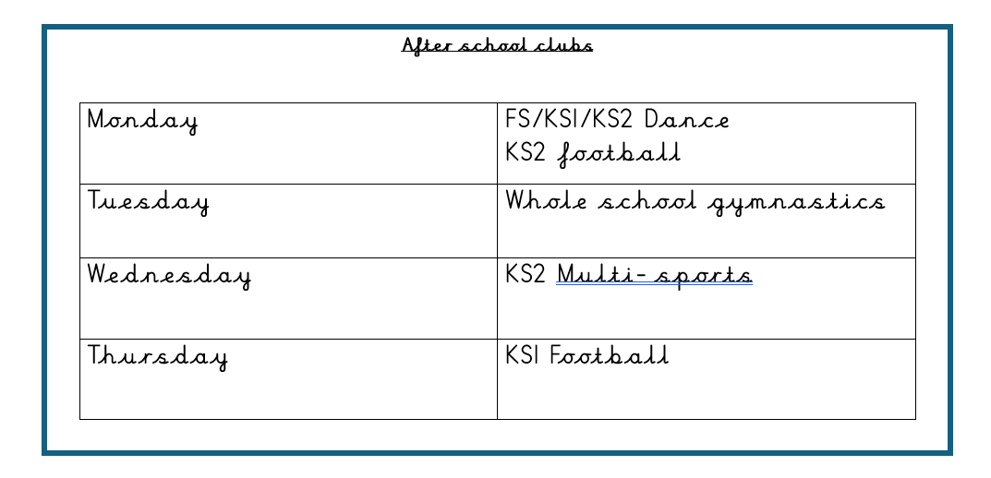

Enrichment @MIDDLETHORPE
At Middlethorpe Primary Academy, we believe that it is vital for all our pupils to learn from and about leading a physical and healthy lifestyle, so that they can understand how to manage/improve their life. Alongside our curriculum, we offer a range of clubs, which allow pupils to access a variety of opportunities to develop their skills and to complete activities at their leisure.
Playleaders– Autumn 2
Experiencing
Competition
Throughout the year, we offer all pupils in Key Stage 2 the chance to compete and participate in competition. We value this as an important factor in developing the skills learnt in school to use them in a competitive environment.
School Games Award 2023/2024
We are proud to have achieved the ‘Gold’ School Games award for 2023/2024.
After School Club Timetable – Autumn 2
Daily implementation:
Daily Mile
Playground leaders
OPAL (Outdoor learning and
play
Club/School Links:
Grimsby Town Football Club
Grimsby Twist and Flip
Cleethorpes Academy
Caistor Yarborough
Oasis Academy Wintringham – School Sport Partnership

