Slide 1



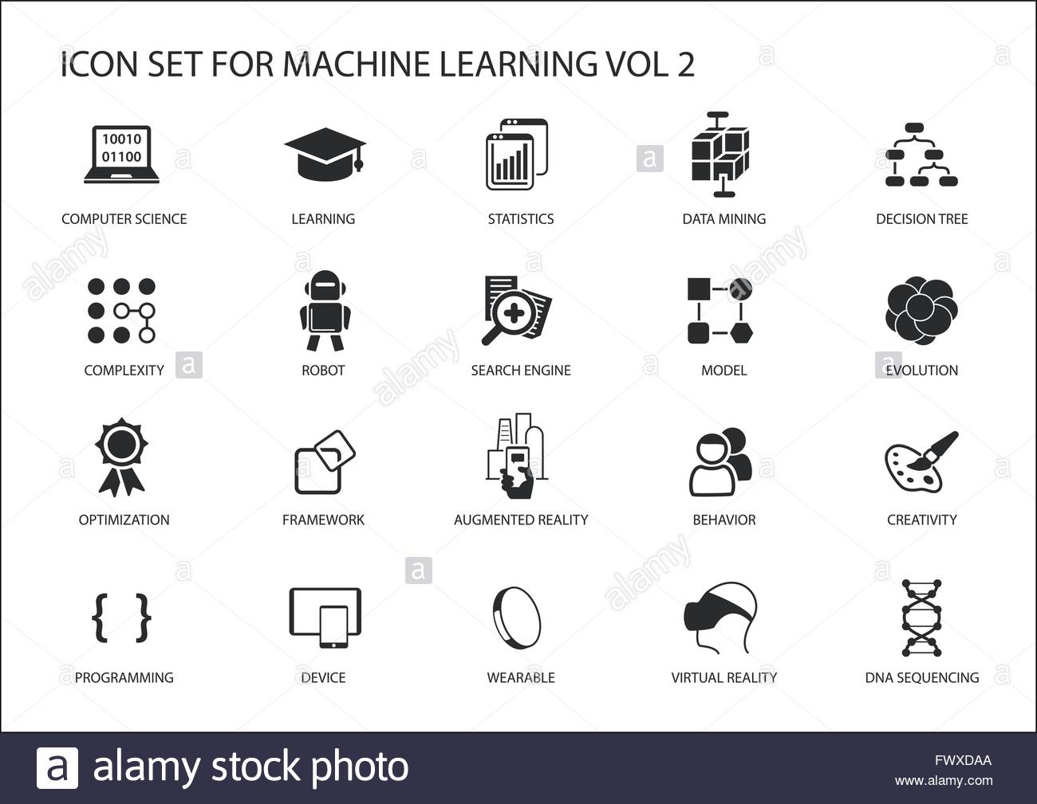

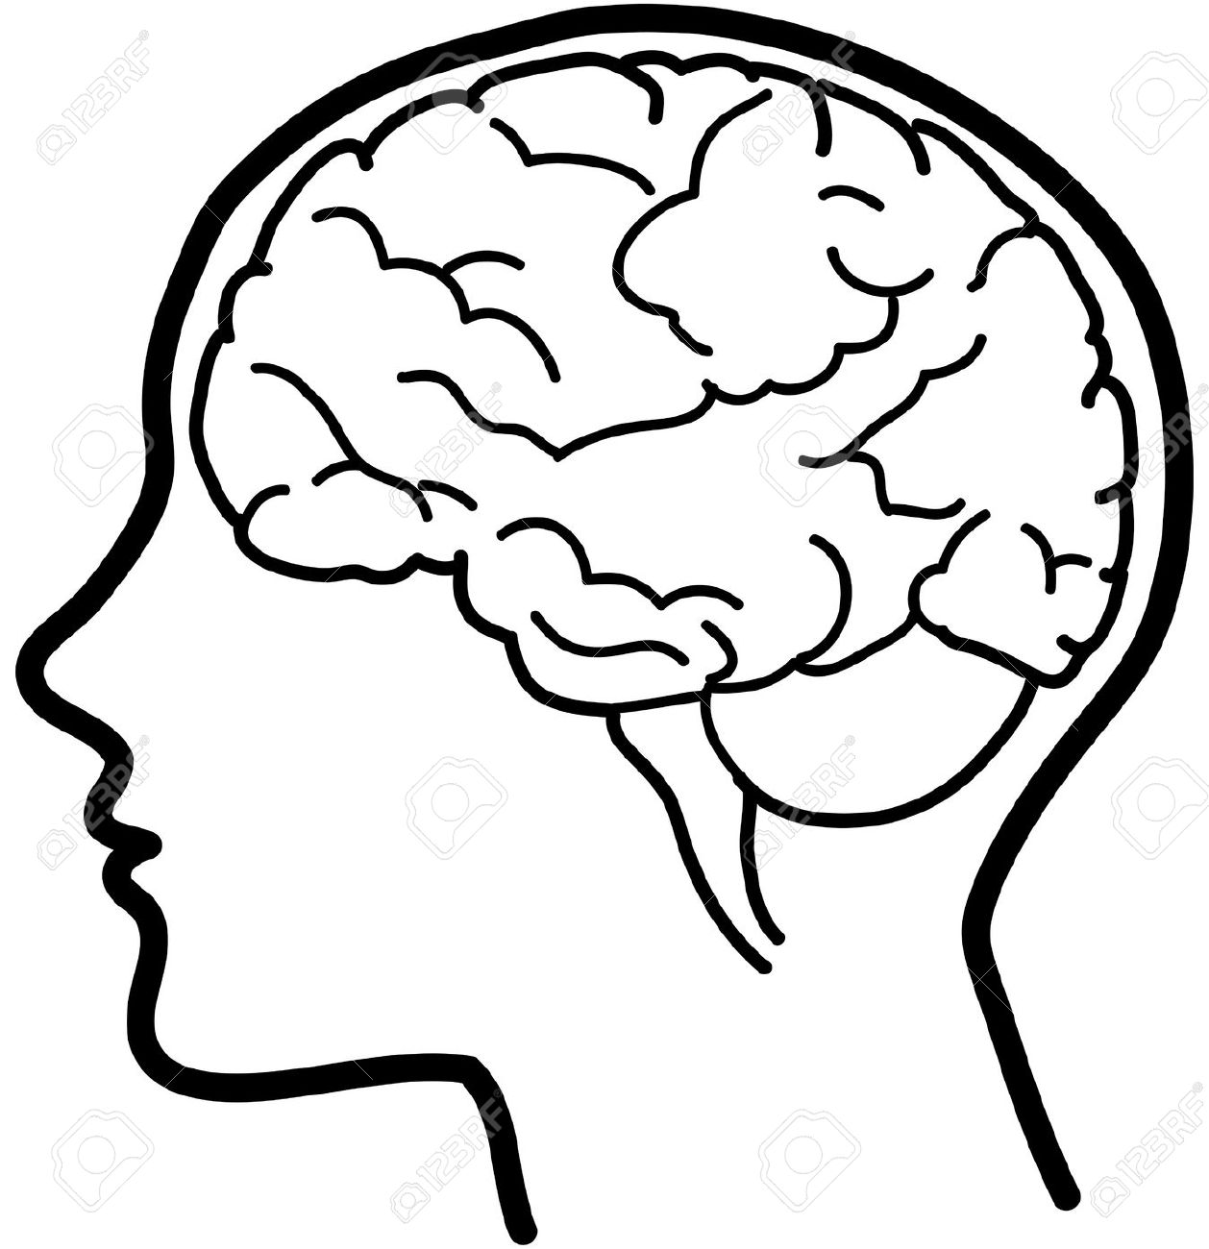

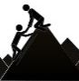
GEOGRAPHY AT MIDDLETHORPE
Our geography curriculum aims to develop a curiosity, fascination and understanding about the world and its people which will equip pupils with the knowledge and skills to be responsible global citizens.
Big Ideas
Place (location, terrain, population, settlement, diversity, community)
Environment (climate, biomes, vegetation)
Physical processes (landforms)
Human processes (trade, development, sustainability, resources, economy)
Geographical skills (maps, fieldwork, enquiry)
Organisation and Sequencing
2 half termly units a year
Content of the National curriculum and current geographical climate
Locality studies in KS1
Y1 study their own locality (Cleethorpes)and a contrasting locality (Hull)
Y2 study a contrasting non-European locality (Cairo)
Human and physical features in KS1
Countries, capital cities of the UK and continents of the world
Y1 environments and biomes
Y2 physical and human features around the world
KS2 Study of Human and Physical Processes
Y3 volcanoes, Y4 mountains, Y5 rivers, Y6 trade and world resources
KS2 Study of locality
Y3 Naples (volcano link), Y4 Whitby (contrasting locality UK), Y5 Amazon Rainforest (rivers link)
Summer Term 2
Response to current geographical climate and application of geographical skills and knowledge
Links with other subjects
Every lesson is a reading lesson- High quality texts chosen for English that link (where appropriate) with the Geography units
Geography links to other subjects have been deliberately planned
Geography- Italy is taught in Y3 before Romans in History Y4. Y2 about living Cairo before learning about the Egyptians and Rivers in Y5
World trade in Geography and Fishing industry in History Y6
Retrieval Practice
Knowledge, skills and vocabulary identified
Knowledge organisers used to support recall and retention
Low stakes quizzing to develop long term memory
Key concepts identified (above) are revisited
Key ideas are investigated by considering what they are and what they are not
Links across year groups for retrieval of knowledge
Assessment/Intervention
Pupil and staff voice tells us what is working well.
Gaps are identified through end of unit assessments, enquiries, assessment for learning in lessons and outcomes of retrieval practice.
Rapid responsive intervention takes place in the form of pre-learning, personalised provision.
Intervention can simply be adapted questions, scaffolds, additional/less instructions
Accessibility
Everyone has access to the History curriculum at the same pace.
Support is provided for those learners who require it- scaffolds are used to develop a secure understanding.
Considerations is given for learners who grasp concepts more rapidly- questions are used to deepen learning

