Slide 1


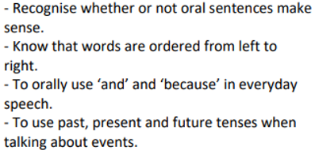
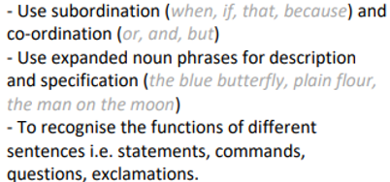
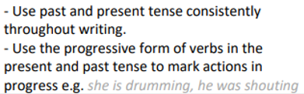
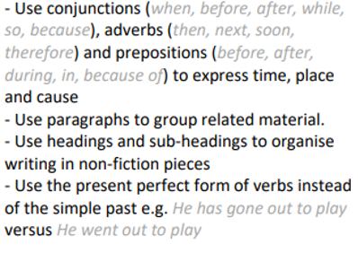



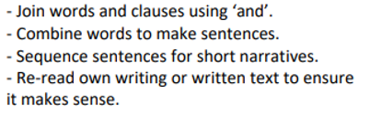
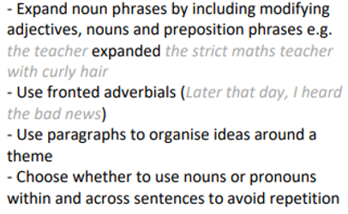
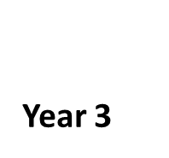

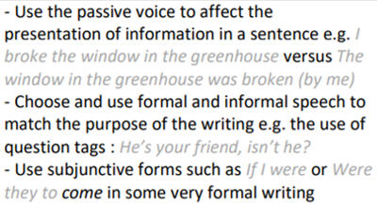
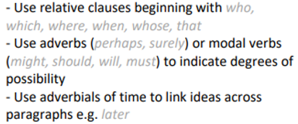


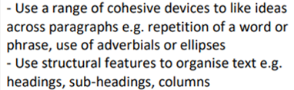
Grammar @ MIDDLETHORPE
-Formation of nouns and adjectives using suffixes.
Use of ‘ly’ to create adverbs.
-Develop the use of expanded noun phrases.
-Begin to write simple, compound and complex sentences (starting sentences with a subordinate clause.
-Begin to use fronted adverbials.
-Understanding pronouns and how they can replace a noun.
-Exploring word families based on common words.
Say a sentence before it is written
Understand suffixes can be added to a verb.
Prefixes can change the meaning of verbs and adjectives.
-Use perfect tense to show when something happened.
-Use the correct tense throughout.
-Organise ideas into paragraphs to show a change on information.
-Create cohesion through conjunctions and adverbial phrases.
-Begin using passive voice to vary sentences.
-Introduce relative clauses and relative pronouns.
-Use past and present tense accurately.
-Use a range of conjunctions confidently.
-Use a range of simple, compound and complex sentences (starting sentences with a subordinate clause.
-Introduce determiners.
Children should be secure with the objectives from the previous year groups as well as the new learning for their year group. Previous learning can be recapped through SPAG retrieval activities at the start of Writing lessons and evidence in writing books.
Use a range of clause structures varying their position in a sentence.
-Use adverbs, prepositional phrases and expanded noun phrases effectively.
Claude Monet

