Slide 1


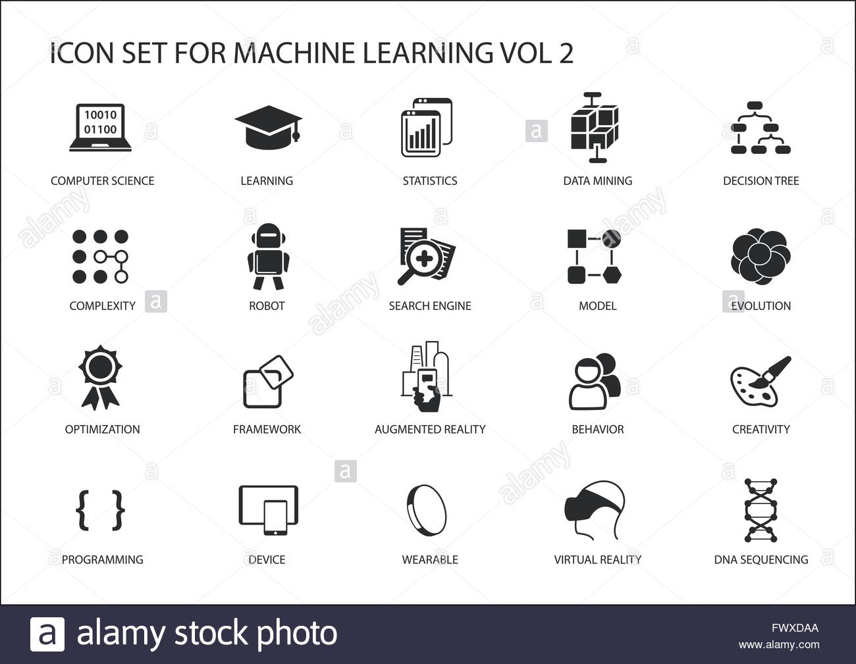





HISTORY AT MIDDLETHORPE
Our history curriculum aims to inspire in children a curiosity and fascination about Britain’s past and that of the wider world. To ensure our children have an accurate understanding of the history of the world in which they live.
Big Ideas- Key concepts are threaded through our history curriculum
Understanding Chronology (AD, BC, century, time, past, present)
Historical Interpretation (cause and consequence, change, significance)
Sources of evidence (primary, secondary, reliable)
Communicate Historically(enquiry, interpretation, organisation)
Organisation and Sequencing
2 half termly units a year- History is a driving subject as it is key our children know how the world has been shaped by key individuals and events
Historical studies in FS
Making a sense of their life journey- past and present, changes over time and their own timelines
Historical studies in KS1
Y1 changes within living memory in locality (transport) and (seaside)
Y2 study a contrasting lives of significant people and events (Explorers) and (Great Fire of London)
Historical studies in KS2
Each year children learn an aspect of British and world history, these are taught sequentially
Y3 Changes in Britain from Stone age to iron age and Ancient Egyptians
Y4 Roman Empire- impact on Britain and Ancient Greece
Y5 Anglo Saxons and Vikings in Britain and Mayan Civilization
Y6 World war 2 in Britain and a local study of the History of Grimsby
Summer Term 2
Retrieval of historical learning and application of historical skills and knowledge
Links with other subjects
Every lesson is a reading lesson- High quality texts chosen for English that link (where appropriate) with the History units
History links to other subjects have been deliberately planned
Geography- Italy is taught in Y2 before Romans in history Y4. Y2rn about living Cairo before learning about the Egyptians and rivers in Y5
DT- transport is studied in history before moving vehicles are designed and made in DT.
Retrieval Practice
Knowledge, skills and vocabulary identified
Knowledge organisers used to support recall and retention
Low stakes quizzing to develop long term memory
Key concepts identified (above) are revisited
Key ideas are investigated by considering what they are and what they are not
Links across year groups for retrieval of knowledge
Assessment/Intervention
Pupil and staff voice tells us what is working well.
Gaps are identified through end of unit assessments, enquiries, assessment for learning in lessons and outcomes of retrieval practice.
Rapid responsive intervention takes place in the form of pre-learning, personalised provision.
Intervention can simply be adapted questions, scaffolds, additional/less instructions
Accessibility
Everyone has access to the History curriculum at the same pace.
Support is provided for those learners who require it- scaffolds are used to develop a secure understanding.
Considerations is given for learners who grasp concepts more rapidly- questions are used to deepen learning

