Slide 1



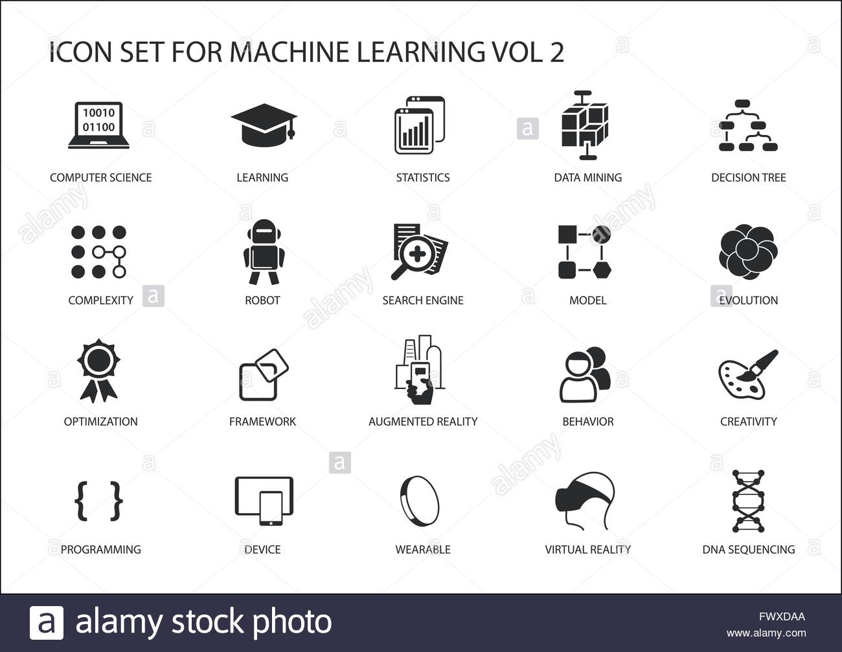



MATHS AT MIDDLETHORPE
Our maths curriculum aims to develop a foundation for understanding the world, the ability to reason mathematically, an appreciation of the power of mathematics, and a sense of enjoyment and curiosity about the subject.
The fundamentals
A belief that every child can and will achieve mastery
A focus on task design – everything is done on purpose
Quick maths for fluency
DNA for retrieval
Pre and post learning intervention
Learning question and steps to success
No ability groupings
Conceptual and procedural variation
Demo and review phase
I Do, We Do, You Do
80:20 children: teacher talk ratio
Up-to-date working walls
Concrete – Pictorial – Abstract
Use of resources including concrete in all year groups
A focus on ‘grown up’ vocabulary
Pace, productivity, progress
Children use Times Tables rockstars
Follow the national curriculum
Maths across the curriculum
Maths will be incorporated into the curriculum where possible, for example:
Using directional language in geography such as North, East, South and West.
Statistics in science eg block graphs, line graphs.
Interpreting different tables and charts eg tally charts.
Ordering time and chronology such as timelines in history.
Repeating patterns in art
Shape and direction in ICT
Making shapes, symmetry and reflection in PE.
Retrieval Practice
Quick maths is used daily in all classes. This covers mathematical concepts such as number bonds and the four operations. Children mark their own quick maths and try to beat their score each day. Children complete a daily DNA which helps with their retrieval of maths concepts.
Outcomes
We aim for all children to reach their full potential and have the confidence to challenge themselves appropriately in maths.
We aim for our children to be fluent in arithmetic, and able to articulate their reasoning clearly.
We aspire to embed a secure mathematical knowledge so that children can apply their skills in the real world.
Support
Everyone has access to the Maths national curriculum.
Support is provided for those learners who require it, via concrete resources, differentiated activities and adult support.
Consideration is given for learners who grasp concepts more rapidly.

