Slide 1





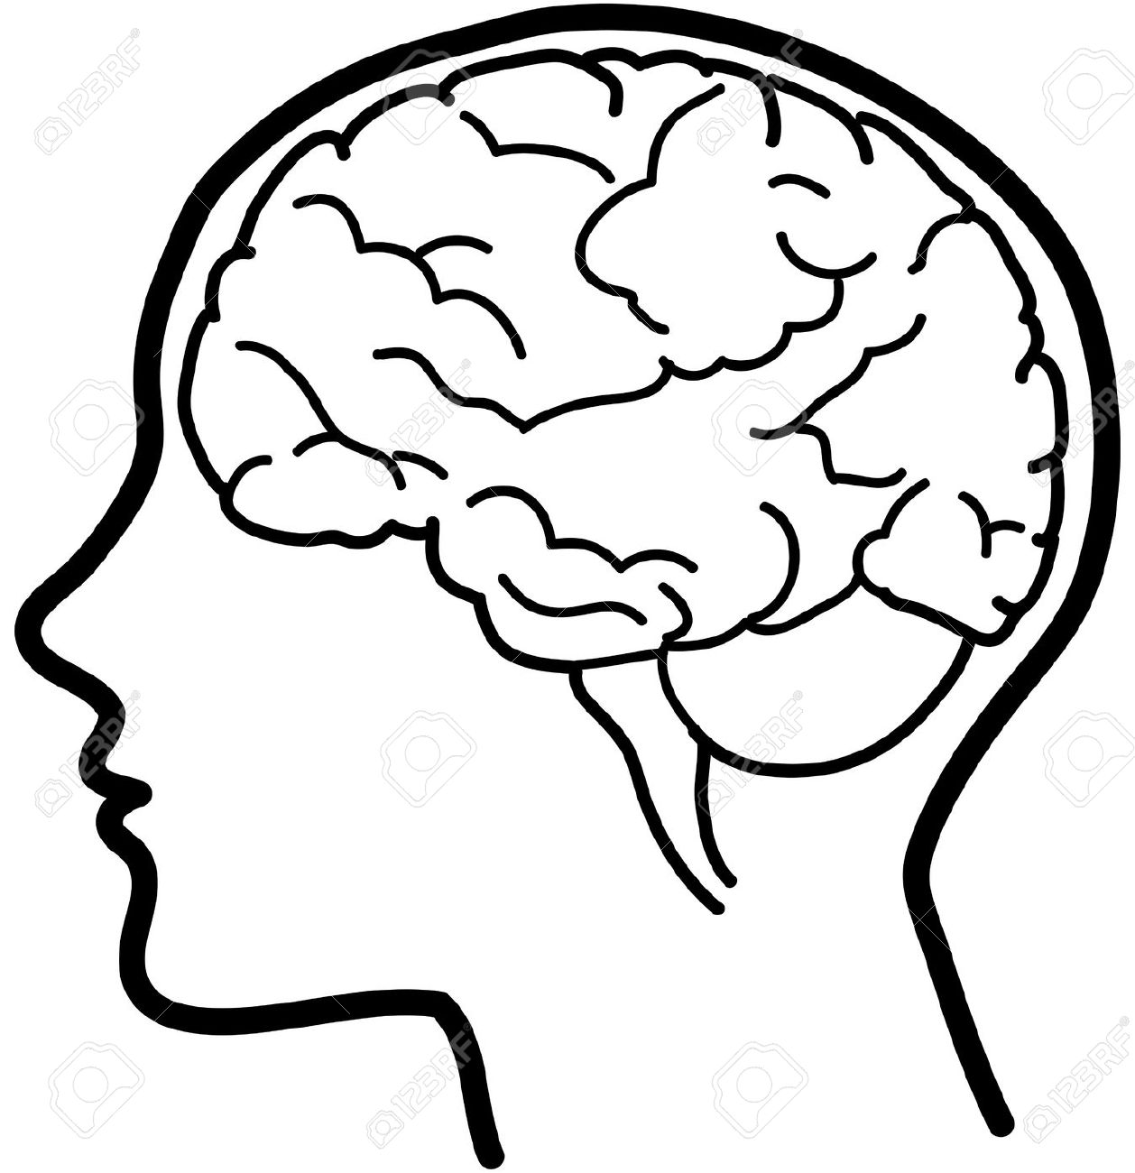


MUSIC AT MIDDLETHORPE
Our music curriculum is designed to provide an inclusive approach to music learning. Children are actively involved in using and developing their singing voices, using body percussion and learning to handle and play musical instruments.
Big Ideas
Musical styles (Rap, Reggae, Hip hop, Pop, Musicals etc)
Pulse (heartbeat of rhythm)
Melody (musical notes, Crotchets etc)
Pitch (High or low notes)
Critique
Great musicians and composers
ABBA, The Beatles, Benjamin Britten, Carole King
Content and Sequencing
1 lesson per week – all year groups study historical content of musical styles
Content of the National curriculum and current music climate
Musical styles in FS & KS1
Foundation Stage explore sound, high and low pitch, beginning to understand pulse and exploring basic musical instruments.
Y1 study Hip Hop, Reggae, Blues, Latin, Folk, Funk, Bhangra, Film, Pop, Musicals
Y2 study South African Styles, Christmas, Big Band, Motown, Elvis, Rock, Reggae, Pop, Soul,
Western Classical
Musical Styles in KS2
Y3 study R&B, Western Classical, Musicals, Motown, Soul, Disco, Playing Glockenspiels
Y4 study ABBA,Grime, Classical Bhangra, Tango, Latin Fusion Gospel, The Beatles
Y5 study Rock, Jazz, Pop Ballads, Hip hop, Motown, Western Classical
Y6 study Pop/Motown, Jazz, Latin, Blues, Gospel. Benjamin Britten, Carole King, Western Classical
Links with English
and Maths
Every lesson is a reading lesson
High quality texts chosen for English that link with the music units where possible
Expression of critiques and opinions Explore sounds, listen actively, compose and perform
Create and express their own and others’ music both orally and in written form.
Retrieval Practice
Knowledge, skills and vocabulary identified
Knowledge organisers used to support recall and retention
Low stakes quizzing to develop long term memory
Key concepts identified (above) are revisited
Key ideas are investigated by considering what they are and what they are not
Links across year groups for retrieval of knowledge
Outcomes
All units begin with an enquiry question which children should be able to answer at the end of the unit
End of the unit children will complete a task which gives them the opportunity to apply all their art skills, knowledge and understanding
End of unit quiz
Support
Everyone has access to the Music National Curriculum.
Support is provided for those learners who require it
Considerations is given for learners who grasp concepts more rapidly

