Slide 1
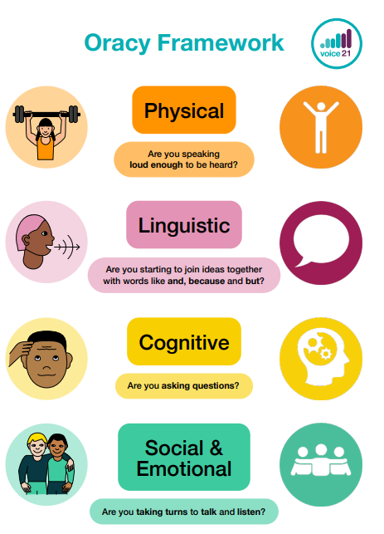

Oracy @ Middlethorpe (EYFS)
Claude Monet

Slide 2
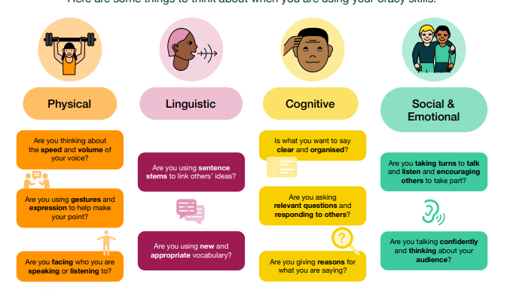
Oracy @ Middlethorpe (KS1)
Claude Monet

Slide 3
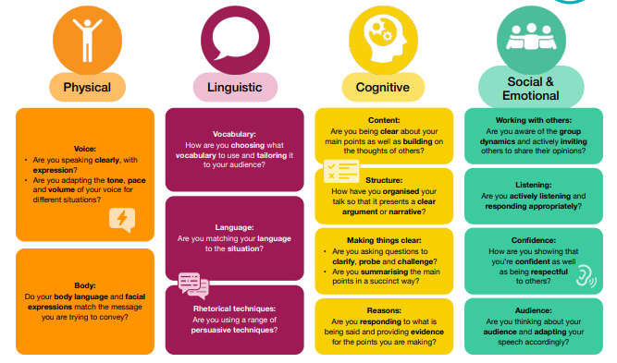
Oracy @ Middlethorpe (KS2)
Claude Monet

