Slide 1
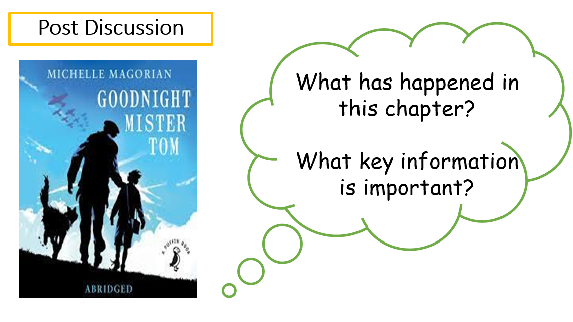


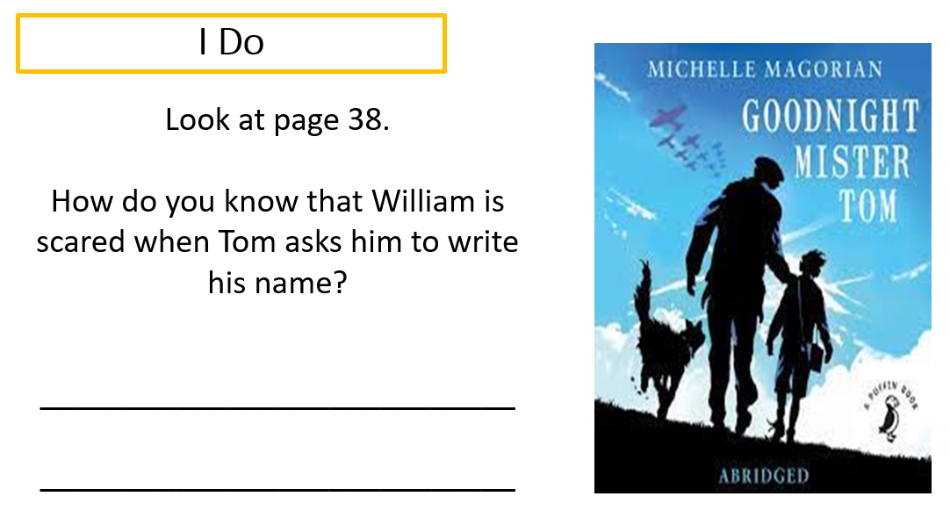
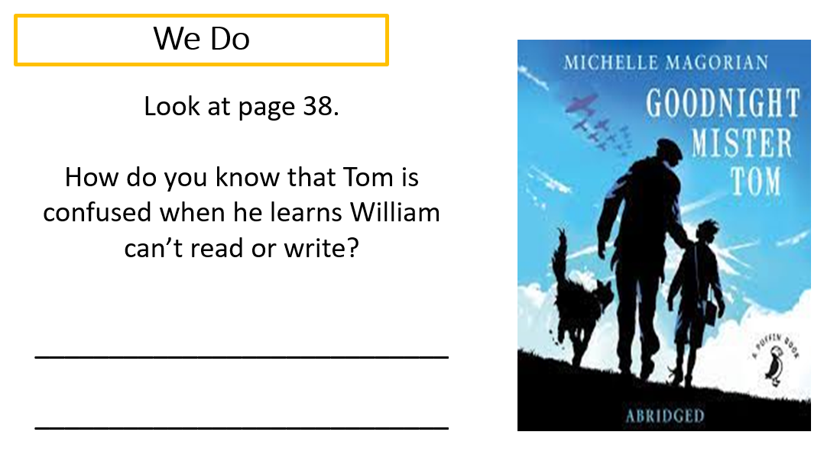
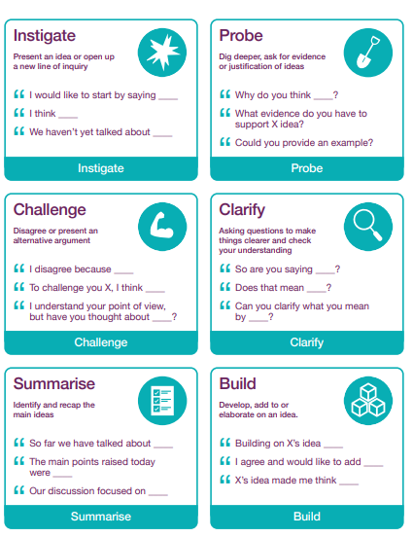
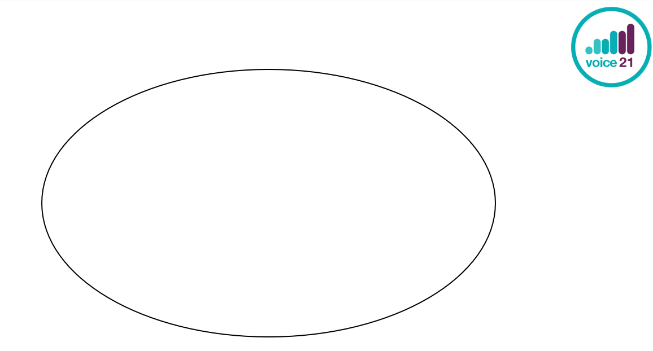
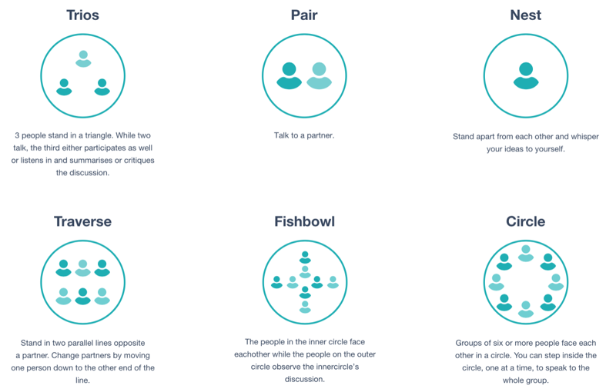
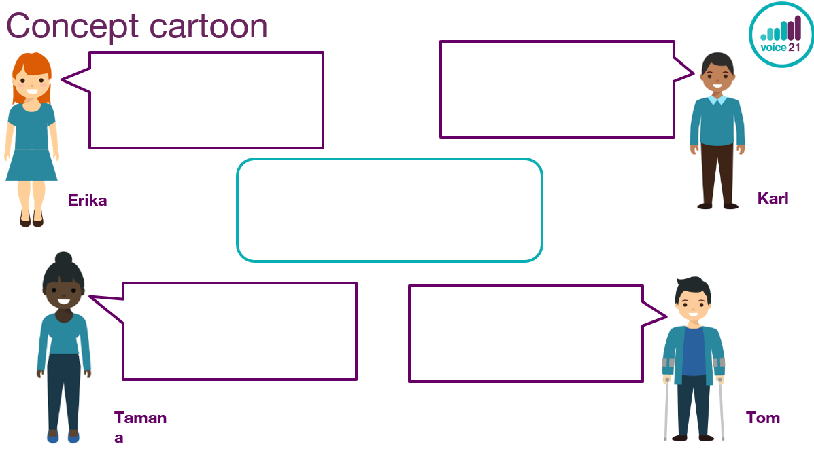
Oracy in Guided Reading
Day One Fluency
During the fluency lesson, children have opportunity to read as a class and take part in the post lesson discussions
During these: Pose a Deeper Thinking Question to the children to develop oracy. For example:
“Tom is happy to be alone and Willie Beech is a hindrance to him.”
Day Two and Three Vocabulary and Skill
During the Vocabulary and Skill lesson, children have opportunity listen to the teach modelling the ‘I Do’ section of the lesson
They also have opportunity to answer questions together during the ‘We Do’ section of the lesson.
Oracy techniques to be weaved in during this section of the lesson.
The Harkness Tracker can monitor who speak and which of the talk tactics are used. This will monitor/assess who the more confident speakers are and can inform planning for future groupings.
Concept cartoons, They could answer the deeper thinking questions. Who do the children agree or disagrees with? Encourage the use of talk tactics with this resource.
The text could be discussed, and groupings could be experimented with.
Traverse could be used to answer questions and children have opportunities to practice listening and repeating etc.
Fishbowls could be used to discuss the book primarily but then also discuss the successes and ways forward in terms of the children’s oracy.
Use of the talk tactics to answer the Deeper Thinking Question or the questions posed in the ‘I Do, We Do’ section of a lesson. Teacher could instigate and model the different roles to ensure that the talk tactics are embedded and become familiar to the children,

