Slide 1
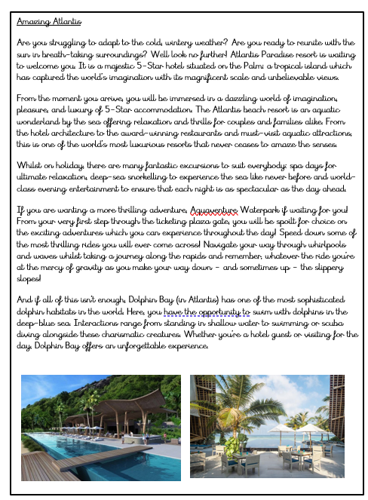
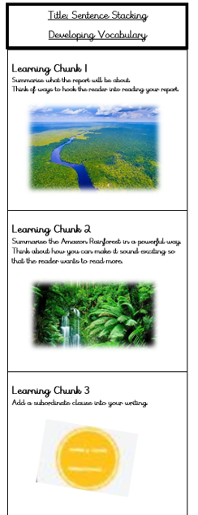

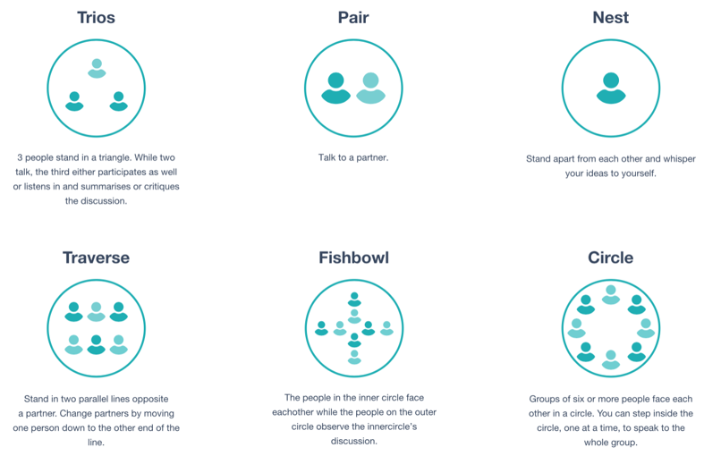
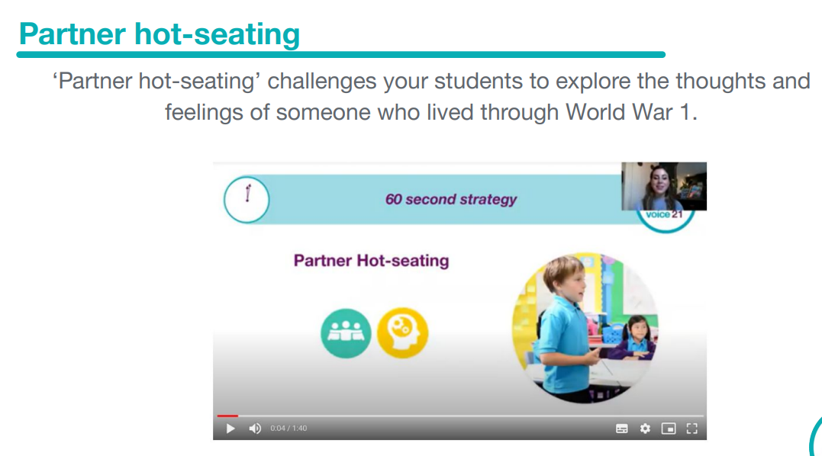
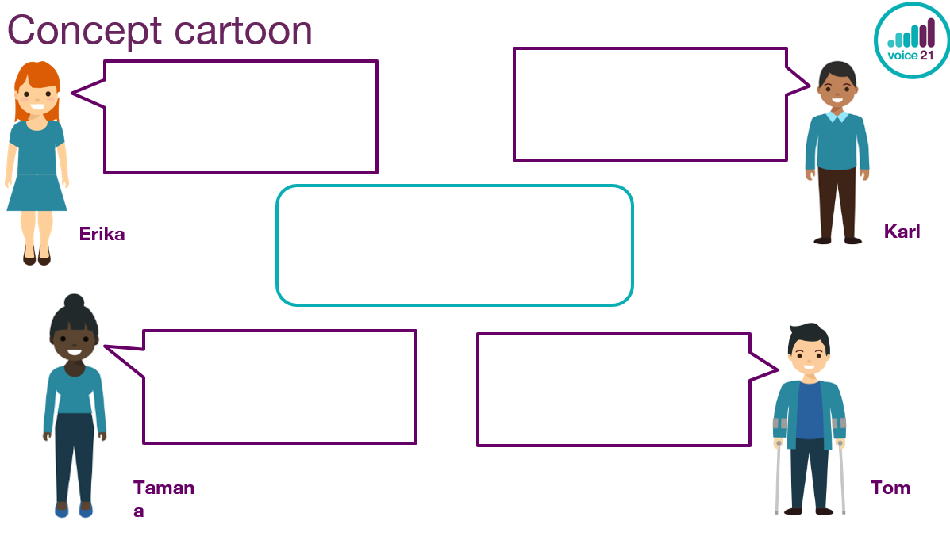
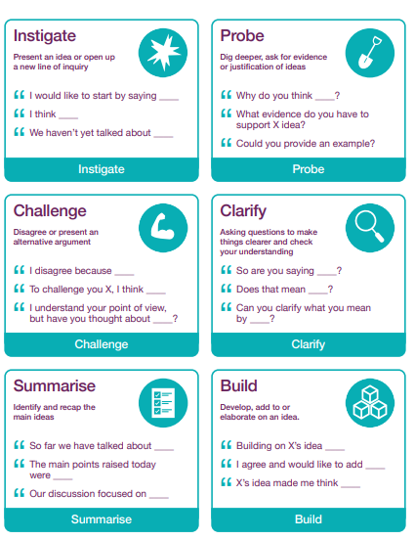
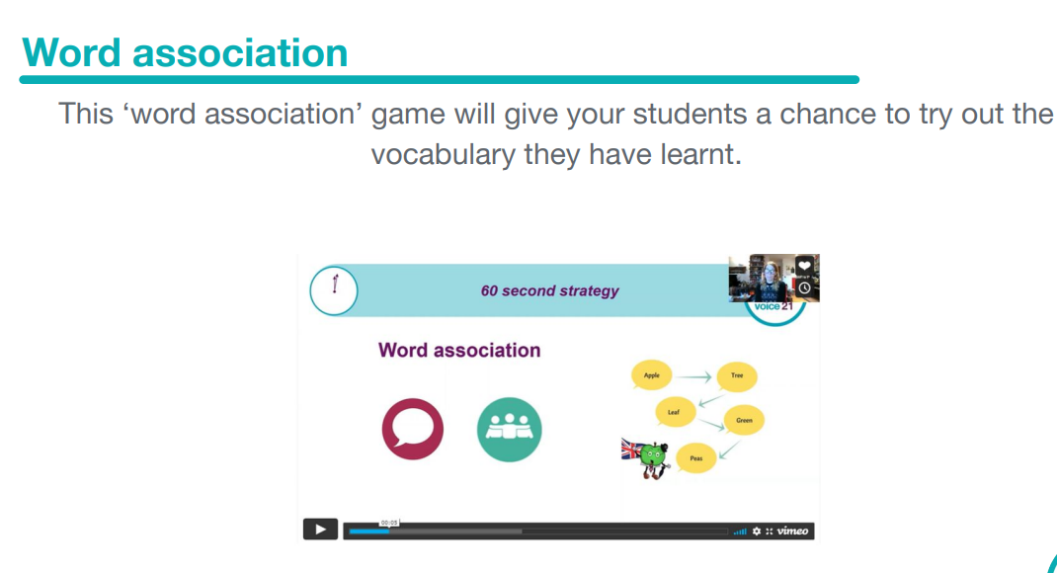
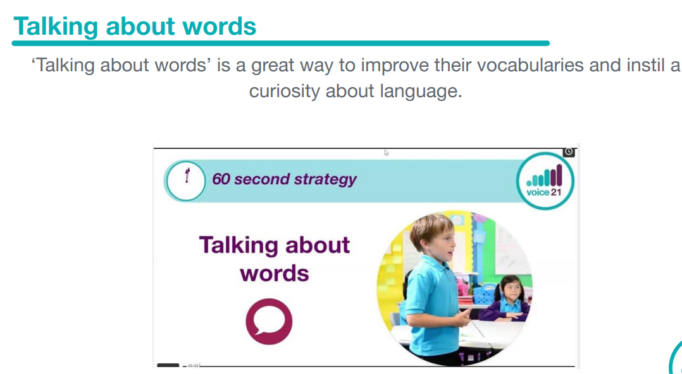
Oracy in Writing
Text Interrogation
During the text interrogation lesson pose the question:
What makes this text successful or unsuccessful?
Children can have opportunity to discuss this genre of text whilst developing their oracy skills.
Honing Writing Skills
Sentence Stacking and Short Burst
Children have many opportunities to discuss ideas for their writing during the sentence stacking lessons.
Children could develop their oracy skills throughout these sessions by experimenting with groupings.
Their ideas could be discussed, and groupings could be experimented with.
Nesting will give children a chance to think of their ideas before sharing them with other children.
Pairs and Trios is a great way to discuss ideas and receive peer feedback before feeding ideas back to the whole class.
Other example of the 60 Second Strategies could be weaved in.
Independent Writing
Editing and Improving
Children have many opportunities to read each other's work and provide feedback.
Grouping could be experimented with again.
Traverse could be used as children could explain why they like their piece of independent writing or what they could do in the editing and improving lesson .
Children could then feedback about what they will do to improve their writing.
Concept cartoons, They could answer the deeper thinking questions. Who do the children agree or disagrees with? Encourage the use of talk tactics with this resource.

