Slide 1


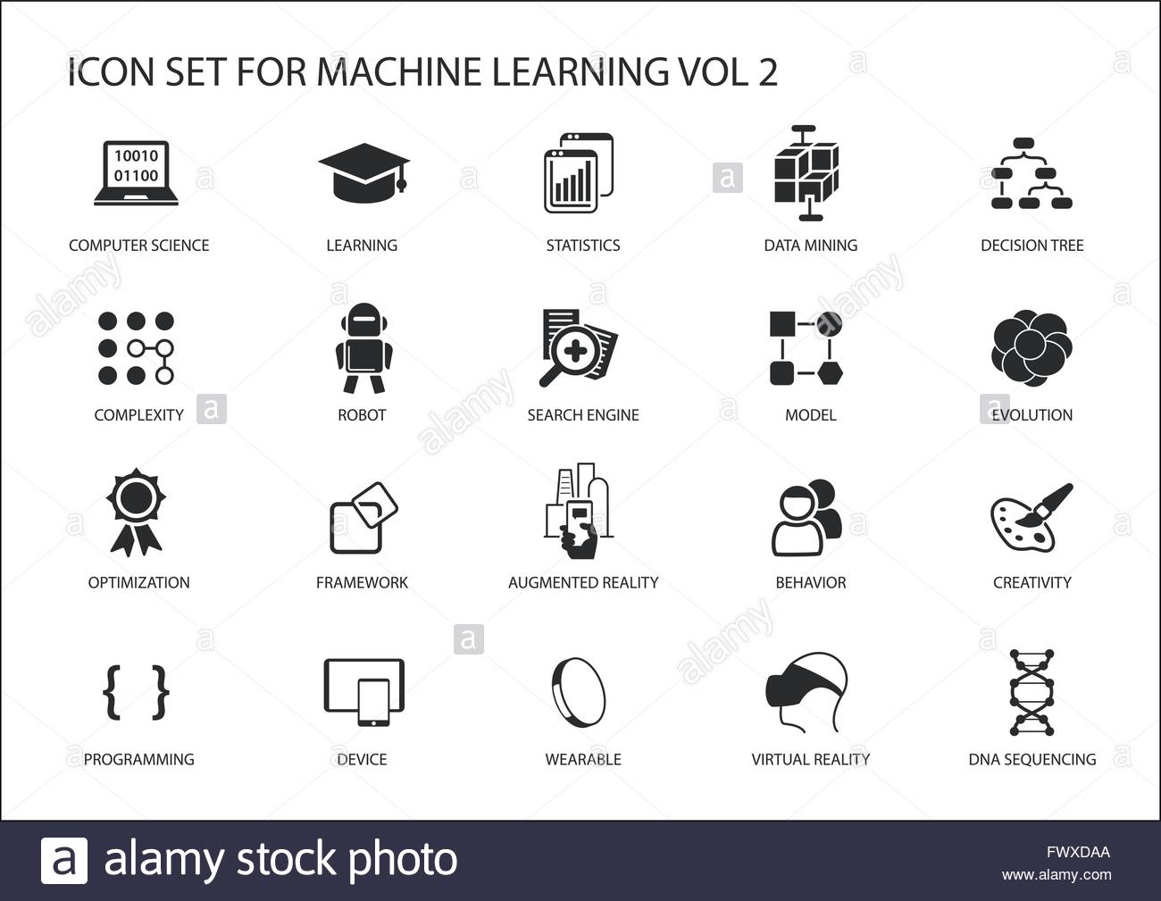
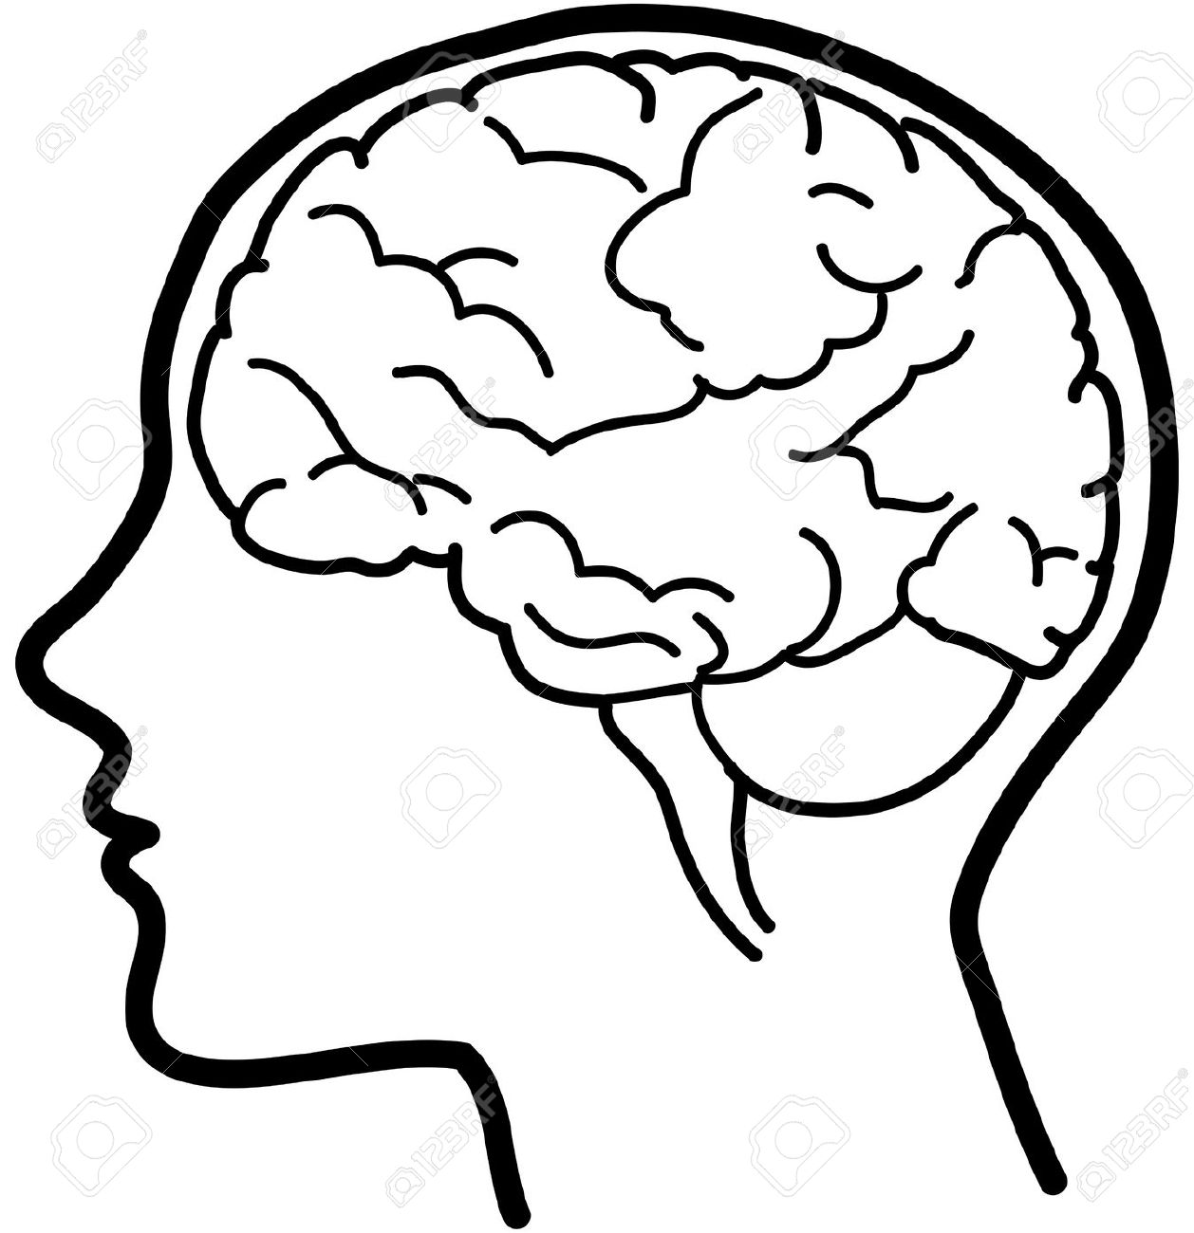



PSHE AT MIDDLETHORPE
Our PSHE syllabus follows the Jigsaw programme and aims to bring together PSHE Education, emotional literacy, social skills and spiritual development
in a comprehensive scheme of learning.
Big Ideas
Understanding - a sympathetic awareness and tolerance of others and difference.
Reflection - to apply thought and consideration to everyday life.
Empathy - to express sensitivity and compassion to others.
Mindfulness - is a vital tool for life, not only does it support the regulation of emotion and build emotional resilience but also enhances focus and concentration; both helping to
optimise learning.
Content and Sequencing
Six half termly units a year
Jigsaw Programme for each year group
Six Themes that run across the school for each half term.
Being in my world
Celebrating Difference.
Dreams and Goals
Healthy Me
Relationships
Changing Me.
In Jigsaw PSHE, mindfulness is developed through the ‘Calm Me’ time in each piece (lesson).
Each theme (or piece) has 6 lessons, each lesson has two learning intentions.
Links with English and Maths
Every lesson is a reading lesson
High quality discussion and use of Talk for Learning vocabulary.
Expression of thoughts, feelings and opinions both orally and in written form.
Retrieval Practice
Knowledge, skills and vocabulary identified
Key concepts identified (above) are revisited
Key ideas are investigated by considering what they are and what they are not
Links across year groups for retrieval of knowledge
Outcomes
All units begin with a whole school assembly
Children are able to respond (in different ways e.g. discussion) to express their thoughts and ideas
Use of relevant, key vocabulary
Support
Everyone has access to the Agreed Syllabus.
Support is provided for those learners who require it.
Considerations is given for learners who grasp concepts more rapidly.

