Slide 1



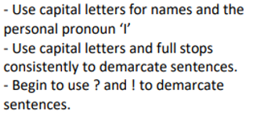
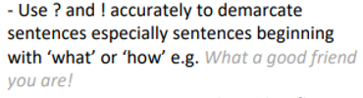



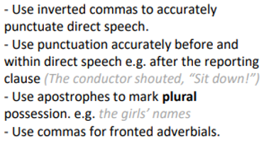



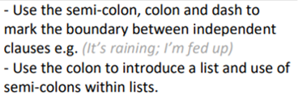



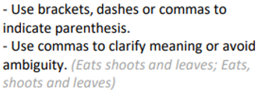
Punctuation @ MIDDLETHORPE
Use capital letters for proper nouns.
Separate words using finger spaces.
Use capital letters and full stops accurately.
Begin to use apostrophes to mark contractions.
Begin to use commas to separate items in a list.
-Spell most contracted words.
Use commas to separate items in a list.
Use apostrophes to show singular possession.
Children should be secure with the objectives from the previous year groups as well as the new learning for their year group. Previous learning can be recapped through SPAG retrieval activities at the start of Writing lessons and evidence in writing books.
-Use colons to introduce a list
-Punctuate bullet point correctly.
-Use a range of punctuation for parenthesis.
-Use commas for clarity when writing.
-Use inverted commas accurately.
Claude Monet

