Slide 1
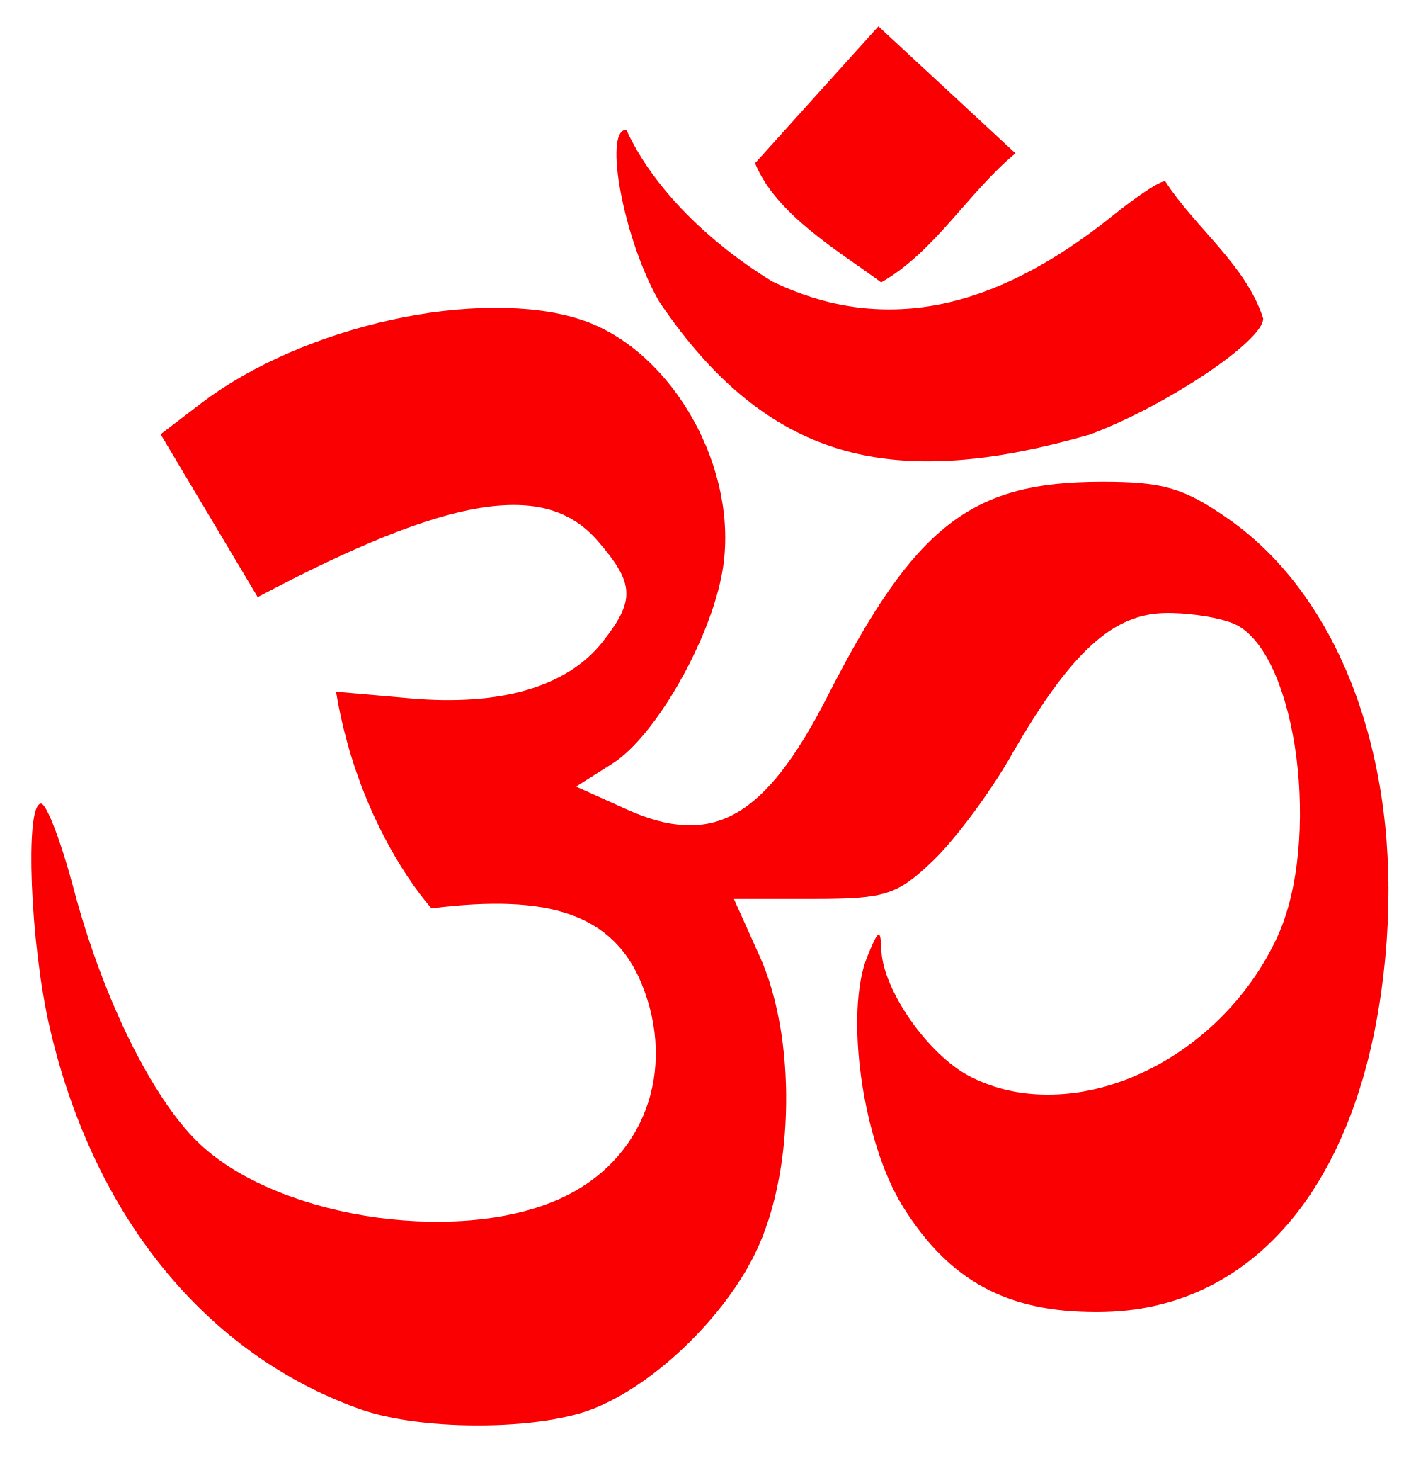
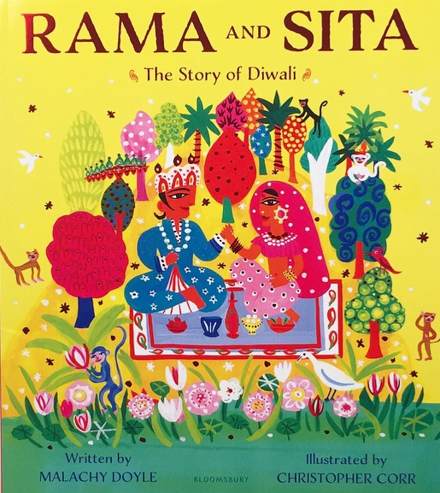
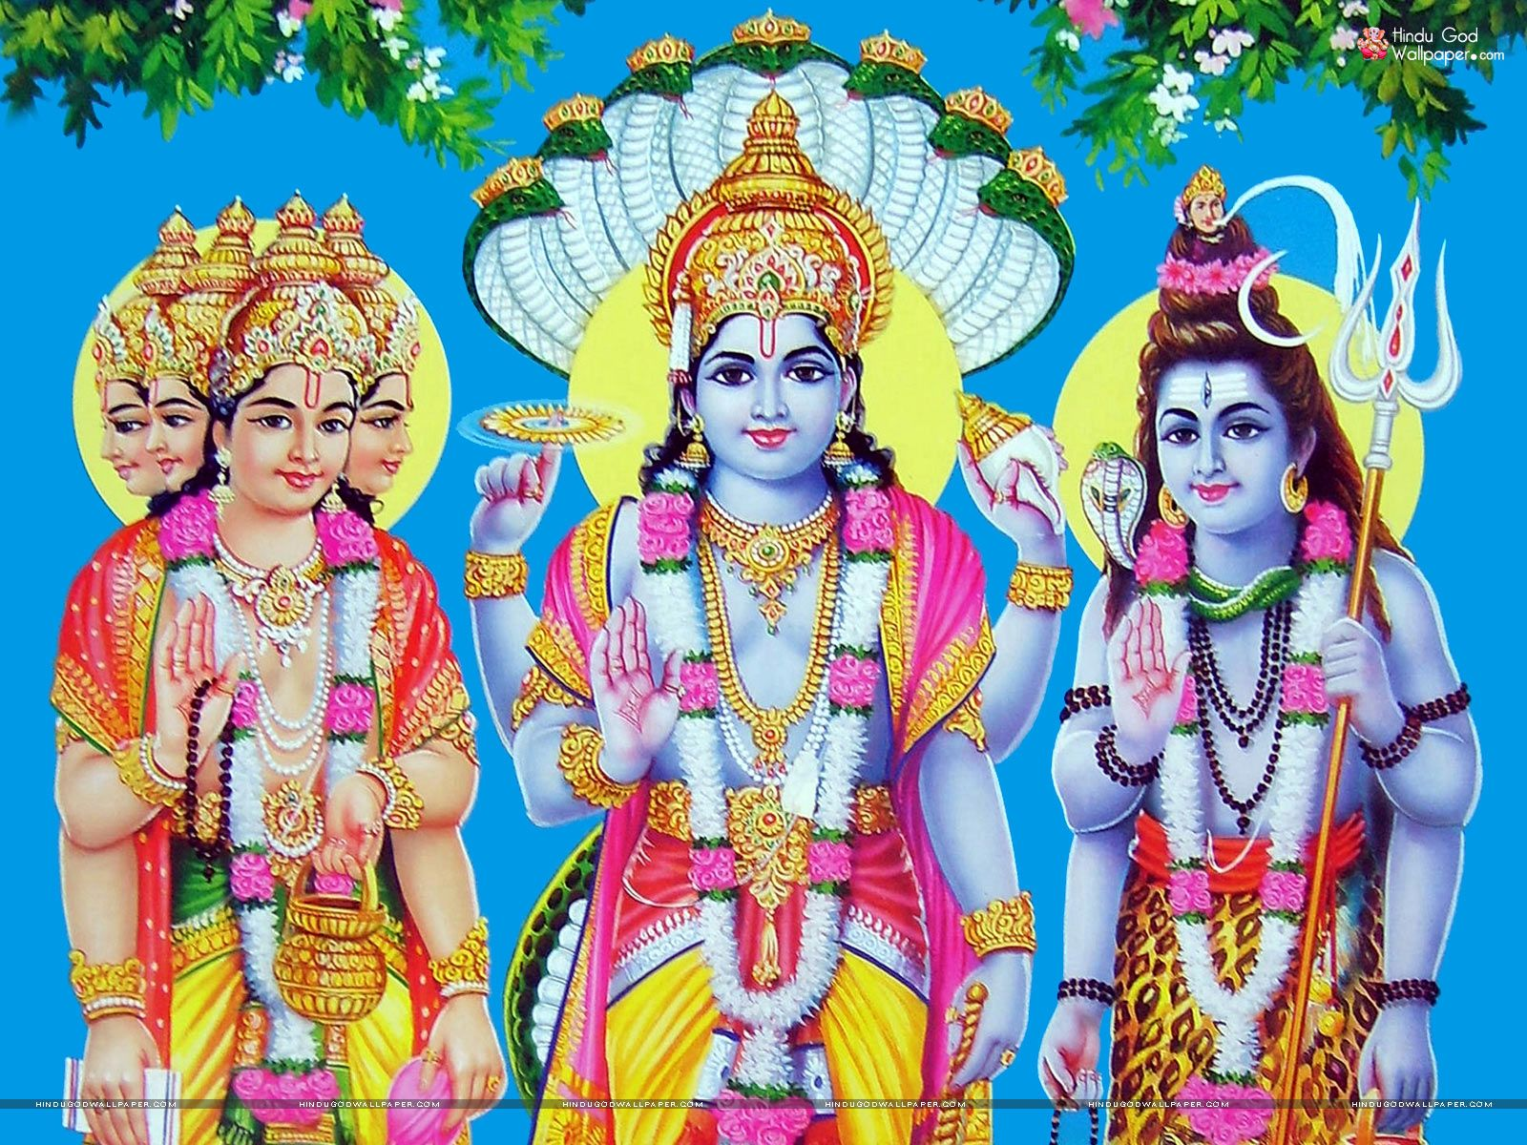
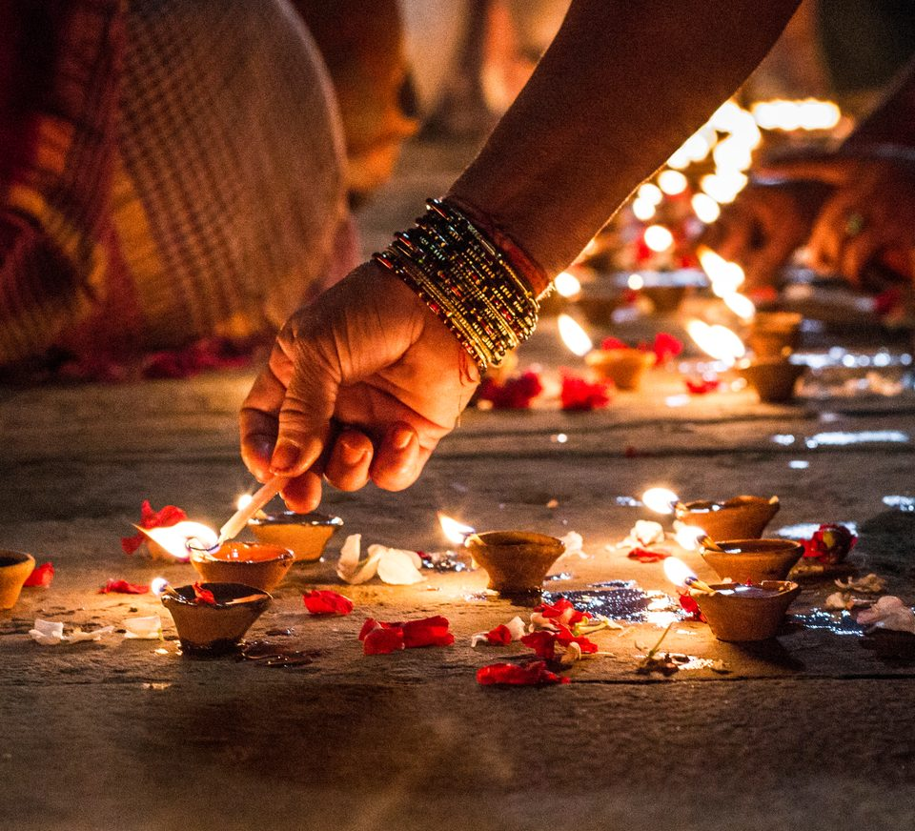

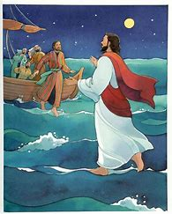
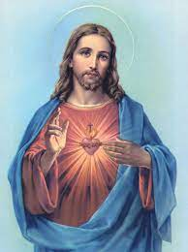
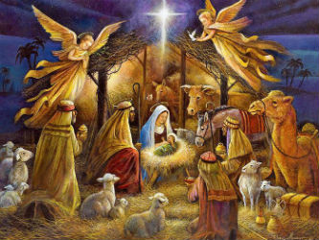
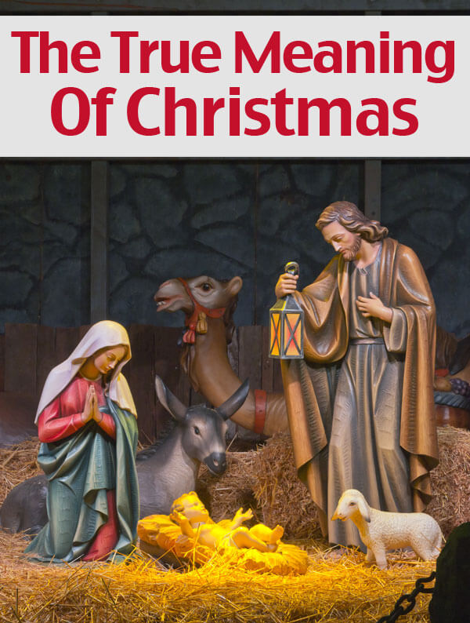
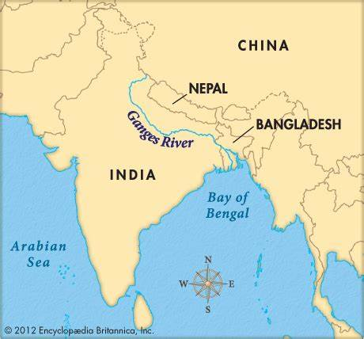


RE – Are all religious texts true?
Year 3 Autumn 2
Vocabulary
Brahman | supreme spirit of the Hindu faith
Hindus | person believing in Hinduism
ritual | a religious service or other ceremony which involves a series of actions performed in a fixed order
deity | a god or goddess
tri-murti | triad of the three gods Brahma, Vishnu, and Shiva
omnipresent | something that is present everywhere or seems to be always present
Om
symbol of Hinduism
Hindu Gods
Brahma, Vishnu and Shiva
Hindu Stories
Hindu celebration: Diwali
Jesus’ miracles
Symbol of Christianity
Jesus
Notes:
Christian celebration: Christmas
Christian Stories
River Ganges - river bordering India and Bangladesh

Slide 2




Week 1, Question 1:
Know the story of Rama and Sita
now and discuss the sense of belonging this brings to the Hindu community
RE – Are all religious texts true?
Year 3 Autumn 2
Sunita day visit for delivering DIWALI -15th/16th November
Ganges River - Kids | Britannica Kids | Homework Help
1 Would celebrating Diwali at home and in the community bring a feeling of belonging to a Hindu child?
Know the story of Rama and Sita
Know different ways of celebrating
Know how Hindus celebrate Diwali
Know and discuss the sense of belonging this brings to the Hindu community
3 Would visiting the River Ganges feel special to a non-Hindu?
Know that the River Ganges is very important to Hindus and why
Link the importance of the River Ganges to the importance of water
Understand the concept that Hindus believe Brahman is in the water
2 How can Brahman be everywhere and in everything?
Find out what Hindus believe about the God Brahman
Know the tri-murti and what they represent
Name some of the other Hindu Gods and link the deity to its role
Know the use of the different deity’s in Hindu homes
Jesus and His Miracles | Bible Fun For Kids
4 Could Jesus really heal people? Were these miracles or is there some other explanation?
Know some of the miracles Jesus performed from different Bible Stories
Discuss and share opinions about Jesus’ miracles and offer other explanations
School Learning Zone - KS2 Christmas (school-learningzone.co.uk)
5 Has Christmas lost its true meaning?
Talk about why Christmas is meaningful to them
Recap why Christmas is important to Christians
Know what the true meaning of Christmas is for Christians
6 Are all religious texts true?

