Slide 1
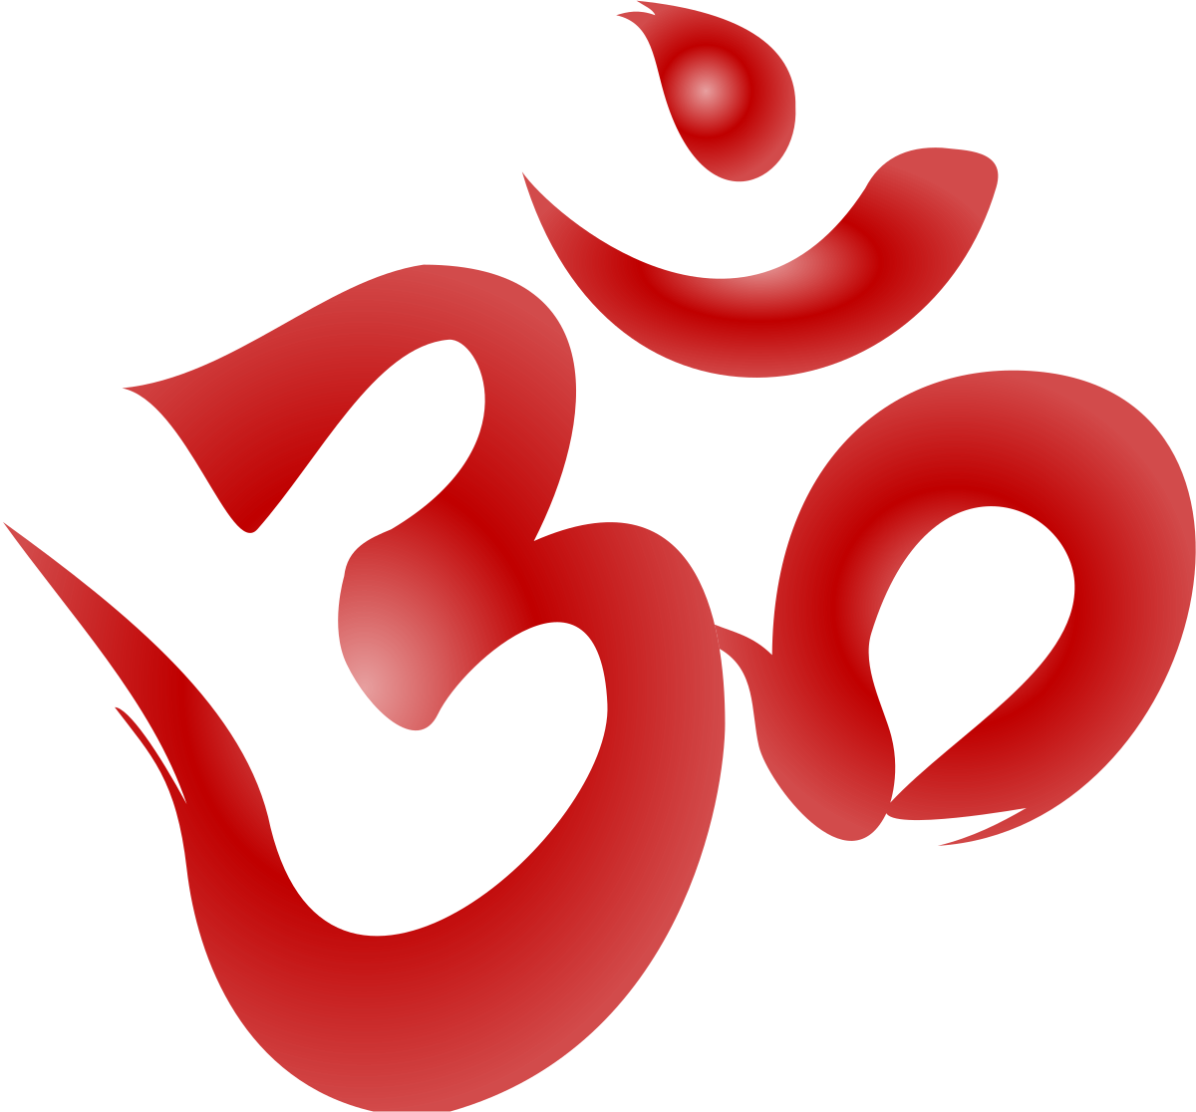


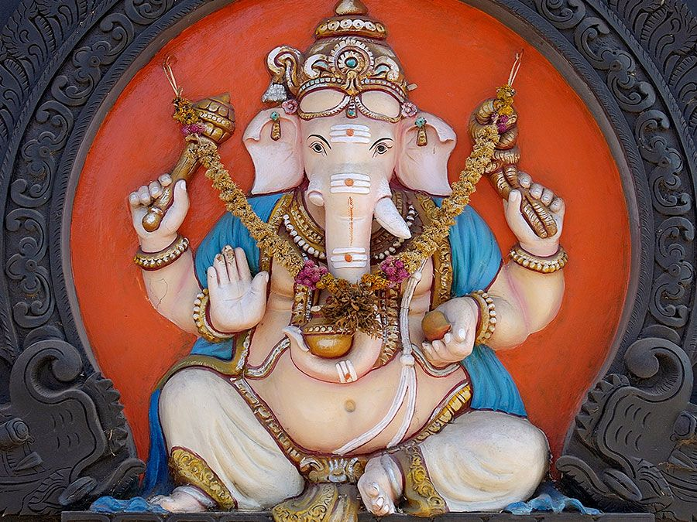

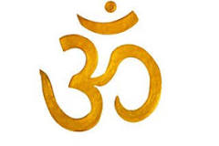
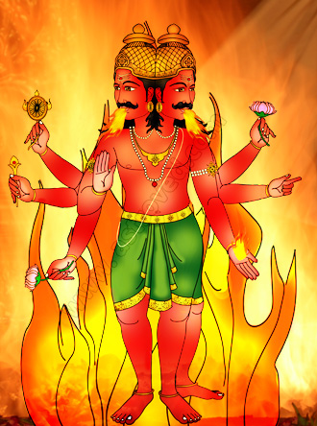
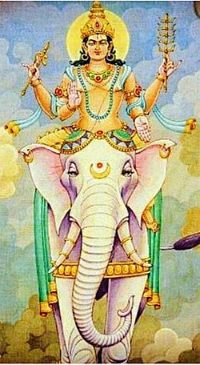
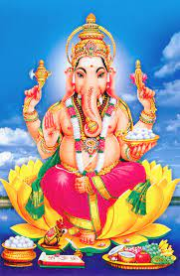
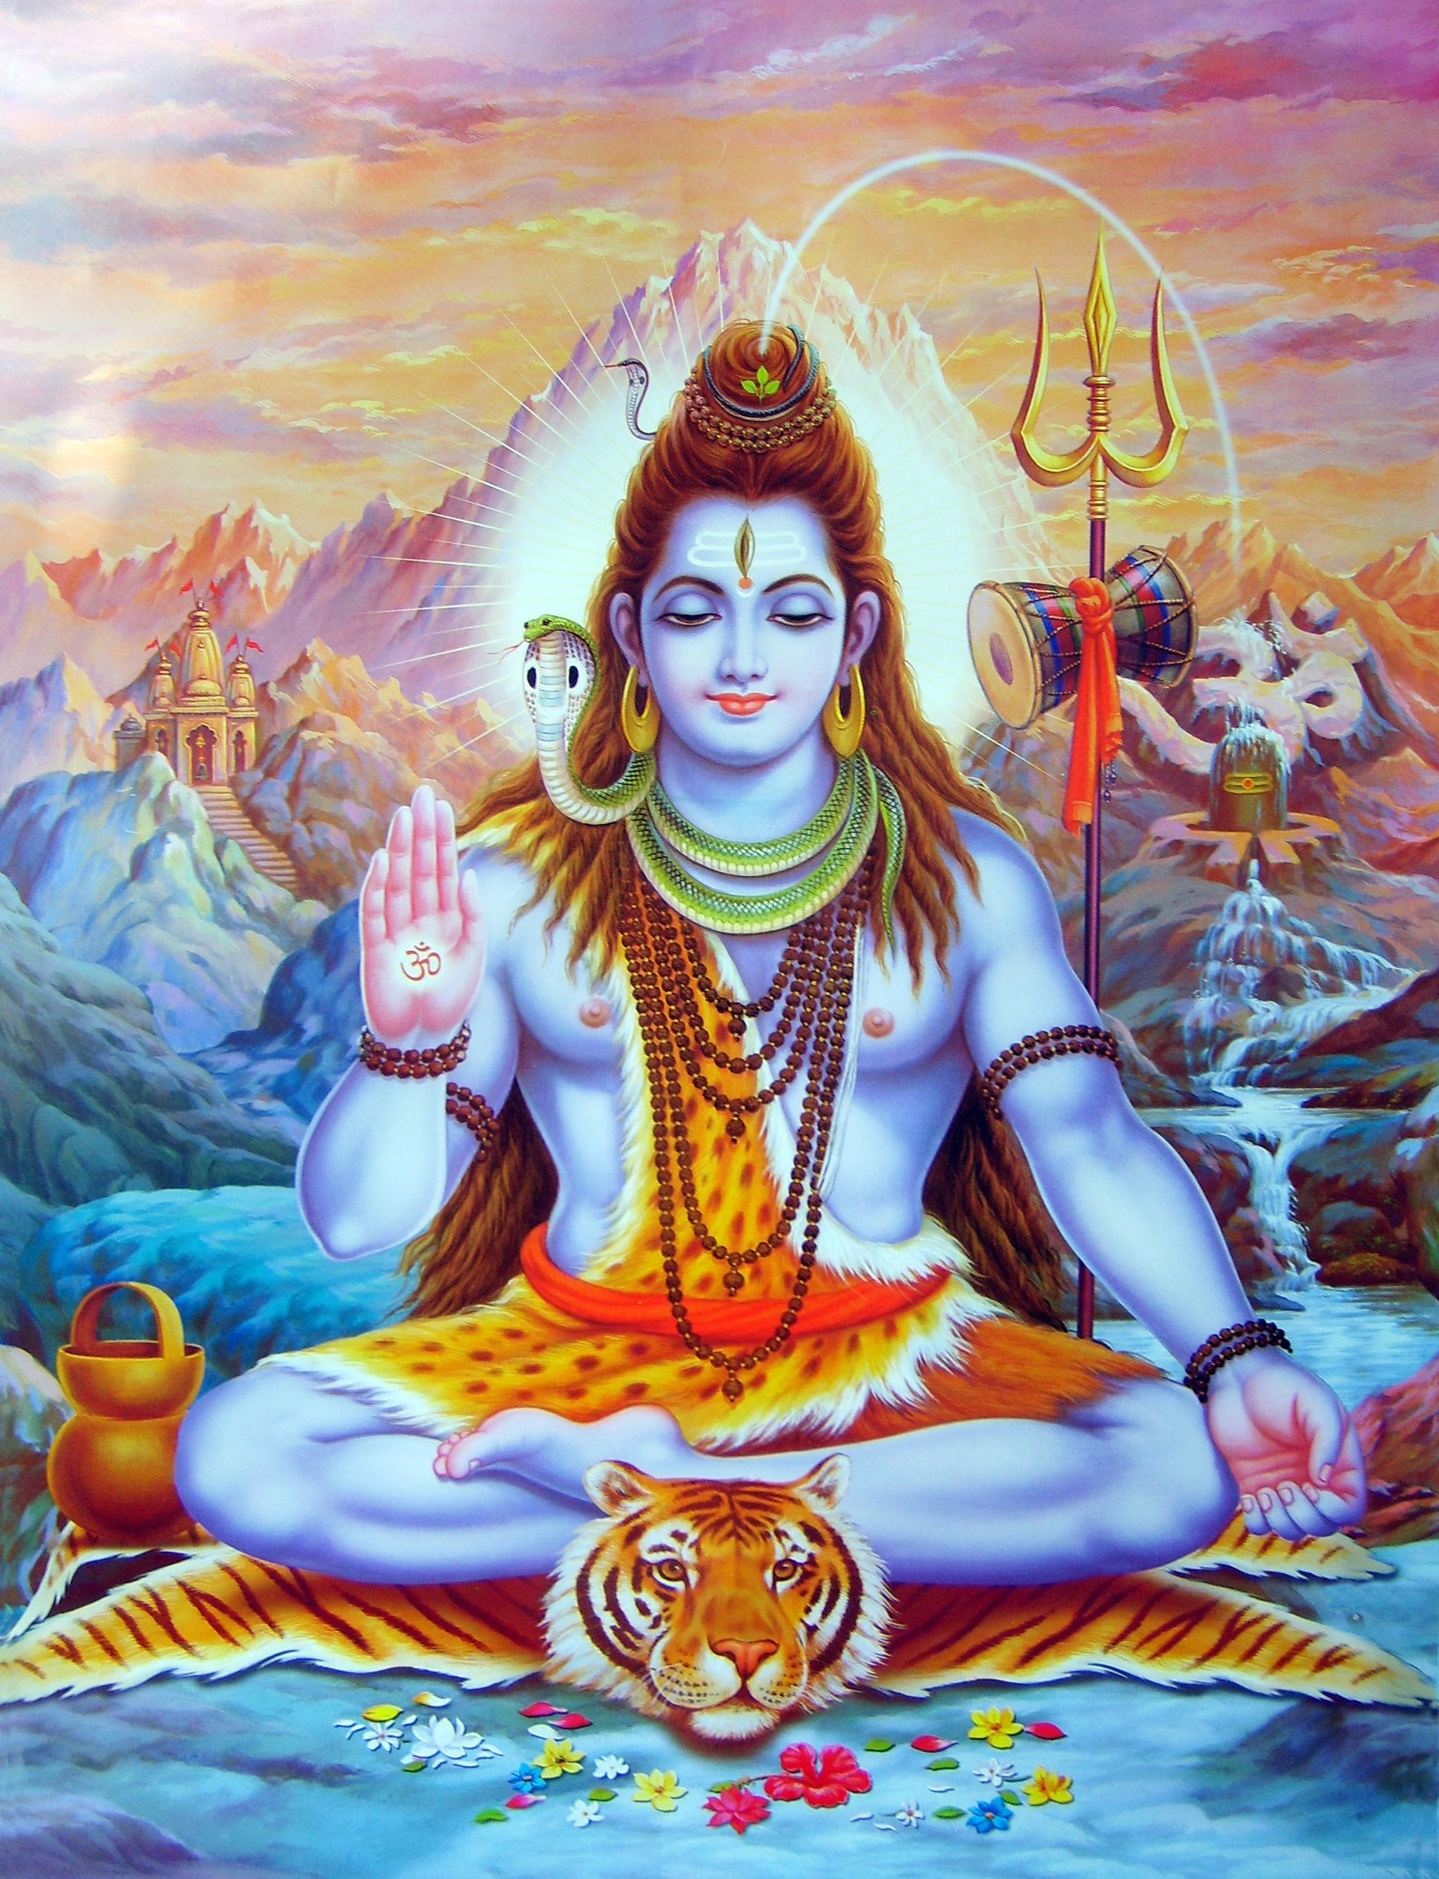
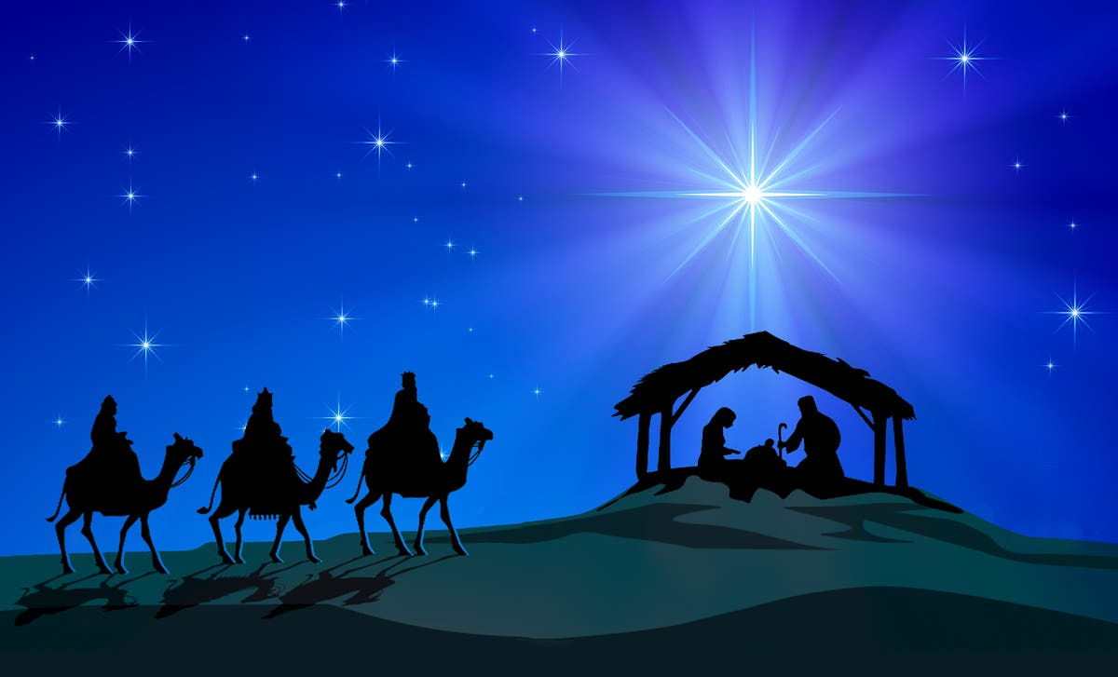
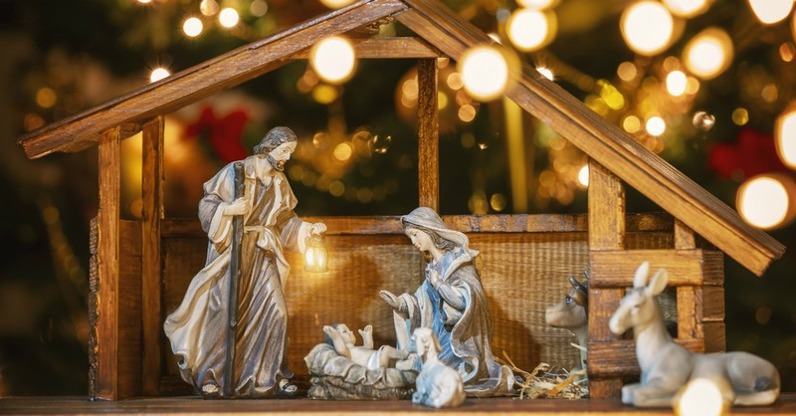
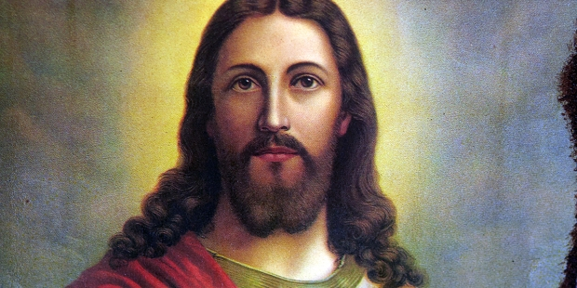

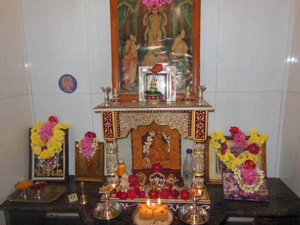
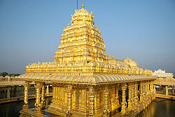
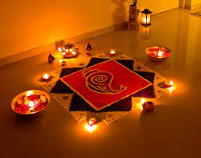
Why is it important to show commitment to God for different people?
YEAR 5 – AUTUMN 2
Christianity
The Christian belief is based on the person and teachings of Jesus Christ.
Hinduism
Hindus believe in Brahman as the one true God who is formless, limitless, allinclusive, and eternal.
How do Christians show commitment to God?
One way is through following the Ten Commandments. Many Christians show commitment to God by attending church every Sunday and worshipping God. Well known Christian celebrations include Christmas and Easter. There are different accounts of the Christmas story.
Gods and Goddesses
Hindu’s pray to a range of Gods and Goddesses, all which have a part of Brahman in. Brahman is said to be everywhere.
Christianity
Hinduism
Key Vocabulary | Definition
Commitment | dedicating yourself to something.
Trimurti | The Trimurti (three form) Brahman is the creator, Vishnu is the preserver and Shiva is the destroyer.
Karma | Karma refers to both the actions and the consequences of the actions.
Gayatri Mantra | The morning Hindu Prayer.
Prayer | A hope or wish.
Hinduism consists of lots of rites and ceremonies.
Ceremonies and rituals are performed to bring spirituality into human life and show feelings of devotion. A well know ceremony of Hinduism is Diwali, the festival of light.
Questions to ponder…
What is a commitment?
How do we show we are committed?
What is a rite?
What do different faiths believe about death?

