Slide 1




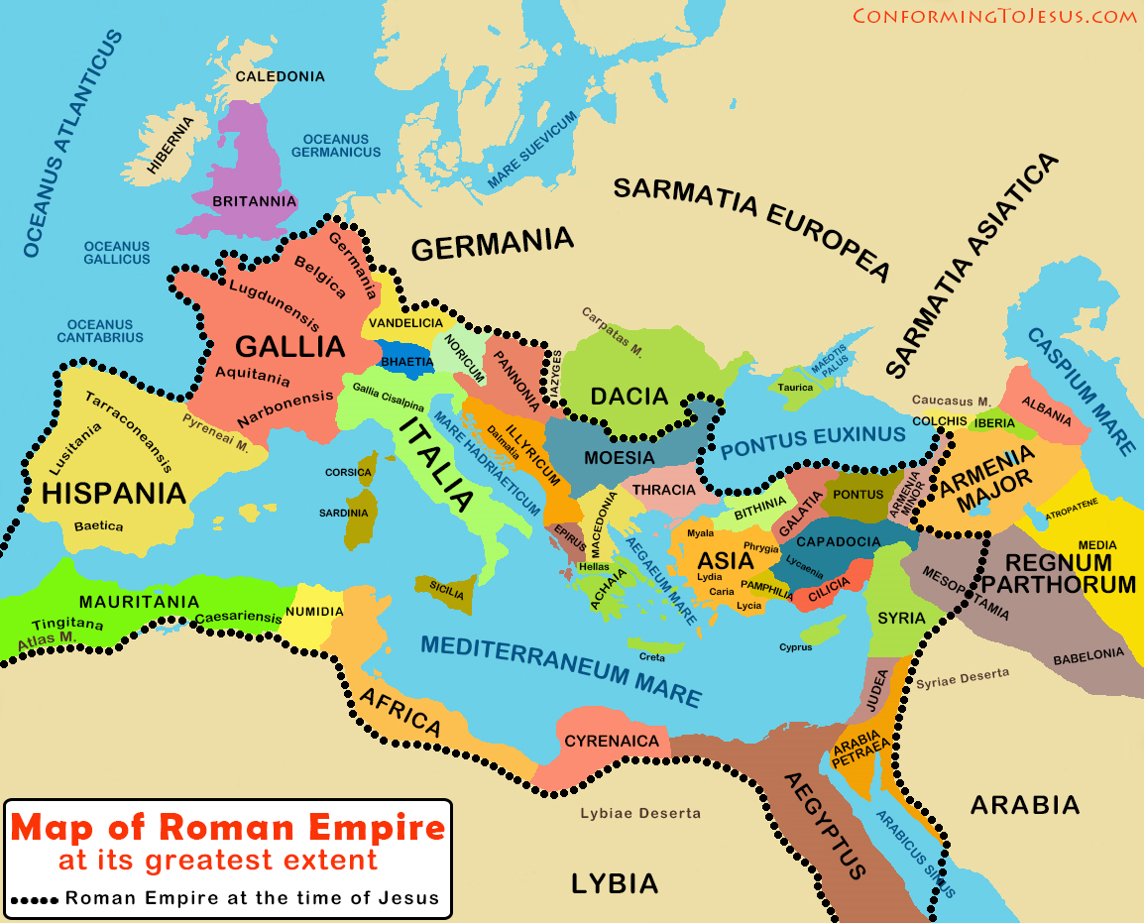


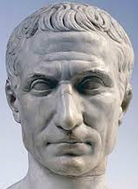

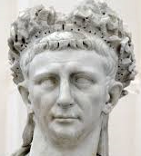
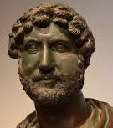
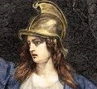

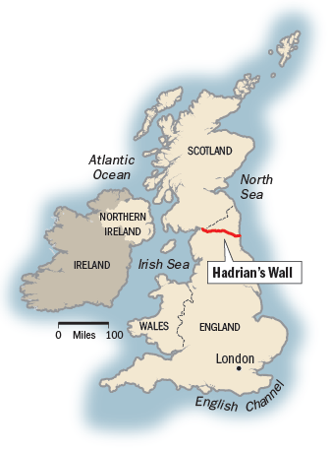





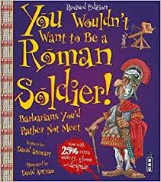
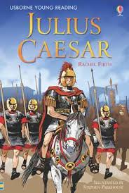

Timeline of key Roman events
793 BC | 510BC | 130BC | 55BC | 54BC | 43AD | 60AD | 71AD | 122AD | 200AD | 235-285AD | 410AD
Building of Rome begins | Rome becomes a Republic | Romans conquer Greece and most of Spain. | Julius Caesar invaded Britain, failed due to the weather and the seas | Julius Caesar invades Britain | Claudius invades Britain and becomes ruler after 30 years | Boudicca rebels against the Romans, but is defeated | Romans conquer Northern England | Hadrian’s Wall was built to keep the Celts out | Barbarians attack the Roman Empire. | Over 20 Roman Emperors killed. | Roman rule in Britain ends, they leave and return to Italy.
Year 4 Autumn Term History 1
What did the Romans do for us?
Vocabulary
city | Large town given title by the crown
invasion | One country attacking another
Army General | Officer of the highest rank
hostage | Person captured by another
empire | Group of countries controlled by one ruler
trade | Activity of buying, selling or exchanging goods
conquer | One group takes over another, taking complete control
rebel | Rise up against authority, especially by force
attack | Hurt or damage a person or place using physical violence
defeat | Win victory over someone in battle
fort | Strong building with a wall around it, to protect soldiers
government | Group of people responsible for ruling a country
Key People
Julius Caesar 100BC-44BC | Augustus 27BC-14AD | Claudius 10AD-54AD | Hadrian 76AD-138AD | Queen Boudicca c30AD-60AD
Exciting books
What was Roman Britain?
Roman Britain was part of the Roman empire from 43AD to 409AD. Before the invasions the tribes of Britain had already begun trading with the rest of Europe, but the Roman invaders introduced new developments such as straight roads, stone buildings, central heating and reading and writing in Latin. After an initial failed attempt to invade, the Romans succeeded on their 2nd attempt and Roman Britain began to develop. From 400AD Britain suffered repeated attacks from barbarian invasions and in c.409 Roman officials left Britain. Over the next 150 years most of the Roman cities fell into ruins, nevertheless, the lasting impact of Roman Rule was seen for many centuries to come because of the changes they had brought to Britain during their time as rulers.

