Slide 1
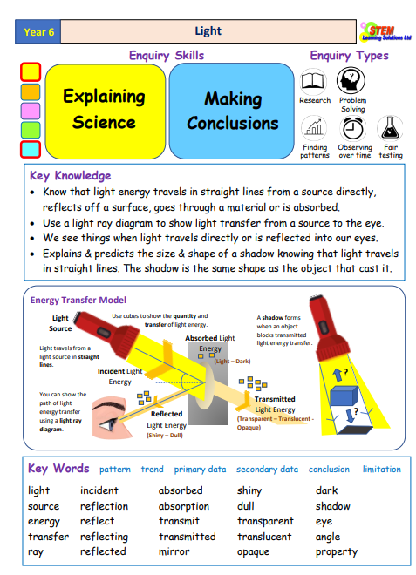

Year 6 Term 2: Light and Sight

