Slide 1



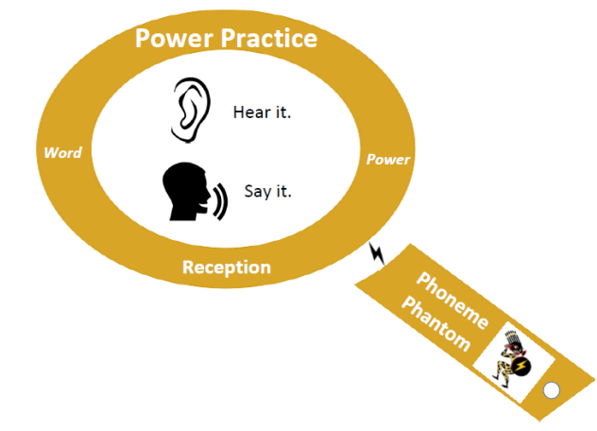
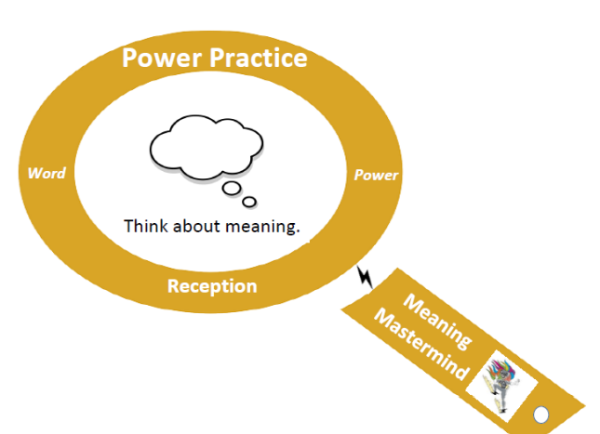
Vocabulary @ Middlethorpe (EYFS)
Children will have opportunity to learn their ‘Weekly 10 Words.’
A vocabulary session to be carried out before every guided reading session. 5 words of the Weekly Ten.
Day 1 (2 x Tier Two Words from POR Driver Text)
Day 2,3,4 (1 x Tier Two Words from POR Driver Text or Independent Text on Day 4).
These words will be linked to the text which will be read that lesson to expose children to Tier 2 words.
Teachers to incorporate the other 5 words of their Weekly Ten into their Science planning/ Driver Subject planning/ Afternoon Curriculum planning.
Say the word. Repeat the word in a variety of ways.
Discuss the meaning of the word in a child friendly way. Make the definition as easy as possible.
Introduce the Ambitious Word.

Slide 2
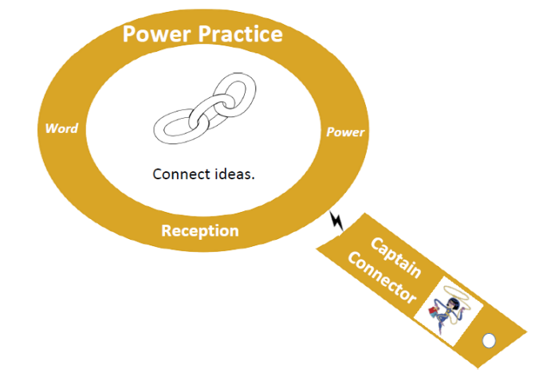
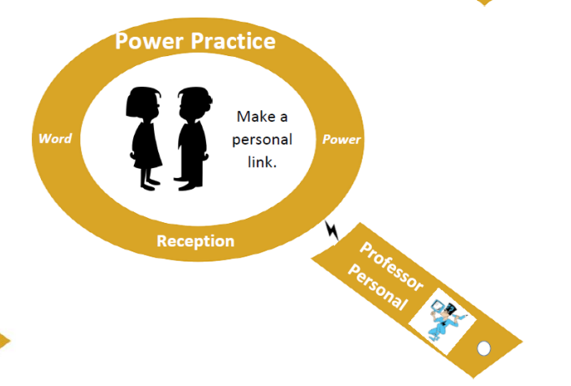
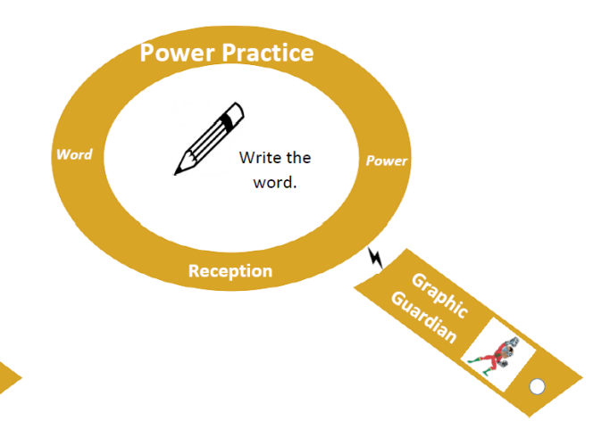
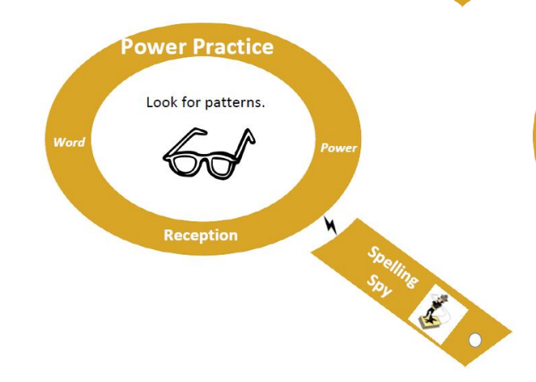
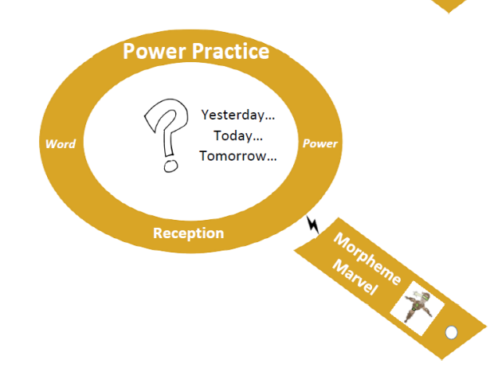
Vocabulary @ Middlethorpe (EYFS)
Children will have opportunity to learn their ‘Weekly 10 Words.’
A vocabulary session to be carried out before every guided reading session. 5 words of the Weekly Ten.
Day 1 (2 x Tier Two Words from POR Driver Text)
Day 2,3,4 (1 x Tier Two Words from POR Driver Text or Independent Text on Day 4).
These words will be linked to the text which will be read that lesson to expose children to Tier 2 words.
Teachers to incorporate the other 5 words of their Weekly Ten into their Science planning/ Driver Subject planning/ Afternoon Curriculum planning.
Does it sound like any other words?
Has it got any sounds which have learnt?
Write the word.
Are their any links from yesterday?
Ask children to think about how the word links to them.

Slide 3

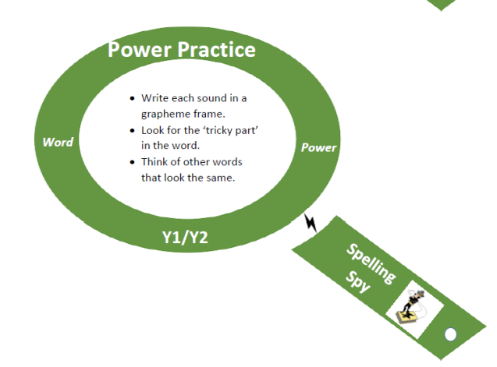
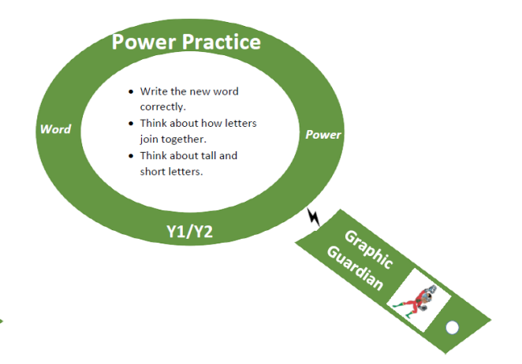
Vocabulary @ Middlethorpe (Year 1 and 2 )
Children will have opportunity to learn their ‘Weekly 10 Words.’
A vocabulary session to be carried out before every guided reading session. 5 words of the Weekly Ten.
Day 1 (2 x Tier Two Words from POR Driver Text)
Day 2,3,4 (1 x Tier Two Words from POR Driver Text or Independent Text on Day 4).
These words will be linked to the text which will be read that lesson to expose children to Tier 2 words.
Teachers to incorporate the other 5 words of their Weekly Ten into their Science planning/ Driver Subject planning/ Afternoon Curriculum planning.
Write it.

Slide 4
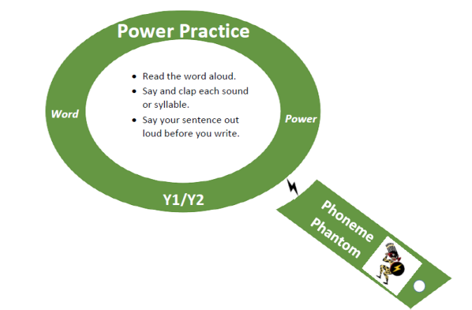
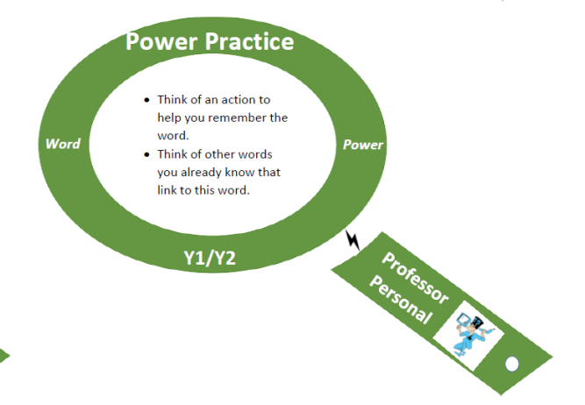
Vocabulary @ Middlethorpe (Year 1 and 2)
Children will have opportunity to learn their ‘Weekly 10 Words.’
A vocabulary session to be carried out before every guided reading session. 5 words of the Weekly Ten.
Day 1 (2 x Tier Two Words from POR Driver Text)
Day 2,3,4 (1 x Tier Two Words from POR Driver Text or Independent Text on Day 4).
These words will be linked to the text which will be read that lesson to expose children to Tier 2 words.
Teachers to incorporate the other 5 words of their Weekly Ten into their Science planning/ Driver Subject planning/ Afternoon Curriculum planning.
Say the word. Repeat the word in a variety of ways.
Say and clap the syllables
Discuss the meaning of the word in a child friendly way. Make the definition as easy as possible.
Think of the children to think of an action which could help them remember the word.
Introduce the Ambitious Word.

Slide 5
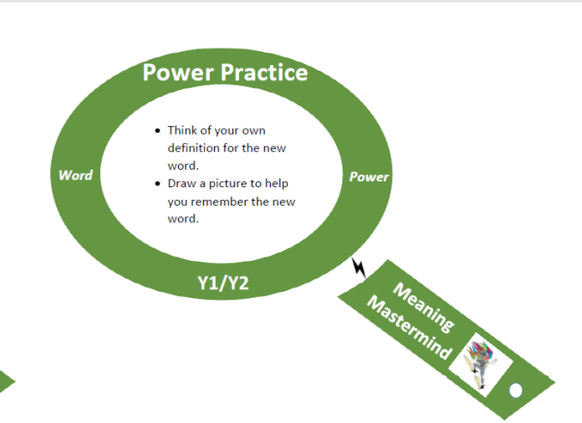
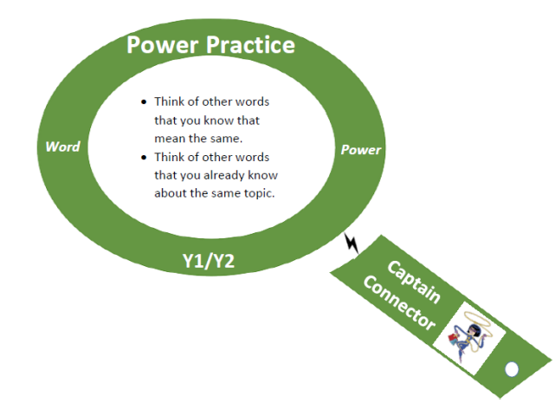
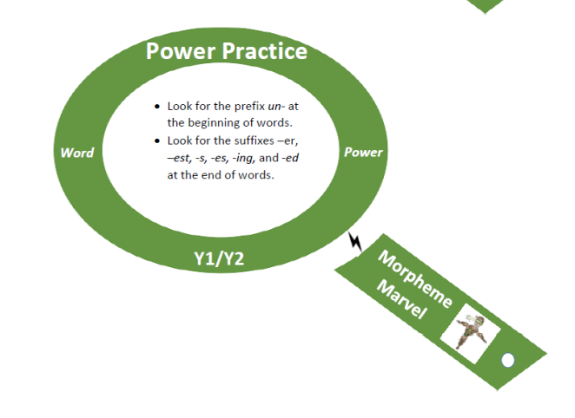
Vocabulary @ Middlethorpe (Year 1 and 2 )
Children will have opportunity to learn their ‘Weekly 10 Words.’
A vocabulary session to be carried out before every guided reading session. 5 words of the Weekly Ten.
Day 1 (2 x Tier Two Words from POR Driver Text)
Day 2,3,4 (1 x Tier Two Words from POR Driver Text or Independent Text on Day 4).
These words will be linked to the text which will be read that lesson to expose children to Tier 2 words.
Teachers to incorporate the other 5 words of their Weekly Ten into their Science planning/ Driver Subject planning/ Afternoon Curriculum planning.
Children to draw a pictures to help them remember the word.
Think of other words which you know mean the same.
How does this change the meaning of the word?

Slide 6
Vocabulary @ Middlethorpe (Year 1 and 2 )
Children will have opportunity to learn their ‘Weekly 10 Words.’
A vocabulary session to be carried out before every guided reading session. 5 words of the Weekly Ten.
Day 1 (2 x Tier Two Words from POR Driver Text)
Day 2,3,4 (1 x Tier Two Words from POR Driver Text or Independent Text on Day 4).
These words will be linked to the text which will be read that lesson to expose children to Tier 2 words.
Teachers to incorporate the other 5 words of their Weekly Ten into their Science planning/ Driver Subject planning/ Afternoon Curriculum planning.
Write it.

Slide 7

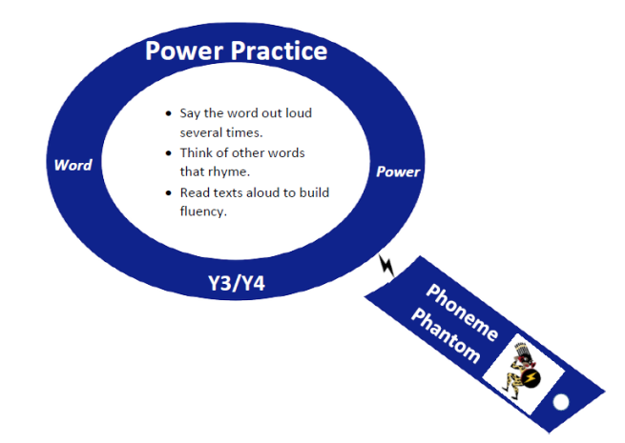
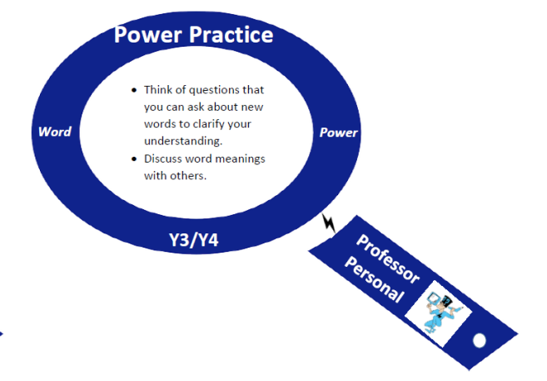
Vocabulary @ Middlethorpe (Year 3 and 4 )
Children will have opportunity to learn their ‘Weekly 10 Words.’
A vocabulary session to be carried out before every guided reading session. 5 words of the Weekly Ten.
Day 1 (2 x Tier Two Words from POR Driver Text)
Day 2,3,4 (1 x Tier Two Words from POR Driver Text or Independent Text on Day 4).
These words will be linked to the text which will be read that lesson to expose children to Tier 2 words.
Teachers to incorporate the other 5 words of their Weekly Ten into their Science planning/ Driver Subject planning/ Afternoon Curriculum planning.
Introduce the Ambitious Word.
Say the word. Repeat the word in a variety of ways.
What words does it sound like or rhyme with?
For younger children, you could get them to say it in a variety of voices to make it more engaging.
Look at on the word in the text. What could it mean?
Encourage the children to ask questions about the word and teacher can give clues.

Slide 8
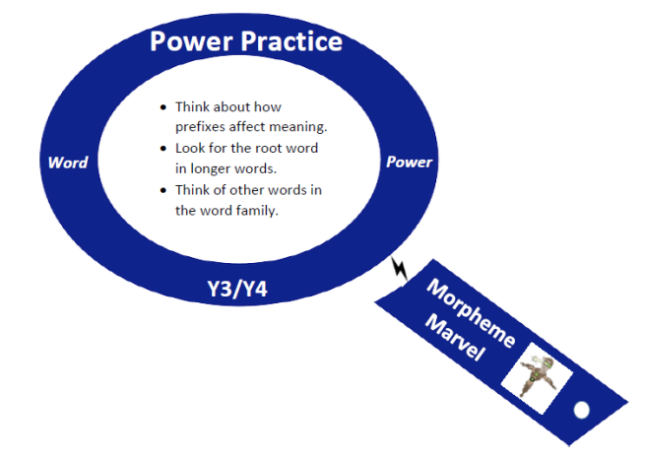
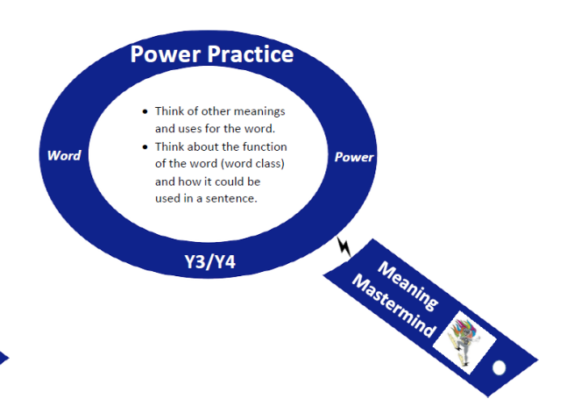
Vocabulary @ Middlethorpe (Year 3 and 4 )
Children will have opportunity to learn their ‘Weekly 10 Words.’
A vocabulary session to be carried out before every guided reading session. 5 words of the Weekly Ten.
Day 1 (2 x Tier Two Words from POR Driver Text)
Day 2,3,4 (1 x Tier Two Words from POR Driver Text or Independent Text on Day 4).
These words will be linked to the text which will be read that lesson to expose children to Tier 2 words.
Teachers to incorporate the other 5 words of their Weekly Ten into their Science planning/ Driver Subject planning/ Afternoon Curriculum planning.
Discuss the meaning of the word in a child friendly way. Make the definition as easy as possible.
Discuss prefixes affect the word and the root words within the word.
Speak about the word class of the word?

Slide 9
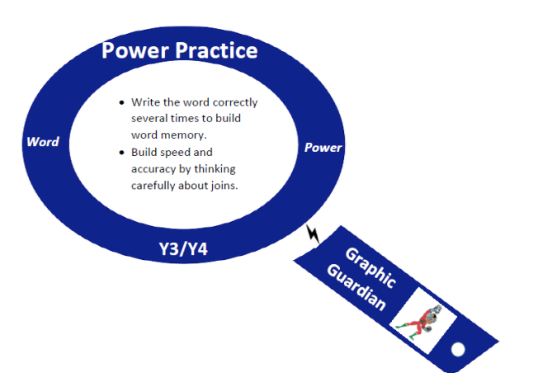
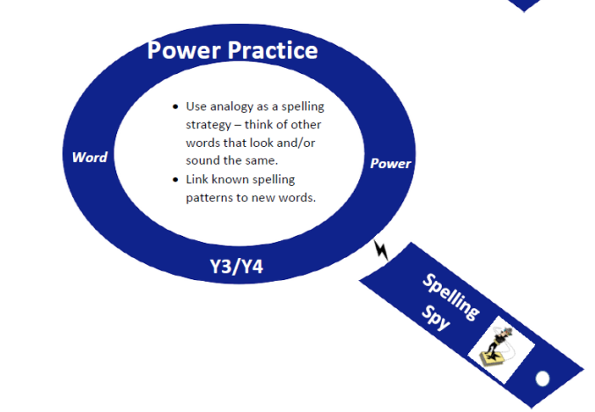
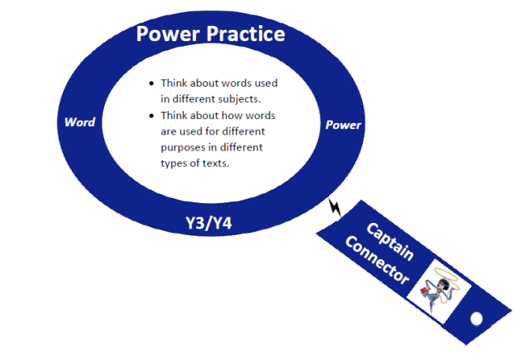
Vocabulary @ Middlethorpe (Year 3 and 4 )
Children will have opportunity to learn their ‘Weekly 10 Words.’
A vocabulary session to be carried out before every guided reading session. 5 words of the Weekly Ten.
Day 1 (2 x Tier Two Words from POR Driver Text)
Day 2,3,4 (1 x Tier Two Words from POR Driver Text or Independent Text on Day 4).
These words will be linked to the text which will be read that lesson to expose children to Tier 2 words.
Teachers to incorporate the other 5 words of their Weekly Ten into their Science planning/ Driver Subject planning/ Afternoon Curriculum planning.
Discuss any spelling patterns which of the new words
Make connections with other subjects.
Write it.
Put the word in a sentence and allow time for children to read/ share their sentence to check application of the word.

Slide 10
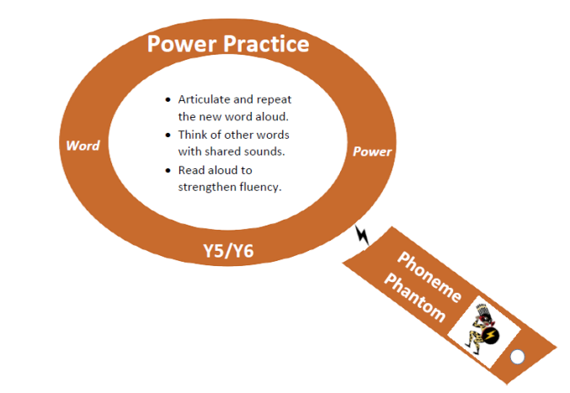
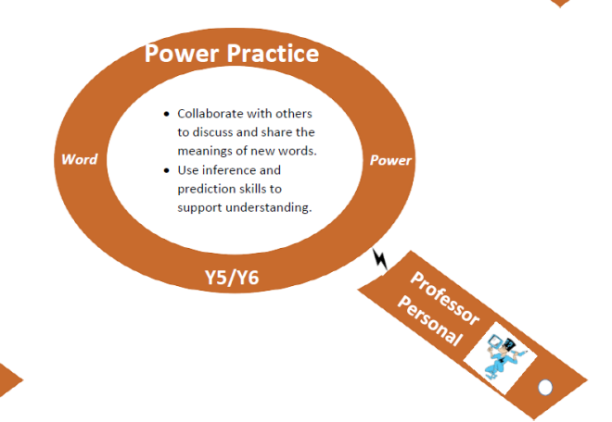
Vocabulary @ Middlethorpe (Year 5 and 6 )
Children will have opportunity to learn their ‘Weekly 10 Words.’
A vocabulary session to be carried out before every guided reading session. 5 words of the Weekly Ten.
Day 1 (2 x Tier Two Words from POR Driver Text)
Day 2,3,4 (1 x Tier Two Words from POR Driver Text or Independent Text on Day 4).
These words will be linked to the text which will be read that lesson to expose children to Tier 2 words.
Teachers to incorporate the other 5 words of their Weekly Ten into their Science planning/ Driver Subject planning/ Afternoon Curriculum planning.
Introduce the Ambitious Word.
Say the word. Repeat the word in a variety of ways.
What words does it sound like?
Look at on the word in the text. What could it mean?
Encourage children to read around the word and think about what the word could mean.

Slide 11
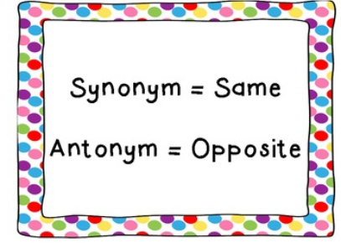
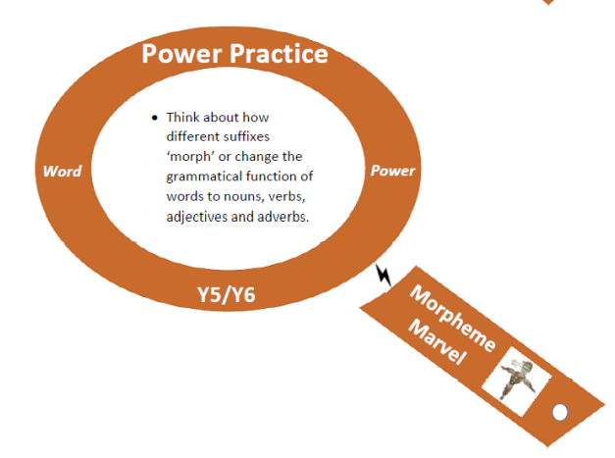
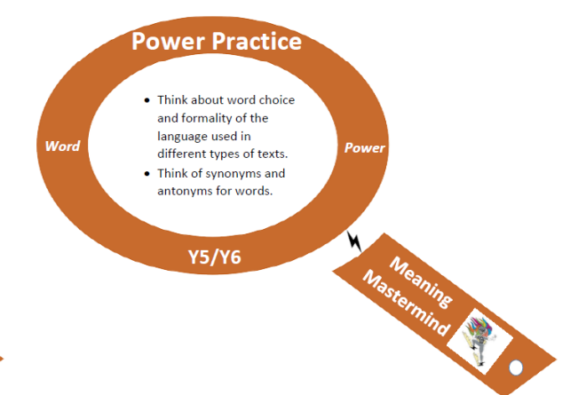
Vocabulary @ Middlethorpe (Year 5 and 6 )
Children will have opportunity to learn their ‘Weekly 10 Words.’
A vocabulary session to be carried out before every guided reading session. 5 words of the Weekly Ten.
Day 1 (2 x Tier Two Words from POR Driver Text)
Day 2,3,4 (1 x Tier Two Words from POR Driver Text or Independent Text on Day 4).
These words will be linked to the text which will be read that lesson to expose children to Tier 2 words.
Teachers to incorporate the other 5 words of their Weekly Ten into their Science planning/ Driver Subject planning/ Afternoon Curriculum planning.
Discuss the meaning of the word in a child friendly way. Make the definition as easy as possible.
Speak about the word class of the word?
Discuss the possibility of it being used in a variety of ways.
(This could be how a suffix or prefix could change the word)
Example: information changes the word inform from a verb to a noun.
Children to find synonyms and antonyms

Slide 12

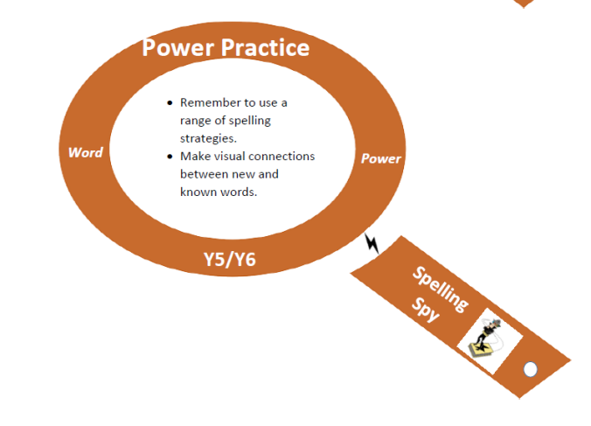
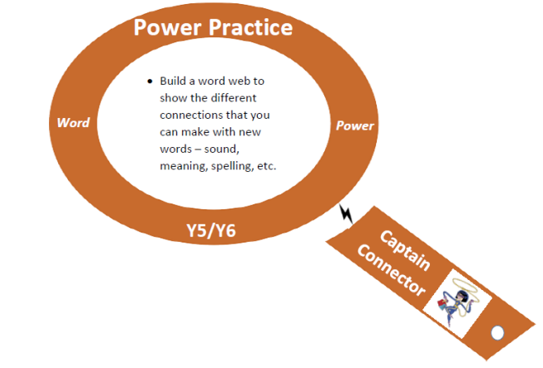
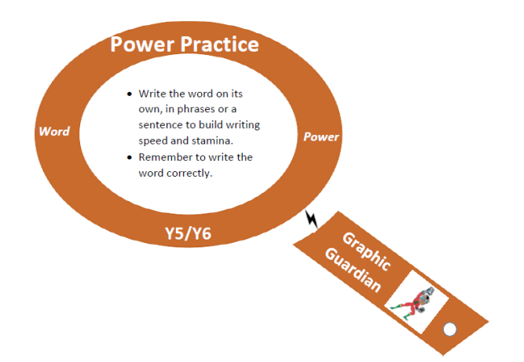
Vocabulary @ Middlethorpe (Year 5 and 6 )
Children will have opportunity to learn their ‘Weekly 10 Words.’
A vocabulary session to be carried out before every guided reading session. 5 words of the Weekly Ten.
Day 1 (2 x Tier Two Words from POR Driver Text)
Day 2,3,4 (1 x Tier Two Words from POR Driver Text or Independent Text on Day 4).
These words will be linked to the text which will be read that lesson to expose children to Tier 2 words.
Teachers to incorporate the other 5 words of their Weekly Ten into their Science planning/ Driver Subject planning/ Afternoon Curriculum planning.
Draw it.
Draw a visual representation of the word. Encourage children to make connections with words which they already know the meaning of
Write it.
Put the word in a sentence and allow time for children to read/ share their sentence to check application of the word.

