Slide 1
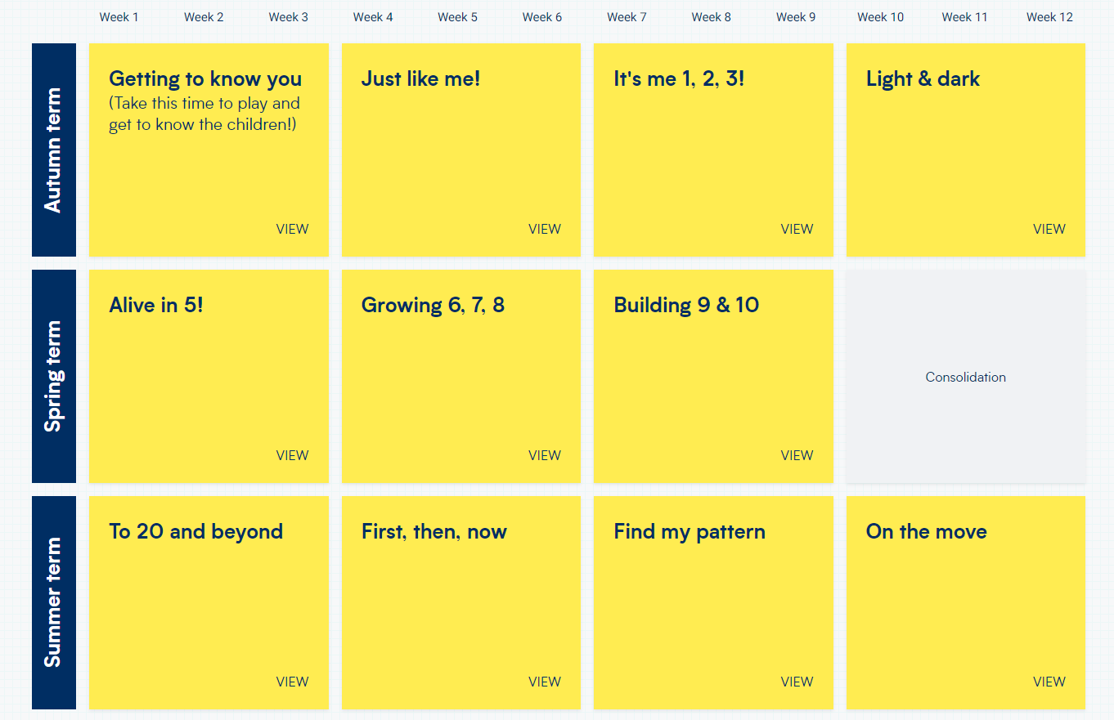
WRM-
EYFS Scheme of Learning

Slide 2
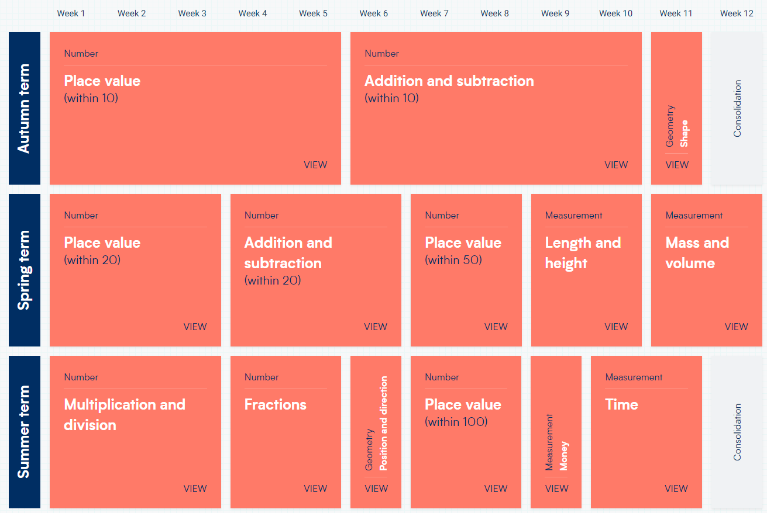
WRM-
Yr1 Scheme of Learning

Slide 3
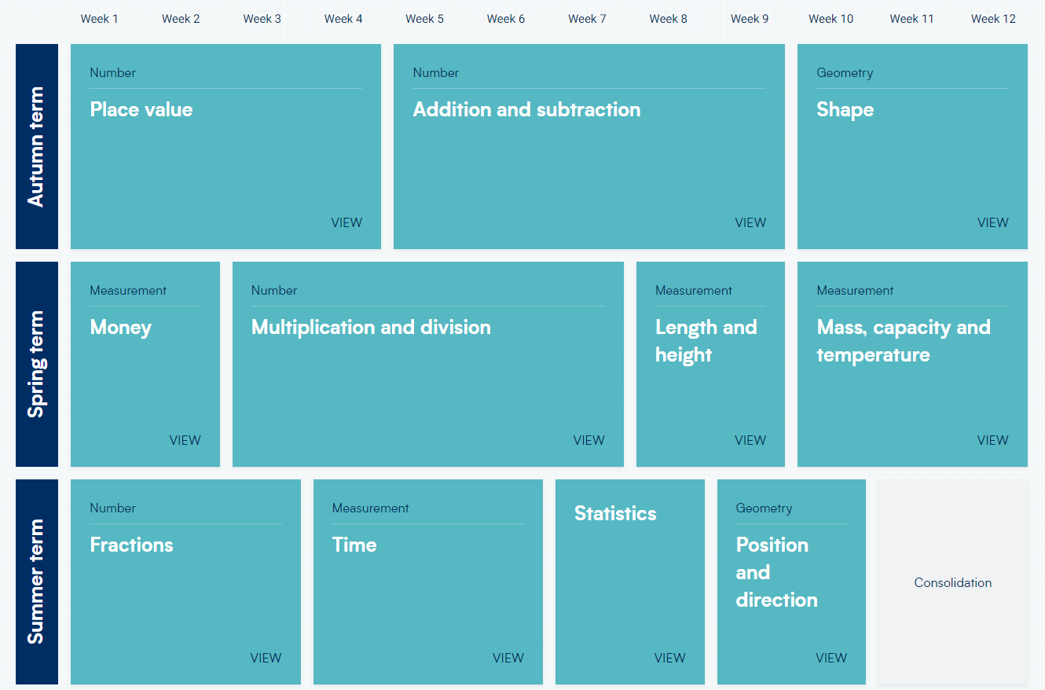
WRM-
Yr2 Scheme of Learning

Slide 4
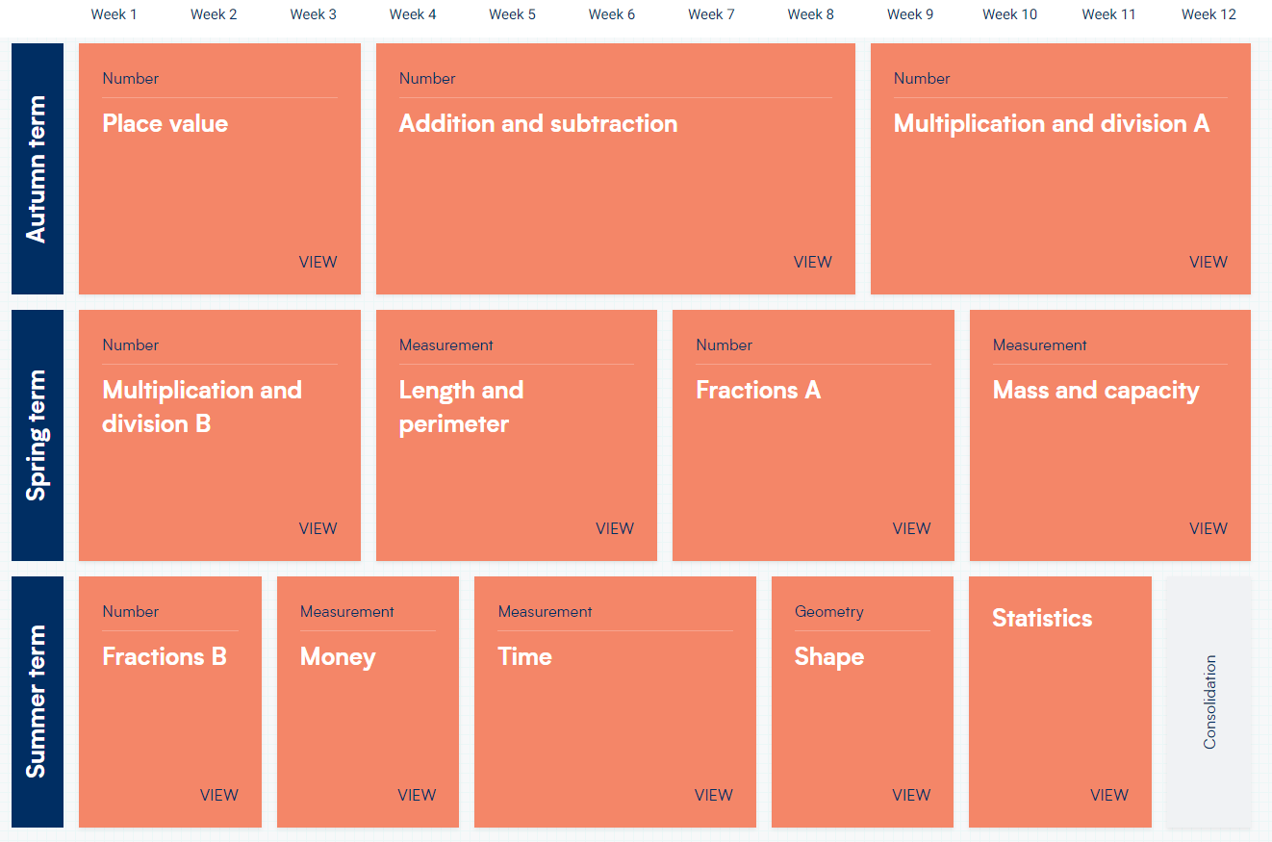
WRM-
Yr3 Scheme of Learning

Slide 5
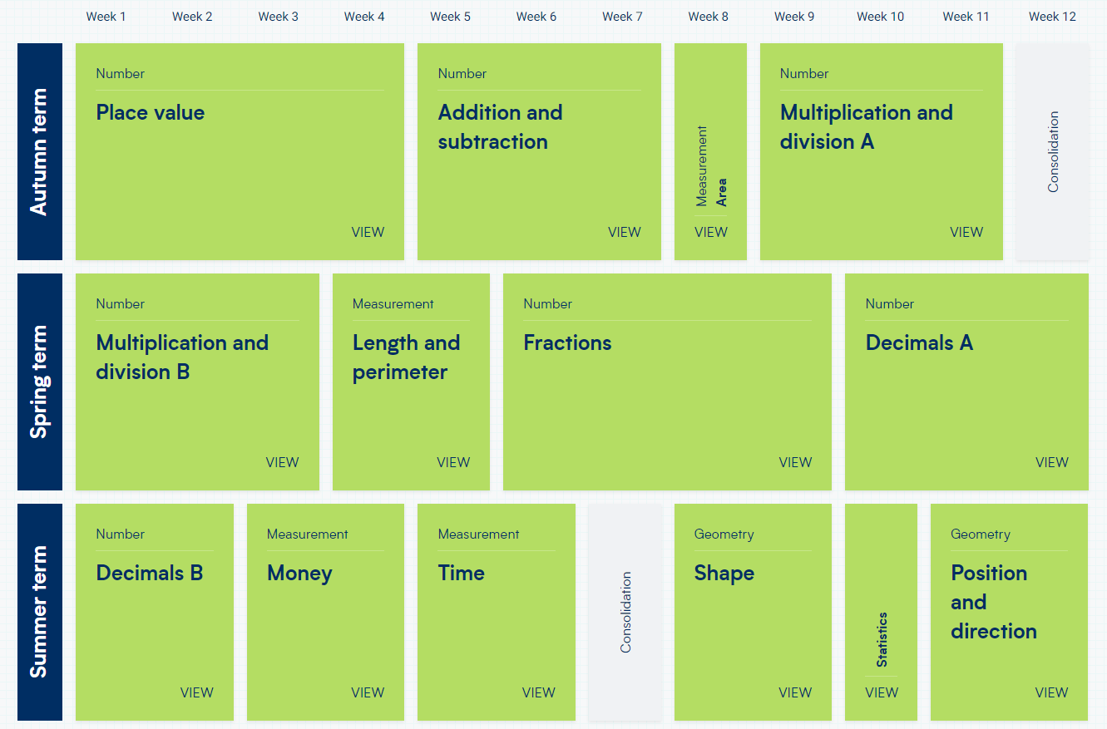
WRM-
Yr4 Scheme of Learning

Slide 6
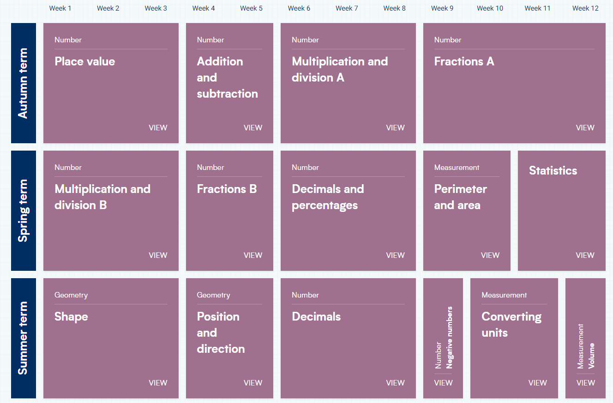
WRM-
Yr5 Scheme of Learning

Slide 7
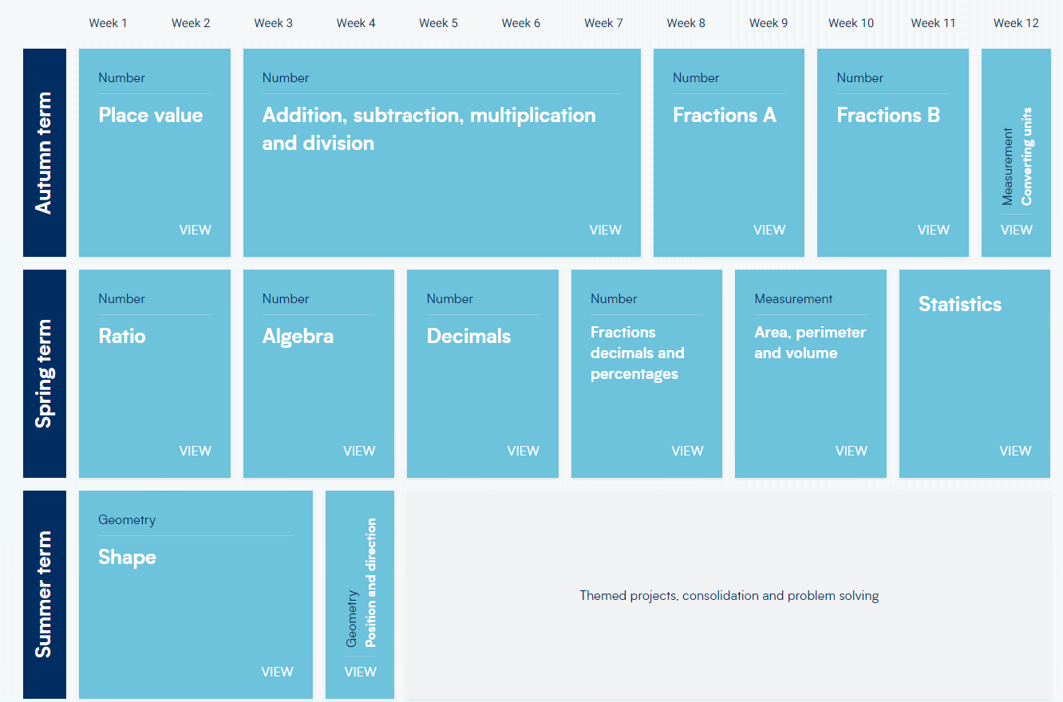
WRM-
Yr6 Scheme of Learning

