Slide 1



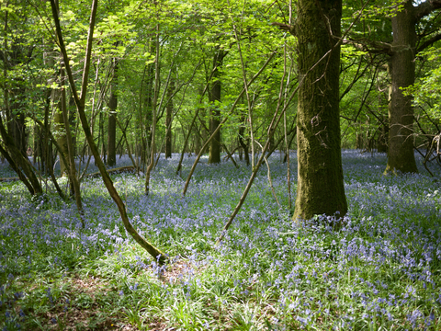

Writing Journey @ Middlethorpe
Section 1/ Day 1= Hook into genre.
Possible Ideas for Hook Lessons:
Drawing and analysing illustrations.
Hook children into the genre of text, giving them a purpose for their piece of writing.
Pose the questions:
-What should we write?
-Who should we write for?
Drama linked to genre or topic.
Experiences linked to genre or topic.
Video Clips (Literacy Shed)
Who is the audience?
What is the purpose?

Slide 2
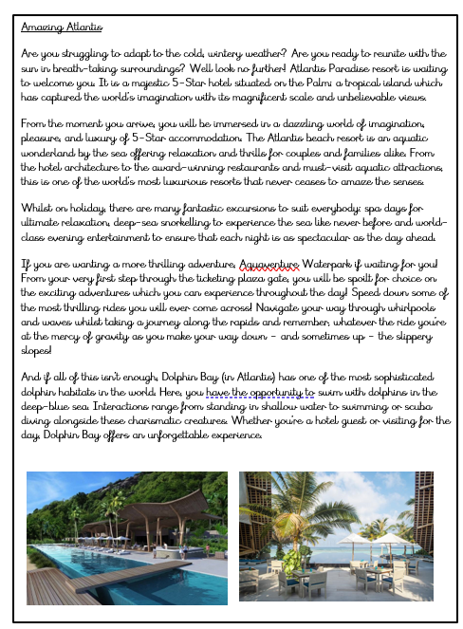


Writing Journey @ Middlethorpe
Section 2/ Day 2 = Text Interrogation
Interrogate a model text. What does a good one look like? What are they aiming for?
Pull the WAGOLL apart thinking about the following:
What is the structure like?
What grammatical features are to be included?
What type of tone is the text?
Children could generate a list of success criteria.
Children could use a double page spread to annotate with features.
Children could give three stars and a wish about a model text they read.

Slide 3
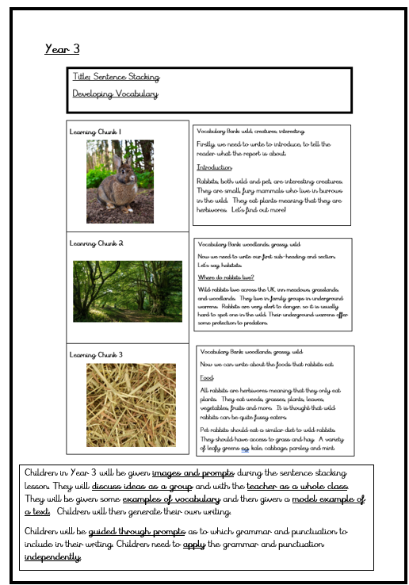
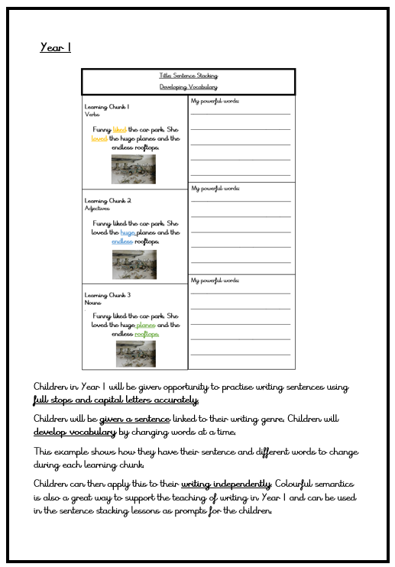
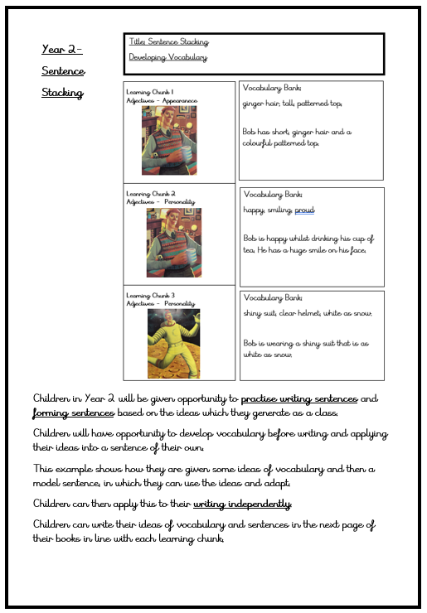
Writing Journey @ Middlethorpe
Section 3= Honing Writing Skills
(This will last multiple days often around 3-6 days-sometimes more.)
Giving children opportunity to write through ‘Sentence Stacking’ and ‘Short burst’ Writing.
Children will experience writing a shorter version of the text type. For example: a shorter version persuasive advert or a setting description/character description linked to a narrative.
This is to be done through a sentence stacking lesson and then a short burst writing opportunity.
This would include teacher modelling of the writing process and opportunities to share ideas.
Year 1
Year 2
Year 3

Slide 4
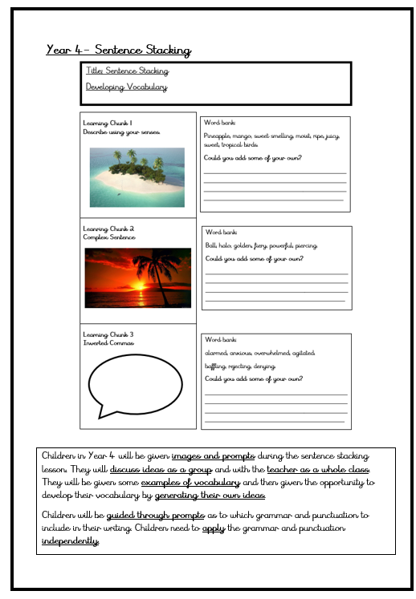
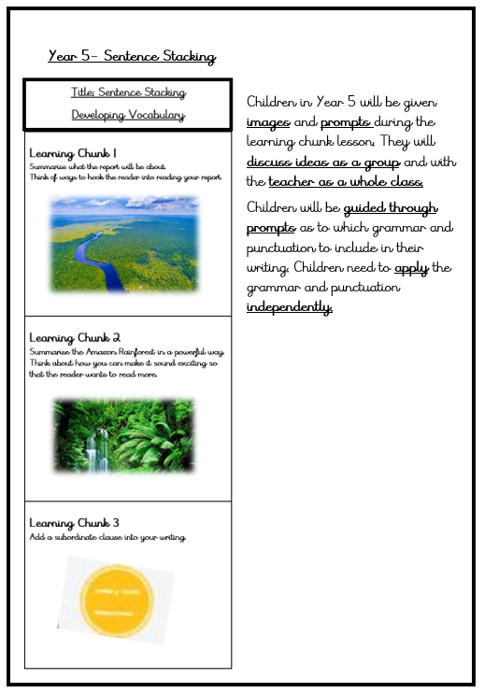
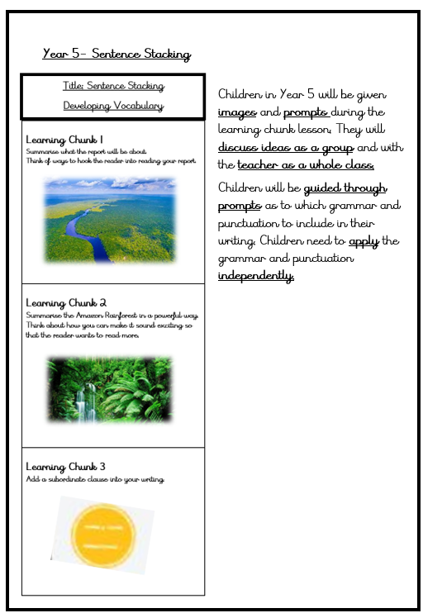
Writing Journey @ Middlethorpe
Section 3= Honing Writing Skills
(This will last multiple days often around 3-6 days)
Giving children opportunity to write through ‘Sentence Stacking’ and ‘Short burst’ Writing.
Children will experience writing a shorter version of the text type. For example: a shorter version persuasive advert or a setting description/character description linked to a narrative.
This is to be done through a sentence stacking lesson and then a short burst writing opportunity.
This would include teacher modelling of the writing process and opportunities to share ideas.
Year 4
Year 5
Year 6

Slide 5
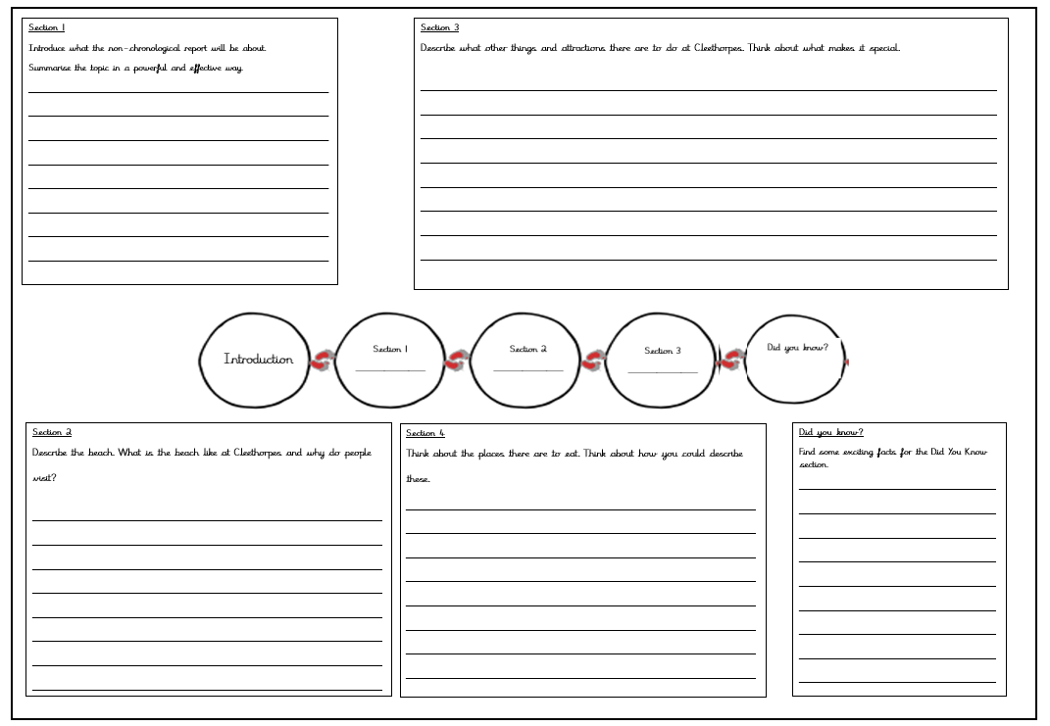

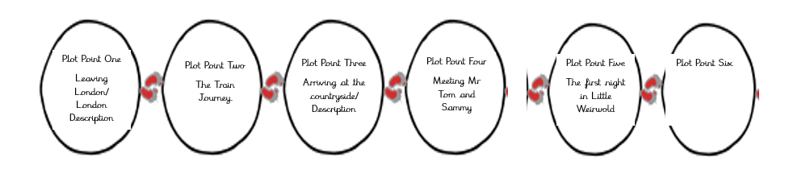
Writing Journey @ Middlethorpe
Section 4= Planning an Independent Final Piece
(This may often last two days to be a quality plan.)
Children to plan for their writing.
Children to think about how to structure the text.
Children to jot down their initial ideas which will form their final piece.
Non- Chronological Report Example.
Narrative Example.

Slide 6
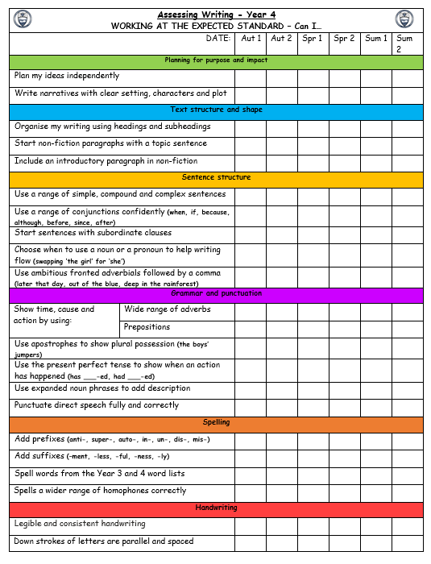
Writing Journey @ Middlethorpe
Section 5= Writing my Independent Piece
(This will often last multiple days)
Children to write their first draft
Success Criteria can be used (not in Year 6) to support the children with their writing process.
Using your assessment grids as a success criteria can help children understand what needs to be in the text type.
You may choose to just select the relevant objectives from the list which you expect to be used and discuss them in a more child-friendly way. Some objectives may not be relevant to the text type or may not have taught yet.

Slide 7
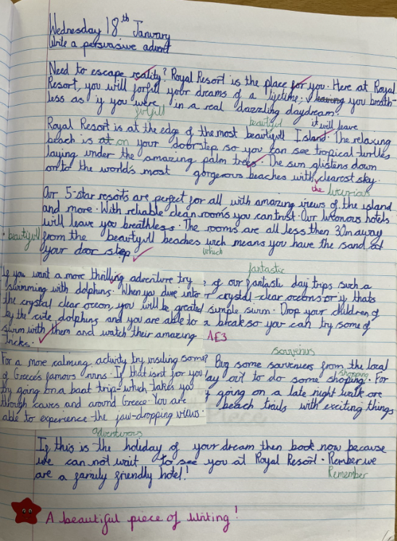
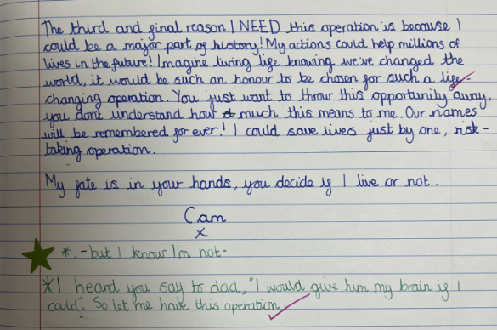
Writing Journey @ Middlethorpe
Section 6= Editing my Writing
Children could look at a bad example and re-write to help support and apply to their own learning
Children to edit their first draft thinking about how they can make it better.
Editing should have three focusses:
E1- Spelling, Punctuation and Grammar errors
E2- Editing parts of the writing which do not make sense.
E3- Adding more detail and re-writing sections to make it better.
Children could use editing flaps.
Children make edits in green pen.

Slide 8

Writing Journey @ Middlethorpe
Section 7= Publish and Perform
Children to publish their writing.
Children could share writing with others and receive peer feedback.
There should be an element of celebration

