Slide 1


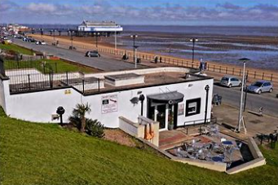
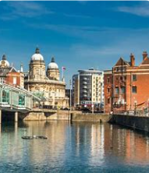
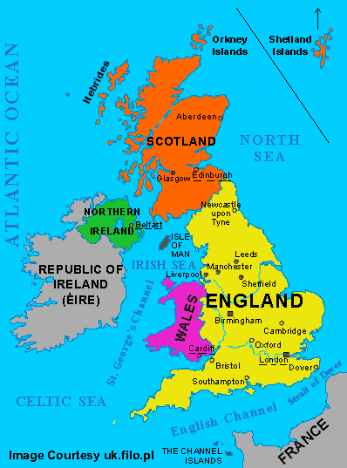
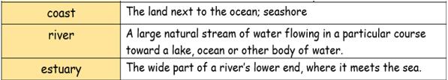



What is similar and different between Cleethorpes and Hull? Y1 T3
Cleethorpes
Hull
Country
An area of land with its own government
Region
An area or part of a country
Population
The number of people who live in a place
Location
A particular place or position
City
A large town
Locality
An area or neighbourhood
Human Features
Man-made features of the location.
Buildings, roads, schools, bridges, shops, houses.
Physical Features
Natural features of the location.
Rivers, mountains, lakes, seas, hills, valleys, beach.
Town
A built-up area, larger than a village and smaller than a city
Village
A group of houses and buildings, smaller than a town, in the countryside

