Slide 1
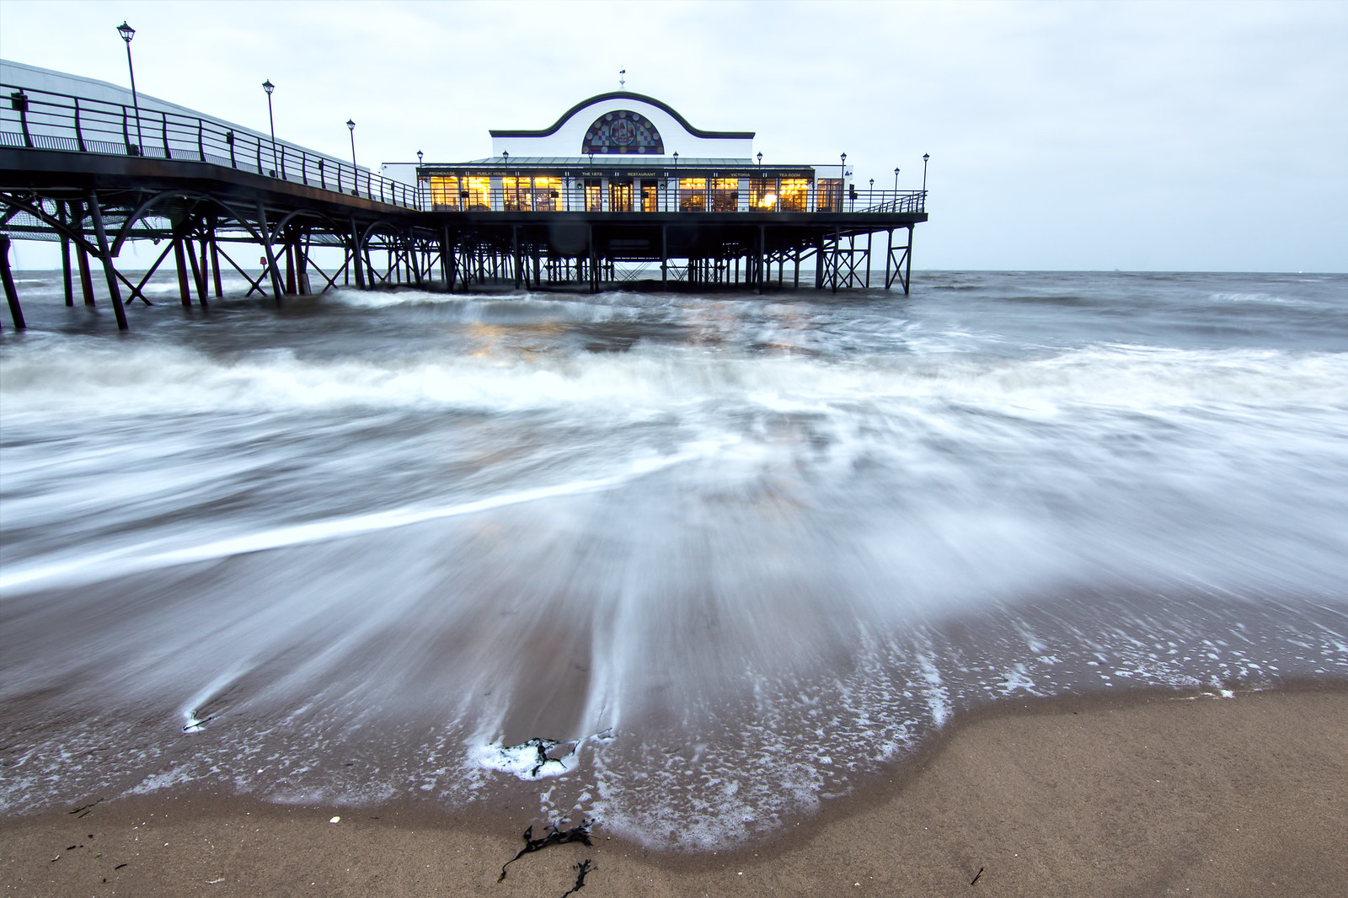

English
Our text this half term will be a story book called The Lighthouse Keeper’s Lunch, by Ronda and David Armitage.
We will focus on how to write a setting description as well as produce a recount from the character’s perspective.
We will continue to develop our phonics skills through Little Wandle, which includes whole class phonic sessions, small group work and guided reading sessions in Year 1.
Handwriting will remain a focus for us this term and we will work on improving the formation of pre-cursive letters, using Letter-join resources, paper and computer based.
Curriculum – Geography
This half term, our geography focus enquiry question will be, ‘What is similar and different about Cleethorpes and Hull?’ We will learn about the location of Cleethorpes and Hull and be able to identify them on a map of the UK. We will learn about the physical and human features of each place, then finally use our knowledge and geographical skills to be able to explain how Cleethorpes and Hull are the same and different.
Maths
In Year 1 this term we will extend our understanding of place value to 20 and apply it in addition and subtraction calculations.
Encouraging your child to have a go at this practically and explain their thinking and reasoning, will help to develop their confidence and be hugely beneficial within their Maths lessons.
We are continuing to focus on spotting reversals in our numerals, spelling numbers up to twenty and improving our mental maths skills .
Bluebell Class
Newsletter
Spring 1 2025
Mrs Colgan
Reading
Please continue to share the love of books with your child. Reading has such a positive impact on our children’s writing and spelling.
Your child’s Little Wandle e-book should be read 5 times per week to improve their fluency and recognition of words. We encourage the children to read and re-read books that contain sounds that they know. A library book of your child’s choice will be brought home to share too.
As always, please encourage your child to share online or real books. Any reading/sharing of books should be recorded on their Reading Record, one entry per day, and brought into school every Thursday. Certificates are given for 25 reads, then 50, 75 and 100 reads.
Science
This half term, Year 1 will learn about ‘Animals including humans’, We will identify and categorise animals including humans. We will also be looking at seasonal changes from autumn to winter, then winter to spring.
Learning Outcome
At the end of this term we will create a quiz, to challenge the children in Year 1.
Wider Curriculum
Computing –Computer science
PHSE – Dreams and Goals
Music – Charanga with Mr Carlton
PE – Interpretative Dance and Dodgeball
P.E.
Year 1 will have PE every Tuesday afternoon. Please ensure that children bring a full PE kit every week.. Children will be expected to come to school in their normal school uniform and we will teach them how to get changed for their lessons.
Long hair should be tied back and earrings removed where possible otherwise please provide plasters. Please remember to label all the children’s uniform, this really helps us to identify mislaid items.
Homework
Every Wednesday the children will be set one piece of homework linked to their Geography or Science Knowledge Organisers. This should be returned by the following Wednesday. Some creative homework will occasionally be included. Remember that any additional learning your child completes will be welcomed and celebrated.

