Slide 1

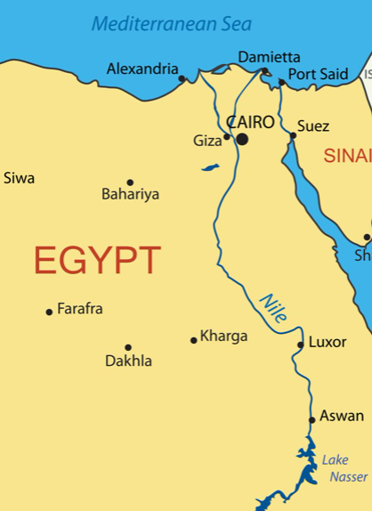
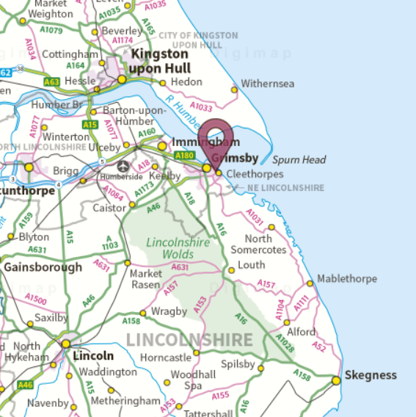
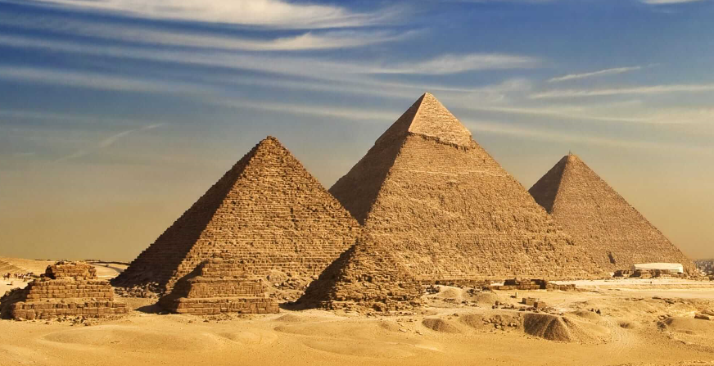
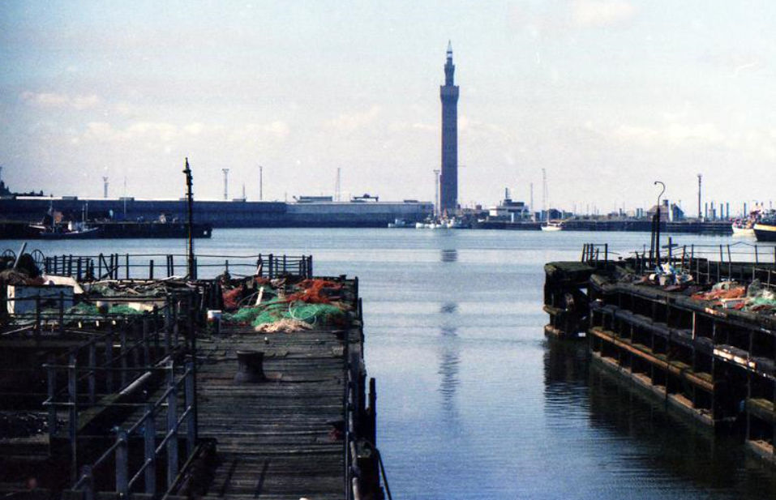
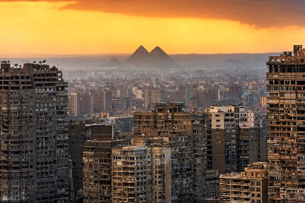
Cleethorpes to Cairo
Cleethorpes and Grimsby
Cleethorpes is in the county of Lincolnshire, located on the East coast of England.
Grimsby is a seaport and used to be the largest and busiest in the world.
Grimsby is very important for food manufacturing in England.
Grimsby is the main centre for fish processing in the UK.
Grimsby and Cleethorpes have a population of 91,200 people.
Cairo
Cairo is the capital city of Egypt on the continent of Africa.
Cairo is located in the North of Egypt on the River Nile.
Cairo is densely populated and has a population of 11 million people.
The River Nile is used to transport goods.
The industry in Cairo is textiles and food processing.
Vocabulary Dozen
Manufacturing | The process of producing a large amount of products.
Processing | Action taken to produce something.
River bank | The sloped ground at the edge of a river.
Densely | A large amount with not a lot of space.
Tourists | A person who is traveling for pleasure.
Industry | A type of business.
Valley | A long area of low land between mountains of hills.
Pyramid | Built by Egyptians years ago as tombs.
Transport | To move from one place to another.
Textiles | Cloth made be weaving or knitting.
Development | Increasing or getting better.

