Slide 1
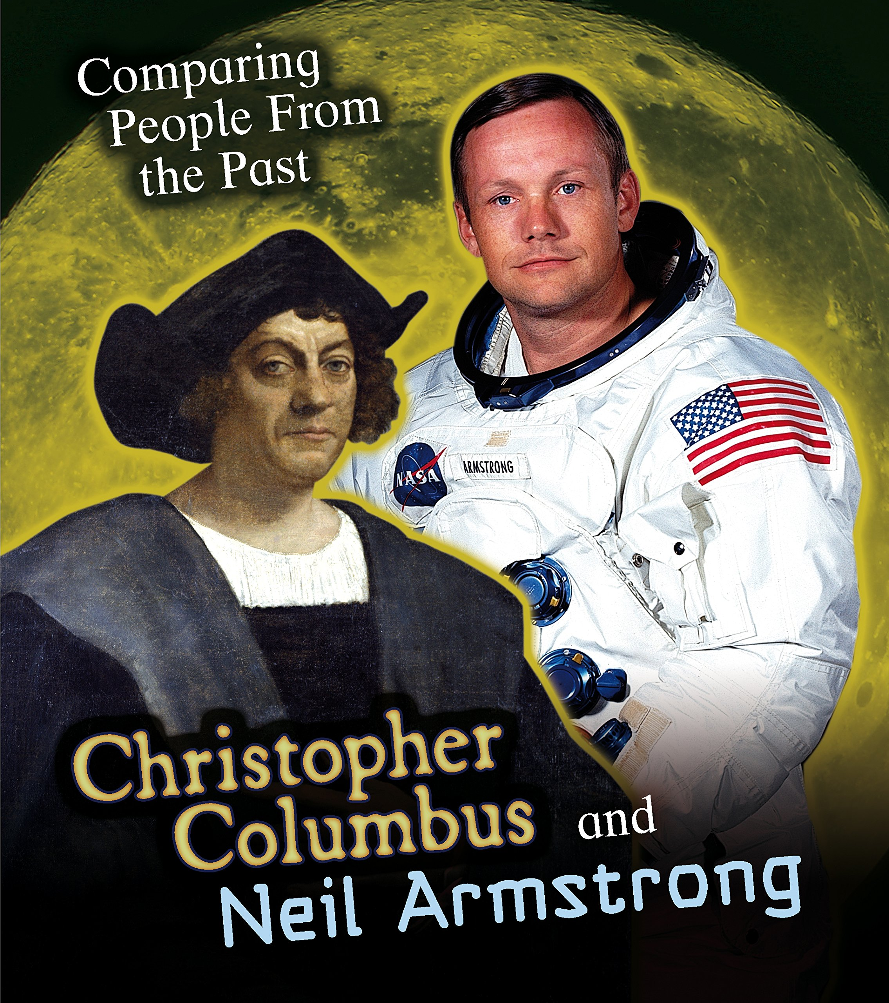

Maths
This term we will continue to build our understanding of addition and subtraction and we will be carrying on with our development of our reasoning and problem solving skills. We will continue to develop our recall and retention of mathematical skills through the use of Quick Maths and our DNA’s at the beginning of every lesson. We will consolidate counting in 2,5,10’s and 3’s’. All children have a login to the TT Rockstars website where they can practise these skills.
English
In English we will be focusing on poetry through the Power of Reading text ‘Poems to Perform’ by Julia Donaldson. From this we will be analysing, writing and performing different types of poetry, as well as writing a descriptive narrative.
In class, we will continue to focus on a high standard of presentation, including joined handwriting. Handwriting practice takes place every morning and follows the Letter Join scheme. Our focus is on the lead ins and joins for each letter in preparation for joining our handwriting.
Curriculum – R.E.
This half term in Year 2, we are focusing on key stories within Christianity and Judaism. We will be researching, investigating and discovering how Jews and Christians show their commitment to God. We will find out why Christmas is important to Christians.
This unit’s learning will lead us to be able to answer our enquiry question of ‘What is Special about God?’
Year 2 Newsletter
Autumn 2 2025
Bramble Class
Science
This half term Year 2 will learn about animals including humans . In this unit, we will look at how humans and animals grow and investigate if they grow differently. Also, we will learn about life cycles, how to be healthy, what do we need to survive and the importance of keeping clean.
Home Reading
Please continue to share the love of books with your child. A book banded (coloured sticker) reading book will be brought home by your child; please encourage them to read their book 5 times per week to build up fluency and comprehension of the text. Each read should be recorded in their Reading Record. Please feel free to comment on your child’s reading so that we can help support them at school. Reads will be counted every Thursday and certificates awarded in Friday’s Star of the week assembly.
Learning Outcome
At the end of this half term, the children will perform a poem to an audience in school.
Wider Curriculum
Computing– Digital Literacy/Information technology
PSHE – Celebrating difference
Music –Glockenspiels with Mr Carlton
PE – Indoor athletics - Body management
Homework
Homework will be sent home on a Friday, to be returned each Thursday.
Please also send Reading Records in on a Thursday .
Our PE Days
Our PE afternoon will be Tuesday. Please ensure that children have a full outdoor and indoor PE kit in school on that day. Long hair should be tied back and earrings removed (or plasters sent to cover them) as outlined in the school’s uniform policy on our website.
Class Dojo.
Please send any extra- curricular achievements over Class Dojo for us to celebrate.

