Slide 1



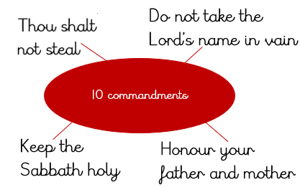
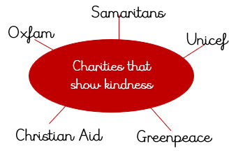
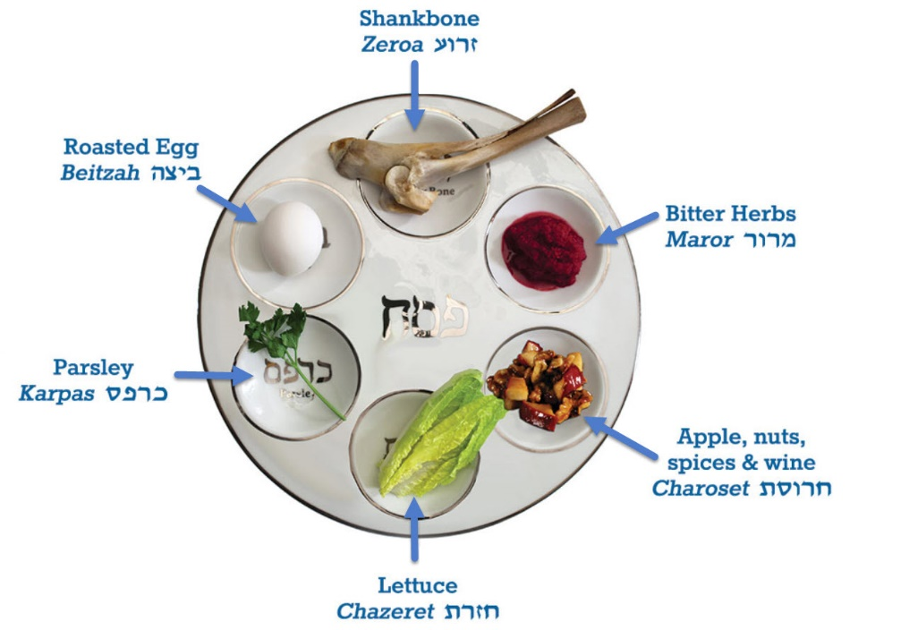
Year 2, Autumn 2
What is special about God?
What is the best way for a Jew to show commitment to God?
One of the 10 commandments is ‘love thy neighbour’
How important is it for Jewish people to do what God asks them to do?
The story of Exodus shows the importance of duty to God
The Seder Plate
How special is the relationship Jews have with God?
Mezuzah reminds Jews of their duty and relationship with God
Vocabulary
Judaism | The religion of the Jewish people
Christianity | A religion based on the teachings of Jesus
mitzvah | A good deed
mitzvoth | Doing good and helping others
synagogue | Place of Jewish worship
Why did God give Jesus to the world?
God sent Jesus to save the world
Christians look forward to Christmas as the time of Jesus’ birth

