Slide 1
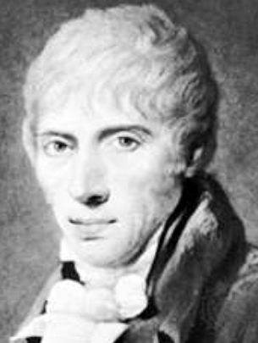
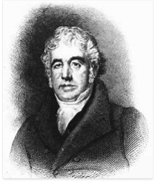
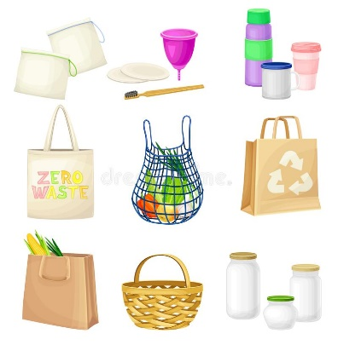

Year 2, Autumn 1 –
Use of Everyday Materials
Charles Mackintosh
Macintosh experimented with various chemicals and found that a by-product of coal tar was able to dissolve India rubber. This paste was able to repel water, creating waterproof fabric.
John McAdam
McAdam noticed that highways were in poor condition and carried investigations to improve the condition of roads. He recommended using large rock, smaller stones and covering these with fine gravel to make them smoother. It took 30 years for him to improve all the roads in the United Kingdom!
Vocabulary | Definition
Rough | An uneven surface.
Smooth | An even and regular surface
Transparent | Lets light through, cannot be seen through.
Opaque | Blocks light, cannot be seen through.
Shiny | Reflects light.
Stretchy | Able to stretch.
Rigid | Not easy to bend or change.
Repel | Do not absorb liquid, liquid stays on the surface.
Absorbent | Lets in water.
Materials | Properties | Uses
Wood | A hard material from a tree. | Door, chair.
Metal | A sold material which is hard and shiny. | Coin, fork.
Glass | A transparent material used for windows. | Window.
Plastic | A man-made material that can be used to make toys. | Water bottle, toys.

